Slide 1
Adhesión Y Retención
Un análisis de los datos sobre el papel de la educación adventista
John Wesley Taylor V taylorjw@gc.adventist.org

Slide 2
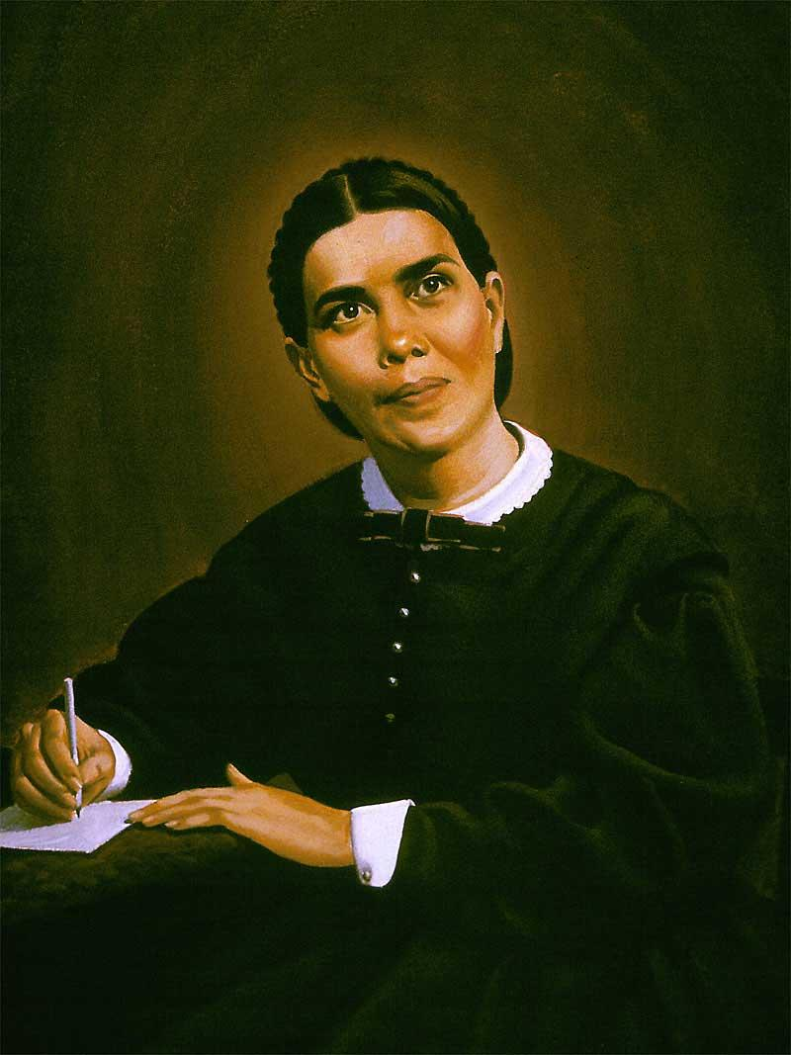
“Lo más importante”
Deberá ser
“la conversión de sus estudiantes.”
Fundamentos de la Educación Cristiana, pág. 483
Conversión
Adhesión

Slide 3
Adhesión a la Iglesia
El Rol de la Educación Adventista
Notes:
Accession—persons joining the Church. Adventist education has a key role to play.

Slide 4
Educación Adventista
Evento Evangelístico
más PROLONGADO y más EXTENSO
que realiza la Iglesia Adventista
Notes:
Adventist education is the longest and largest means of evangelism carried out by the Adventist Church.

Slide 5
Duración
800
- 37,400 horas
5-9 horas/día
160-260 días/año
1-16⁺ años
Notes:
https://norberthaupt.com/2012/04/20/school-days-around-the-world/
http://elearninginfographics.com/school-days-around-world-infographic/
China holds both highest hours/day and highest days/year (9 & 260 respectively)
Total hours: 15,200 (Finland) to 37,400 (China)

Slide 6
Tamaño
Nivel
Sitios
Evangelistas
Asistentes
Primaria
5,943
55,331
1,183,337
Secundaria
2,429
36,592
595,848
Superior
167
15,053
148,373
Totales
8,539
106,976
1,934,810
31 de diciembre del 2017
Notes:
Schools = evangelistic sites; teachers = evangelists; students = attendees

Slide 7
Educación Adventista
Evento Evangelístico
más PROLONGADO y más EXTENSO
¿Exitoso?
Notes:
Adventist education is the longest and largest means of evangelism carried out by the Adventist Church.

Slide 8
Bautismos en Educación Adventista
Año | Bautizados
2007 | 33,766
2008 | 33,138
2009 | 40,415
2010 | 49,176
2011 | 50,752
2012 | 49,774
2013 | 48,604
2014 | 47,435
2015 | 43,475
2016 | 49,308
445,843
bautismos
Un campo establecido cada año
Notes:
Baptisms of students during the school year.
Note: Report figures for 2013 is 31,824. Given that a number of fields did not report that year in the switch from paper to electronic reporting, the figure appearing in the table is extrapolated based on trend.

Slide 9
Bautismo y la Educación Adventista
13 veces más
Jim Epperson
Hijos de familias adventistas en la Southern Union N=844
Notes:
Jim Epperson – 1990
No Adventist education: 58% stayed in the church; Some Adventist education: 79% stayed in the church
Sample: 300 family units were randomly selected from the Southern Union and 210 families responded. N = 844
Procedure: Compared Adventist youth with no Adventist education and those with some Adventist education on whether they stayed in the church.

Slide 10
Adhesión y la Educación Adventista
W. E. Minder
Hijos de familias adventistas en la Lake Union
N=807
Notes:
Warren E. Minder (1985). A study of the relationship between church sponsored K-12 education and church membership in the Seventh-day Adventist Church. Ed.D. dissertation, Western Michigan University.
Sample: 400 family units were randomly selected from the Lake Union and 287 families responded. N = 993.
Procedure: Compared Adventist youth with no Adventist education, some Adventist education, and those with only Adventist education on whether they joined and stayed in the Adventist church.

Slide 11
Años Promedio en la Escuela Adventista
W. E. Minder
Hijos de familias adventistas en la Lake Union
N=807
Notes:
Warren E. Minder (1985). A study of the relationship between church sponsored K-12 education and church membership in the Seventh-day Adventist Church. Ed.D. dissertation, Western Michigan University.
Sample: 400 family units were randomly selected from the Lake Union and 287 families responded. N = 993.
Procedure: Compared Adventist youth with no Adventist education, some Adventist education, and those with only Adventist education on whether they joined and stayed in the Adventist church.

Slide 12
Educación Adventista es Misión
“La obra de la educación y la de la redención,
son una.” Educación, pág. 30
Notes:
“There should be schools established wherever there is a church or company of believers. Teachers should be employed to educate children of Sabbath-keepers.” Ellen G. White. 1898. Special Testimony to Battle Creek Church, p. 40.

Slide 13
Educación Adventista es Misión
Reafirmar el rol medular de la educación adventista
en la misión evangelística de la Iglesia
Notes:
“There should be schools established wherever there is a church or company of believers. Teachers should be employed to educate children of Sabbath-keepers.” Ellen G. White. 1898. Special Testimony to Battle Creek Church, p. 40.

Slide 14
Retención en la Iglesia
El Rol de la Educación Adventista
Notes:
Perhaps even more important, however, than accession—joining the Church, is retention—remaining in the Church.
Adventist education has a vital role here, as well.

Slide 15
Miembros que abandonan
-15M -10M -5M 0 5M 10M 15M 20M
13,737,025
20,647,979
Desde 1965: 34,385,004 miembros
Tasa de pérdida: 39.95%
De cada 10 miembros,
Miembros que abandonaron
Miembros que permanecieron
4 salieron.
Notes:
First, the problem.
Out of every 10 members, 6 remained, and 4 slipped away.

Slide 16
Miembros que abandonan
-6M -4M -52 0 2M 4M 6M 8M
5,918,483
7,729,798
Miembros que abandonaron
Miembros que permanecieron
En 2000-2012: 13,648,281 accesiones
Tasa de pérdida: 43.36%
Notes:
First, the problem.
Out of every 10 members, 6 remained, and 4 slipped away.

Slide 17
Jóvenes que abandonan
Estudio “Retención Juvenil”
Más de 1,500 jóvenes bautizados (edad: 15-16)
Representativo de la juventud adventista: iglesias grandes y pequeñas, rurales y urbanas, todo grupo étnico
Entrevistados cada año por los siguientes 10 años
¿Cuántos salieron a los 25-26 años de edad?
En muchos grupos demográficos, aproxima: 50%
Notes:
Began in 1987. Roger Dudley
We are losing one half of our youth. Not one lost coin, but half of the coins!
In his landmark 10-year longitudinal study, Roger Dudley (2000) began in 1988 with 1,523 Adventist youth ages 15 and 16. When the study ended 10 years later, 578 (about 1/3) of the original group, now young adults, completed the form. Did the type of college the students attended make any difference in retaining their membership in the Adventist Church? Of the responding young adults who attended all or mostly all Adventist schools during high school and college, 92% were members at age 25. If they had attended part Adventist schools and part non-Adventist schools, 79% remained members at age 25. If all or most of their schooling was in non-Adventist schools, 72% remained members at age 25 (Thayer, 2008b). Dudley speculates that many of the young people who dropped out of the study are no longer church members, which would lower the percentages in all categories if all original subjects had completed the final survey. Dudley (2000) estimates that “at least 40 percent to 50 percent of Seventh-day Adventist teenagers in North America are essentially leaving the church by their middle 20s” (p. 35).
Dudley, R. L. (2000). Why our teenagers leave the church: Personal stories from a 10-year study. Hagerstown, MD: Review and Herald.
Thayer, J. D. (2008b). Dudley’s Youth Retention Study, additional analysis.

Slide 18
Jóvenes que abandonan…
No solamente UNA moneda perdida…
¡La MITAD de ellas!

Slide 19
¿Dónde está el rebaño que te fue dado, tu hermosa grey? Jeremías 13:20

Slide 20
Siete Estudios
a través de 3 décadas;
3 estudios desde 2010
Retención y la Educación Adventista:
Estudio “Valuegenesis” (multi-año)
Estudio “Retención Juvenil” (longitudinal)
Estudio “Epperson” (tesis doctoral)
Estudio “Rice” (tesis doctoral, longitudinal)
Estudio “Minder” (tesis doctoral)
Estudio “Centro Min. Creativo” (global, cual.)
Estudio “ASTR Abandonan Iglesia” (global)
Notes:
Youth Retention Study was a longitudinal study emerged from the Valuegenesis Study.
Center for Creative Ministry Study, also known as the Richardson Study

Slide 21
Estudio “Valuegenesis”
1
Datos de 2,267 alumnos adventistas de 12º-grado en escuelas adventistas indicaron que cuanto más años de educación adventista, más elevada su
Lealtad denominacional
Ortodoxia adventista
Intención permanecer como adventista a los 40 años de edad
Dudley, R. (1992). Valuegenesis: Faith in the balance. La Sierra University Press, Riverside, CA.
Thayer, J. (2008). Valuegenesis reanalysis. Unpublished manuscript. Andrews University, Berrien Springs, MI.
Notes:
Actually 5 studies: Valuegenesis I – 1990, Avance (NAD) – 1994, Avance (Puerto Rico) – 1995, Valuegenesis II – 2000, Valuegenesis3 – 2010
The Valuegenesis study. 10,641 Adventist students in Adventist schools and 457 Adventist students in non-Adventist schools were studied. Non-Adventist students in Adventist schools and Adventist students in public schools were excluded from most analyses reported in this paper. For this paper, Thayer studied two sub-samples from the Valuegenesis study: 2,267 12-grade Adventist students in Adventist schools and 683 of these students who reported that they had a good home, religious parents, a good church, and a good school.
Procedure: The Valuegenesis study gathered a wealth of data related to the influence of family, school, and church on the formation of faith. Two types of comparisons were made that are related to this paper. First, Adventist students in public schools were compared to Adventist students in Adventist schools. Also Adventist students in Adventist schools with fewer years in Adventist schools were compared to those with more years in Adventist schools. Dudley authored the book on the original analysis of the Valuegenesis data and Thayer reanalyzed the data for this paper. Thayer studied two sub-samples of the complete Valuegenesis dataset to partially control for church membership and age of the student, and school, home and church characteristics. Eliminated in this analysis were students in grades 6-11, students not a member of the Adventist church, and students not in Adventist schools.

Slide 22
Factores que Desarrollan la Fe Religiosa
–Estudio “Valuegenesis3” (2010)

Slide 23
81% de los estudiantes dijeron…
“Asistir a una escuela Adventista es lo que más me ayudó a desarrollar mi fe religiosa.”
–Estudio “Valuegenesis3” (2010)

Slide 24
Estudio “Retención Juvenil”
2
Un estudio de 10 años de jóvenes de edad 15-16 (N=1523)
Muestra dividida casi equitativamente entre estudiantes en escuelas adventistas y no-adventistas
Hallazgo: Número de años en una escuela adventista se relacionaba positivamente con
Compromiso con Jesucristo
Compromiso con estudio bíblico personal
Mi relación con Cristo es más sólida y robusta ahora
La religión es importante en mi vida
Dudley, 2000; Thayer, 2008
Notes:
Dudley and Kangas (1990) reported on results for years 1 and 2, Dudley (2000) reported on all 10 years, and Thayer (2008) reanalyzed data for all 10 years.
N =783 in year 10. Thayer (2008c) checked the characteristics of the 1,526 subjects from whom data was collected in year one with the 769 subjects who responded in year 10. He found that on two religious characteristics, the groups were relatively similar, indicating that the subjects who dropped out of the study were not noticeably different in these initial characteristics. The percentage of subjects who attended church weekly in year one was 88% for the complete year one sample and 90% for the year ten sample. The percentage of subjects who said they intended to remain an active Adventist at age 40 in year one was 56% for the complete year one sample and 62% for the year ten sample. The ten-year sample was almost identical in beginning characteristics on these two items.
34% of youth in Adventist schools in year 5 scored high on the Thayer Faith Maturity Scale compared to 20% of those in public schools
The reanalysis of the Youth Retention Study (Thayer, 2008c) found a positive relationship between attendance at an Adventist academy and personal Bible study (years 6 and 10).
Dudley, R. L. (1999). Understanding the spiritual development and the faith experience of college and university students on Christian campuses. Journal of Research on Christian Education, 8(1), 5-28. In 1987, the Seventh-day Adventist Church in the Unites States and Canada began a ten-year study of youth retention and dropout. The aim of the project was to select a group of middle-teenagers who were already members of the church and to survey them each year for ten years in order to determine what factors were related to staying or leaving the church. This article explores data to understand how faith develops and matures among young people of college and university age, including a look at those attending Adventist Christian colleges and universities

Slide 25
Estudio “Epperson”
3
4.5 veces más probable
Inactivo Abandonar
Jim Epperson, 1990
Hijos de familias adventistas de la Southern Union
N=844
Notes:
Kenneth James Epperson. (1990). “The relationship of Seventh-day Adventist school attendance to Seventh-day Adventist church membership in the Southern Union Conference." EdD dissertation, Loma Linda University.
No Adventist education: 58% stayed in the church; Some Adventist education: 79% stayed in the church
Rock JAE articles say 89% vs. 53%
Sample: 300 family units were randomly selected from the Southern Union and 210 families responded. N = 844
Procedure: Compared Adventist youth with no Adventist education and those with some Adventist education on whether they stayed in the church.

Slide 26
Estudio “Rice”
4
2 veces más probable – permanecer
23%
63%
Robert Rice, 1990
Sur de California
Longitudinal (13 años)
N=264
Notes:
Robert W. Rice. (1990). "A survey of the relationship between attending Seventh-day Adventist academies 9-12 and subsequent commitment to the Seventh-day Adventist Church," PhD dissertation, University of Denver.
13-year longitudinal study
Public high school graduates: 37% stayed in the church; SDA academy graduates: 77% stayed in the church
Sample: Adventist academy and public high school graduates from Southern California. N = 264.
Procedure: The class of 1976 was studied 13 years later. Compared Adventist public high school graduates and Adventist academy graduates on whether they stayed in the church.
Rice study utilized two California groups of 1976 graduates: a public school group and an academy group

Slide 27
Estudio “Rice”
2 veces más – devolución del diezmo
Hallazgos similares en los estudios Valuegenesis y Retención Juvenil.
Robert Rice, 1990
Southern California
13-year longitudinal
N=264
Notes:
Robert Rice – 1990; 13-year longitudinal study
Three studies examined the relationship between paying tithe and Adventist schooling. Data from Valuegenesis (Dudley, 1992) showed a positive relationship between Adventist schooling and paying tithe. Rice found that 50% of graduates from an Adventist academy pay tithe compared to 26% of graduates from a non-Adventist high school. The reanalysis of the Youth Retention Study (Thayer, 2008c) showed a positive relationship between attending an Adventist academy and paying tithe (year 6).
Procedure: The class of 1976 was studied 13 years later. Compared Adventist public high school graduates and Adventist academy graduates on whether they stayed in the church.

Slide 28
Estudio “Rice”
3 veces más – casarse con un adventista
Robert Rice, 1990
Southern California
13-year longitudinal
N=264
Notes:
Robert Rice – 1990; 13-year longitudinal study
Found that 78% of graduates from an Adventist academy were married to an Adventist compared to 27% of graduates from a non-Adventist high school.
Sample: Adventist academy and public high school graduates from Southern California. N = 264.
Procedure: The class of 1976 was studied 13 years later. Compared Adventist public high school graduates and Adventist academy graduates on whether they stayed in the church.

Slide 29
Estudio “Minder”
5
W. E. Minder, 1985
Hijos de familias adventistas en la Lake Union
N=807
Notes:
Note: Those who joined but then left represent 17.6%, 17.2%, and 1.8% respectively of those who joined
Rock JAE article says 98% vs. 51% (but could be combining groups 1 & 2)
Warren Earl Minder. (1985). A study of the relationship between church sponsored K-12 education and church membership in the Seventh-day Adventist Church. Ed.D. dissertation, Western Michigan University.
Sample: 400 family units were randomly selected from the Lake Union and 287 families responded. N = 993.
Procedure: Compared Adventist youth with no Adventist education, some Adventist education, and those with only Adventist education on whether they joined and stayed in the Adventist church.
Thayer states: Minder (1985) found that close to 100% of those with all Adventist education joined the church compared to slightly less than 70% of those with no Adventist education. Of those with all Adventist education, 98% joined and stayed in the church, compared to 79% of those with some Adventist education and 51% of those with no Adventist education.

Slide 30
Estudio “Centro Ministerio Creativo”
6
P. Richardson, 2013 Estudio Cualitativo. Global. N=925.
3 veces
Ex-Miembros e Inactivos
Miembros Actuales
Notes:
Paul Richardson, 2013, “Survey of Former & Inactive Adventist Church Members,” ASTR Publication produced by the Center for Creative Ministry, p. 13. [global study on Retention, it was qualitative, n=925]
In the survey of lapsed and ex-Adventists, 17% had attended Adventist schools (About six percent had attended an Adventist primary or elementary school at some point in their life. About seven percent had attended an Adventist secondary school and eight percent had attended an Adventist college or university), while 83% reported no experience of Adventist education, but the equivalent figure for all church–members is 56%; thus, there is clear evidence that those who have not gone through denominational education are disproportionately more likely to become inactive or leave.

Slide 31
Estudio “ASTR Miembros Salieron”
7
Perm.:
3 veces
2.5 veces
2 veces
ASTR, 2014. 9 divisiones.
Asistencia a la Escuela Primaria
Asistencia a la Escuela Secundaria
Asistencia al Nivel Superior
Notes:
Other Education for Ex-Members includes attendance to both SDA and Non-SDA, but these percentages were low: 7% primary, 7% secondary, and 5% tertiary. Based on data presented by D. Trim at 2016 LEAD Conference.
The data for ex-members’ school attendance came from the report titled Leaving the Church: Why some Seventh-day Adventist members leave the church, and why some come back (April 14, 2014), it was conducted by ASTR in all divisions.
The data for current members came from the Church Member Global Survey, conducted in 2013 in nine divisions. The question in this survey asked only about Adventist schools attendance.
To create a cylinder chart, insert a 3D rectangle and then change the shape type after it is inserted. Double click the bars in a clustered bar chart, and select the Series menu in the panel on the right, then select Cylinder.

Slide 32
¿Se relaciona en la Iglesia la adhesión y la retención de los niños y jóvenes con su participación en la educación adventista?

Slide 33
¡Sí!
Consistente y Convincente

Slide 34
Enseña al niño el camino en que debe andar…
Proverbios 22:6, LBLA

Slide 35
Conclusión

Slide 36
En la educación adventista
Niños y jóvenes experimentan…
Adhesión
Retención
Redención
“En el sentido más elevado, la obra de la educación y la de la redención, son una.”
La Educación, pág. 30

Slide 37
Y todos tus hijos serán enseñados por Jehová.
Y multiplicará la paz de tus hijos.
Isaías 54:13
Notes:
shâlôm = peace, well-being, happiness, prosperity, safety, security

Slide 38
Enseñados Por Dios
Educación
Adventista
Notes:
Taught by God… through Seventh-day Adventist education.

