Slide 1

Northern Asia-Pacific Division of Seventh-day Adventist
DISCIPLING STUDENTS:
Every Student Is A Disciple
A Report to the LEAD Regional Conference
NSD, SPD, SSD, SUD
Bangkok, January 28 to February 1, 2018

Slide 2
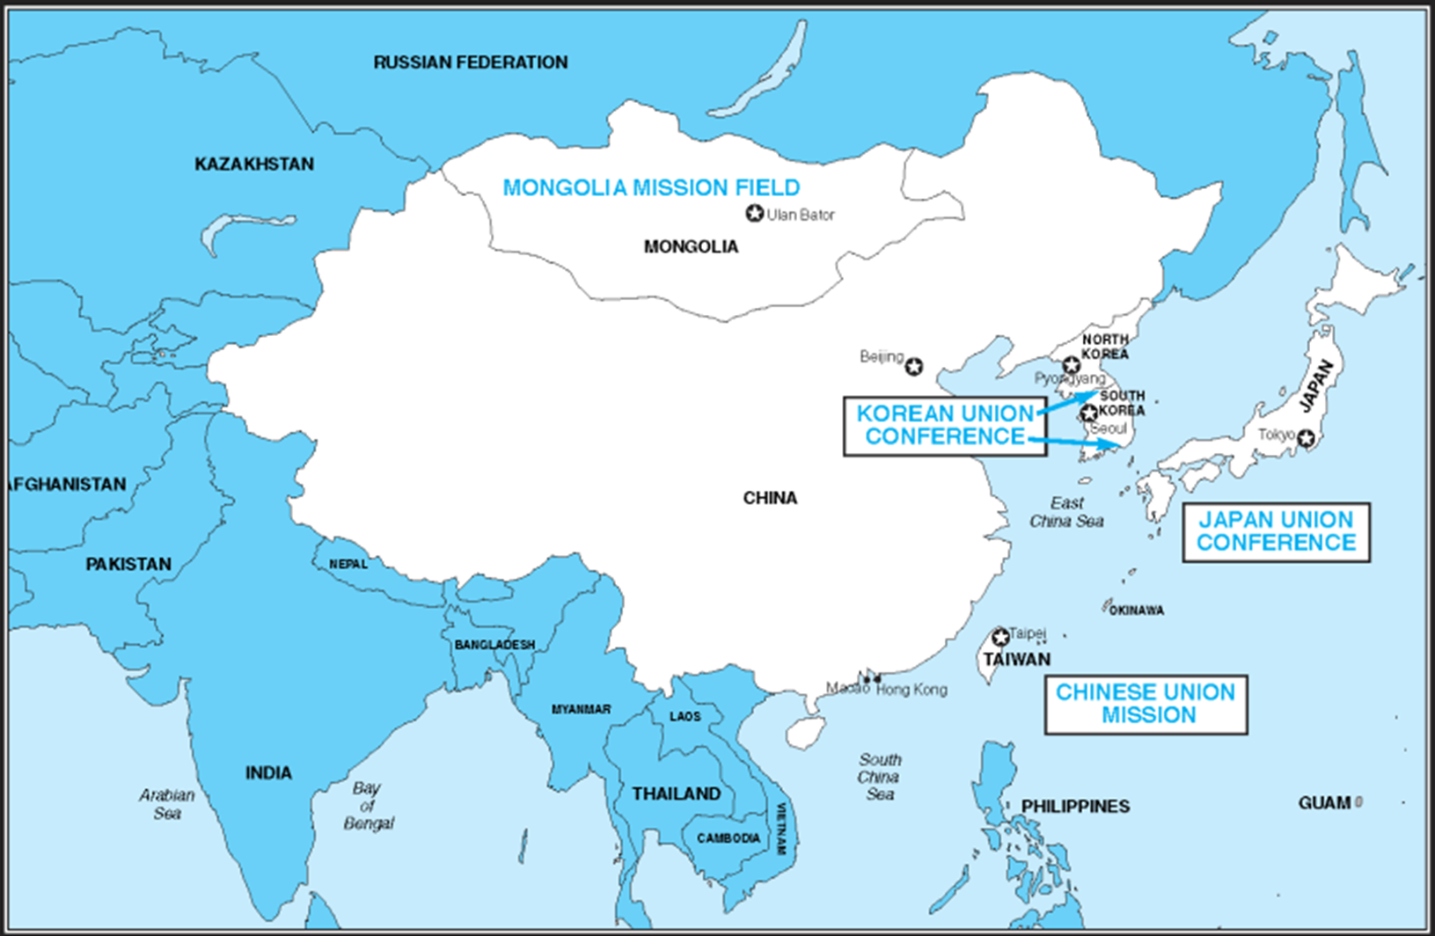
MONGOLIA MISSION
1.6 Billion People
KOREAN UNION CONFERENCE
JAPAN UNION CONFERENCE
CHINESE UNION MISSION
TAIWAN CONFERENCE

Slide 3
 | Schools | SDA Teachers | Non-SDA Teachers | SDA Students | Non-SDA Students | Baptism
Primary | 24 | 229 | 1 | 1,054 | 3,765 | 259
Secondary | 28 | 614 | 131 | 2,799 | 5,361 | 443
Tertiary | 6 | 308 | 20 | 1,427 | 6,295 | 320
Total | 58 | 1,151 | 152 | 5,280 | 15,421 | 1,022
 |  | 88.2% | 11.8% | 25.5% | 74.5%
Total | 58 | 1,303 |  | 20,701

Slide 4
AE Goals, Objectives
100%
SDA Faculty
Student engagement in Mission Outreach
Above the national average Academic Performance
Pass rate
Professional Licensure Exam
10 Objectives
NSD: 58 Schools 1,303 Teachers 20,701 Students

Slide 5
58
Schools
1,303 Teachers
20,701 Students
Challenges:
1. Declining Birth Rate
2. Government Regulations &
Requirements
3. Competition with Public Schools

Slide 6
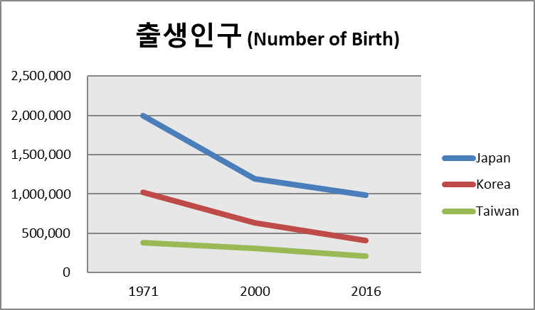

Slide 7
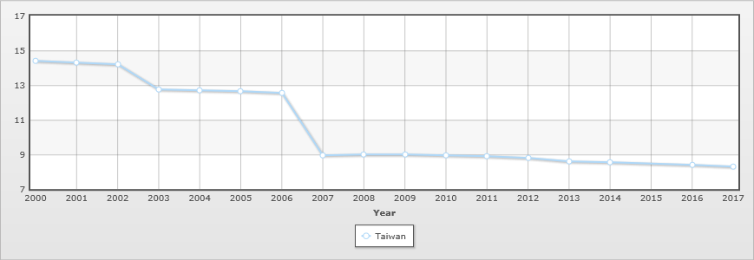
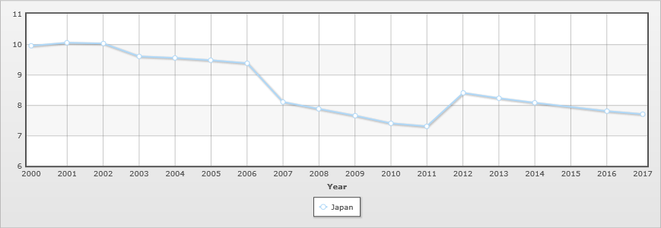
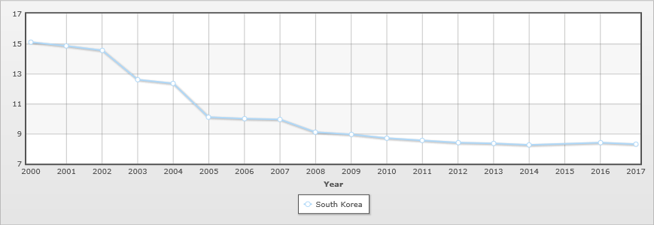
Birth rate (births/1,000 population)
Japan
Taiwan
* School closing due to fewer students:
2023: Out of 345, 116 Universities and
Colleges will be closed (32%)
Korea

Slide 8

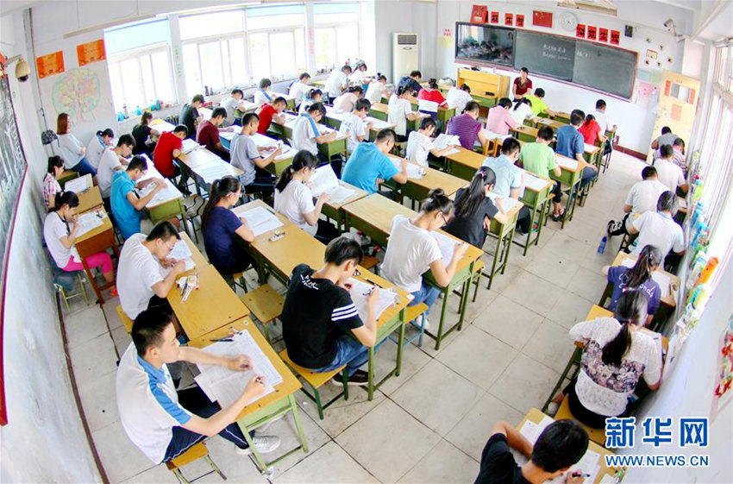

Entrance Exam Competition Rate
Sahmyook University 11.27 : 1
Sahmyook Health University: 22.5 : 1

Slide 9
10 Objectives
LEAD Conference 2016
Summarized in a Strategic Plan
With the spirit of Mission First, and the Motto of
DISCIPLING STUDENTS: Every Student Is a Disciple!
NSD supports the objectives of the 2016 LEAD Conference on education, and put them into a strategic plan;

Slide 10
REACH

Slide 11
REACH
To reach up to God, the NSD aims:
To promote God-seeking lifestyle in all classes and school activities including Bible study and prayer;
To acquaint students and faculty of the Historical Grammatical Method of Bible study and the Historicist approach;

Slide 12
REACH
To reach in with God, we aim:
To enhance the participation of all students in the life of the church;
To provide access to recruit more Adventist students for Adventist education; and
To provide quality Adventist mission-focused education in all existing schools as well as in the Unorganized Territory

Slide 13
REACH
To reach out with God, we are determined:
To orient students and teachers to be mission-focused; every Adventist student is a disciple; and
To identify mission fields for all education institutions and empower disciples of Christ to serve the fields

Slide 14
REACH
We are implementing this strategic plan in the 24 Primary Schools, 28 Secondary, and 6 Colleges/Universities, including Chinese Adventist Seminary (CAS),
with 1,327 teachers/professors who are teaching in these schools, serving almost 21,000 students.

Slide 15

Reach Up

Slide 16
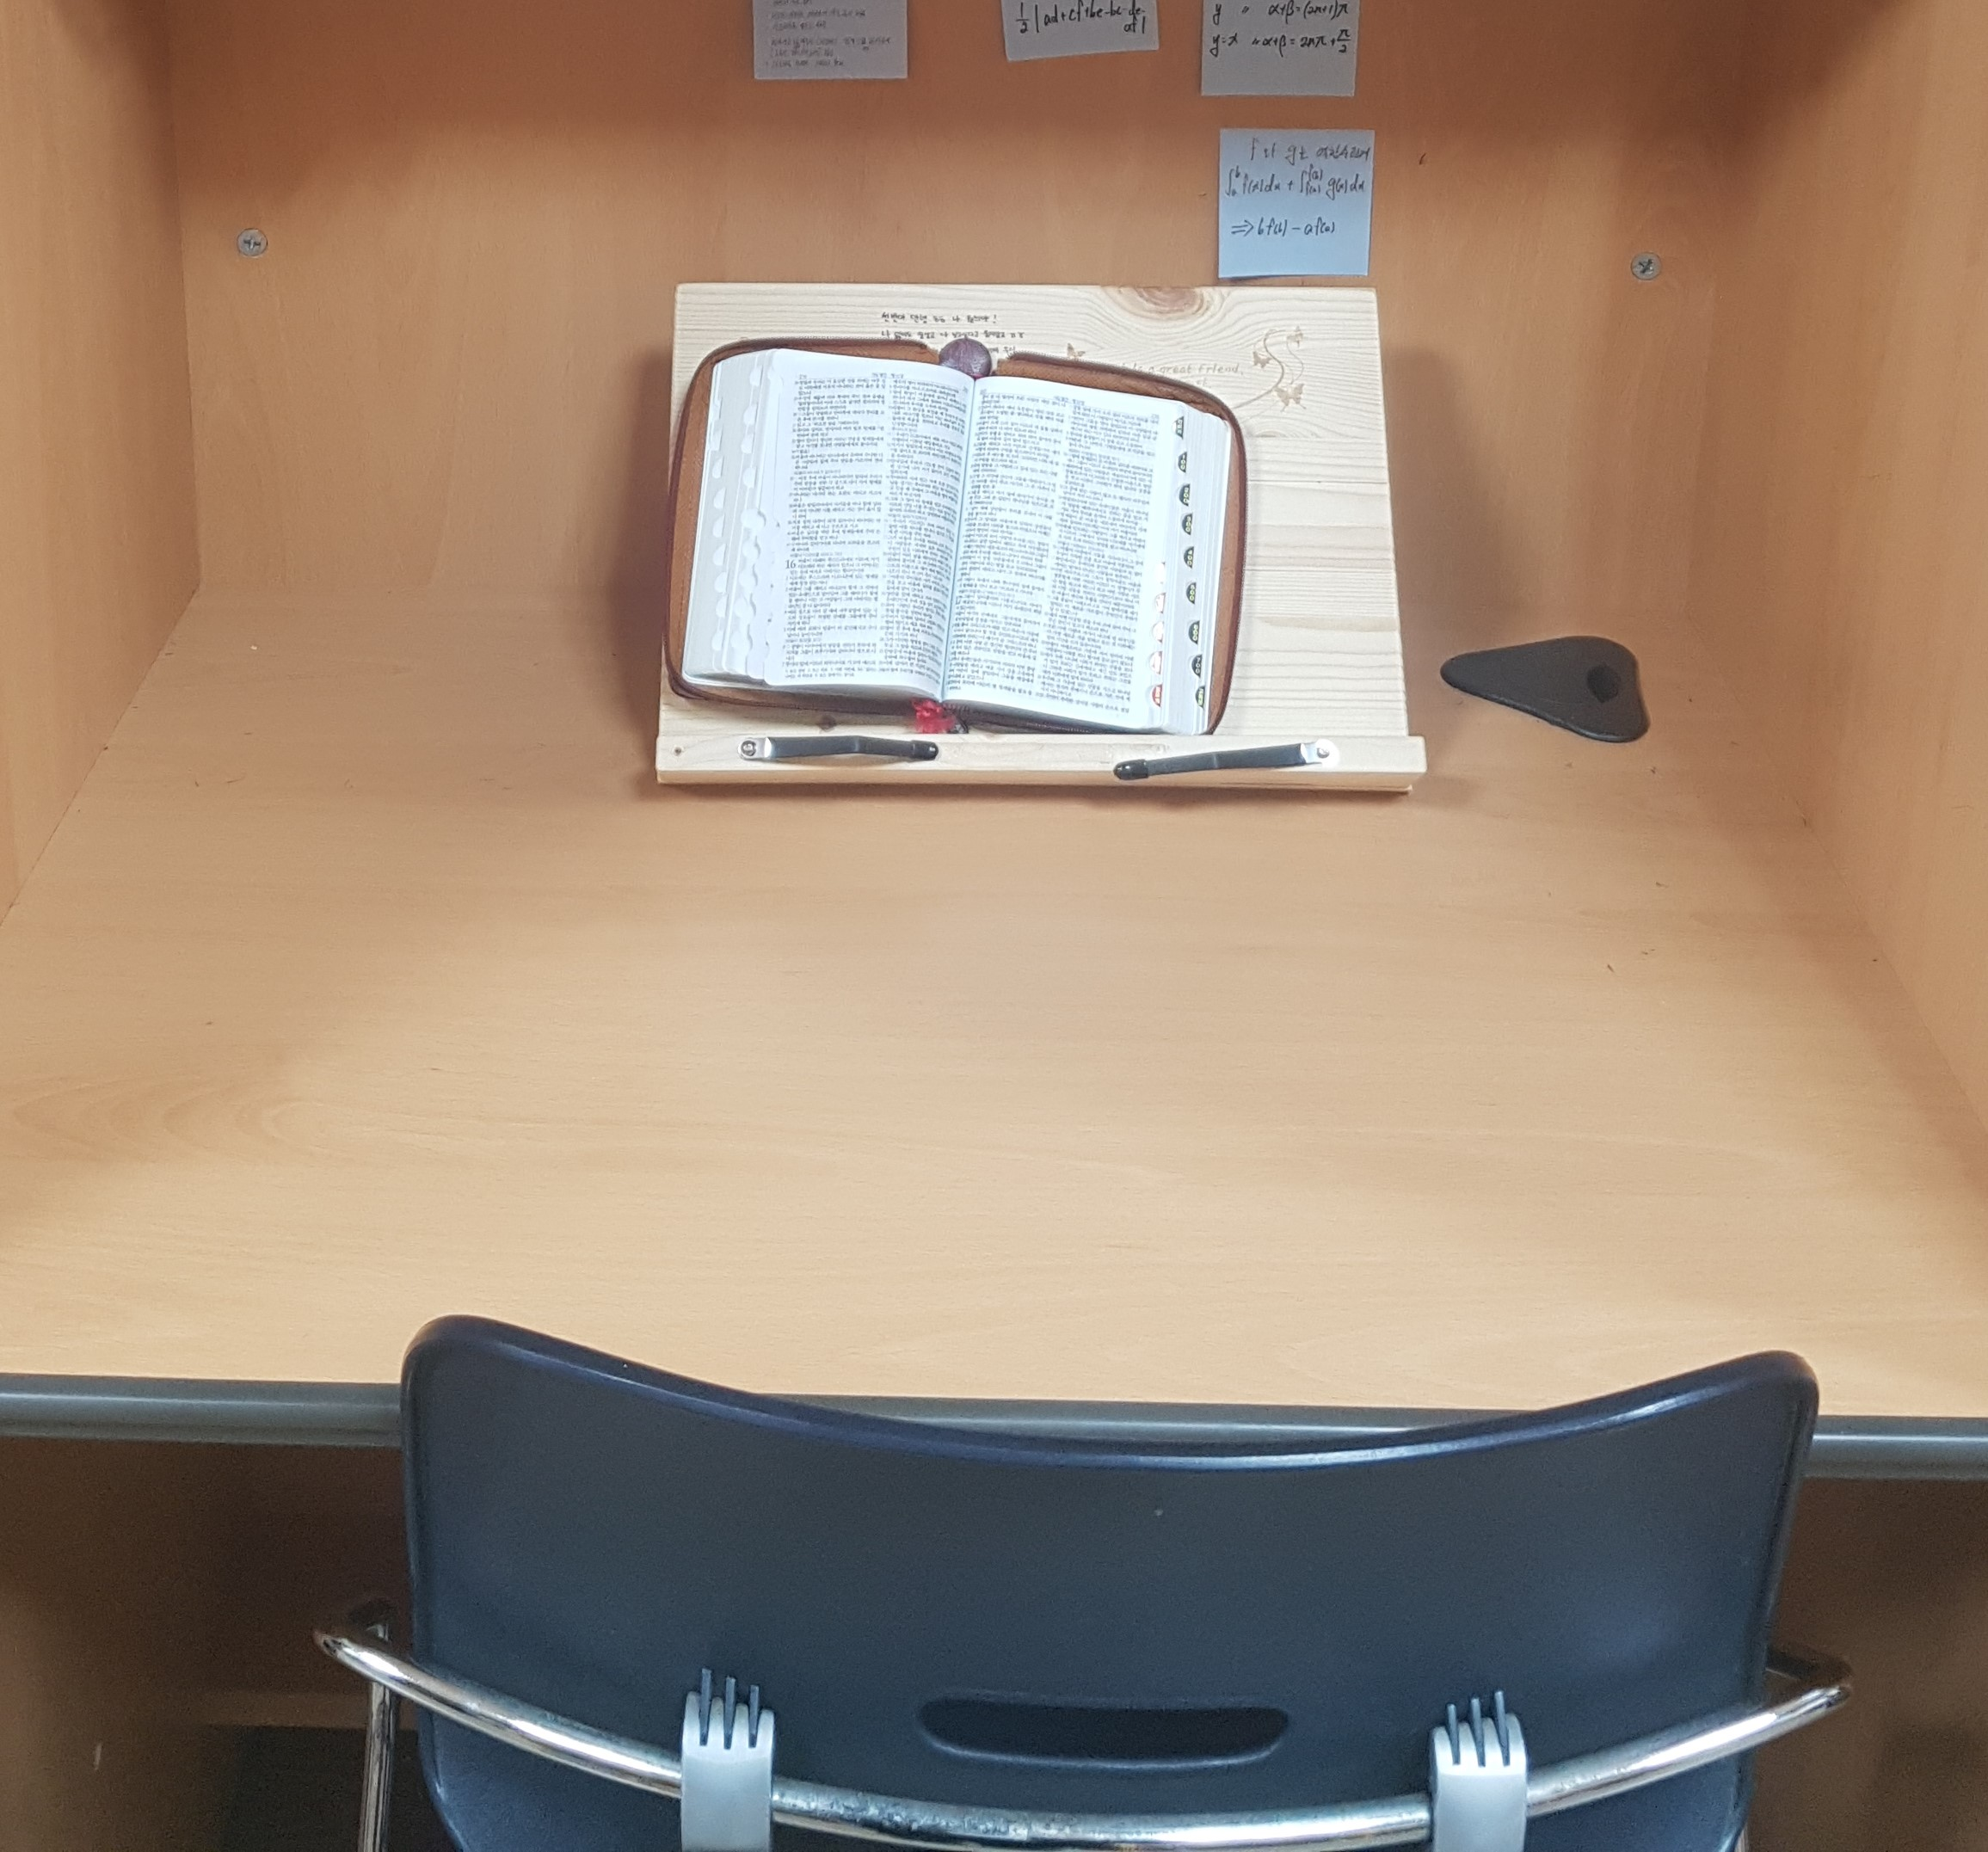
1. Bible Reading
Collective and personal Bible reading by all students.
This is done in the first hour of daily classes as a group or personally.

Slide 17
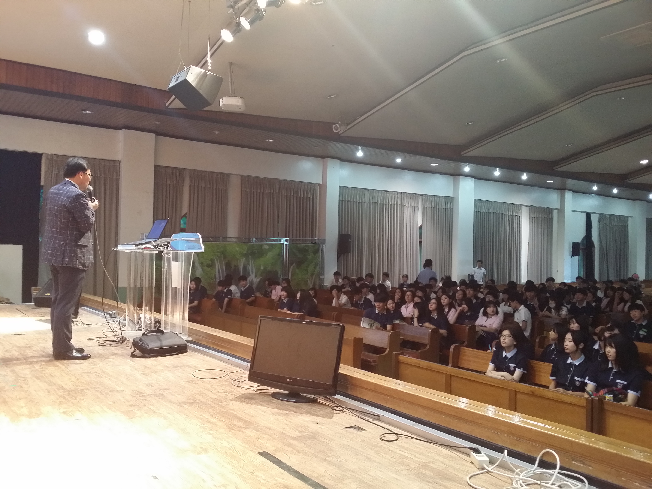
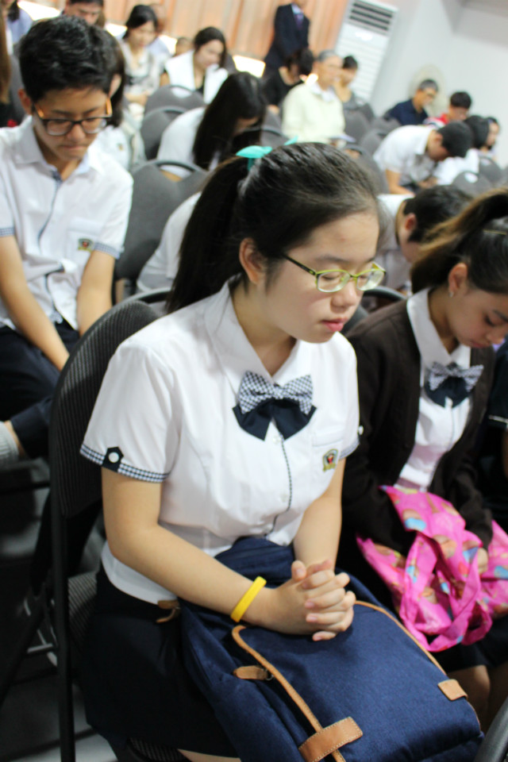
2. Weeks of Prayer
Two times every year to strength the faith of Adventist students and win students from other faiths to Jesus Christ.

Slide 18
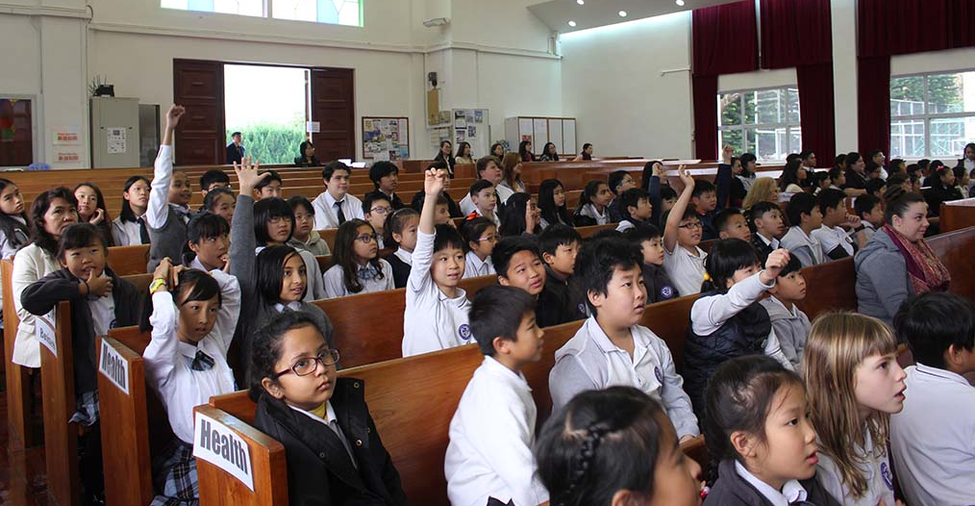
3. Chapel Programs
At least once a week, where Biblical values and doctrines are emphasized.

Slide 19

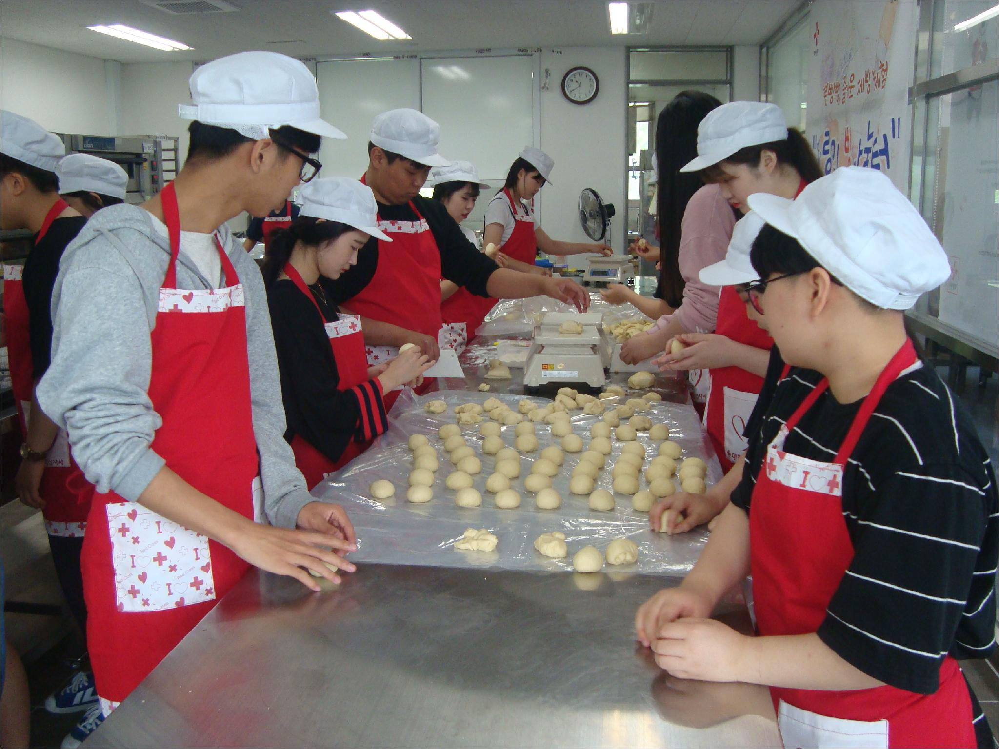
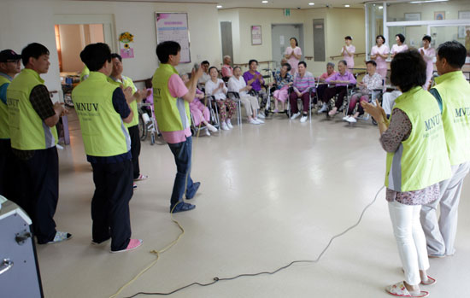
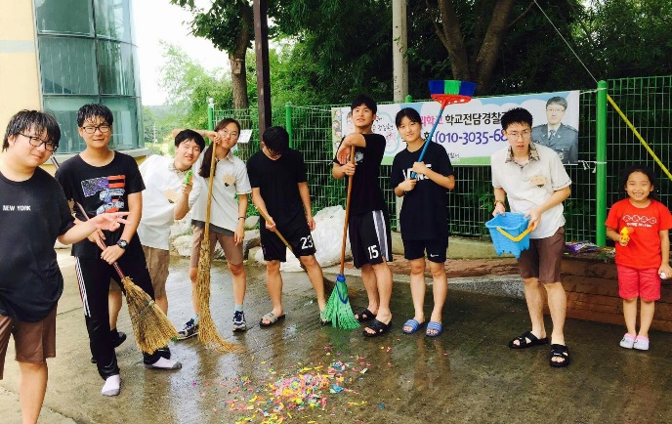
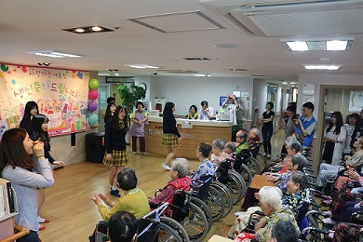
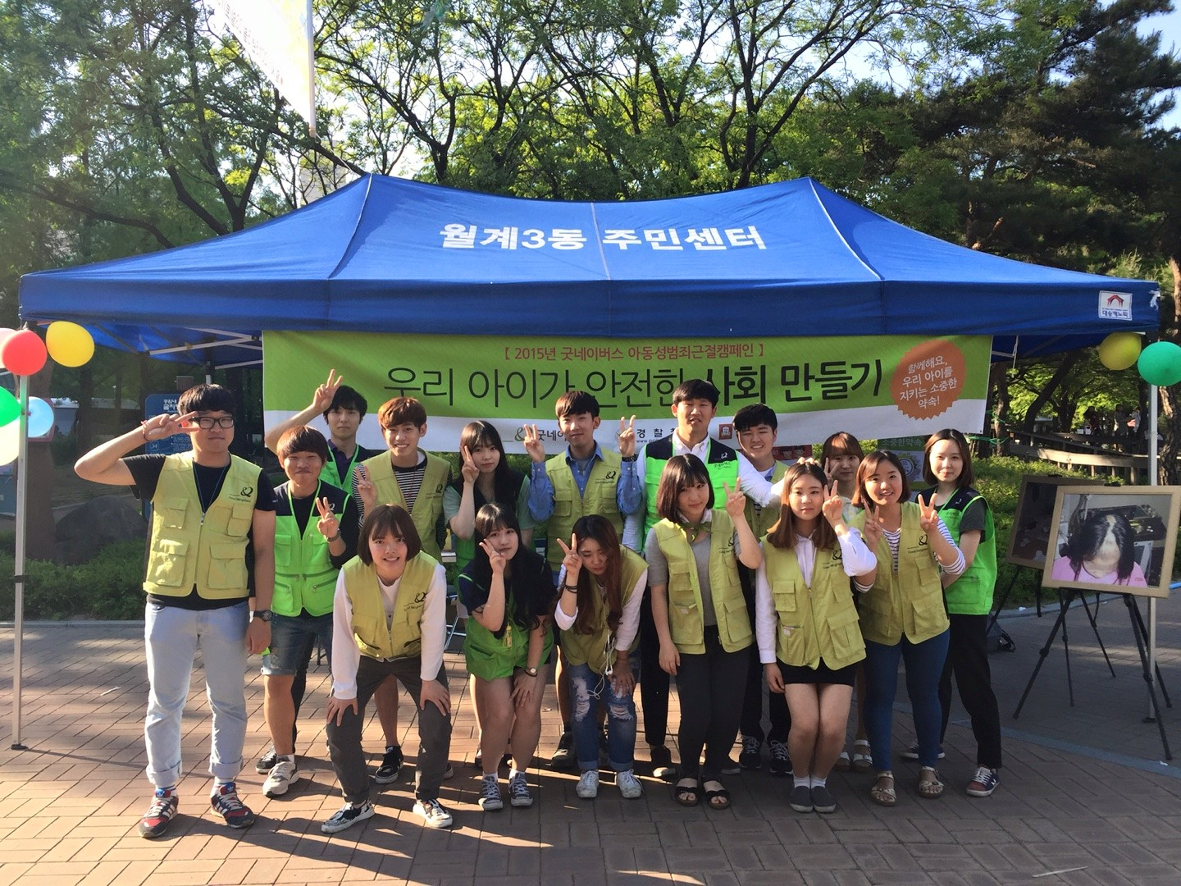
4. Community Service
At least once in every quarter/semester to encourage students to share the love of God with others.

Slide 20
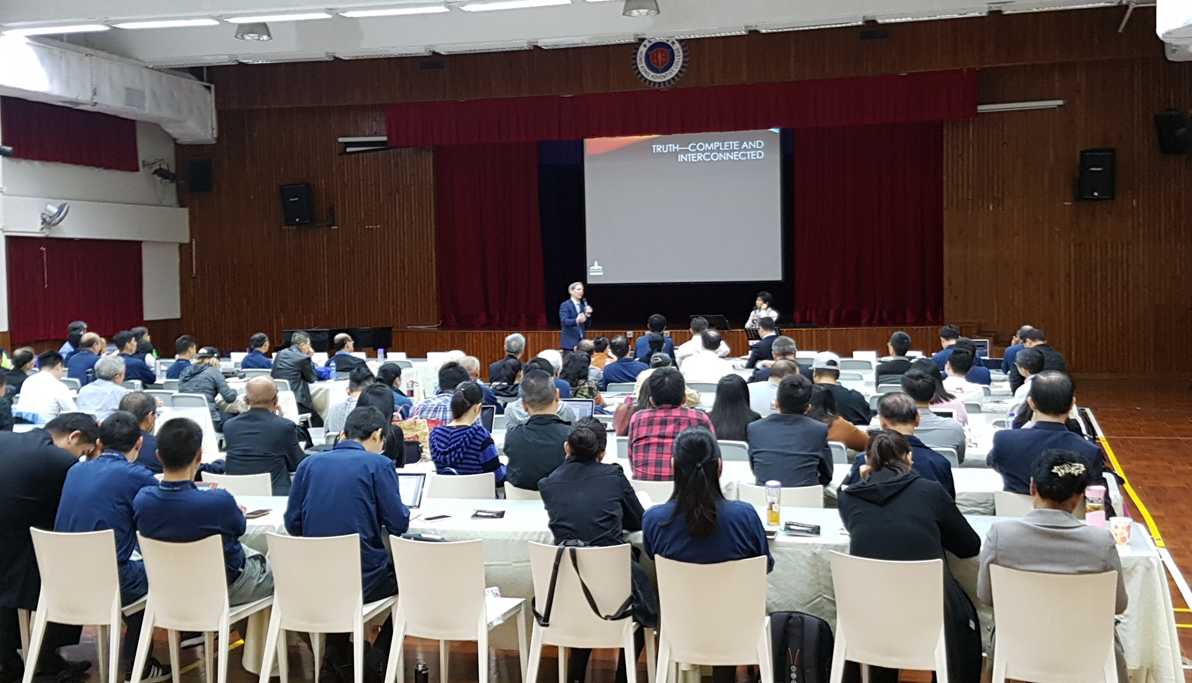
5. Theological Forum
NSD tertiary institutions are encouraged to be the center of biblical and theological education. TAC and HKAC have initiated theological forums, in Apr and Nov 2017, the first ever for both colleges. In emphasizing mission, biblical presentations are based on the Historical Grammatical Method of Bible Study.

Slide 21

Reach In

Slide 22
Students Retention
and Nurturing
Reaching up is incomplete without reaching in.
We reach-in to keep our Adventist students in the church, so that when they graduate from the school, they will NOT “graduate” from the church.

Slide 23
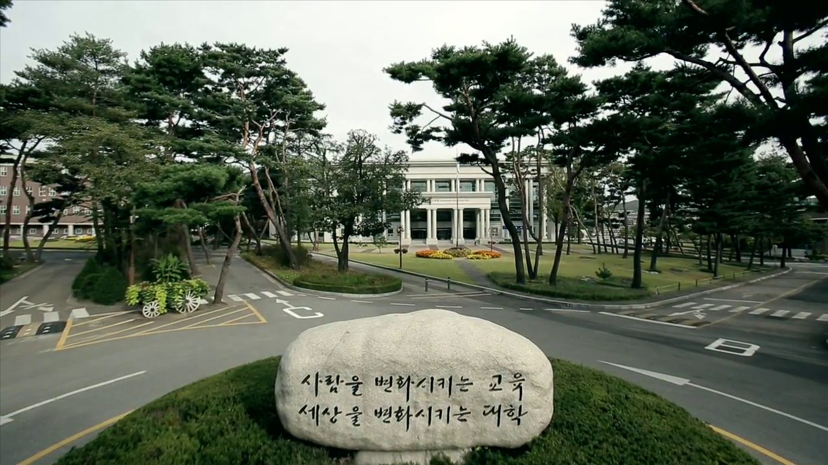
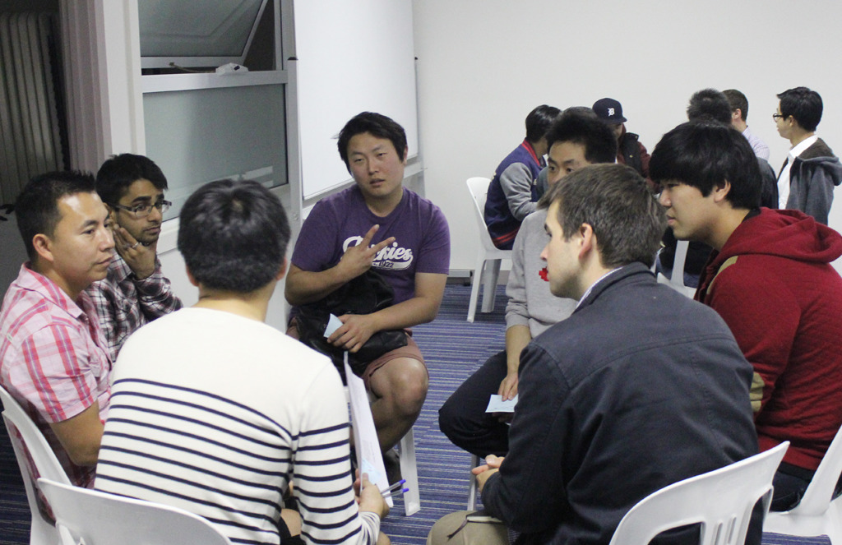
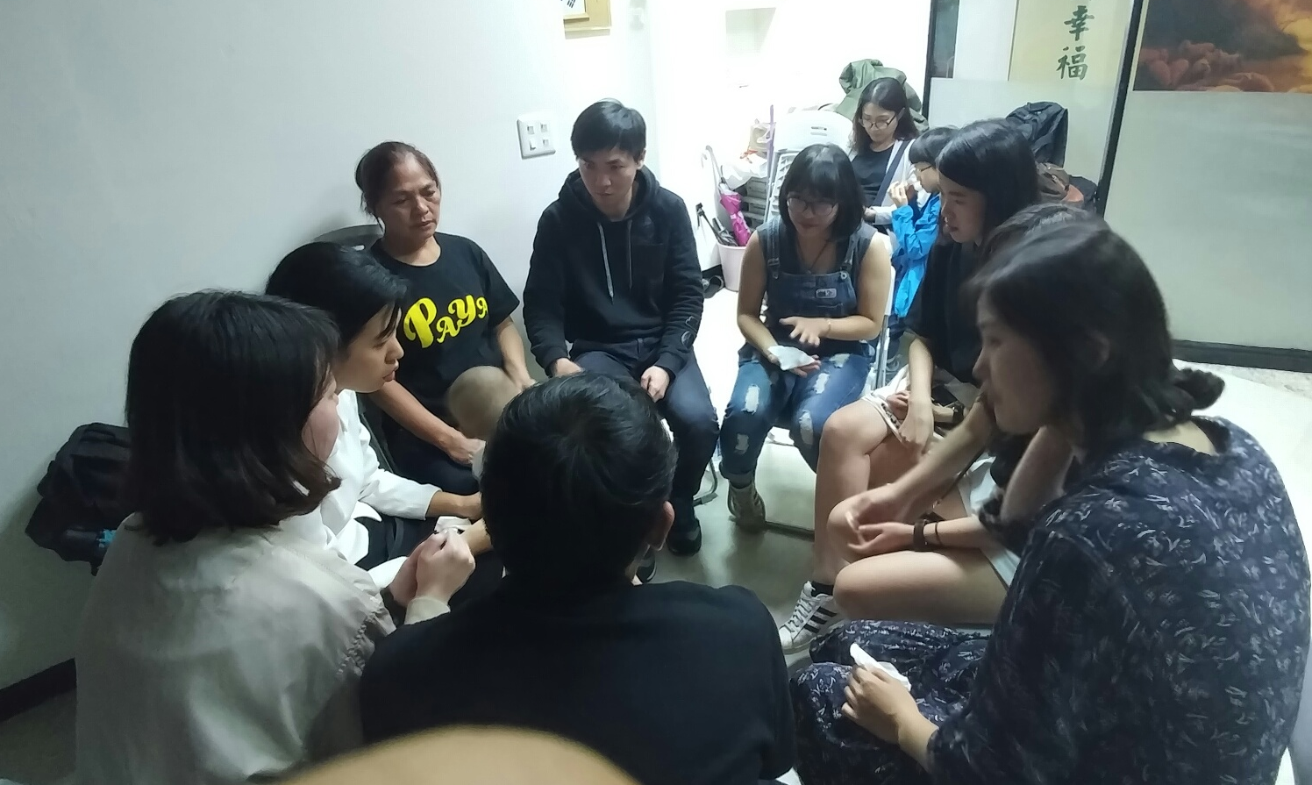
a. Discipleship Program
To strengthen discipleship programs for all our education institutions, we value the role of chaplains in organizing the discipleship programs.
At Sahmyook University, 25 pastors are working in the university chaplaincy team.

Slide 24
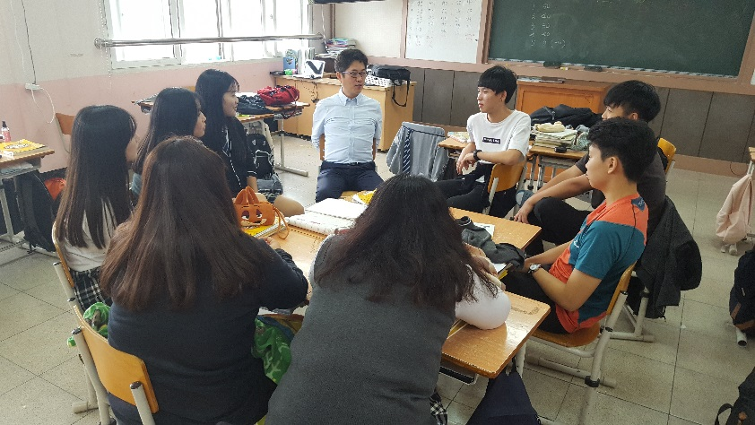
b. Connecting Students to Local Churches
Encourage our schools to connect their students to local churches. At Seoul Sahmyook High School, 21 teachers regularly visit 24 local churches, and 128 students regularly attend 44 local churches.
Pastors from local churches are invited to teach Bible classes. Church members are invited to come to the school and have family chapel program with the students.

Slide 25
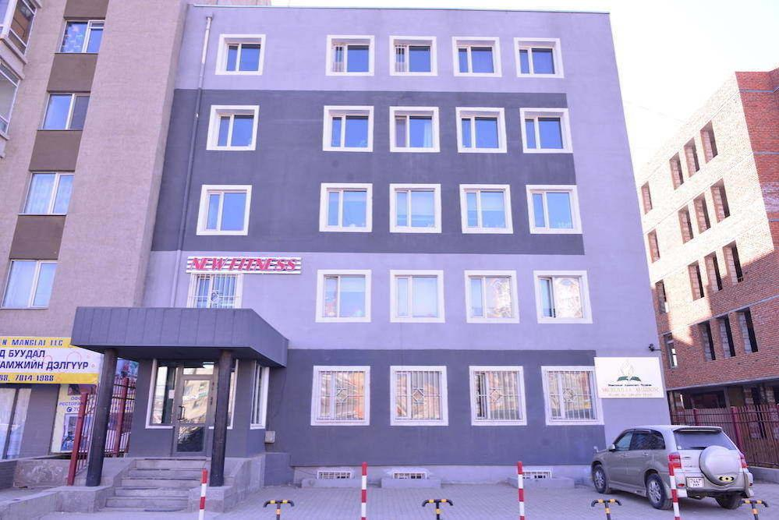
c. Nurturing Students
Nurturing our Adventist students studying in non-Adventist tertiary institutions.

Slide 26
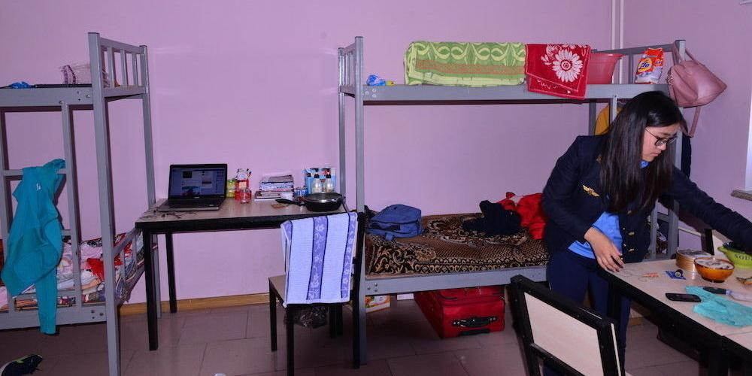
Adventist Dormitory
In Mongolia, a dormitory is provided in the building of the mission office to accommodate students studying in universities in UB.

Slide 27
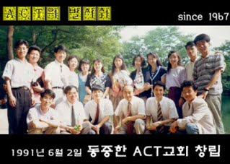
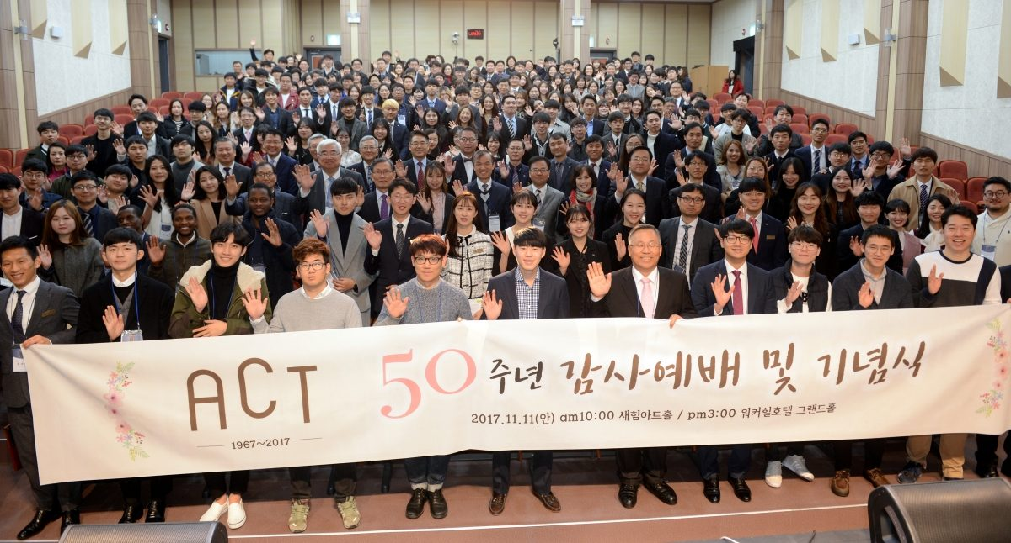
ACT Church
For Public Campus Ministry, KUC established 2 churches
for college students and graduates of non-Adventist universities, namely, the Adventist Collegians with the Tidings (ACT) churches.

Slide 28
Access to Adventist Education
We also reach-in by providing access as much as we can for our Adventist children and young people to study in our Adventist education institutions:

Slide 29
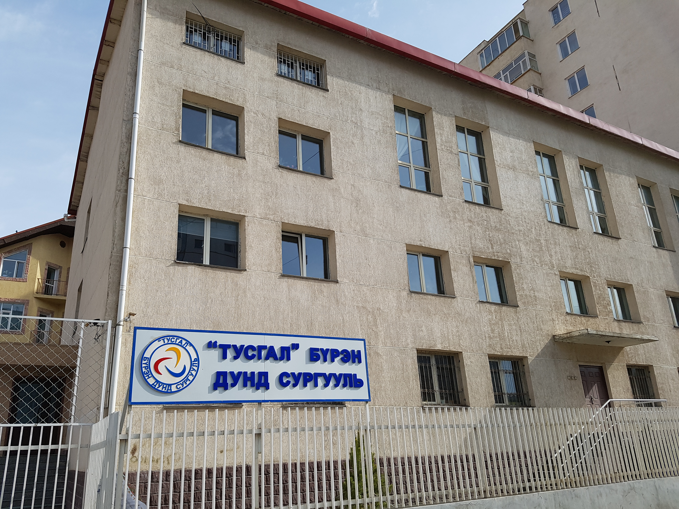
a. Accreditation for New Schools
2017, two secondary schools and one primary school have been accredited by the AAA for the first time: Korean Advanced Preparatory School (Grades 7-12) operated under the SDA Language Institution.

Slide 30
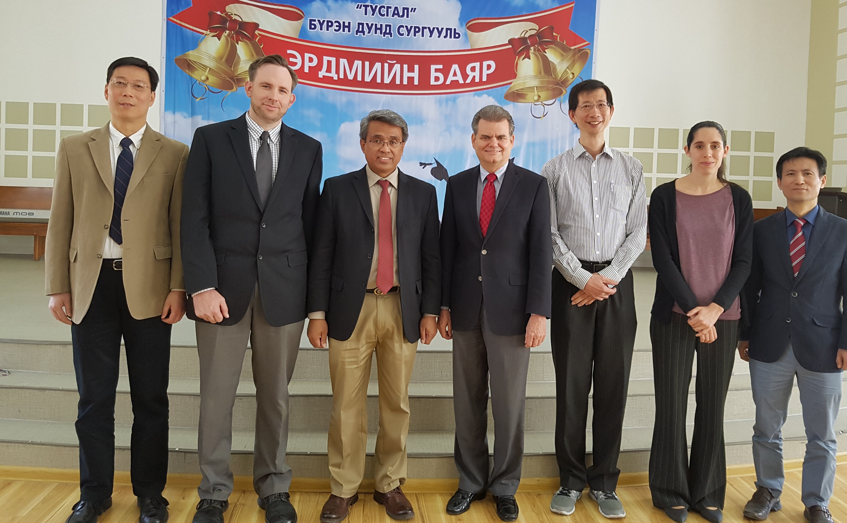
First AAA Visit to Tusgal School
Mongolia, May 22-25, 2017
Tusgal Adventist School (Grades 1-12), the first Adventist school in Mongolia.

Slide 31
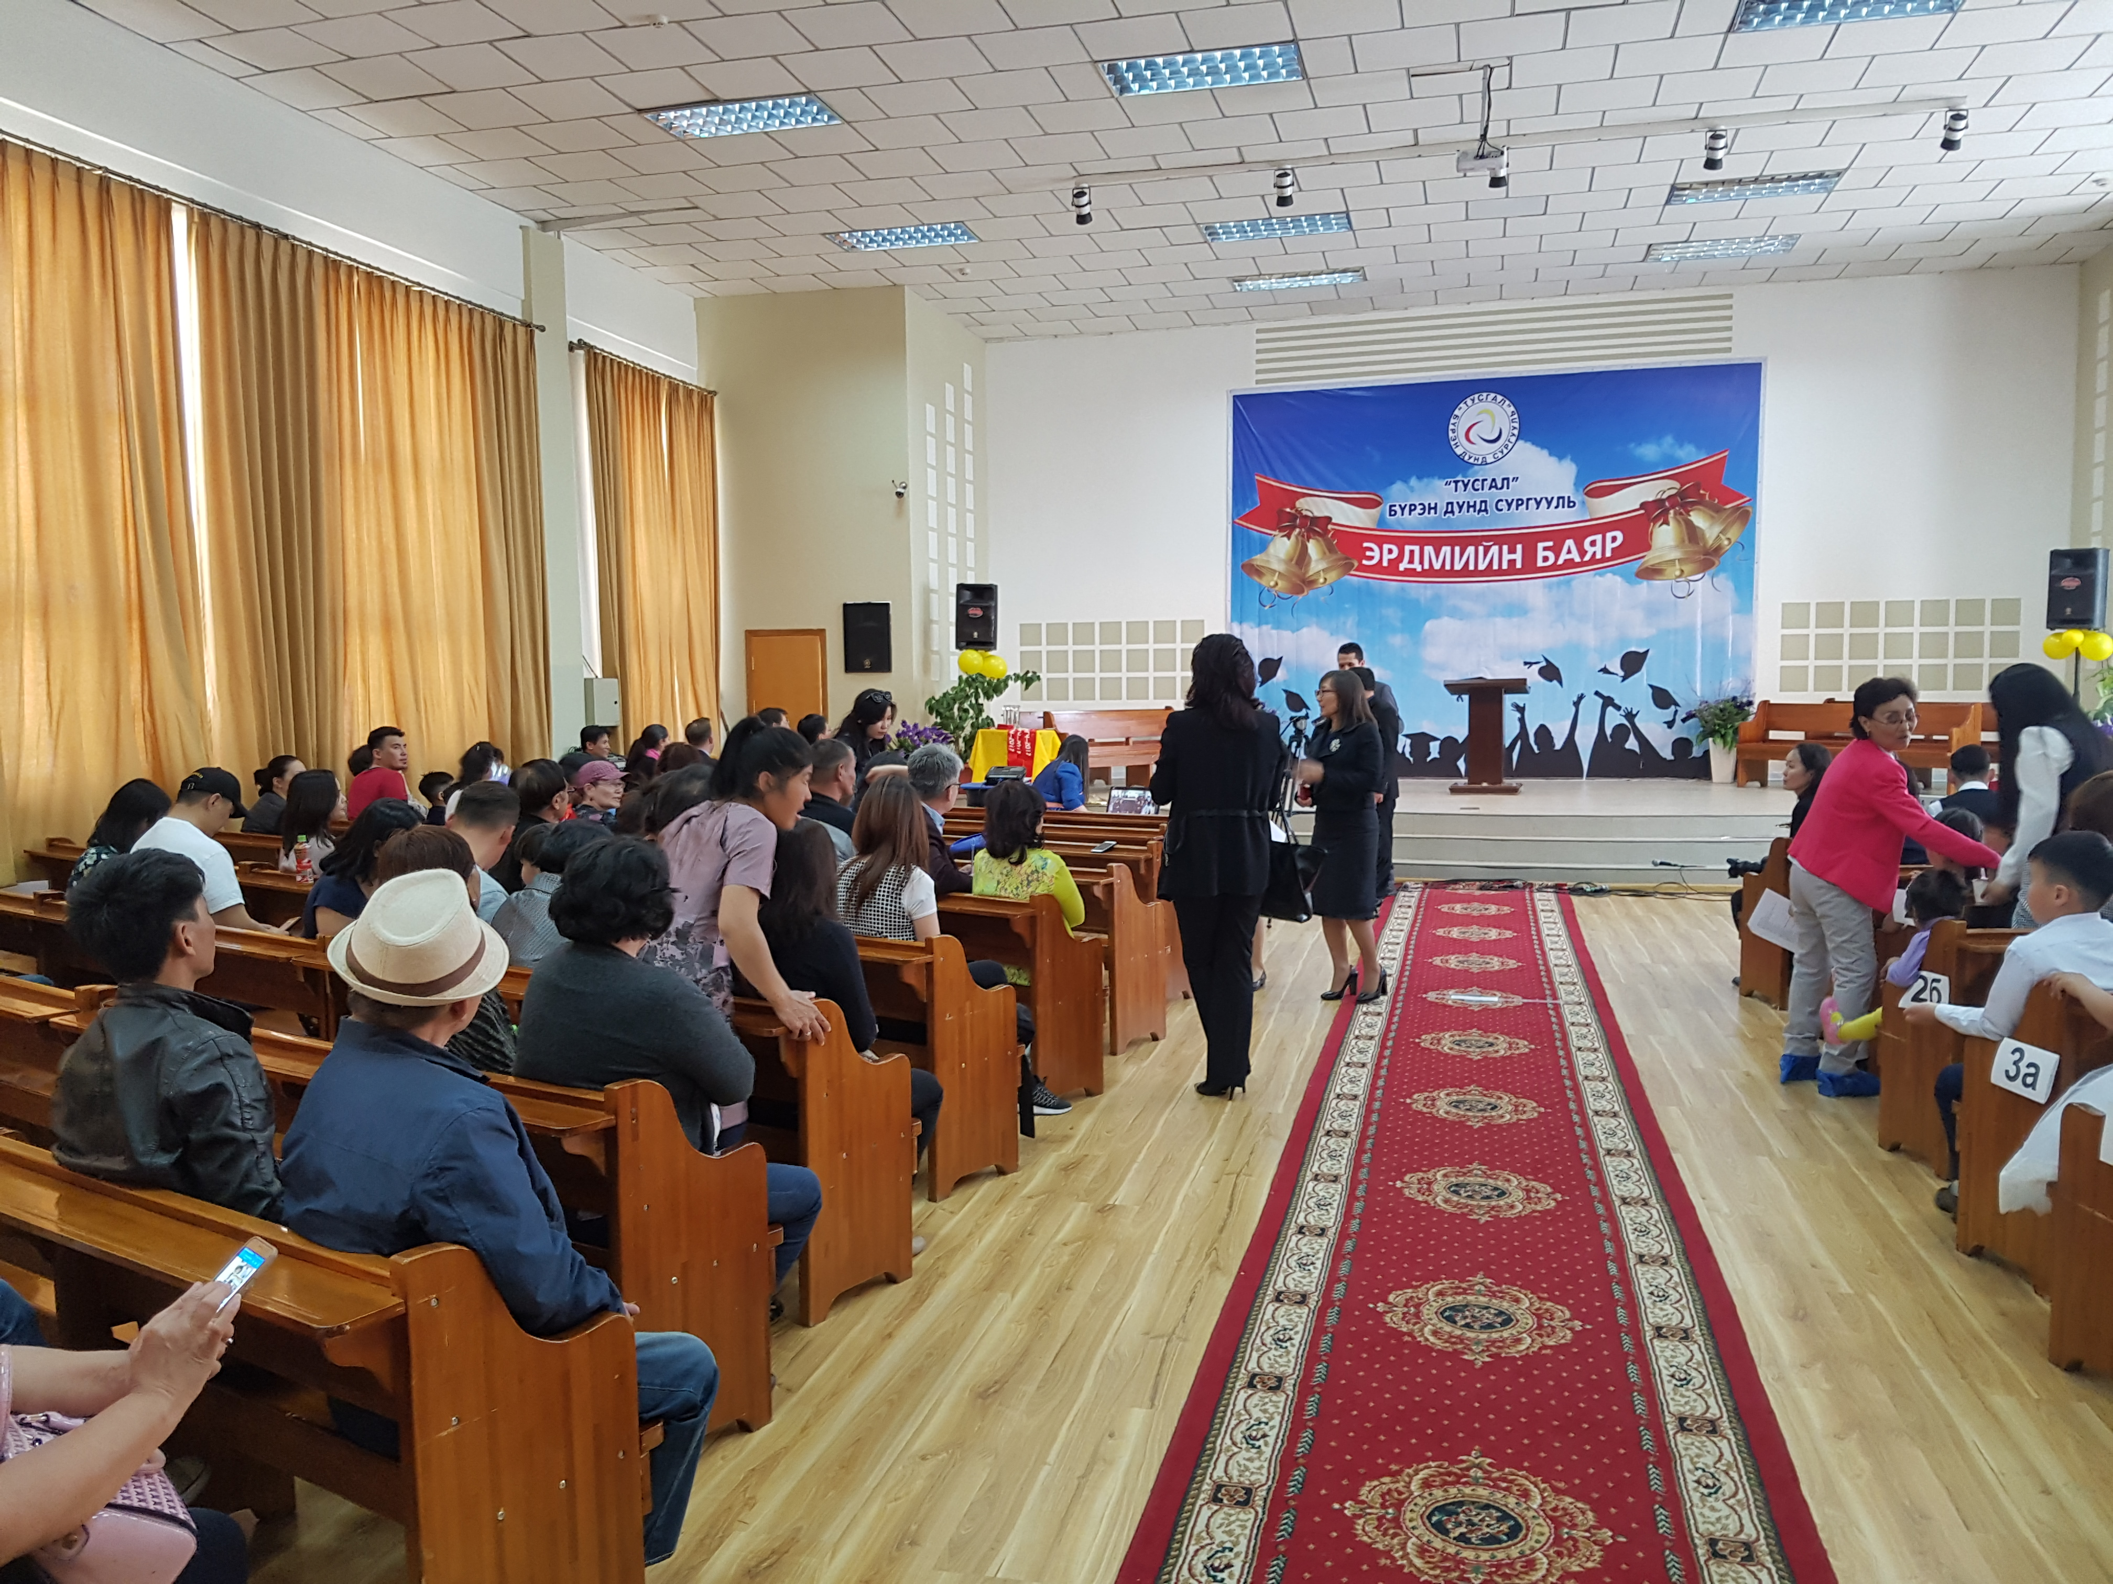
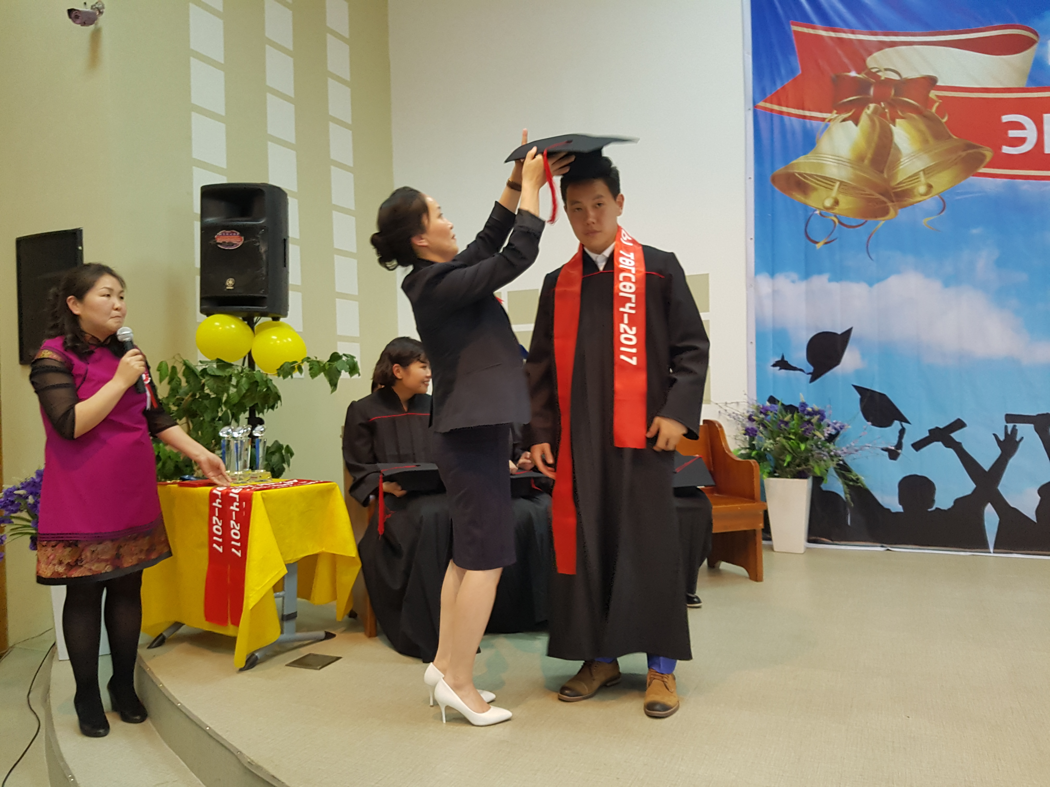
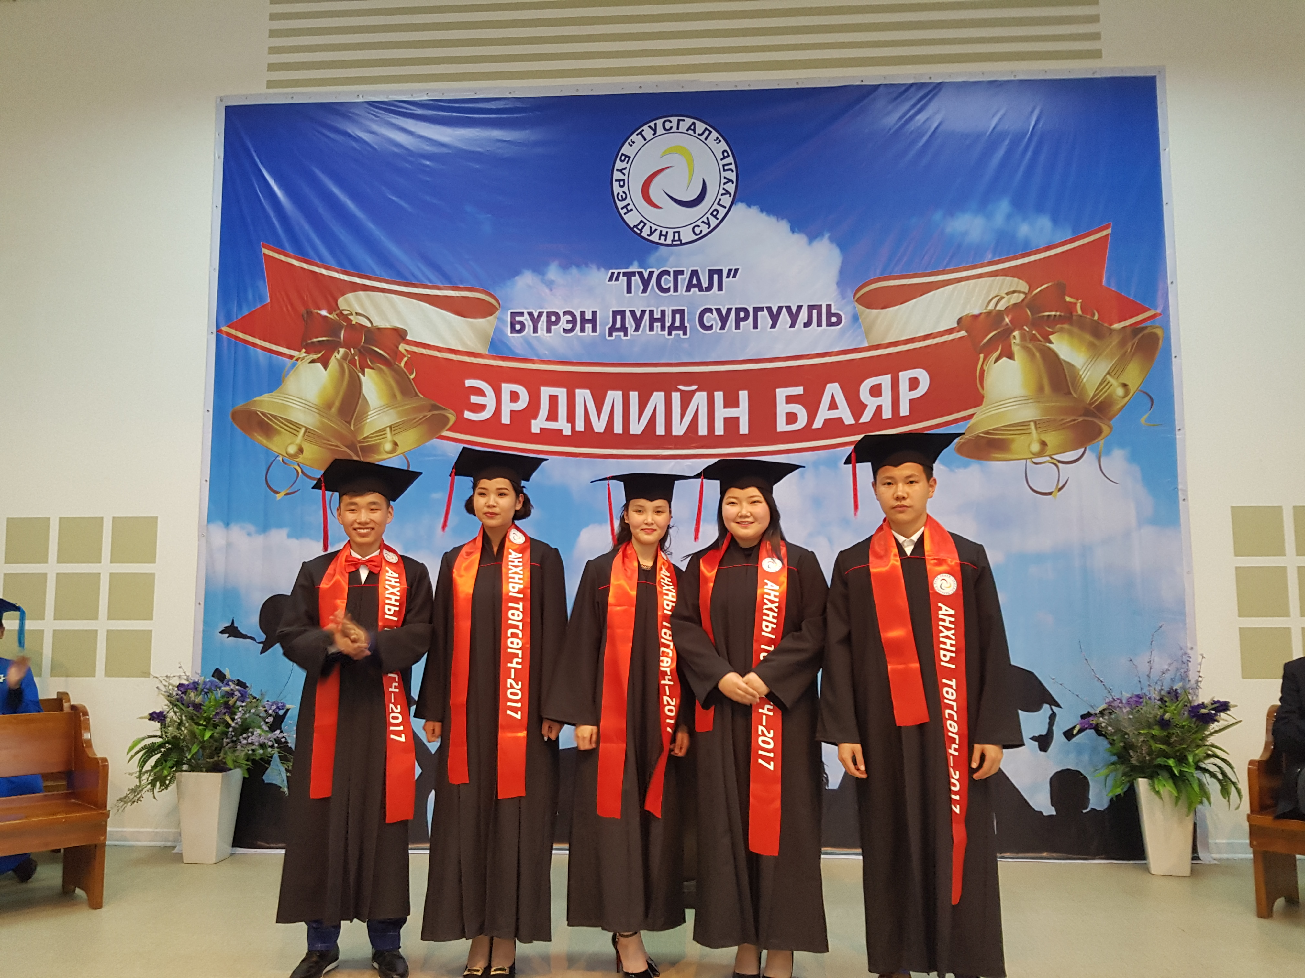
First High School Graduation
Tusgal School has 128 students.
May 22, 2017, a historic event took place in Tusgal School:
the first graduation of grade 12 (High School) students.

Slide 32
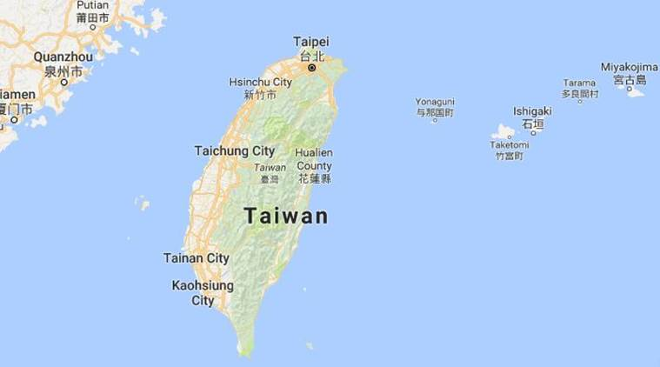
b. Establishing New Schools

Slide 33

Taiwan Adventist American School

Slide 34

We Need Schools
We are planning to establish one primary school in the area where most of our Adventist members are located.
In Mongolia, our only primary school has limited space for the 109 primary students. A strategy is being developed to accommodate more students, even to the point of establishing a new school.

Slide 35
Teachers Quality Enhancement
We are reaching-in by equipping and enhancing the quality of our teachers through the following:

Slide 36
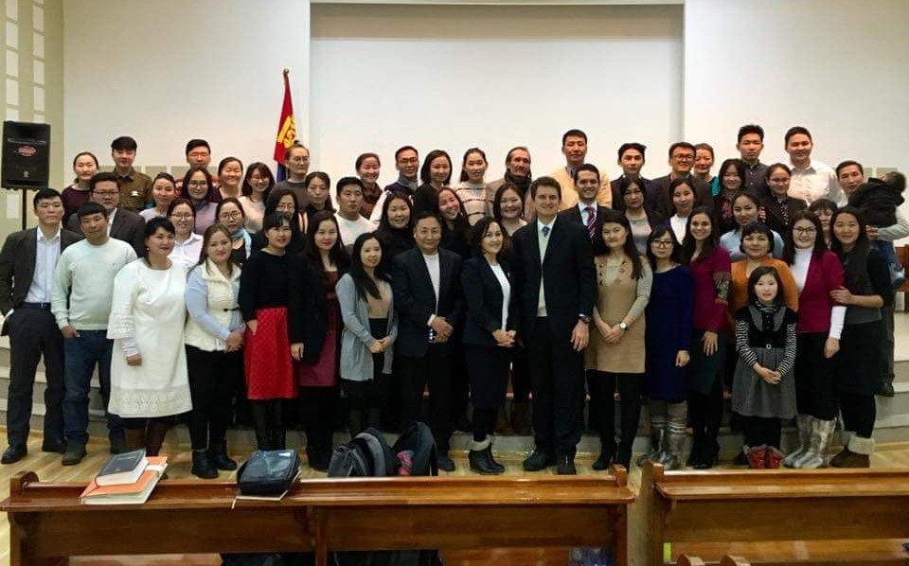
a. Adventist Teacher Certification
We would like to see that all our Adventist teachers are denominationally certified. Tusgal Adventist School in Mongolia, for example, is now conducting teacher’s training, with emphasis in Adventist history and teachings. This is because most of our teachers there are graduates of non-Adventist universities.

Slide 37
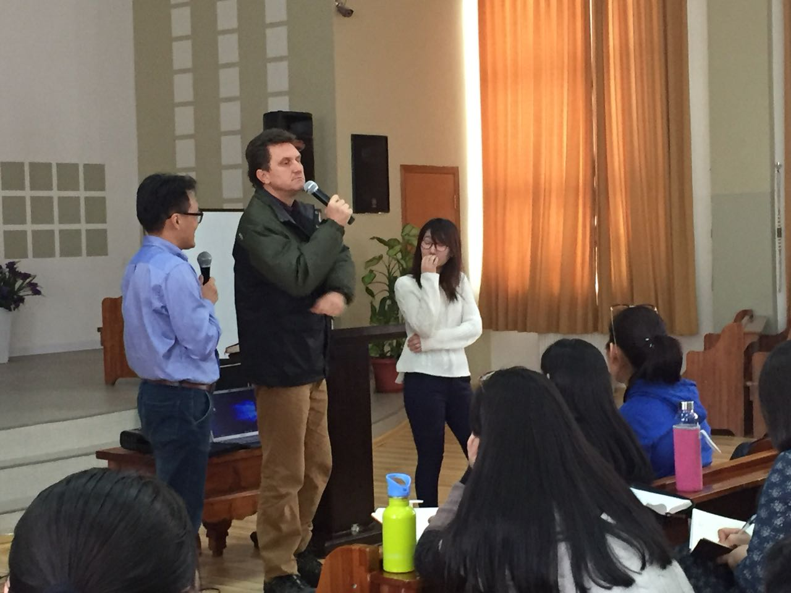
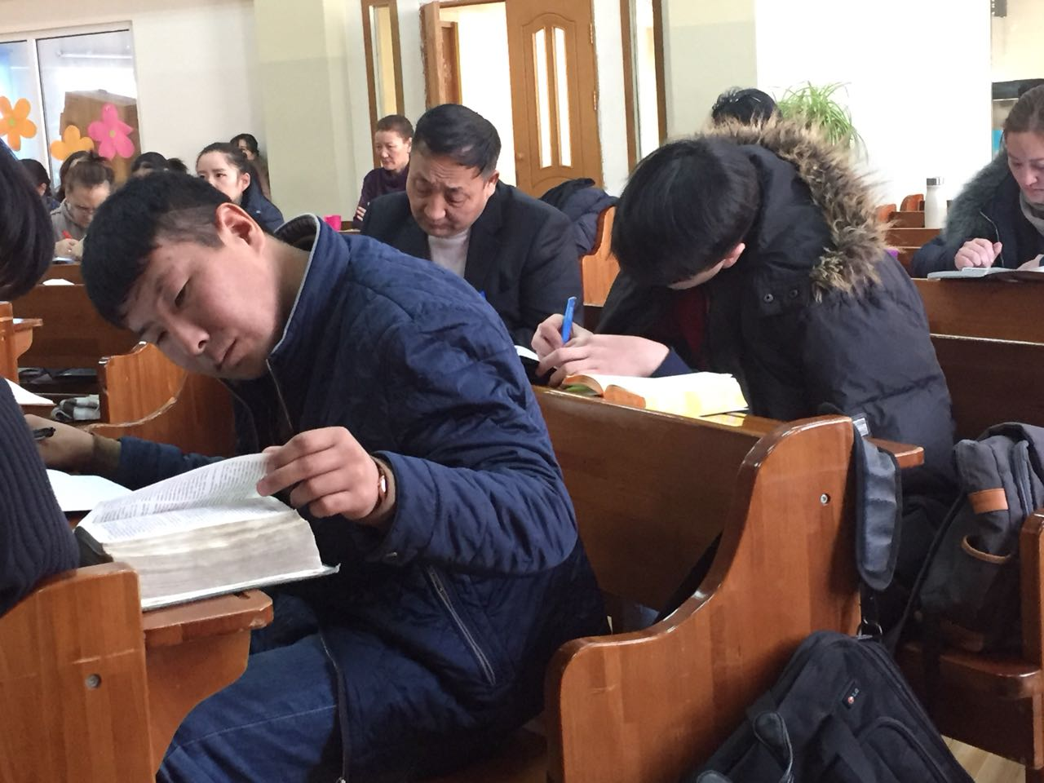
We thank UNASP of the South American Division for sending its theology professors at their own expenses to give at least six
30-hour religion/Bible classes to our teachers.

Slide 38
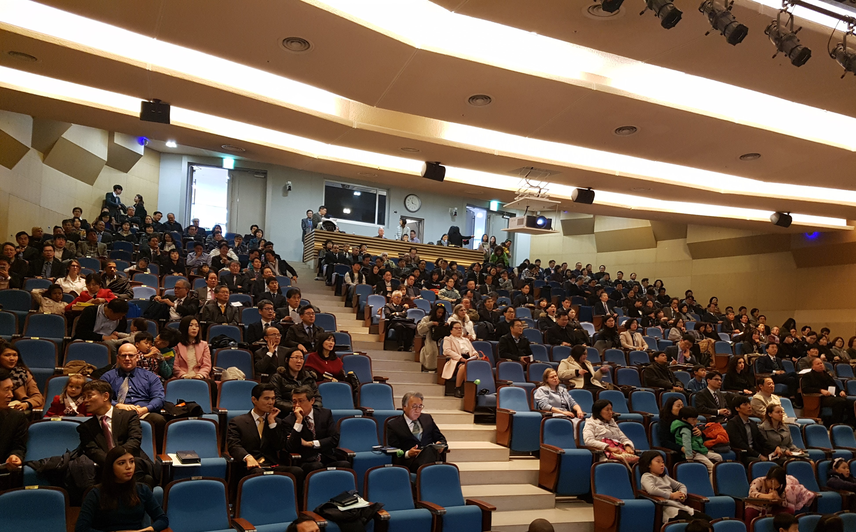
b. Teacher Trainings
In 2017, 8 teacher training events were conducted. Besides teaching methods, the theme of integration of faith and learning has been the focus of training/seminars, both for college/universities professors and for school teachers.

Slide 39
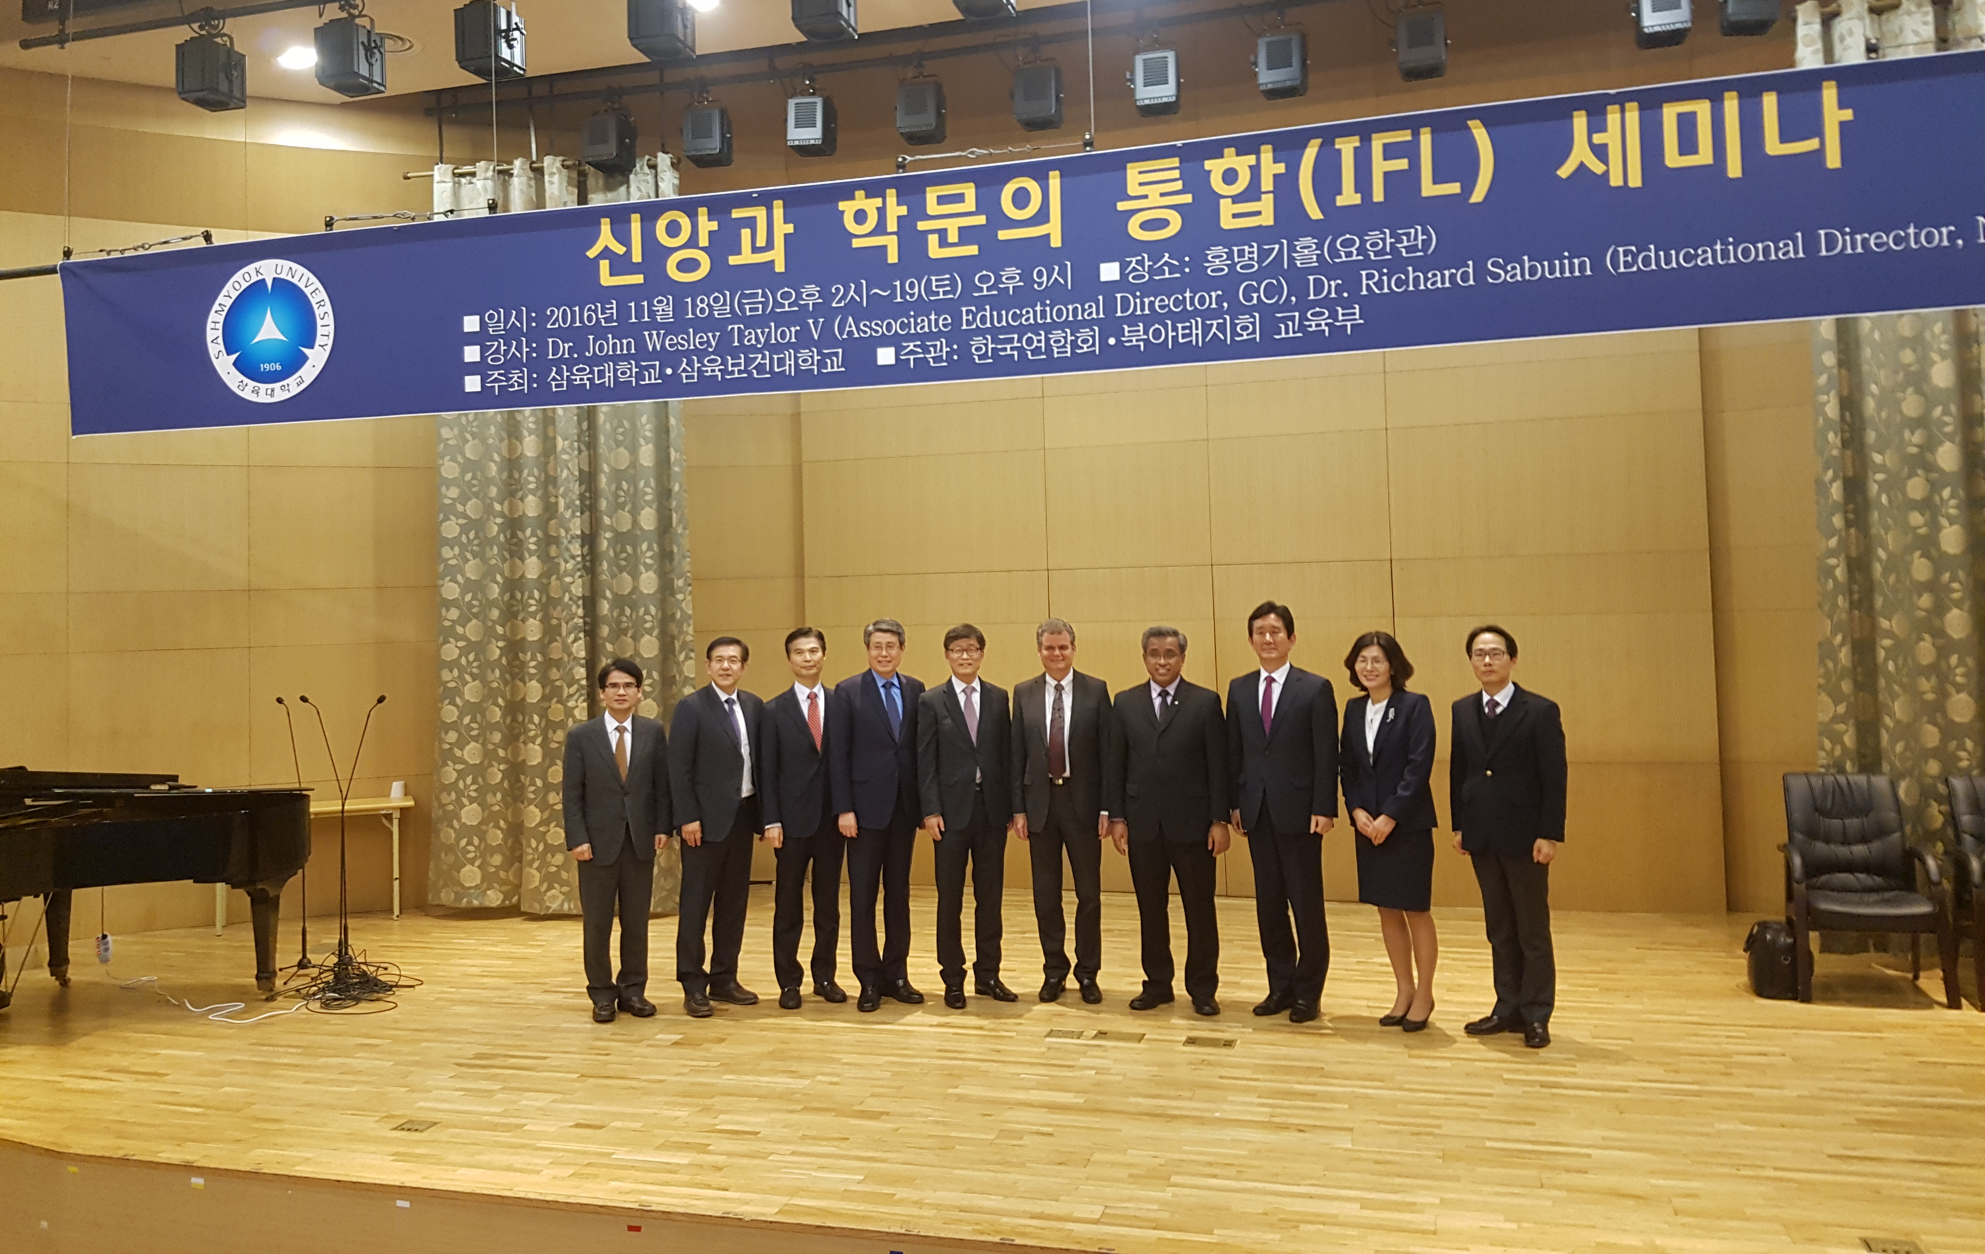
SHU and SYU, Nov 10-11, 2016

Slide 40
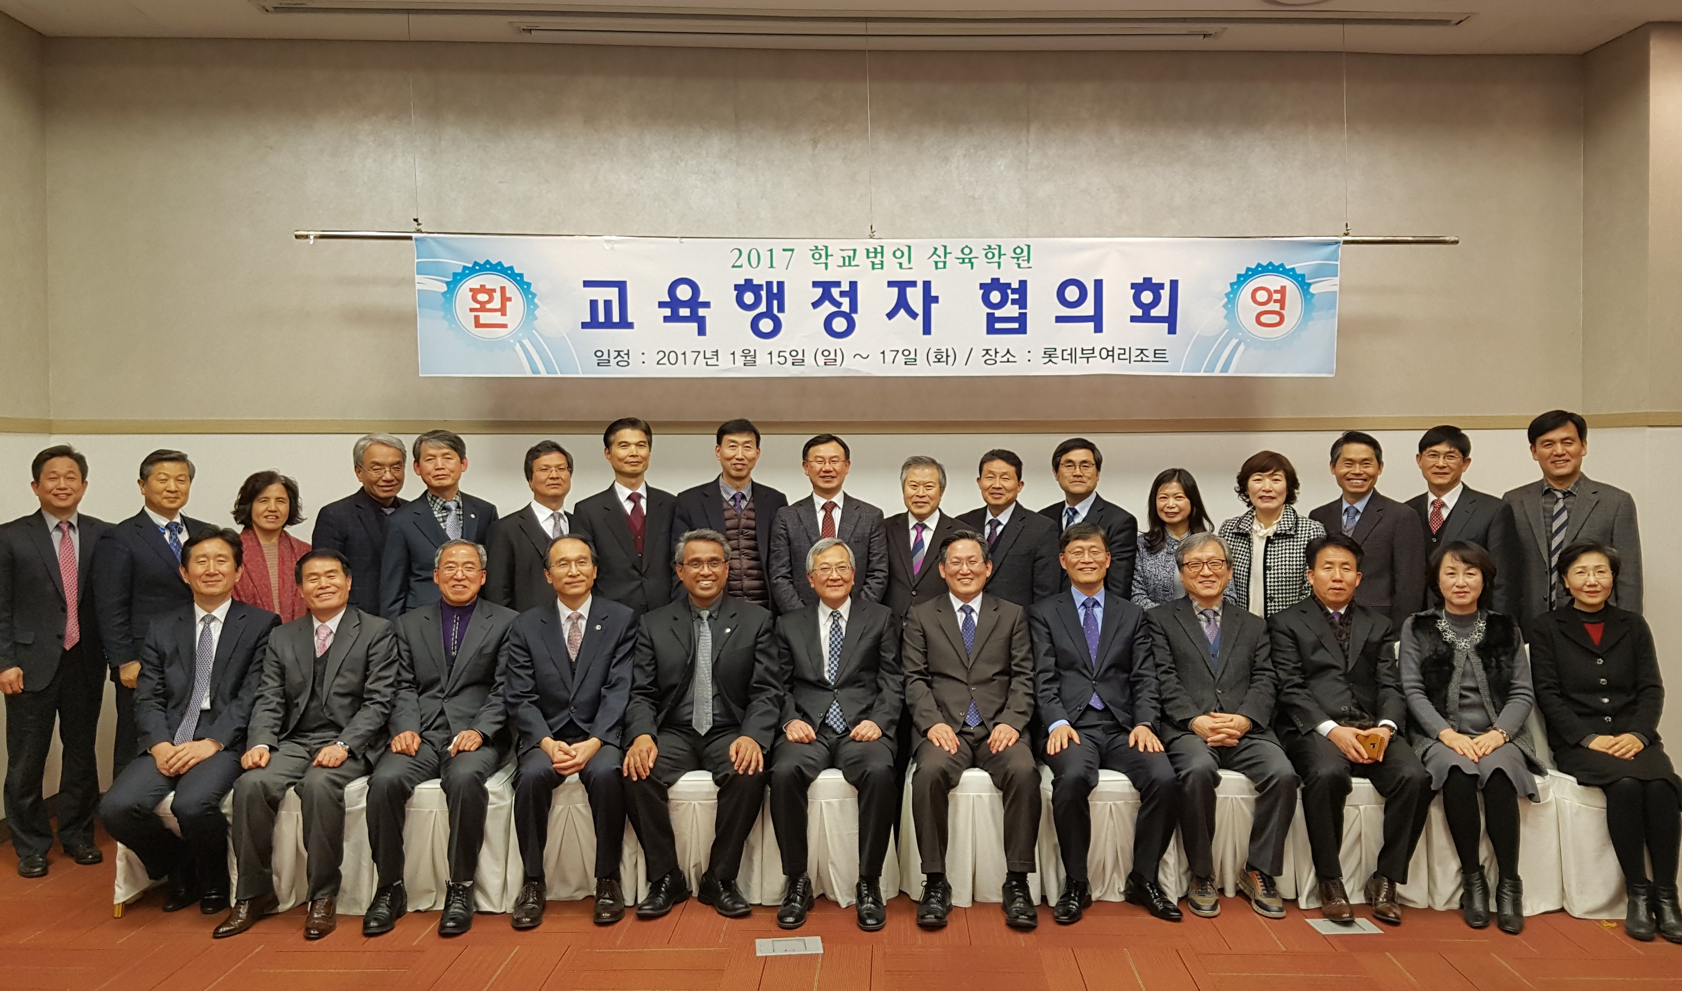
KUC Education Leaders

Slide 41
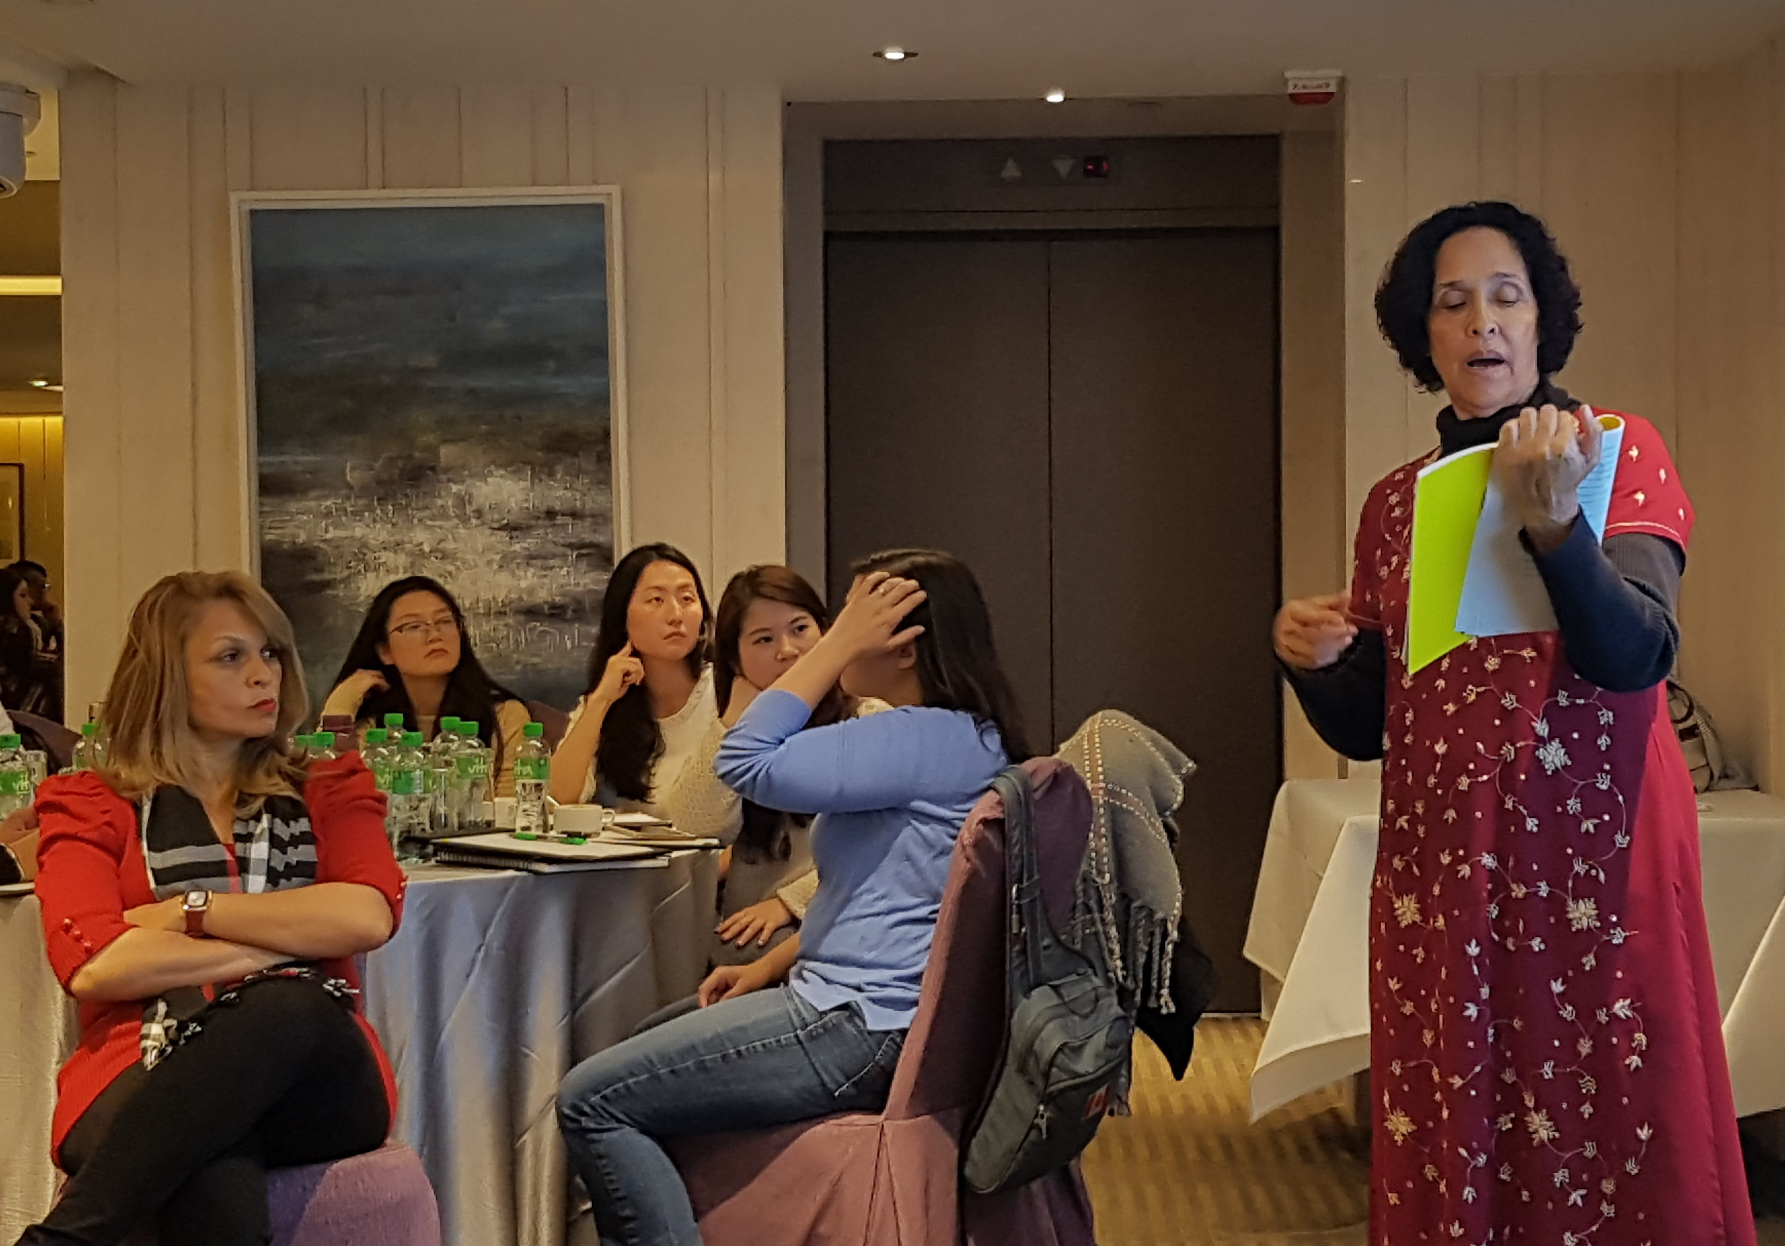
HKAA, Jan 23-24, 2017

Slide 42
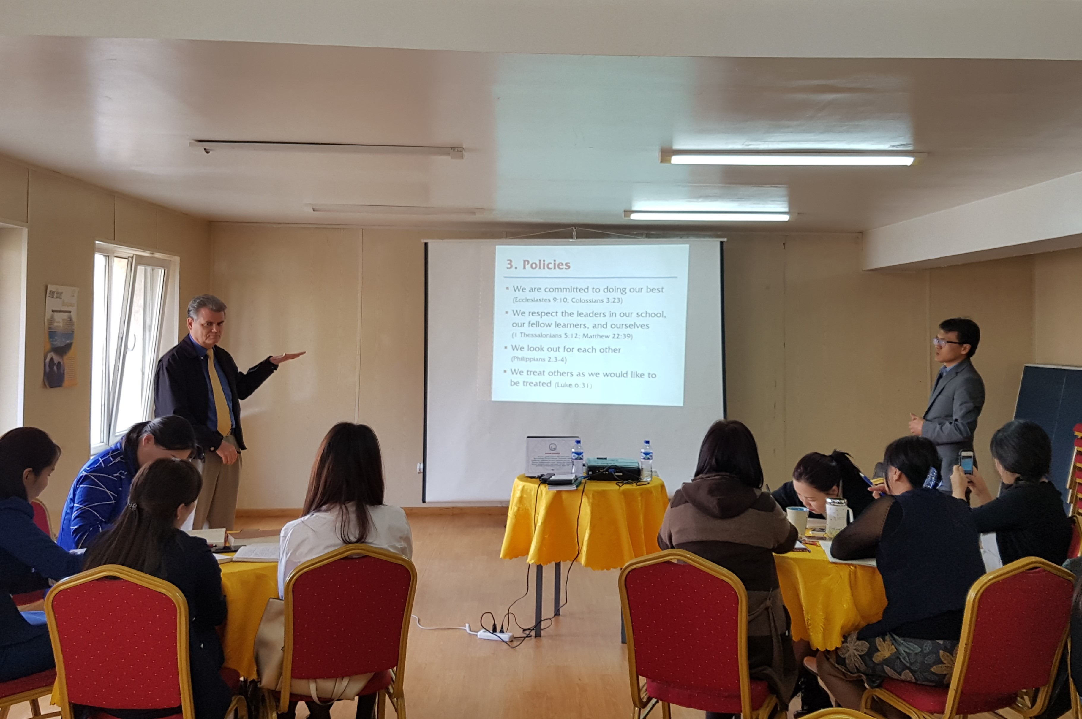
Tusgal, Mongolia, May 22, 2017

Slide 43
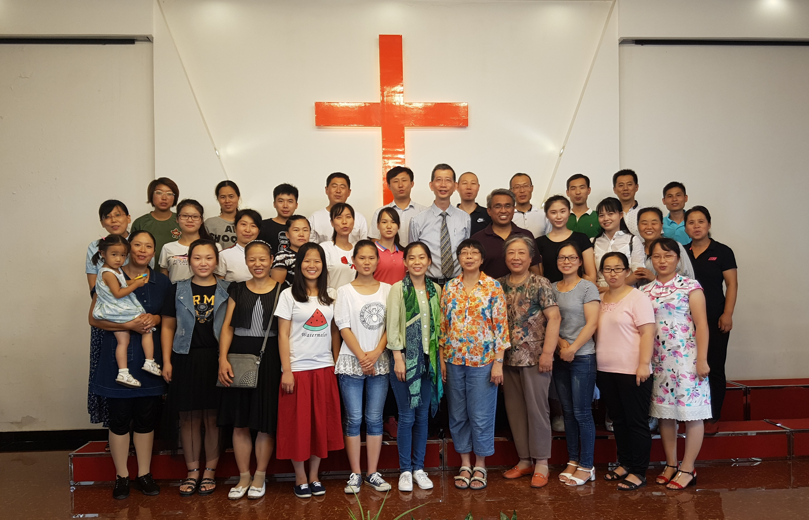
UT Teachers, Aug 24-26, 2017

Slide 44
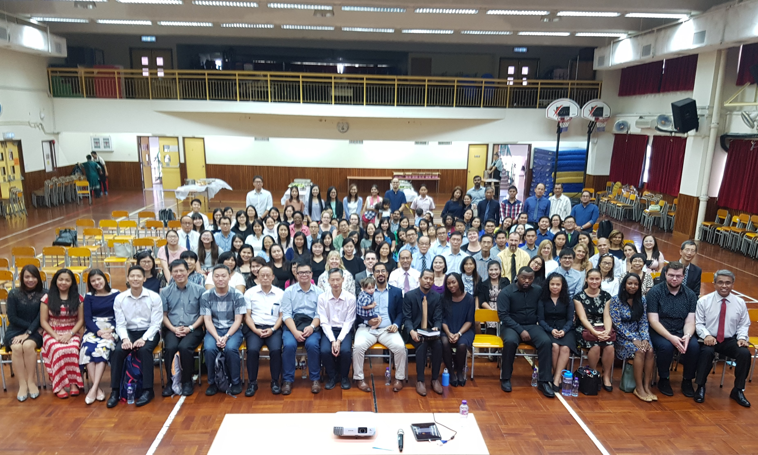

HKMC, SEP 16, 2017

Slide 45
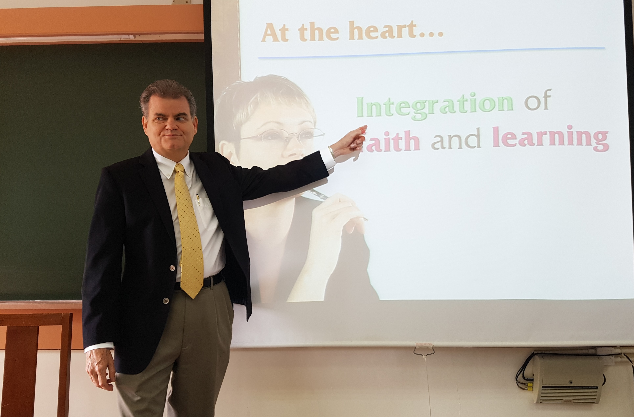
HKAC,
Oct 27,
2917

Slide 46
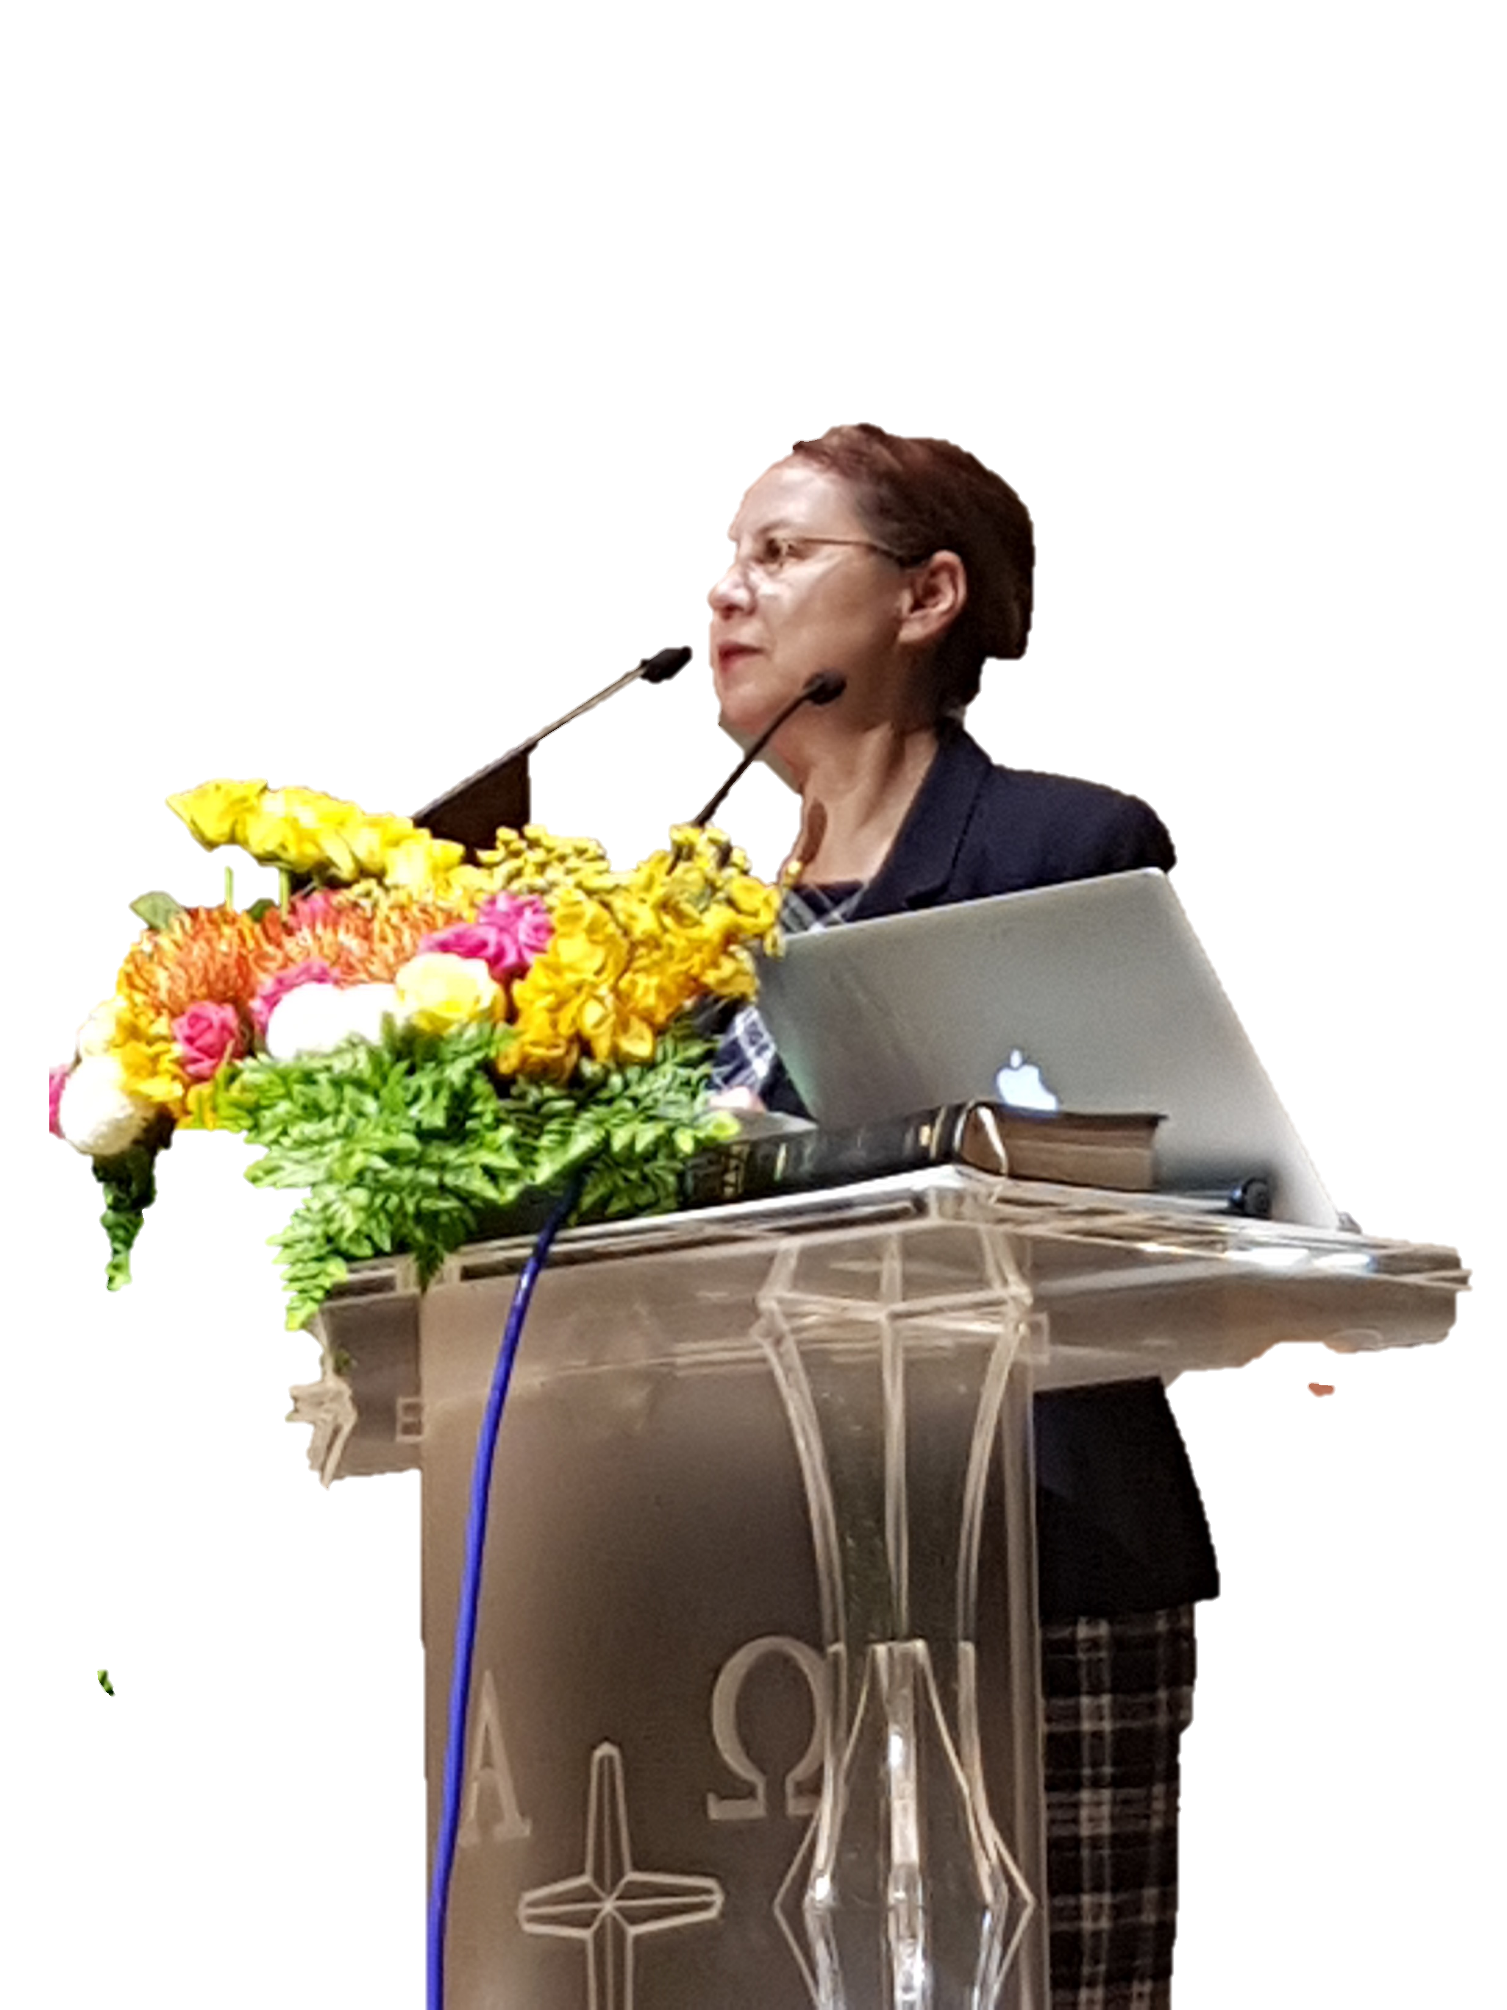

Slide 47

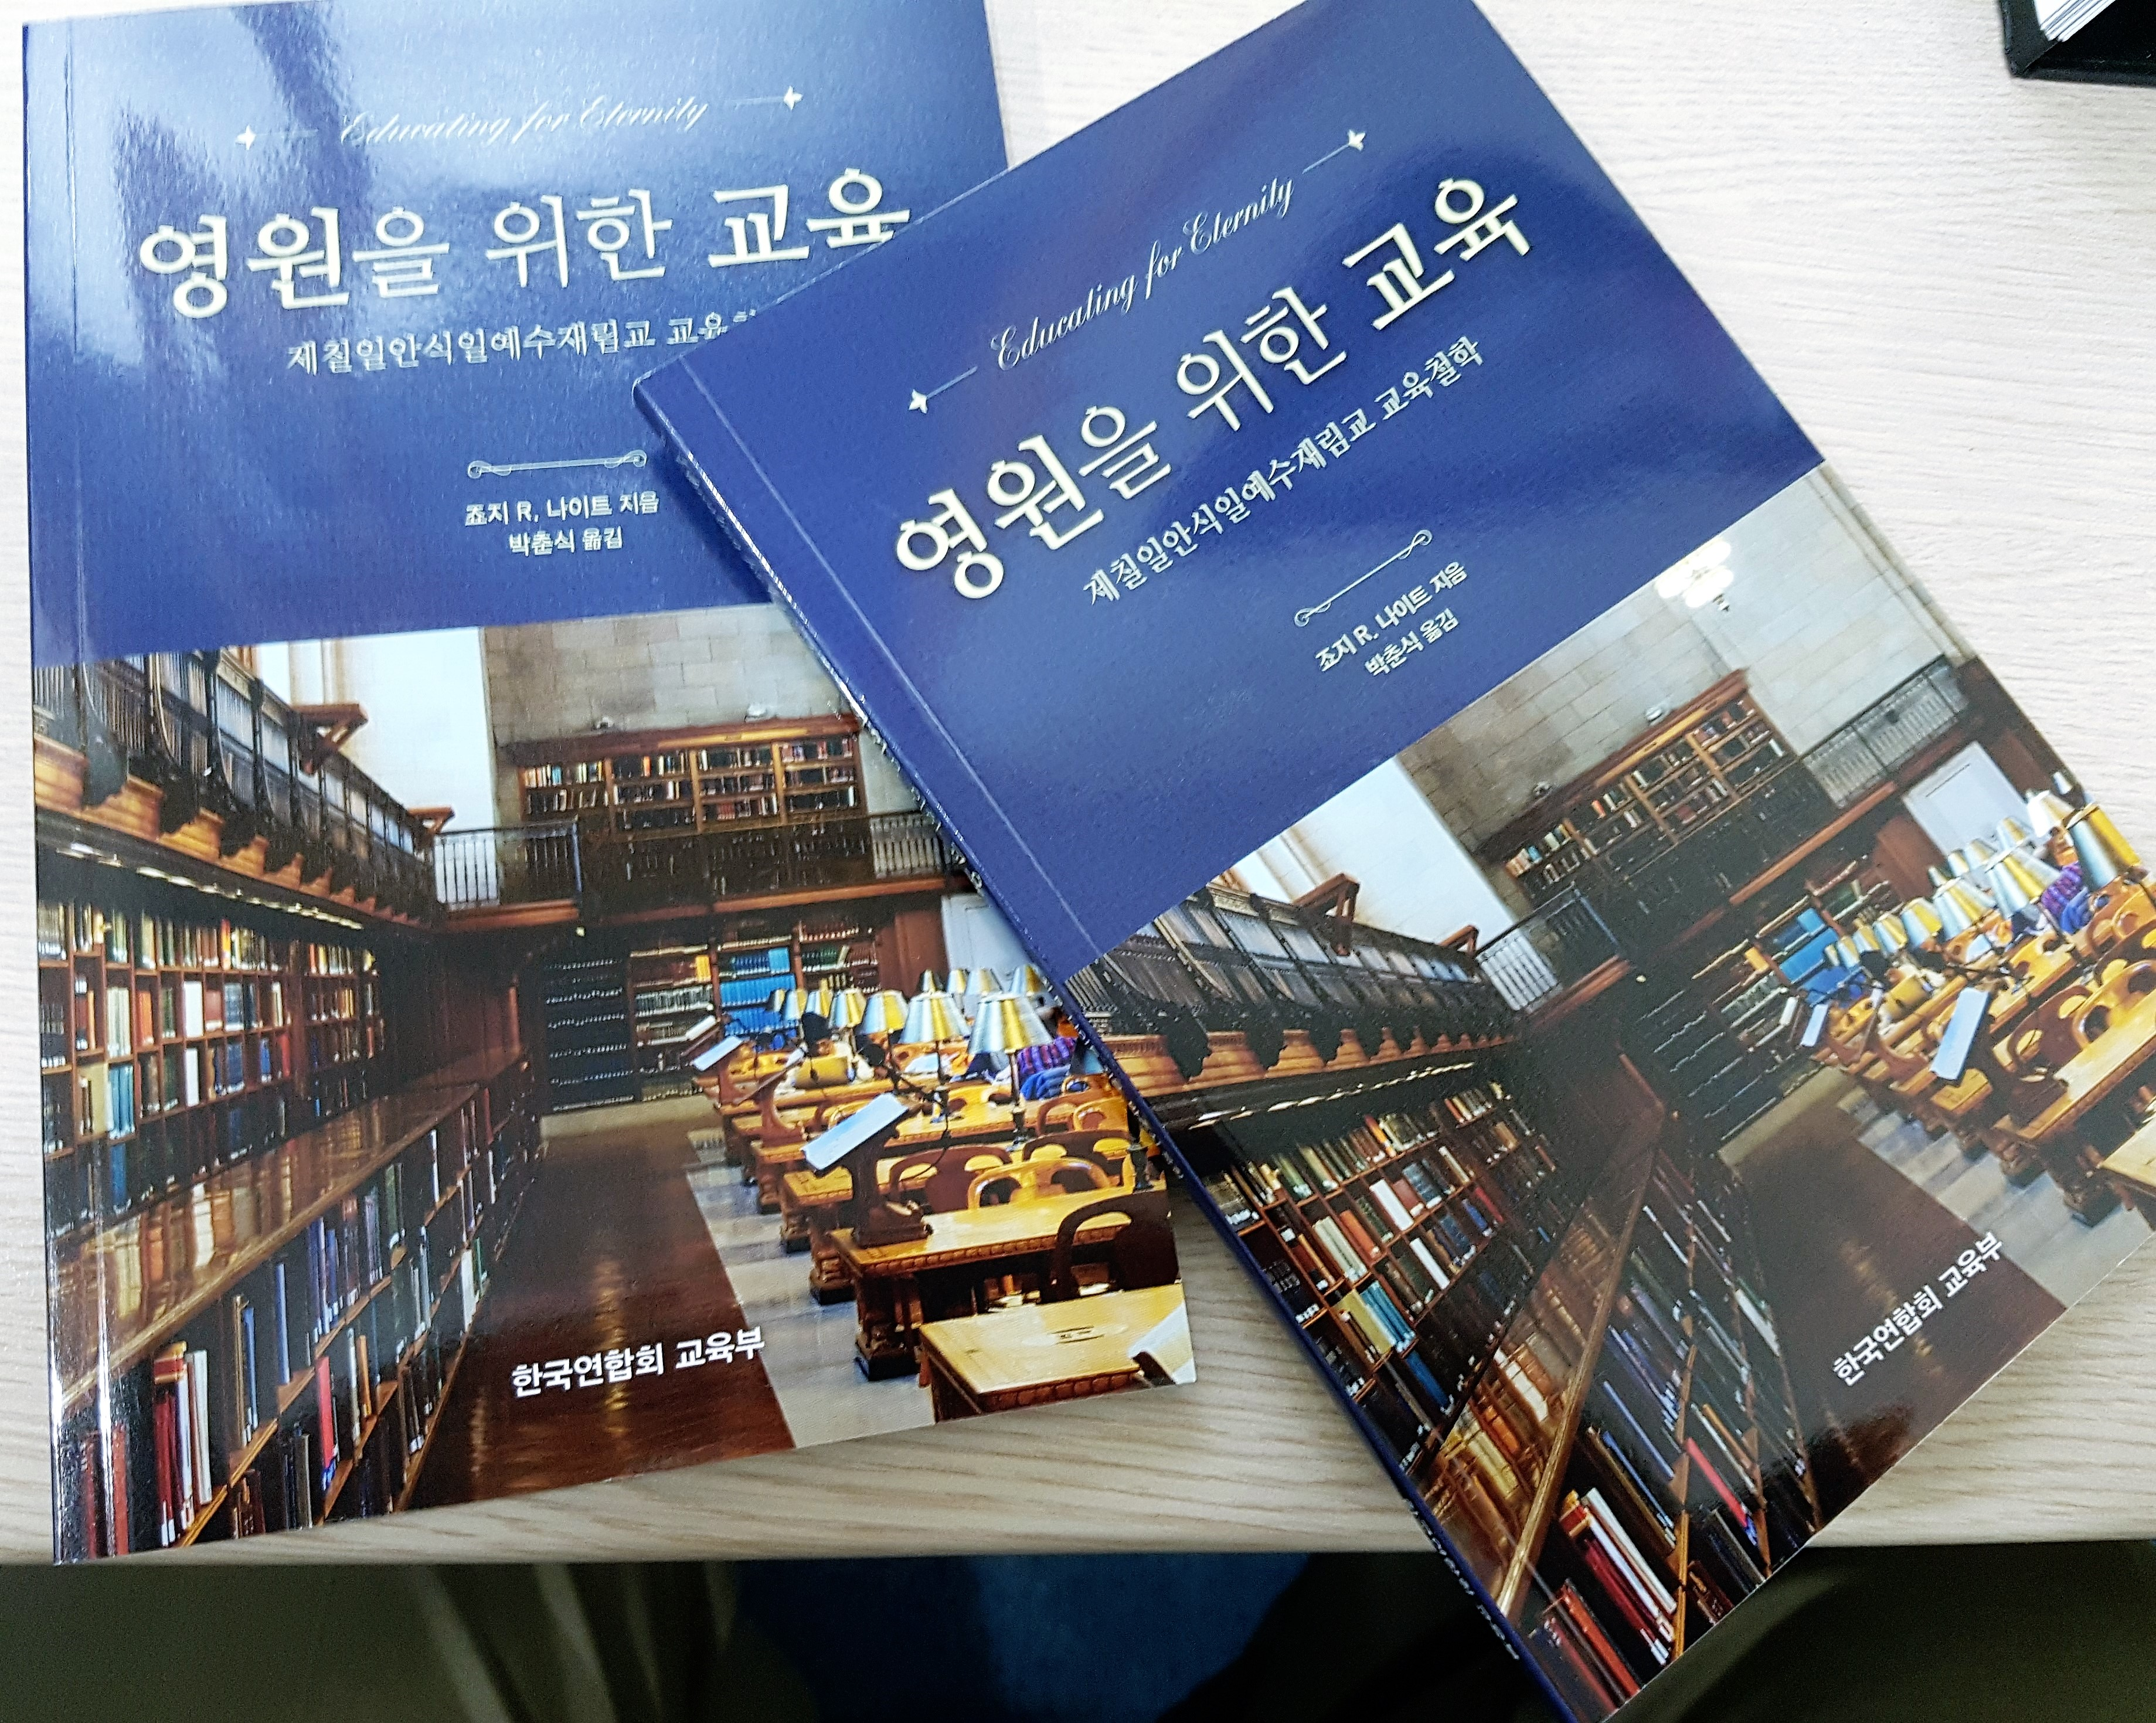
c. Orientation of Philosophy
of Adventist Education
We have translated the book Educating for Eternity into Korean and printed 1,000 copies to be distributed to all teachers.
Japanese - 500 copies will be distributed as well as in Chinese.

Slide 48
d. Upgrading Program
NSD is upgrading 26 teachers:
8 doing Bachelor programs
9 pursuing Master’s programs
9 working on Doctoral programs.

Slide 49

Reach Out

Slide 50
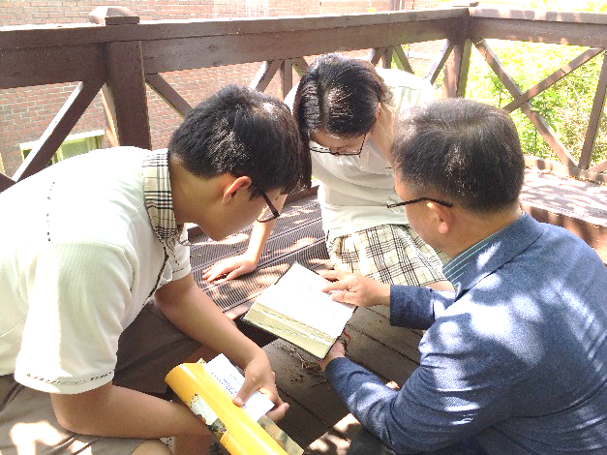
Gospel Week
Adventist schools exist for God’s mission, the proclamation of the Three Angels’ Messages. We emphasize mission in our schools.

Slide 51
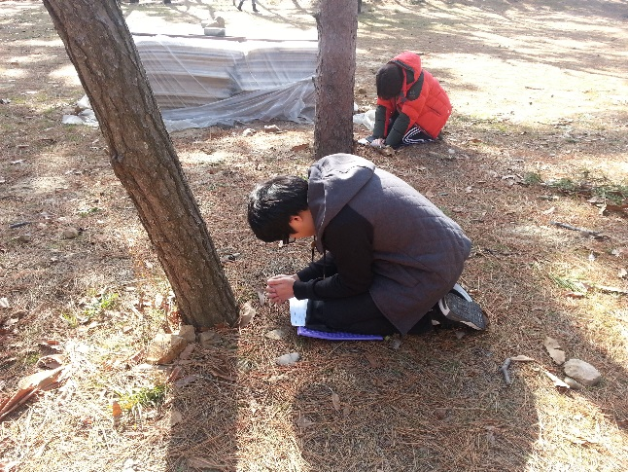

Discipleship Program
Through discipleship programs, Gospel weeks, and mission trips, students have accepted Jesus Christ as their personal Savior.

Slide 52
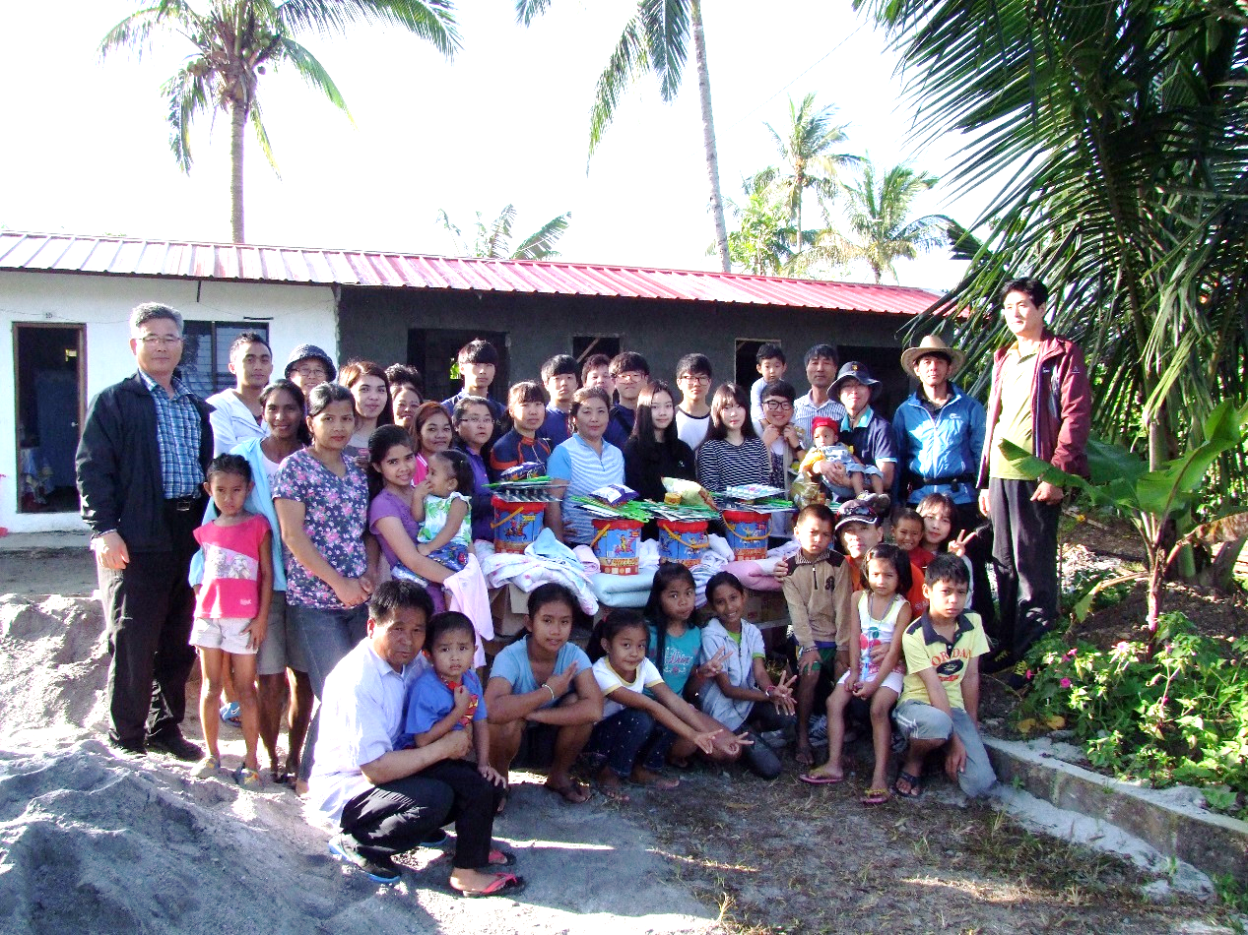
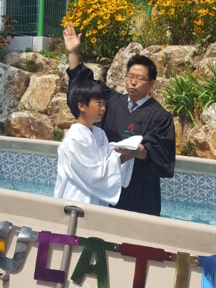
Mission trips
Last year, about 7% of the non-Adventist students were baptized.
All our schools are focused on mission through discipleship programs, community services, mission trips, etc.
Our schools are to be mission centers..

Slide 53
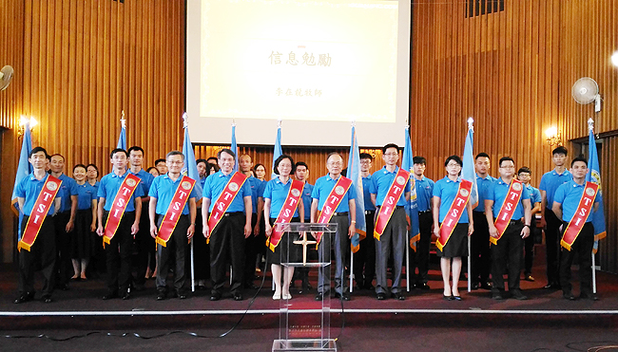
Total Student Involvement
TAC
Taiwan Adventist College initiated Total Student Involvement in 2017.
As of December 2017, 91 evangelistic series have been conducted in UT and in Taiwan by students and professors, including the president of the college.

Slide 54
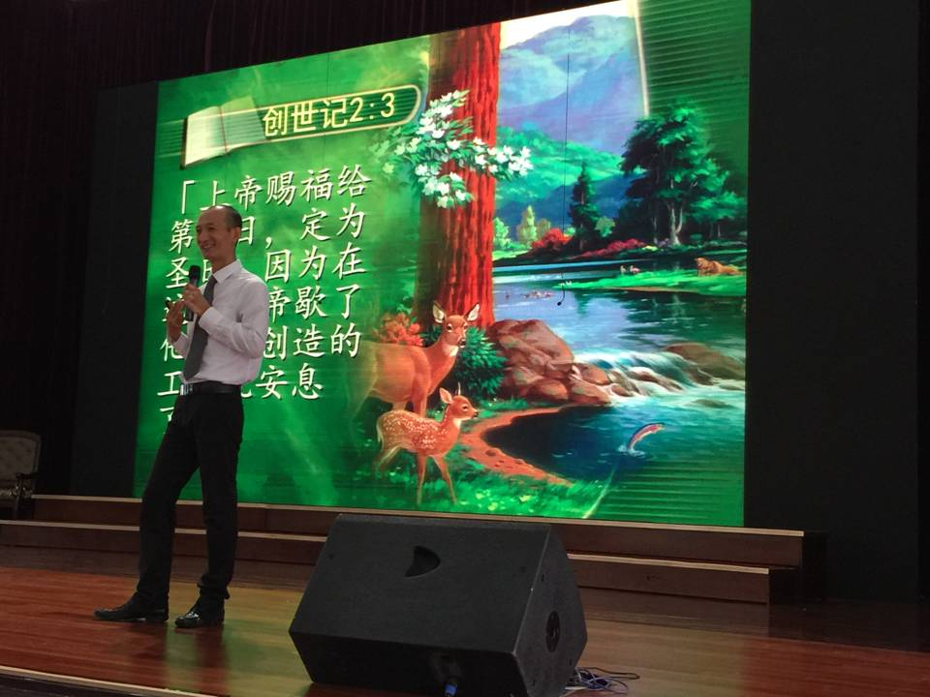
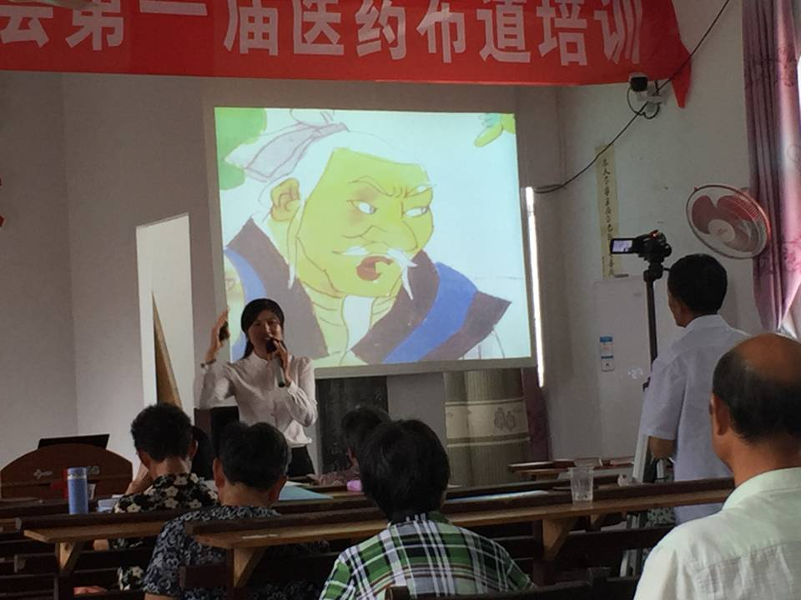



Slide 55


Slide 56
Result in 2017
Evangelistic series : 91 (73 in UT; 18 in Taiwan)
Attendance : 11,000+
Sermons : 620
Health talks : 338
Gospel skits : 120
Baptism : 1,657

Slide 57
Continuous Plans
More Adventist teachers
More Adventist Students
More Adventist Schools

Slide 58

“Do you have a Bible?” he asked them.
“Yes, we do,” they replied in good English.
“Who gave you the Bible?” he followed-up.
“We bought it,” they enthusiastically replied.
“Do you read your Bible?” he asked with curiosity.
“Yes, we do,” they confidently confirmed.
“When?” he inquired.
“We bring it to our classroom to read every morning,” they explained.
Amazing!

