Slide 1
Joining & Remaining
A Look at the Data on the Role of Adventist Education
John Wesley Taylor V taylorjw@gc.adventist.org
Notes:
Adventist education is the longest and largest evangelistic event held by the Seventh-day Adventist church. Is it effective? This presentation examines findings from a set of research studies spanning the past three decades that have explored the relationship between Adventist education and young people joining and remaining in the Adventist church. Implications will be discussed and specific actions proposed to reinforce the redemptive purpose of Adventist education.

Slide 2
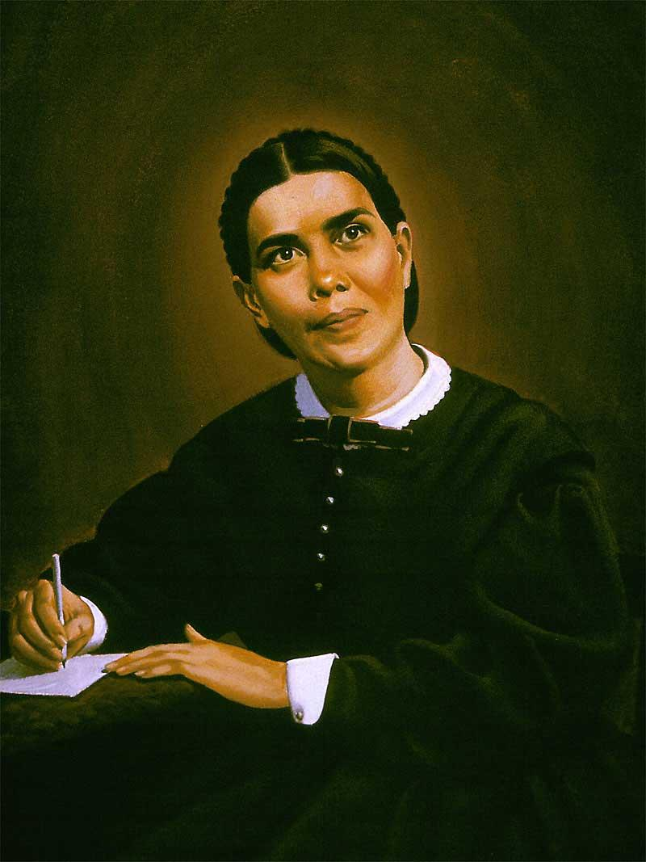
All-important matter…
“Conversion of the students.”
Fundamentals of Christian Education, p. 436
Notes:
In Adventist education, there is a matter of highest importance. Writing to church leaders and educators, Ellen White declared that:
According to the biblical model, conversion is expressed in baptism, through formally joining the Church. And that takes us to accession.

Slide 3
Accession to the Church
The Role of Adventist Education
Notes:
Accession—persons joining the Church. Adventist education has a key role to play.

Slide 4
Adventist Education
LONGEST and LARGEST
EVANGELISTIC EVENT
held by the Adventist Church
Notes:
Adventist education is the longest and largest means of evangelism carried out by the Adventist Church.

Slide 5
Duration
800
– 37,400 hours
5-9 hours/day
160-260 days/year
1-16⁺ years
Notes:
https://norberthaupt.com/2012/04/20/school-days-around-the-world/
http://elearninginfographics.com/school-days-around-world-infographic/
China holds both highest hours/day and highest days/year (9 & 260 respectively)
Total hours: 15,200 (Finland) to 37,400 (China)

Slide 6
Size
Level
Sites
Evangelists
Attendees
Children
5,943
55,331
1,183,337
Adolescents
2,429
36,592
595,848
Youth
167
15,053
156,713
Totals
8,539
106,976
1,935,898
December 31, 2017
Notes:
Schools = evangelistic sites; teachers = evangelists; students = attendees

Slide 7
Adventist Education
LONGEST and LARGEST
EVANGELISTIC EVENT
Effective?
Notes:
Adventist education is the longest and largest means of evangelism carried out by the Adventist Church.

Slide 8
Baptisms in Adventist Education
Year | Baptized
2008 | 33,138
2009 | 40,415
2010 | 49,176
2011 | 50,752
2012 | 49,774
2013 | 48,604
2014 | 47,435
2015 | 43,475
2016 | 49,308
2017 | 46,310
458,387
baptisms
A conference established each year
Notes:
Baptisms of students during the school year.
Note: Report figures for 2013 is 31,824. Given that a number of fields did not report that year in the switch from paper to electronic reporting, the figure appearing in the table is extrapolated based on trend.

Slide 9
Children from Adventist families
13x more likely
Jim Epperson
Southern Union
N=844
Notes:
Jim Epperson – 1990
No Adventist education: 58% stayed in the church; Some Adventist education: 79% stayed in the church
Sample: 300 family units were randomly selected from the Southern Union and 210 families responded. N = 844
Procedure: Compared Adventist youth with no Adventist education and those with some Adventist education on whether they stayed in the church.

Slide 10
Children from Adventist families
W. E. Minder
Lake Union N=807
Notes:
Warren E. Minder (1985). A study of the relationship between church sponsored K-12 education and church membership in the Seventh-day Adventist Church. Ed.D. dissertation, Western Michigan University.
Sample: 400 family units were randomly selected from the Lake Union and 287 families responded. N = 993.
Procedure: Compared Adventist youth with no Adventist education, some Adventist education, and those with only Adventist education on whether they joined and stayed in the Adventist church.

Slide 11
Children from Adventist families
W. E. Minder
Lake Union N=807
Notes:
Warren E. Minder (1985). A study of the relationship between church sponsored K-12 education and church membership in the Seventh-day Adventist Church. Ed.D. dissertation, Western Michigan University.
Sample: 400 family units were randomly selected from the Lake Union and 287 families responded. N = 993.
Procedure: Compared Adventist youth with no Adventist education, some Adventist education, and those with only Adventist education on whether they joined and stayed in the Adventist church.

Slide 12
Adventist Education Is Mission
“The work of education and the work of redemption are one.” Education, p. 30
Notes:
“There should be schools established wherever there is a church or company of believers. Teachers should be employed to educate children of Sabbath-keepers.” Ellen G. White. 1898. Special Testimony to Battle Creek Church, p. 40.

Slide 13
Adventist Education Is Mission
Reaffirm the central role of Adventist education
in the evangelistic mission of the church
Notes:
“There should be schools established wherever there is a church or company of believers. Teachers should be employed to educate children of Sabbath-keepers.” Ellen G. White. 1898. Special Testimony to Battle Creek Church, p. 40.

Slide 14
Retention in the Church
The Role of Adventist Education
Notes:
Perhaps even more important, however, than accession—joining the Church, is retention—remaining in the Church.
Adventist education has a vital role here, as well.

Slide 15
Members who leave
-15M -10M -5M 0 5M 10M 15M 20M
13,737,025
20,647,979
Since 1965: 34,385,004 accessions
Net loss rate: 39.95%
Of 10 members,
Members who left
Members who stayed
4 have slipped away.
Notes:
First, the problem.
Out of every 10 members, 6 remained, and 4 slipped away.

Slide 16
Members who leave
-6M -4M -52 0 2M 4M 6M 8M
5,918,483
7,729,798
Members who left
Members who stayed
In 2000-2012, there were 13,648,281 accessions
Net loss rate: 43.36%
Notes:
As of 2012

Slide 17
Youth who leave
Landmark “Youth Retention” study
Over 1,500 baptized 15- and 16-year-olds
Representative of Adventist youth: Large & small churches, small towns & big cities, public schools & Adventist schools, all ethnic groups
Interviewed each year for the next 10 years
How many left the church by age 25-26?
Many demographic groups, approaching: 50%
Notes:
Began in 1987. Roger Dudley
We are losing one half of our youth. Not one lost coin, but half of the coins!
In his landmark 10-year longitudinal study, Roger Dudley (2000) began in 1988 with 1,523 Adventist youth ages 15 and 16. When the study ended 10 years later, 578 (about 1/3) of the original group, now young adults, completed the form. Did the type of college the students attended make any difference in retaining their membership in the Adventist Church? Of the responding young adults who attended all or mostly all Adventist schools during high school and college, 92% were members at age 25. If they had attended part Adventist schools and part non-Adventist schools, 79% remained members at age 25. If all or most of their schooling was in non-Adventist schools, 72% remained members at age 25 (Thayer, 2008b). Dudley speculates that many of the young people who dropped out of the study are no longer church members, which would lower the percentages in all categories if all original subjects had completed the final survey. Dudley (2000) estimates that “at least 40 percent to 50 percent of Seventh-day Adventist teenagers in North America are essentially leaving the church by their middle 20s” (p. 35).
Dudley, R. L. (2000). Why our teenagers leave the church: Personal stories from a 10-year study. Hagerstown, MD: Review and Herald.
Thayer, J. D. (2008b). Dudley’s Youth Retention Study, additional analysis.

Slide 18
Youth who leave…
Not just ONE lost coin…
But HALF of the coins!

Slide 19
Where is the flock that was entrusted to you,
your beautiful flock?
Jeremiah 13:20

Slide 20
Seven Studies
Span 3 decades
3 studies since 2010
Retention and Adventist Education:
Valuegenesis Study (multi-year)
Youth Retention Study (longitudinal)
Epperson Study (dissertation)
Rice Study (dissertation, longitudinal)
Minder Study (dissertation)
Center Creative Ministry Study (global, qual)
ASTR “Leaving the Church” Study (global)
Notes:
Youth Retention Study was a longitudinal study emerged from the Valuegenesis Study.
Center for Creative Ministry Study, also known as the Richardson Study

Slide 21
Valuegenesis Study
1
Data from 2,267 12th-grade Adventist students in Adventist schools showed that the more years of Adventist schooling, the greater the person’s
Denomination loyalty
Adventist orthodoxy
Intention to remain an Adventist at age 40
Dudley, R. (1992). Valuegenesis: Faith in the balance. La Sierra University Press, Riverside, CA.
Thayer, J. (2008). Valuegenesis reanalysis. Unpublished manuscript. Andrews University, Berrien Springs, MI.
Notes:
Actually 5 studies: Valuegenesis I – 1990, Avance (NAD) – 1994, Avance (Puerto Rico) – 1995, Valuegenesis II – 2000, Valuegenesis3 – 2010
The Valuegenesis study. 10,641 Adventist students in Adventist schools and 457 Adventist students in non-Adventist schools were studied. Non-Adventist students in Adventist schools and Adventist students in public schools were excluded from most analyses reported in this paper. For this paper, Thayer studied two sub-samples from the Valuegenesis study: 2,267 12-grade Adventist students in Adventist schools and 683 of these students who reported that they had a good home, religious parents, a good church, and a good school.
Procedure: The Valuegenesis study gathered a wealth of data related to the influence of family, school, and church on the formation of faith. Two types of comparisons were made that are related to this paper. First, Adventist students in public schools were compared to Adventist students in Adventist schools. Also Adventist students in Adventist schools with fewer years in Adventist schools were compared to those with more years in Adventist schools. Dudley authored the book on the original analysis of the Valuegenesis data and Thayer reanalyzed the data for this paper. Thayer studied two sub-samples of the complete Valuegenesis dataset to partially control for church membership and age of the student, and school, home and church characteristics. Eliminated in this analysis were students in grades 6-11, students not a member of the Adventist church, and students not in Adventist schools.

Slide 22
Factors that Develop Religious Faith
–Valuegenesis3 Study (2010)

Slide 23
81% of all students said…
“Attending an Adventist school is the most important thing that has helped me develop my religious faith.”
–Valuegenesis3 Study (2010)

Slide 24
Youth Retention Study
2
A 10-year study of youth (N=1523), beginning at ages 15-16
Key finding: Number of years in an Adventist school was positively related to:
Commitment to Jesus Christ
My relationship with Christ is stronger now
Religion is important in my life
Personal Bible study
Dudley, 2000; Thayer, 2008
Notes:
Dudley and Kangas (1990) reported on results for years 1 and 2, Dudley (2000) reported on all 10 years, and Thayer (2008) reanalyzed data for all 10 years.
N =783 in year 10. Thayer (2008c) checked the characteristics of the 1,526 subjects from whom data was collected in year one with the 769 subjects who responded in year 10. He found that on two religious characteristics, the groups were relatively similar, indicating that the subjects who dropped out of the study were not noticeably different in these initial characteristics. The percentage of subjects who attended church weekly in year one was 88% for the complete year one sample and 90% for the year ten sample. The percentage of subjects who said they intended to remain an active Adventist at age 40 in year one was 56% for the complete year one sample and 62% for the year ten sample. The ten-year sample was almost identical in beginning characteristics on these two items.
34% of youth in Adventist schools in year 5 scored high on the Thayer Faith Maturity Scale compared to 20% of those in public schools
The reanalysis of the Youth Retention Study (Thayer, 2008c) found a positive relationship between attendance at an Adventist academy and personal Bible study (years 6 and 10).
Dudley, R. L. (1999). Understanding the spiritual development and the faith experience of college and university students on Christian campuses. Journal of Research on Christian Education, 8(1), 5-28. In 1987, the Seventh-day Adventist Church in the Unites States and Canada began a ten-year study of youth retention and dropout. The aim of the project was to select a group of middle-teenagers who were already members of the church and to survey them each year for ten years in order to determine what factors were related to staying or leaving the church. This article explores data to understand how faith develops and matures among young people of college and university age, including a look at those attending Adventist Christian colleges and universities

Slide 25
Epperson Study
3
4.5x more likely
Inactive Leaving
Jim Epperson. 1990.
Children of Southern Union Adventist families.
N=844
Notes:
Kenneth James Epperson. (1990). “The relationship of Seventh-day Adventist school attendance to Seventh-day Adventist church membership in the Southern Union Conference." EdD dissertation, Loma Linda University.
No Adventist education: 58% stayed in the church; Some Adventist education: 79% stayed in the church
Rock JAE articles say 89% vs. 53%
Sample: 300 family units were randomly selected from the Southern Union and 210 families responded. N = 844
Procedure: Compared Adventist youth with no Adventist education and those with some Adventist education on whether they stayed in the church.

Slide 26
Rice Study
4
2x more likely to stay
23%
63%
Robert Rice. 1990.
Southern California
13-year longitudinal.
N=264
Notes:
Robert W. Rice. (1990). "A survey of the relationship between attending Seventh-day Adventist academies 9-12 and subsequent commitment to the Seventh-day Adventist Church," PhD dissertation, University of Denver.
13-year longitudinal study
Public high school graduates: 37% stayed in the church; SDA academy graduates: 77% stayed in the church
Sample: Adventist academy and public high school graduates from Southern California. N = 264.
Procedure: The class of 1976 was studied 13 years later. Compared Adventist public high school graduates and Adventist academy graduates on whether they stayed in the church.
Rice study utilized two California groups of 1976 graduates: a public school group and an academy group

Slide 27
Rice Study
2x more likely to pay tithe
Similar findings in Valuegenesis study and Youth Retention Study.
Robert Rice. 1990.
Southern California
13-year longitudinal.
N=264
Notes:
Robert Rice – 1990; 13-year longitudinal study
Three studies examined the relationship between paying tithe and Adventist schooling. Data from Valuegenesis (Dudley, 1992) showed a positive relationship between Adventist schooling and paying tithe. Rice found that 50% of graduates from an Adventist academy pay tithe compared to 26% of graduates from a non-Adventist high school. The reanalysis of the Youth Retention Study (Thayer, 2008c) showed a positive relationship between attending an Adventist academy and paying tithe (year 6).
Procedure: The class of 1976 was studied 13 years later. Compared Adventist public high school graduates and Adventist academy graduates on whether they stayed in the church.

Slide 28
Rice Study
3x more likely to marry an Adventist
Robert Rice. 1990.
Southern California
13-year longitudinal.
N=264
Notes:
Robert Rice – 1990; 13-year longitudinal study
Found that 78% of graduates from an Adventist academy were married to an Adventist compared to 27% of graduates from a non-Adventist high school.
Sample: Adventist academy and public high school graduates from Southern California. N = 264.
Procedure: The class of 1976 was studied 13 years later. Compared Adventist public high school graduates and Adventist academy graduates on whether they stayed in the church.

Slide 29
Minder Study
5
W. E. Minder. 1985.
Children of Lake Union Adventist families.
N=807
Notes:
Note: Those who joined but then left represent 17.6%, 17.2%, and 1.8% respectively of those who joined
Rock JAE article says 98% vs. 51% (but could be combining groups 1 & 2)
Warren Earl Minder. (1985). A study of the relationship between church sponsored K-12 education and church membership in the Seventh-day Adventist Church. Ed.D. dissertation, Western Michigan University.
Sample: 400 family units were randomly selected from the Lake Union and 287 families responded. N = 993.
Procedure: Compared Adventist youth with no Adventist education, some Adventist education, and those with only Adventist education on whether they joined and stayed in the Adventist church.
Thayer states: Minder (1985) found that close to 100% of those with all Adventist education joined the church compared to slightly less than 70% of those with no Adventist education. Of those with all Adventist education, 98% joined and stayed in the church, compared to 79% of those with some Adventist education and 51% of those with no Adventist education.

Slide 30
Center for Creative Ministry Study
6
P. Richardson, 2013. Qualitative. Global. N=925.
3x
Lapsed & Ex-Members
Current Members
Notes:
Paul Richardson, 2013, “Survey of Former & Inactive Adventist Church Members,” ASTR Publication produced by the Center for Creative Ministry, p. 13. [global study on Retention, it was qualitative, n=925]
In the survey of lapsed and ex-Adventists, 17% had attended Adventist schools (About six percent had attended an Adventist primary or elementary school at some point in their life. About seven percent had attended an Adventist secondary school and eight percent had attended an Adventist college or university), while 83% reported no experience of Adventist education, but the equivalent figure for all church–members is 56%; thus, there is clear evidence that those who have not gone through denominational education are disproportionately more likely to become inactive or leave.

Slide 31
ASTR “Leaving the Church” Study
7
Stayed:
3x
2.5x
2x
ASTR. 2014. 9 divisions.
Elementary/Primary School Attendance
Secondary/High School Attendance
Tertiary: College/ University Attendance
Notes:
Other Education for Ex-Members includes attendance to both SDA and Non-SDA, but these percentages were low: 7% primary, 7% secondary, and 5% tertiary. Based on data presented by D. Trim at 2016 LEAD Conference.
The data for ex-members’ school attendance came from the report titled Leaving the Church: Why some Seventh-day Adventist members leave the church, and why some come back (April 14, 2014), it was conducted by ASTR in all divisions.
The data for current members came from the Church Member Global Survey, conducted in 2013 in nine divisions. The question in this survey asked only about Adventist schools attendance.
To create a cylinder chart, insert a 3D rectangle and then change the shape type after it is inserted. Double click the bars in a clustered bar chart, and select the Series menu in the panel on the right, then select Cylinder.

Slide 32
Are the accession and the retention of children and youth in the Church associated with their participation in Adventist education?

Slide 33
Yes!
Consistent
Persuasive

Slide 34
Train up a child in the way he should go…
Proverbs 22:6, NKJV

Slide 35
Conclusion
Notes:
Accession—persons joining the Church. Adventist education has a key role to play.

Slide 36
In Adventist Education
Children and youth experience…
Accession
Retention
Redemption
“In the highest sense, the work of education and the work of redemption are one.”
Education, p. 30

Slide 37
All your children shall be taught by God.
And great shall be the peace of your children. Isaiah 54:13
Notes:
shâlôm = peace, well-being, happiness, prosperity, safety, security

Slide 38
Taught By God
THROUGH
Notes:
Taught by God… through Seventh-day Adventist education.

