Slide 1
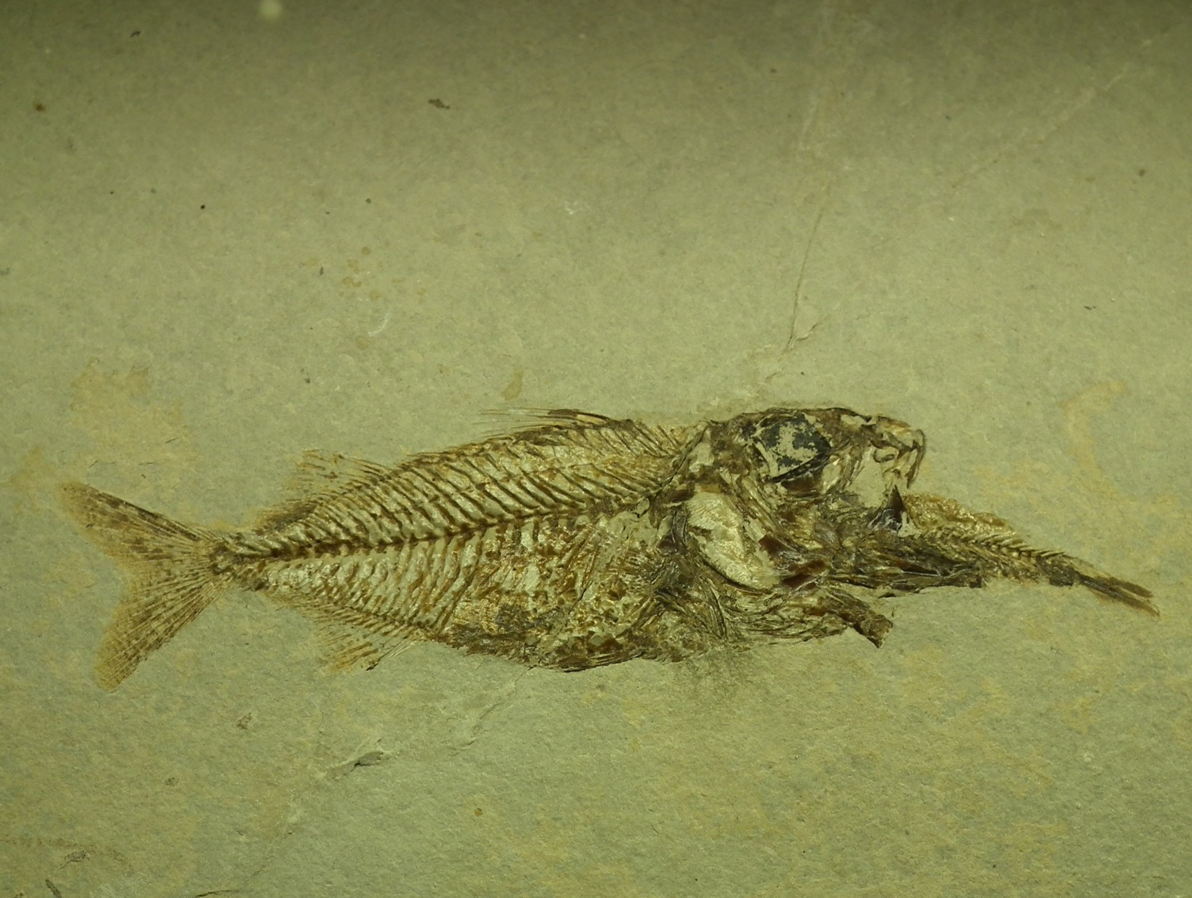
Introduction to the Fossil Record
“Every living thing on the face of the earth was wiped out; people and animals and the creatures that move along the ground and the birds were wiped from the earth.”
(Gen 7:23)

Slide 2
Goals of the presentation
Review some of the “big picture” patterns and implications derived from the study of the fossil record
Show how a biblical worldview impacts our understanding of the fossil record

Slide 3
Summary of the presentation
Relevance
A record of death and change
Patterns of distribution of fossils
A creationist model

Slide 4
Why should we care about fossils?
“In the days of Noah, men, animals, and trees, many times larger than now exist, were buried, and thus preserved as an evidence to later generations that the antediluvians perished by a flood. God designed that the discovery of these things should establish faith in inspired history.” Ellen G. White, Patriarchs and Prophets, p.112.
Notes:
Divine design in the study of fossils. It’s the only record of the world that was. Biological change can be observed over generations, but Darwinian theory suggests this change is minimal over what natural selection has driven over time. Only fossils can provide an actual test of the theory (the extrapolation of this change over time).

Slide 5
Why should we care about fossils?
The fossil record is a key pillar of the evolutionary model, the kind of empirical evidence that is thought to provide support for the theory of evolution
Notes:
Divine design in the study of fossils. It’s the only record of the world that was. Biological change can be observed over generations, but Darwinian theory suggests this change is minimal over what natural selection has driven over time. Only fossils can provide an actual test of the theory (the extrapolation of this change over time).

Slide 6
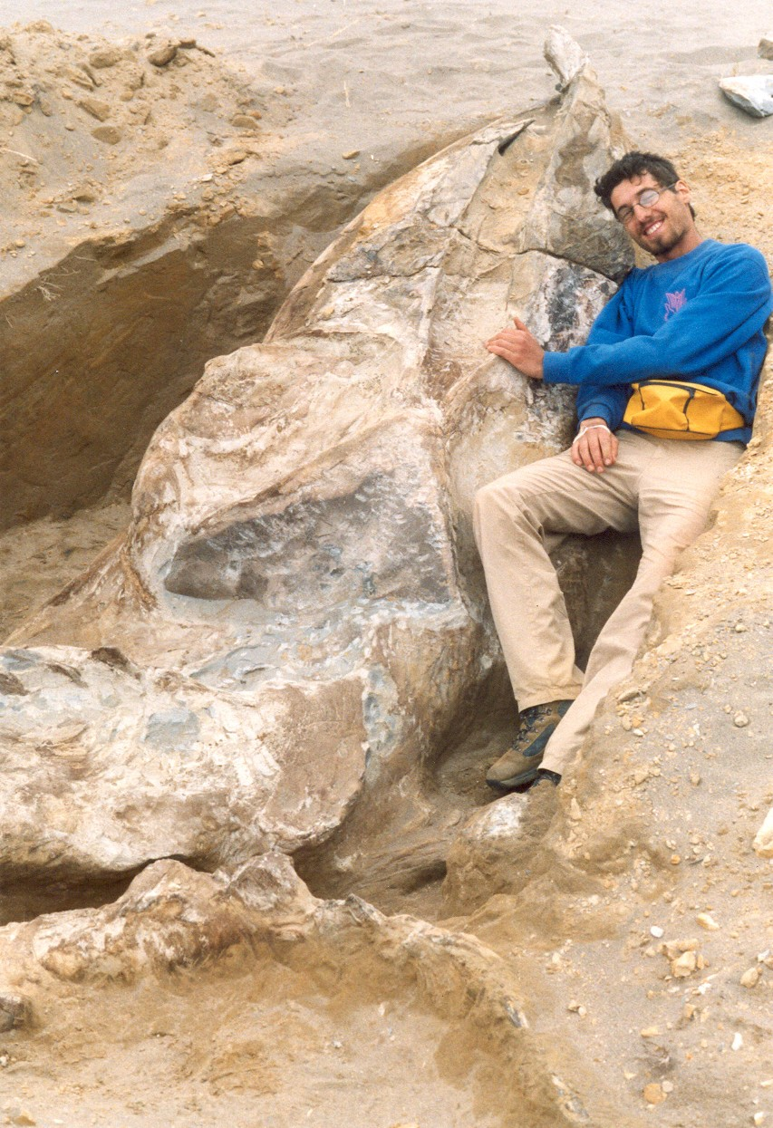
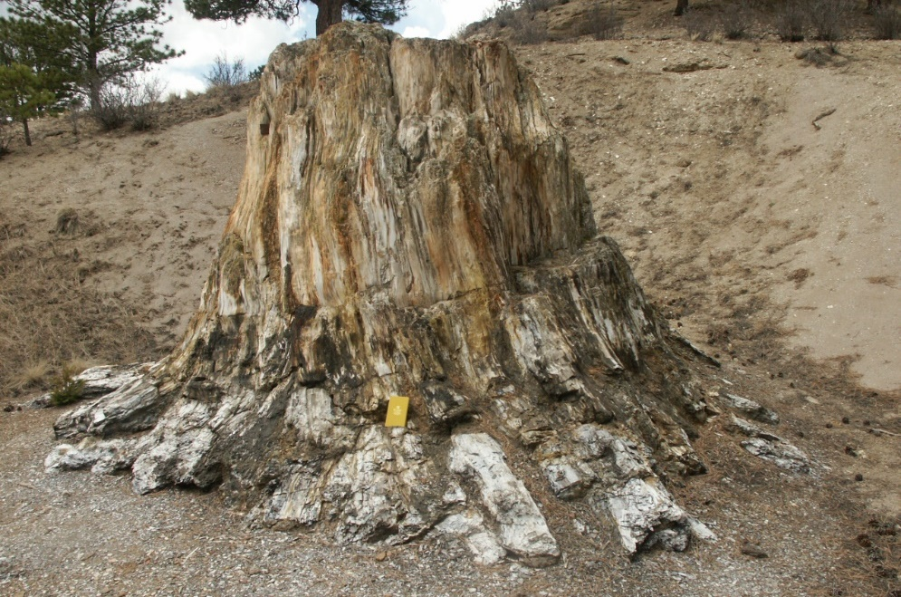
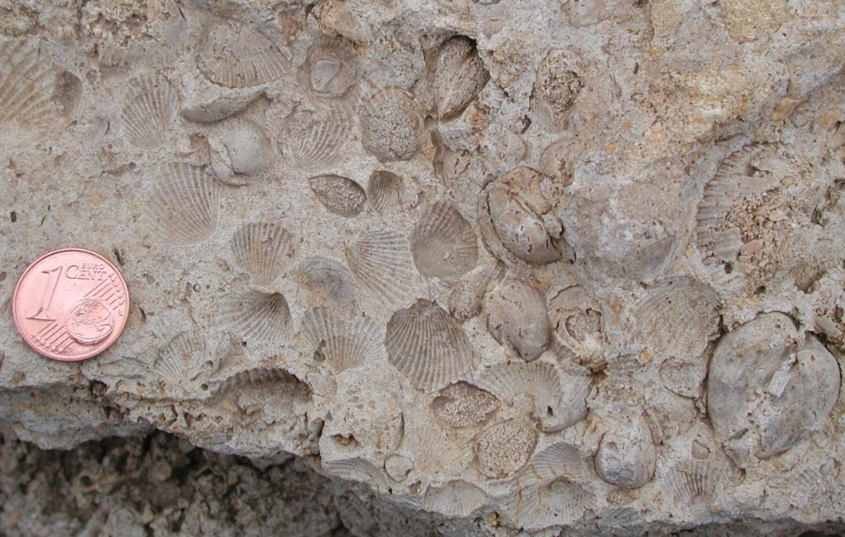
A record of death
Notes:
Although I look quite happy and excited next to this fossil whale, every fossil shell, every fossil vertebrate, every fossil plant constitutes the remains of an organism that was once alive and then died. It’s true that these fossils are the only direct evidence of past forms of life, but they also witness to the reality of death across the biological spectrum.

Slide 7
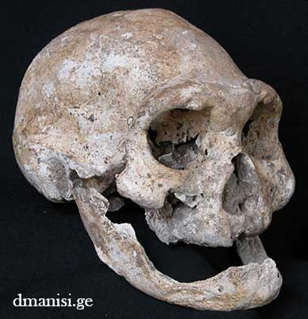
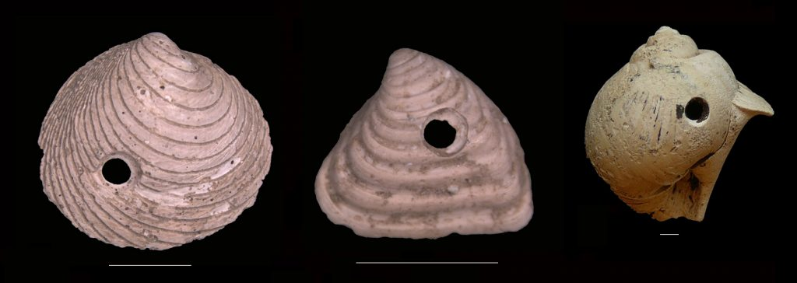
A record of predation and disease
Image from http://ucmp.berkeley.edu/blog/archives/4399
Notes:
Fish with its meal, edentulous human, drill holes in molluscs…we could add broken bones, infections/tumors, a variety of predatory strategies, envenomation, etc.

Slide 8
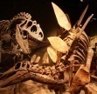
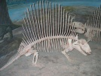
The uniformitarianist model: evolution over long time
Hominins
Mammals
Birds
“No vestige of a beginning, no prospect of an end:” Death, competition, natural selection have always been part of how biology works
Recent and literal creation The goodness of creation and its Creator
Dinosaurs
Reptiles
Amphibians
Fish
Brachiopods
Trilobites
Ediacara fauna
Unicellular organisms
Notes:
This model impacts our understanding of what good means for God

Slide 9
Applying the biblical filter…
“Now the earth was corrupt in God's sight, and the earth was filled with violence. And God saw the earth, and behold, it was corrupt, for all flesh had corrupted their way on the earth.”
(Gen 6:11-12)
Change: Corruption
“Every living thing on the face of the earth was wiped out; people and animals and the creatures that move along the ground and the birds were wiped from the earth.”
(Gen 7:23)
Catastrophe: Flood
Notes:
Two guiding principles that can help make sense of the fossil record. Escalation hypothesis in the fossil record + A major event responsible for a lot of fossilization.

Slide 10
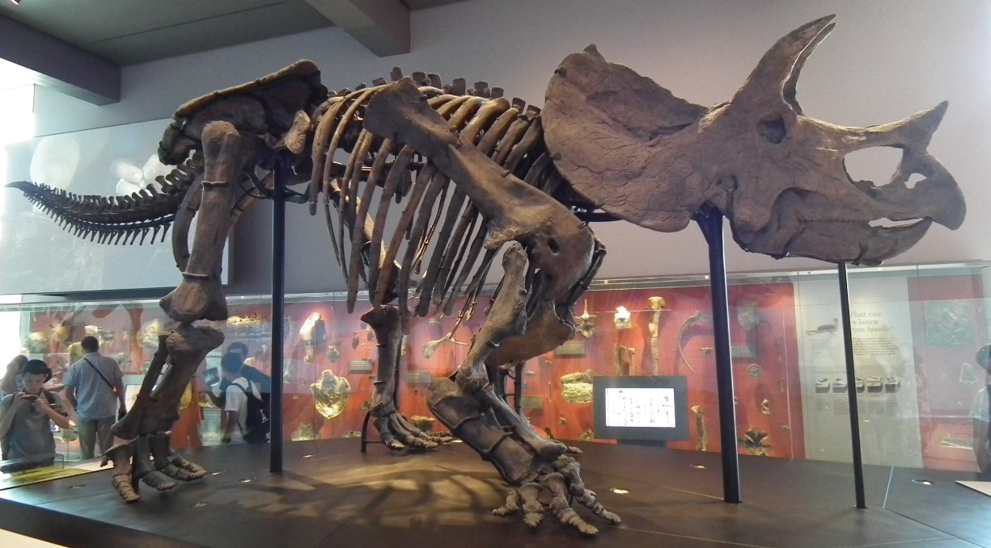
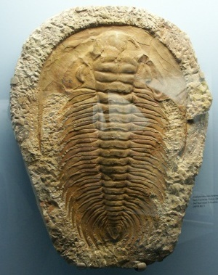
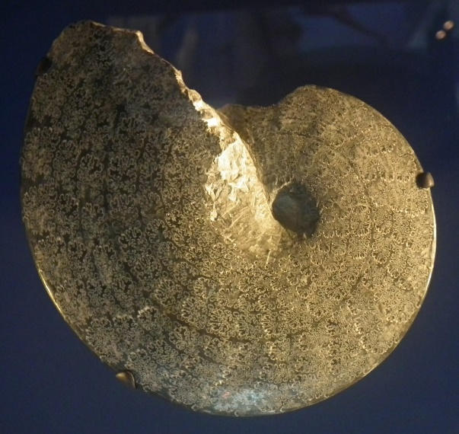
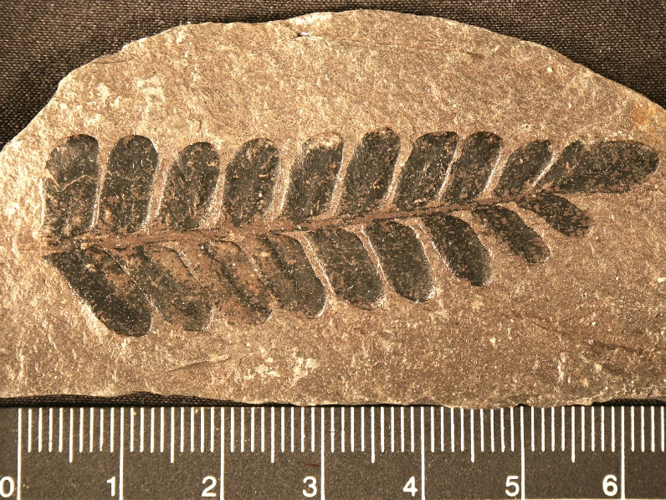
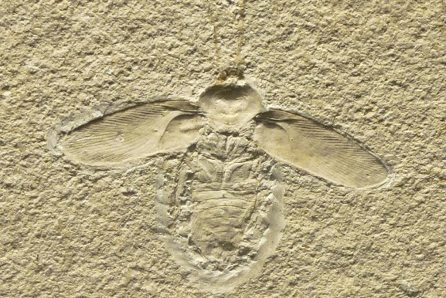
How much change?
Notes:
We encounter pretty bizarre things, most of which are extinct. However, at the same times, they fit into same larger categories/groups of living things we have today (plants, invertebrates, vertebrates, reptiles, arthropods, mollusks, insects, etc.).

Slide 11
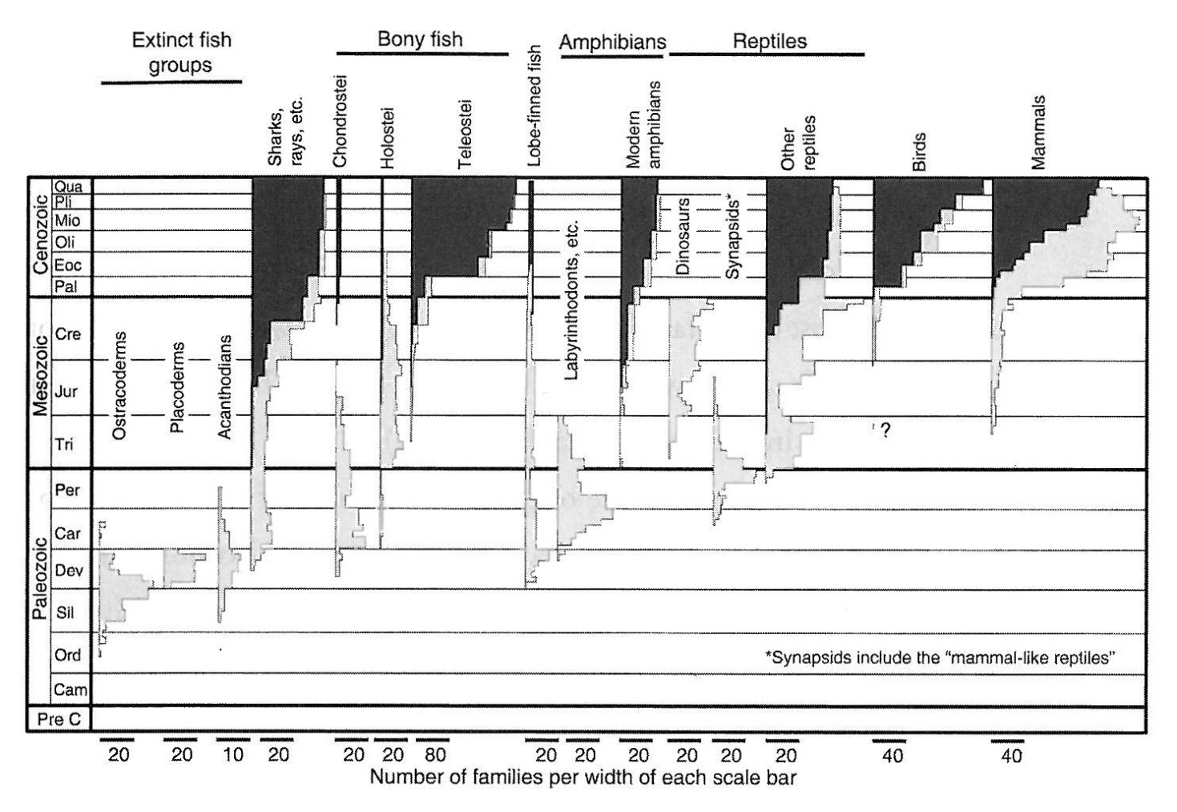
How much change?
From Brand, 2009
Increasing modernity in the Cenozoic
Notes:
The organisms more similar to those living today are found mostly in the upper part of the geologic column.

Slide 12
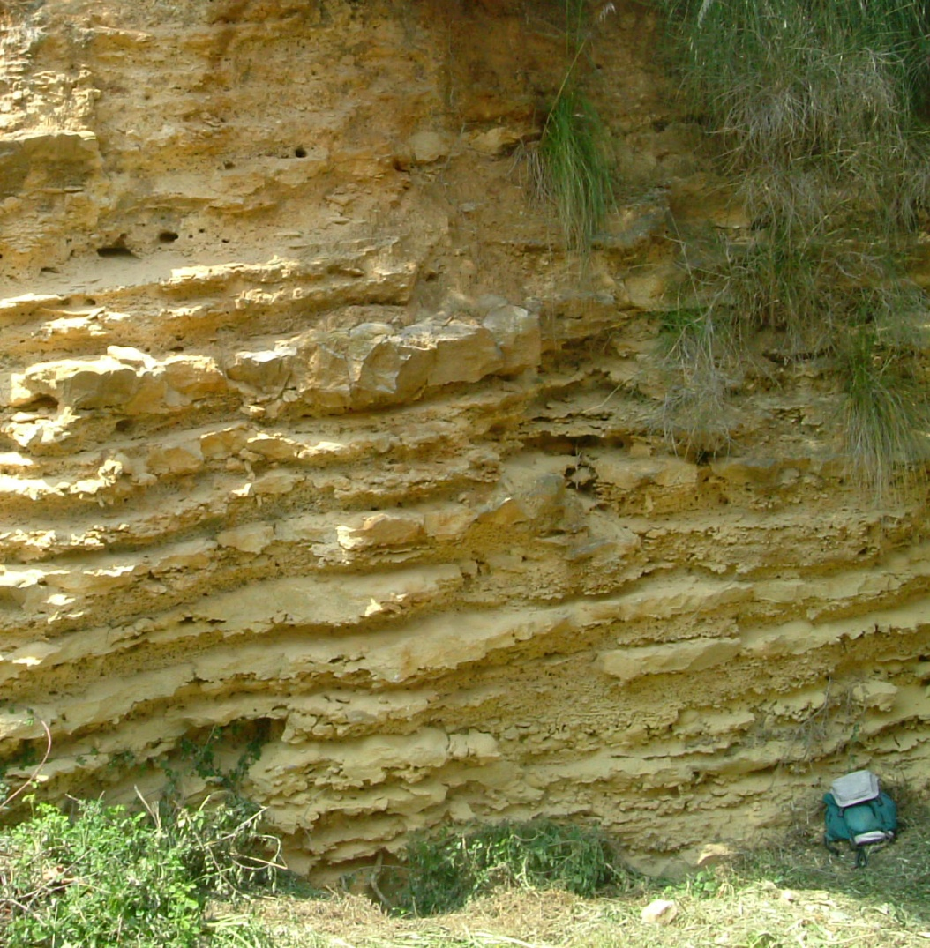
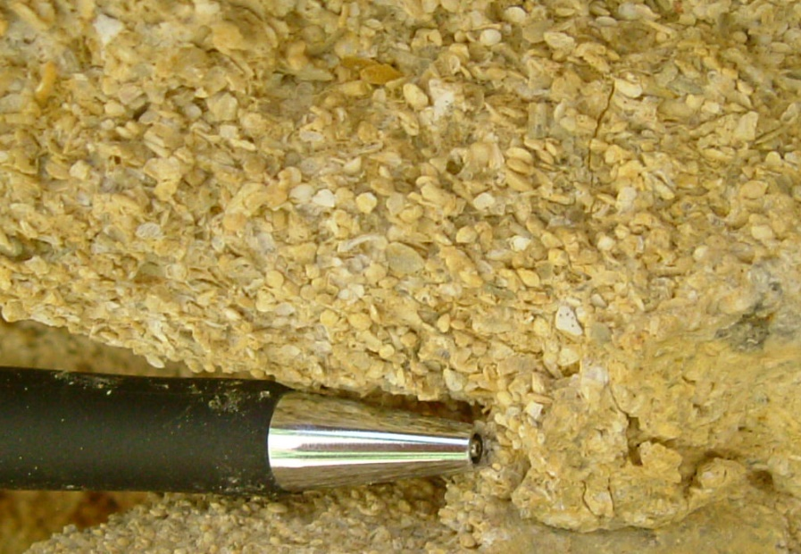
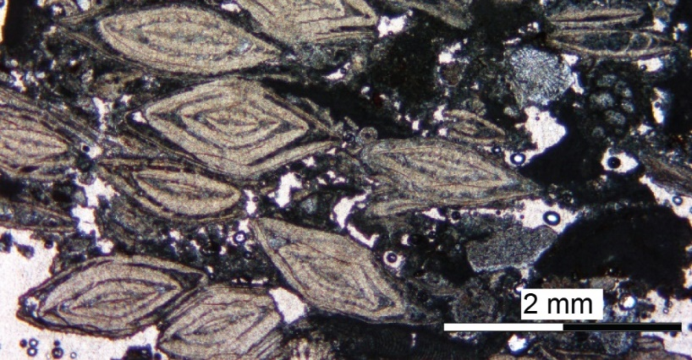
How many fossils?
Are fossils common or rare?
- Sedimentary rocks likely to have some type of fossil. Some consist almost entirely of fossils

Slide 13
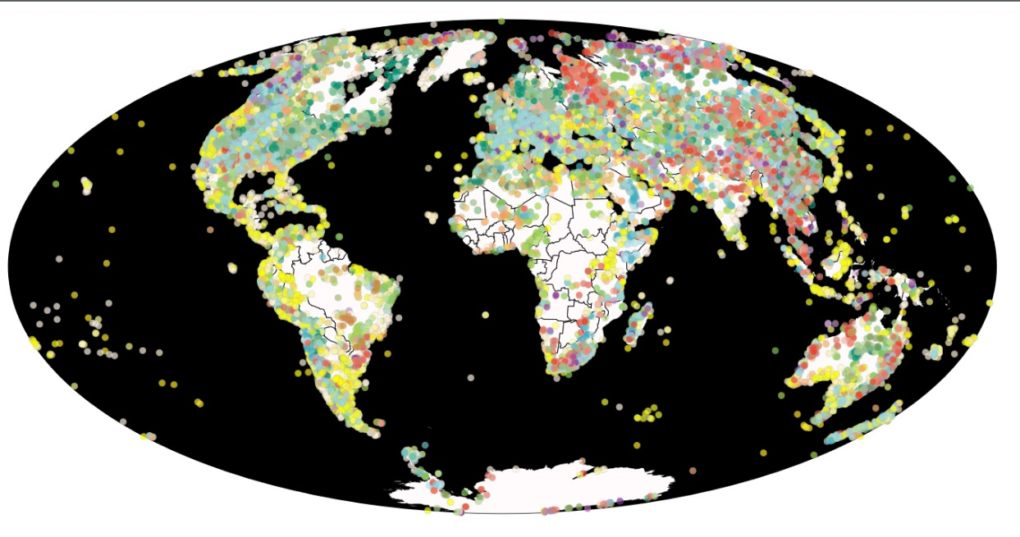
How many fossils?
Data from PDBD, available at https://paleobiodb.org/navigator/
Notes:
Important discontinuity. Especially macroscopic fossils become more represented in the Phanerozoic (that is the reason for the name…). Precambrian rocks have less fossils and there are actually less sedimentary rocks. Note white areas on the maps: crystalline basement of the cratons or ice-covered areas.

Slide 14
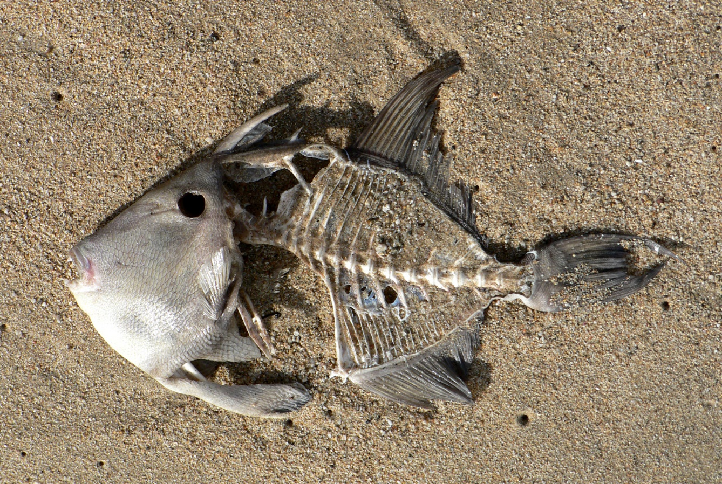
How much catastrophe?
Factors favoring fossilization:
Hard parts
Rapid Burial
Early mineralization (often through permeating solutions)
Rapid Burial
Early mineralization (often through permeating solutions)
Notes:
Especially these two conditions would be greatly enhanced during a global flood. Would be favorable for much fossilization

Slide 15
Many examples of catastrophic deposition of fossils in the rock record (bonebeds/shellbeds related to storm events or sediment gravity flows)
How much catastrophe?
From Brett et al., 2007
Notes:
You are going to learn more about one such bonebed which has been studied extensively by DR Chadwick and his team.

Slide 16
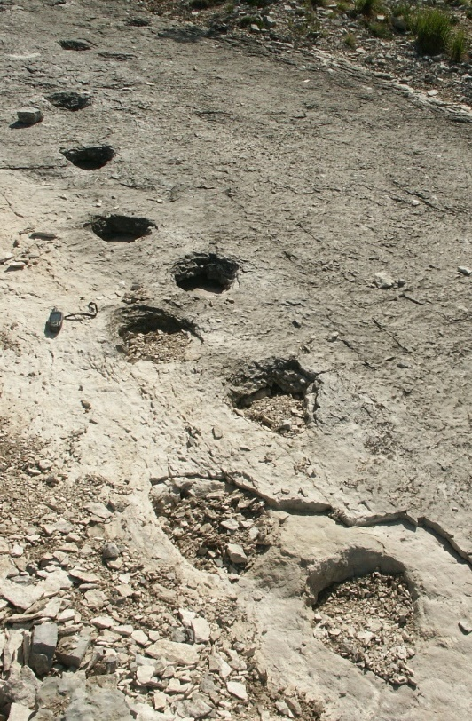
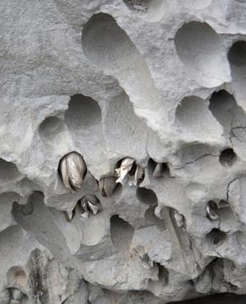
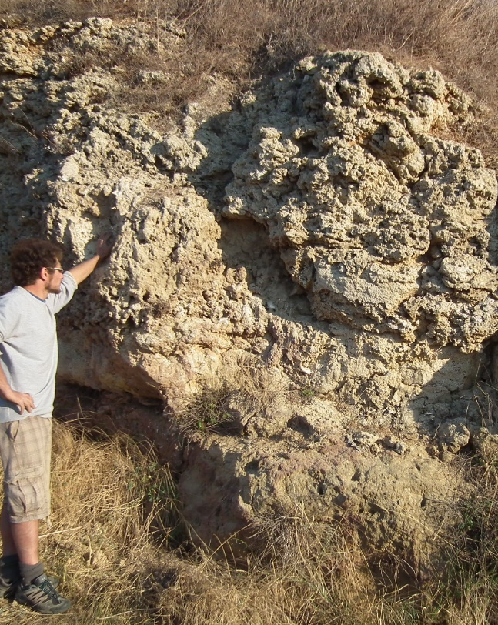
However, not everything sudden/instantaneous, also examples indicative of some passage of time
How much catastrophe?
Image from http://forum.rocktumblinghobby.com/thread/66859/lithophaga-means-stone-eater-genus
Trackways, trace fossils
Bioerosion, encrustation
Build-ups, bioconstructions
Potential research project…
Notes:
Estimate of how much of the fossil record has been deposited catastrophically. Patterns of distribution of bioerosion in the geologic record.

Slide 17
Patterns of distribution in the fossil record
Stratigraphic order
Non random distribution of fossils, occurrence in specific intervals of the geologic column
True for higher taxonomic ranks but especially at the genus/species level
Notes:
Give some examples: tetrapods, four limbed vertebrates from Devonian upward; Flowering plants from Cretaceous upward.

Slide 18
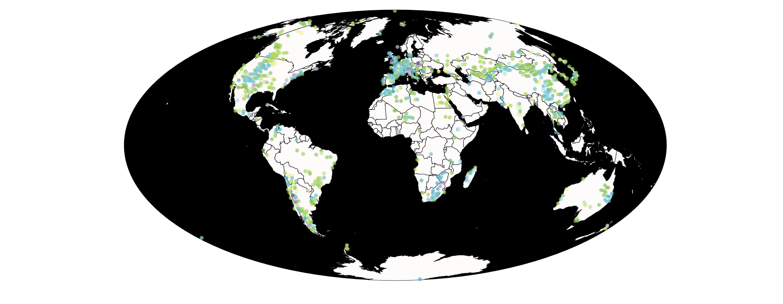
Patterns of distribution in the fossil record
Stratigraphic distribution of dinosaurs
Data from PDBD, available at https://paleobiodb.org/navigator/
Note also cosmopolitan occurrence (all continents)

Slide 19
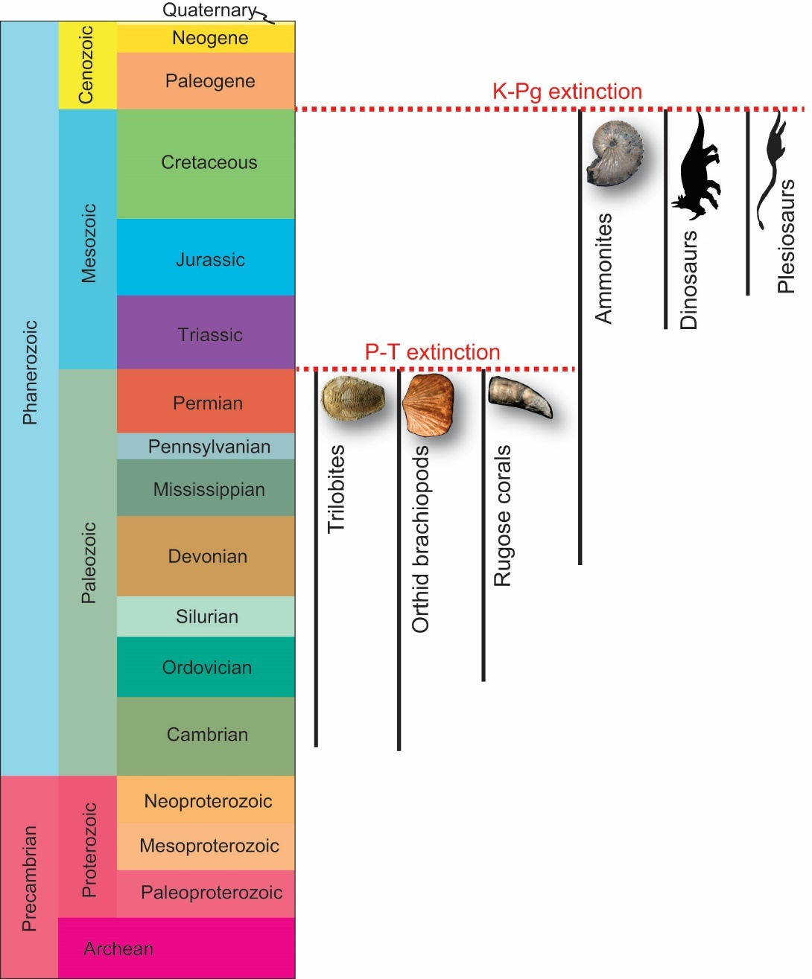
Patterns of distribution in the fossil record
Stratigraphic order
Coordinated disappearance (extinction)

Slide 20
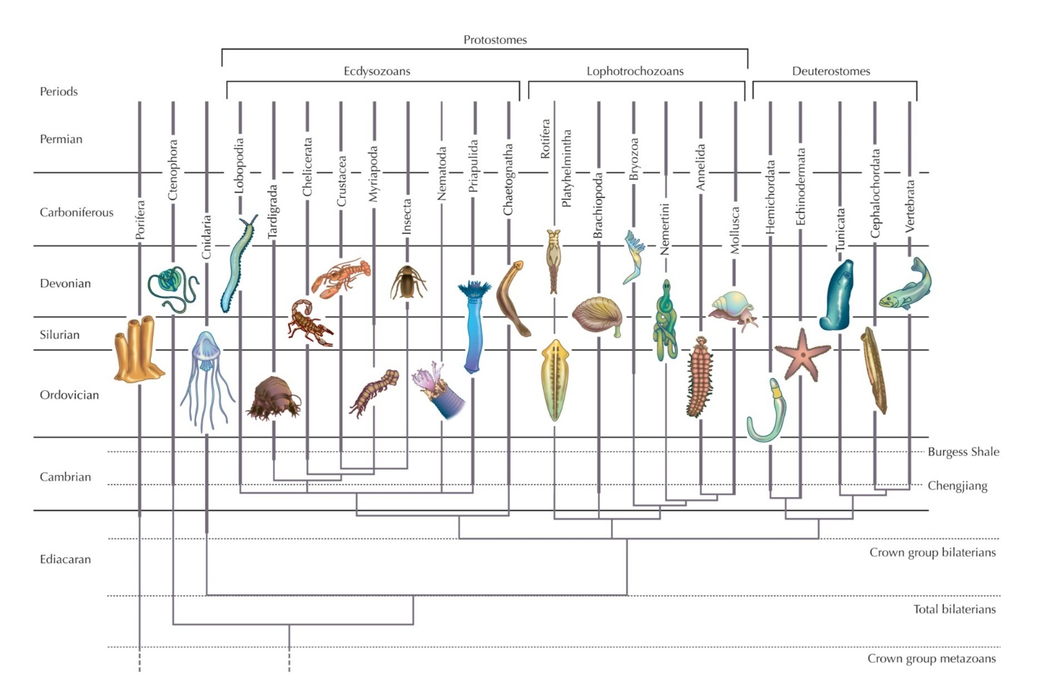
Patterns of distribution in the fossil record
Stratigraphic order
Coordinated disappearance (extinction)
Coordinated appearance (radiation)
Cambrian “explosion”
From Barton et al., 2007, Evolution, Cold Spring Harbor Laboratory Press

Slide 21
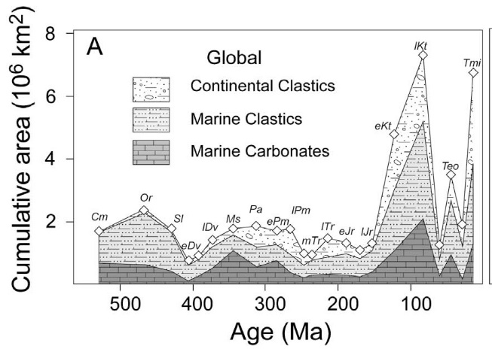
Patterns of distribution in the fossil record
Stratigraphic order
Coordinated disappearance (extinction)
Coordinated appearance (radiation)
Marine to Terrestrial
Marine + Terrestrial
Marine + Transitional
Marine only
From Wall et al., 2009
Could partly reflect available volumes of rock types

Slide 22
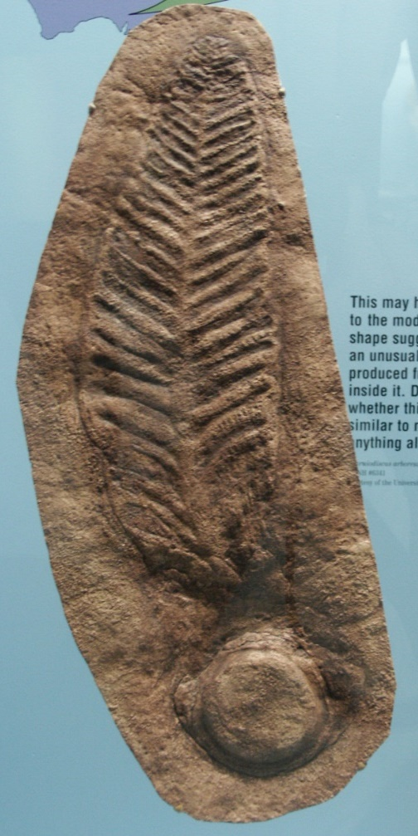
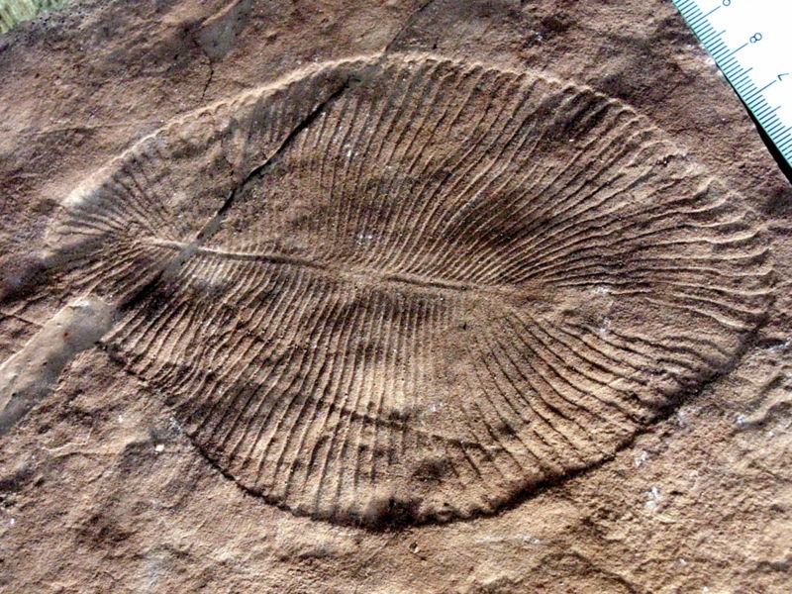
A creationist model of the fossil record
Precambrian fossil record:
- After creation/pre-flood
Dickinsonia costata Image from commons.wikimedia.org/wiki/Image:DickinsoniaCostataC.jpg
Limited predation, “Garden of Ediacara”
Not much dispersal yet of some created types
Charniodiscus arboreus
Notes:
Attempt at providing a big picture synthesis that includes the patterns we have discussed

Slide 23
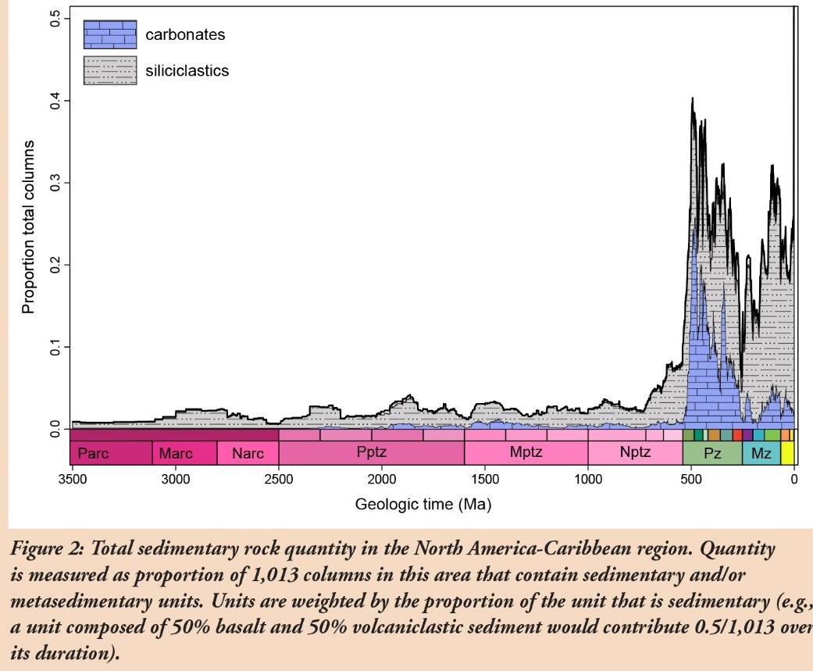
A creationist model of the fossil record
Paleozoic - Mesozoic fossil record:
- Flood deposits
From Peters & Husson, 2018
Notes:
Base of Phanerozoic/Cambrian explosion: discontinuity, onset of flood deposition, mirrored by volume of sedimentary rocks

Slide 24
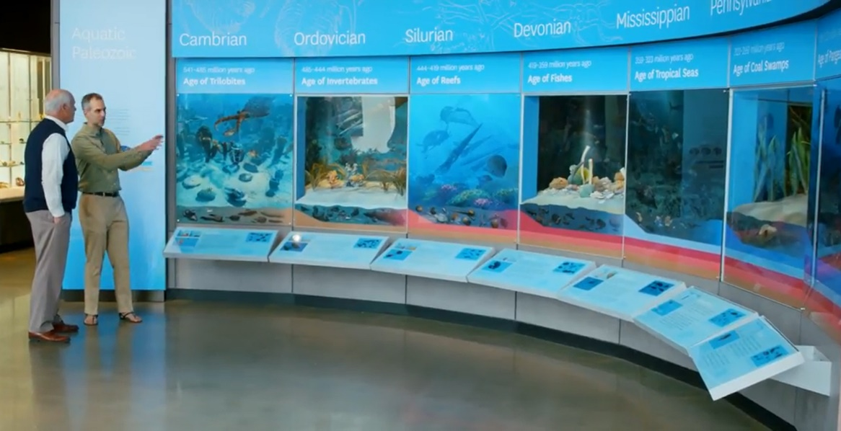
A creationist model of the fossil record
Paleozoic - Mesozoic fossil record:
- Flood deposits: Why the ordered distribution?
The Order of the Fossils : Beyond Is Genesis History? https://www.youtube.com/watch?v=_Mj9bR9BiqI
Ecological Zonation Theory (Biome Succession)
Notes:
The million dollar question

Slide 25
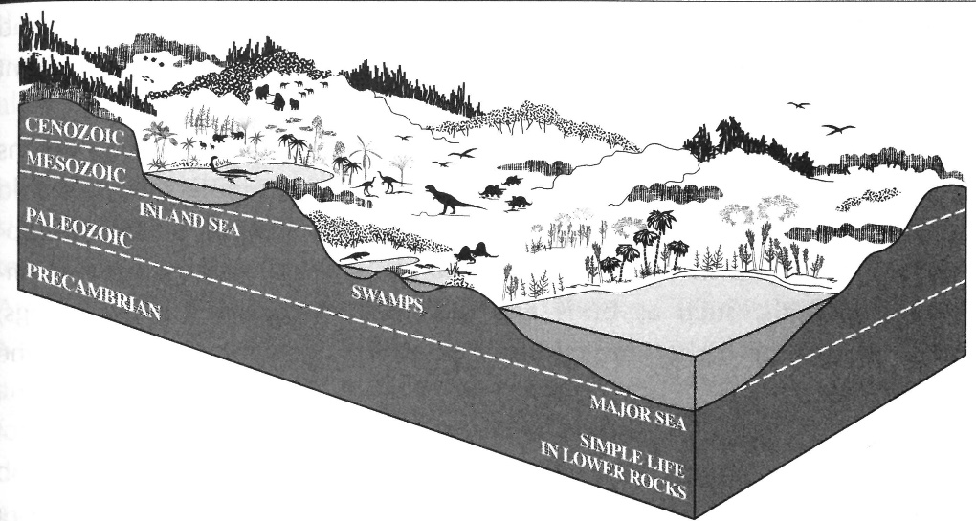
A creationist model of the fossil record
Paleozoic - Mesozoic fossil record:
- Flood deposits: Why the ordered distribution?
Ecological Zonation Theory (Biome Succession)
Instead of evolution + time,
depositional processes + coeval ecologically distinct communities
From Roth, 1998

Slide 26
A creationist model of the fossil record
Cenozoic fossil record:
- Post-flood dispersal and within type rapid evolution?
Accounts for increasing modernity
From Brand, 2009

Slide 27
A creationist model of the fossil record
Cenozoic fossil record:
Post-flood dispersal and within type rapid evolution?
Some prefer to include most Cenozoic in flood deposits (otherwise, too much geologic record and biological change in too little time)

Slide 28
A creationist model of the fossil record
This lecture did not try to evaluate the evolutionary interpretation of the fossil record
Rather, it focused on showing how patterns in the record are addressed from a creationist perspective
Other lectures (e.g., Cambrian explosion, Can evolution survive the challenge of the fossil record?, Hominin fossil record) will provide examples of evaluations of the evolutionary interpretation

Slide 29
Conclusions
The Bible provides two important guiding principles to help us interpret the fossil record: change after the fall (corruption) and a global flood (catastrophe)
We can build a big picture framework of how to interpret patterns in the fossil record based on these guiding principles
Much work remains to be done at a higher resolution. Areas in need of improvement include: integration of sedimentary/tectonic processes with distribution of fossils; time implications of certain types of fossils/traces; demarcation of flood vs non-flood related fossils
Notes:
If our biblical worldview presents us with some unsolved questions when looking at the fossil record, it will certainly also give us the ability to ask different questions than the standard uniformitarian approach and hopefully contribute valuable results. In the process, by the grace of God, we’ll stay humble, learn how to balance our strengths and limits, increase understanding, and keep our foundations anchored in God and His trustworthy Word.

Slide 30
The fossil record: so much death, so much corruption…
The nursing child shall play by the cobra’s hole, and the weaned child shall put his hand in the viper’s den. They shall not hurt nor destroy in all My holy mountain, for the earth shall be full of the knowledge of the Lord
Isaiah 11:8-9

