Slide 1
Croire en la Création Change Tout Believing in the Creation Changes Everything
Timothy G. Standish, PhD

Slide 2
Quand est
Création Sabbat?
26 octobre 2019
creationsabbath.net

Slide 3
For you created my inmost being; you knit me together in my mother’s womb.
I praise you because I am fearfully and wonderfully made; your works are wonderful, I know that full well.
Psalm 139:13,14 NIV
C’est toi qui as formé mes reins,
qui m’as tissé dans le ventre de ma mère. Je te loue de ce que je suis une créature si merveilleuse.
Tes œuvres sont admirables,
et je le reconnais bien.
Psaume 139:13,14. Segond 21

Slide 4
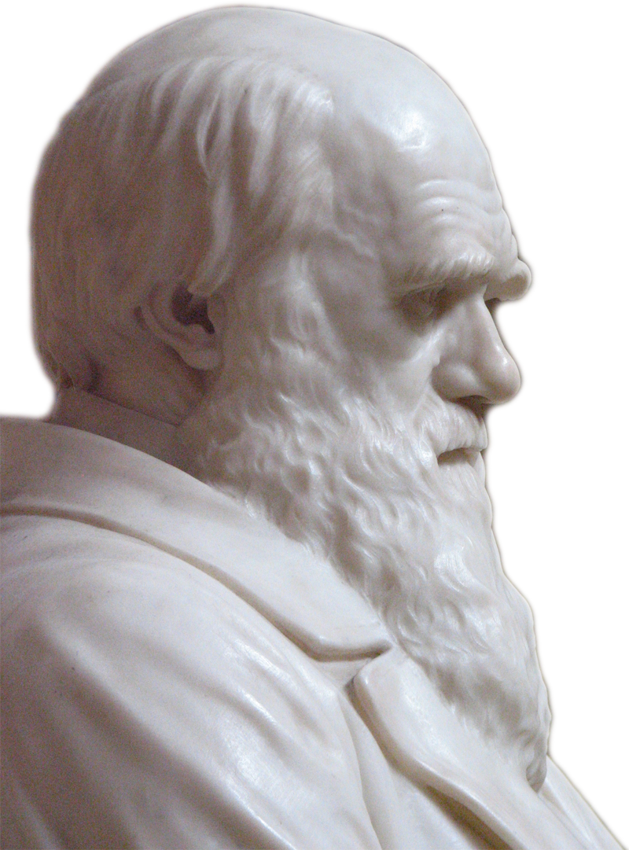
“Man in his arrogance thinks himself a great work worthy the interposition of a deity (sic), more humble & I believe truer to consider him created from animals.”
Charles Darwin, 1838
“L’homme dans son arrogance pense être lui-même une grande œuvre digne de l’interposition d’une déité (sic), plus humble & Je pense qu’il faut plus le considérer comme créé à partir des animaux.”
Charles Darwin, 1838
Notes:
12:05
Note that Darwin’s theory of evolution was not published until 1859 in the Origin of Species. This quote is from page 196-197 in Darwin’s Notebook C on transmutation as transcribed and printed in: Charles R. Darwin, “Darwin's Notebooks on Transmutation of Species Part II,” Second Notebook (February To July 1838) (ed. Gavin de Beer; London: Bulletin of the British Museum (Natural History) Historical Series 2[3], 1960), 106.

Slide 5
Croire en la création change la perception que nous avons de nous-mêmes Believing in the creation changes how we view ourselves
Créés “très bon” avec un but, à l’image de Dieu et responsables du reste de la création et objets de l’amour du Créateur
Ou
Sans but, créatures victimes de l’impassible processus qui nous a faits
Created “very good” with a purpose, in the image of God and responsible for the rest of the creation and objects of our Creator’s love
Or
Purposeless, creatures victims of the uncaring process that made us

Slide 6
“At some future period, not very distant as measured by centuries, the civilised races of man will almost certainly exterminate, and replace, the savage races throughout the world.”
Charles Darwin, 1882
“Dans un avenir, pas très lointain mesuré en siècles, les races civilisées de l’humanité presque certainement extermineront and remplaceront les races sauvages à travers le monde.”
Charles Darwin, 1882
Notes:
11:50
Charles R. Darwin, The Descent of Man, and Selection in Relation to Sex 2d edition. (London: John Murray, 1882), 156.

Slide 7
“[A]n evolutionary perspective denies that humans are different in kind from other animals; and one cannot reasonably make distinctions in morals where none exist in fact.”
James Rachels, 1990
“Une perspective évolutionniste nie que les humains constituent un genre différent des autres animaux. Et l’on ne peut pas de façon raisonnable faire des distinctions morales là où en fait il n’en existe pas.”
James Rachels, 1990
Notes:
James Rachels, Created From Animals: The Moral Implications of Darwinism (Oxford: Oxford University Press,1990), 174.

Slide 8
So God created mankind in his own image, in the image of God he created them; male and female he created them.
Genesis 1:27
Dieu créa l'homme à son image, il le créa à l'image de Dieu. *Il créa l'homme et la femme.
Genèse 1:27

Slide 9
There is neither Jew nor Gentile, neither slave nor free, nor is there male and female, for you are all one in Christ Jesus.
Galatians 3:28 NIV
Il n'y a plus ni Juif ni non-Juif, il n'y a plus ni esclave ni libre, il n'y a plus ni homme ni femme, car vous êtes tous un en Jésus-Christ.
Galates 1:27

Slide 10
“If we compare a severely defective human infant with a nonhuman animal, a dog or a pig, for example, we will often find the nonhuman to have superior capacities, both actual and potential, for rationality, self consciousness, communication, and anything else that can plausibly be considered morally significant.”
Peter Singer, 1983
“Si nous comparons un enfant humain sévèrement handicapé à un animal non-humain, un chien ou un porc par exemple, nous trouverons souvent que le non-humain a des capacités supérieures à la fois actuelles et potentielles pour la rationalité, la conscience propre, la communication, et tout autre chose qui peut de façon plausible être considérée comme moralement significatif.”
Peter Singer, 1983
Notes:
Peter Singer, “Sanctity of Life or Quality of Life,” Pediatrics (1983) 72[1]:128-129.

Slide 11
“[W]e claim that killing a newborn could be ethically permissible in all the circumstances where abortion would be. Such circumstances include cases where the newborn has the potential to have an (at least) acceptable life, but the well-being of the family is at risk.”
Alberto Giubilini & Francesca Minerva, 2012
“Nous pensons que tuer un noueau-né pourrait être éthiquement acceptable dans toutes les circonstances où l’avortement le serait. De telles circonstances comprennent les cas où le nouveau-né a le potentiel d’avoir (au moins) une vie acceptable, mais tout en mettant en jeu le bien-être de la famille.”
Alberto Giubilini & Francesca Minerva, 2012
Notes:
12:00
Alberto Giubilini Francesca Minerva, “After-birth abortion: why should the baby live?” Journal of Medical Ethics (2012) doi:10.1136/medethics-2011-100411
For more examples see many publications of Singer’s collaborator Helga Kuhse including, Helga Huhse, “Death by non-feeding: Not in the baby's best interests,” Journal Of Medical Humanities 7(2):79-90. Michael Tooley has also advocated similar position: Michael Tooley, “Abortion and Infanticide,” Philosophy & Public Affairs (Autumn, 1972) 2[1]:37-65.

Slide 12
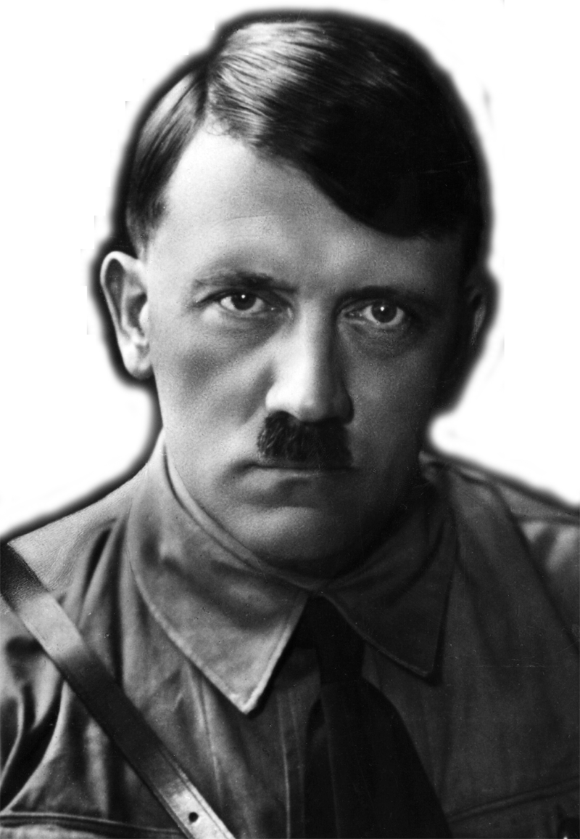
“By means of the struggle, the élites are continually renewed. The law of selection justifies this incessant struggle, by allowing the survival of the fittest. Christianity is a rebellion against natural law, a protest against nature. Taken to its logical extreme, Christianity would mean the systematic cultivation of the human failure.”
Adolf Hitler, 1941-1944
“Par la lutte, les élites sont continuellement renouvellées. La loi de la sélection justifie cette lutte incessante en permettant la survie du plus fort. Le Christianisme est une rébellion contre cette loi naturelle. Mené à sa juste conclusion , le Christianisme serait la perpétuation systématique de l’échec humain..”
Adolf Hitler, 1941-1944
Notes:
Adolf Hitler, Hitler's Table Talk, 1941-1944: His Private Conversations (trans. Norman Cameron and R.H. Stevens Introduced and with a new Preface by H.R. Trevor-Roper; New York: Enigma Books, 2000), 51.
Hitler wrote at least one other book, commonly called Hitler’s Zweites Buch, that was only published after his death: Adolf Hitler, Hitler's Second Book: The Unpublished Sequel to Mein Kampf. (ed. Gerhard L. Weinberg; trans. Krista Smith; New York: Enigma Books, 2003).

Slide 13
Defend the weak and the fatherless; uphold the cause of the poor and the oppressed. Rescue the weak and the needy; deliver them from the hand of the wicked.
Psalm 82:3,4
»Rendez justice au faible et à l’orphelin,
faites droit au malheureux et à l’indigent, sauvez le faible et le pauvre,
délivrez-les des méchants!
Psaume 82:3, 4

Slide 14
Croire en la création change la perception que nous avons des autres Believing in the creation changes how we view others
Égaux, tous créés à l’image de Dieu, objets de l’amour de Dieu et notre responsabilité
Ou
Ennemis pour s’approprier les ressources
Equal, all created in the image of God, objects of God’s love and our responsibility
Or
Enemies competing for resources

Slide 15
“What a book a Devil's Chaplain might write on the clumsy, wasteful, blundering low and horribly cruel works of nature.”
Charles Darwin, 1856
“Quel livre un aumonier du diable pourrait écrire sur la maladresse, l’inefficacité, la misère et la cruauté horrible des œuvres de la nature.”
Charles Darwin, 1856
Notes:
Charles Darwin-Letter to Hooker, 1856

Slide 16
“He has made everything beautiful in its time. He has also set eternity in the human heart; yet no one can fathom what God has done from beginning to end.”
Ecclesiastes 3:11 NIV
Il fait toute chose belle au moment voulu. Il a même mis dans leur cœur la pensée de l'éternité, même si l'homme ne peut pas comprendre l'œuvre que Dieu accomplit du début à la fin.
Ecclésiaste 3:11

Slide 17
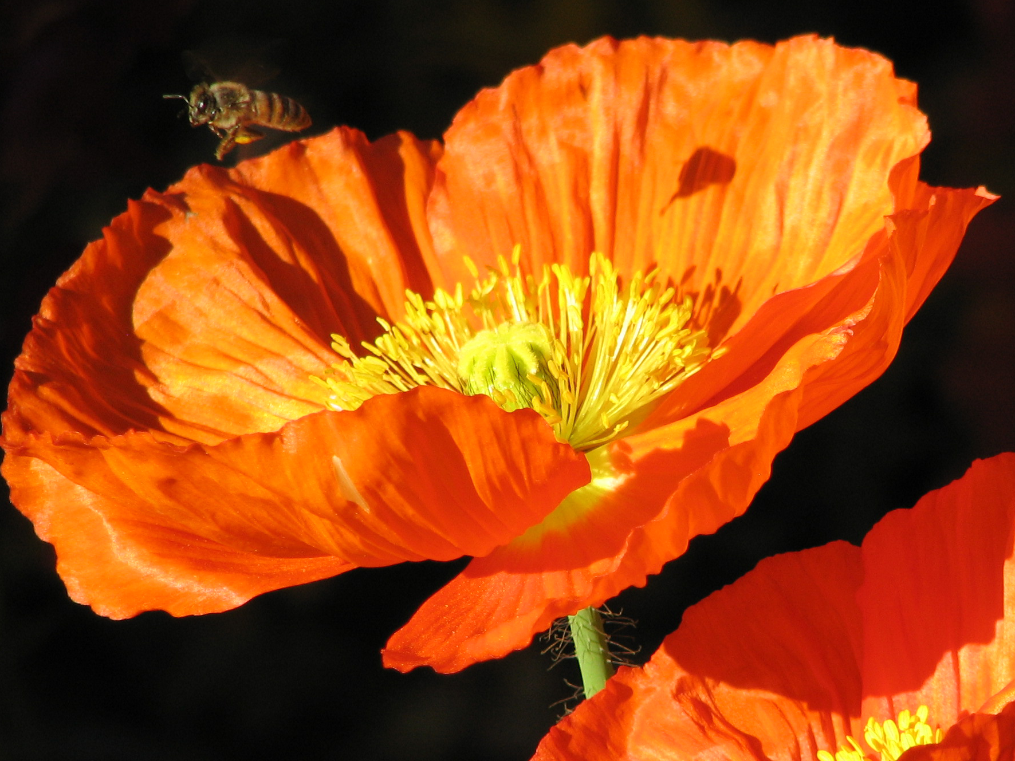

Slide 18
Croire en la création change la perception que nous avons du reste de la création Believing in the creation changes how we view the rest of creation
Entrenus par le Créateur et digne de notre étude et admiration, notre responsabilité
Ou
Cruel, insensible, tout en étant Créateur
Sustained by the Creator and worthy of our study and admiration, our responsibility
Or
Cruel, unfeeling, but also our creator

Slide 19
He who was seated on the throne said, “I am making everything new!” Then he said, “Write this down, for these words are trustworthy and true.”
Revelation 21:5 NIV
Celui qui était assis sur le trône dit: «Voici que je fais toutes choses nouvelles.» Il ajouta: «Ecris cela, car ces paroles sont dignes de confiance et vraies.»
Apocalypse 21:5

Slide 20
La création biblique
-The biblical creation provides a reasonable and sufficient cause for all that we see that is wonderful in nature
-The biblical creation provides a coherent hope of salvation and a “new creation”
-The biblical creation changes our whole view of ourselves, the rest of creation, our past and our future
La création biblique fournit une cause raisonable et suffisante pour tout ce que nous voyons de merveilleux dans la nature
La création biblique fournit une espérance du salut cohérente et une “nouvelle création”
La création biblique change la perception que nous avons de nous-mêmes, du reste de la création, de notre passé et de notre avenir

Slide 21
Croire en la création change tout

Slide 22
Fin

Slide 23
The END

Slide 24
Abstract:
Believing in the biblical creation changes everything – Our worldview drives our whole perception of reality. The biblical worldview has, at its core, the creation. Believing in the biblical creation changes how we see ourselves, other humans and the rest of the creation. This view will be contrasted with the materialistic Darwinian worldview and how it logically causes those who embrace it to see their world.

Slide 25
“The God of the Old Testament is arguably the most unpleasant character in all fiction: jealous and proud of it; a petty, unjust, unforgiving control-freak; a vindictive, bloodthirsty ethnic cleanser; a misogynistic, homophobic, racist, infanticidal, genocidal, filicidal, pestilential, megalomaniacal, sadomasochistic, capriciously malevolent bully.”
Richard Dawkins – The God Delusion

Slide 26
Croire en la création change notre perception de l’histoire
Création, chute, salut, nouvelle création
Ou
Sans visée et inévitablement dirigée vers le néant, sans aucun espoir

Slide 27
“There are three things that are too amazing for me, four that I do not understand: the way of an eagle in the sky, the way of a snake on a rock, the way of a ship on the high seas, and the way of a man with a young woman.”
Proverbs 30:18, 19
Il y a trois choses qui sont trop merveilleuses pour moi, même quatre que je ne parviens pas à connaître: la trace de l’aigle dans le ciel, la trace du serpent sur le rocher, la trace du bateau au milieu de la mer et la trace de l’homme chez la jeune fille.
Proverbes 30:18, 19

Slide 28
Up to the age of thirty, or beyond it, poetry of many kinds, such as the works of Milton, Gray, Byron, Wordsworth, Coleridge, and Shelley, gave me great pleasure, and even as a schoolboy I took intense delight in Shakespeare, especially in the historical plays. I have also said that formerly pictures gave me considerable, and music very great delight. But now for many years I cannot endure to read a line of poetry: I have tried lately to read Shakespeare, and found it so intolerably dull that it nauseated me. I have also almost lost my taste for pictures or music. ... I retain some taste for fine scenery, but it does not cause me the exquisite delight which it formerly did…
Charles Darwin
Notes:
Darwin CR. 1958. The Autobiography of Charles Darwin 1809–1882 With original omissions restored Edited with appendix and notes by his grand-daughter Nora Barlow. Collins, St James's Place, London.
I have said that in one respect my mind has changed during the last twenty or thirty years. Up to the age of thirty, or beyond it, poetry of many kinds, such as the works of Milton, Gray, Byron, Wordsworth, Coleridge, and Shelley, gave me great pleasure, and even as a schoolboy I took intense delight in Shakespeare, especially in the historical plays. I have also said that formerly pictures gave me considerable, and music very great delight. But now for many years I cannot endure to read a line of poetry: I have tried lately to read Shakespeare, and found it so intolerably dull that it nauseated me. I have also almost lost my taste for pictures or music. Music generally sets me thinking too energetically on what I have been at work on, instead of giving me pleasure. I retain some taste for fine scenery, but it does not cause me the exquisite delight which it formerly did. On the other hand, novels which are works of the imagination, though not of a very high order, have been for years a wonderful relief and pleasure to me, and I often bless all novelists.

Slide 29
The universe: “a vast agglomeration of matter and energy churning around in a variety of ways, evolving, never still, never stable, and in fact always running down.”
Brian May
Notes:
May – an astronomy PhD dropout – played lead guitar in the rock group Queen. May has now completed his PhD I think
http://www.brianmay.com/brian/brianssb/brianssboct06.html [emphasis in original].

Slide 30
C’est pourquoi, de même que par un seul homme le péché est entré dans le monde, et par le péché la mort, de même la mort a atteint tous les hommes parce que tout ont péché.
Romains 5:12

Slide 31
Création, Péché, Mort, Nouvelle Création
Bonne
création
Mort
Création brisée
Péché
Victoire
sur le
péché
Victoire
sur la
mort
Bonne
Re-création/
Vie éternelle

Slide 32
Croire en la création change notre perception de la beauté

Slide 33
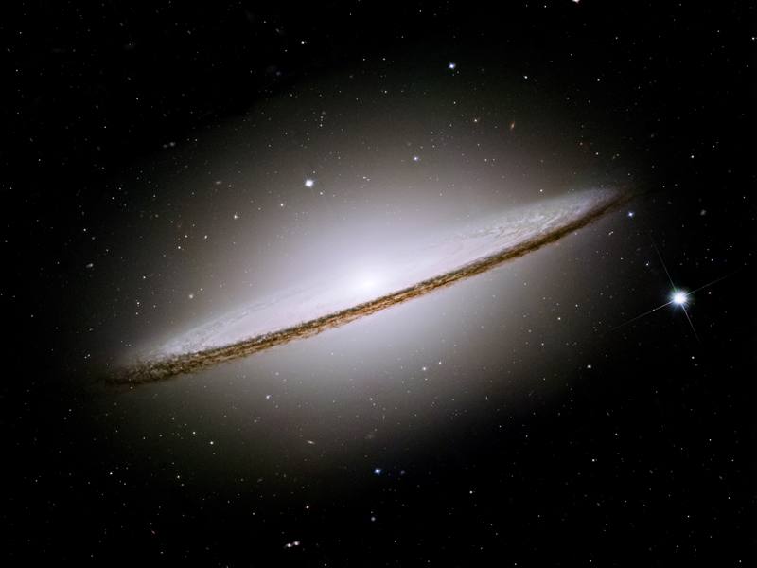
“Le ciel raconte la gloire de Dieu et l’étendue révèle l’œuvre de ses mains.”
Psaume 19:1

Slide 34
“Le Fils est le reflet de sa gloire et l’expression de sa personne, il soutient tout par sa parole puissante.”
Hébreux 1:3

Slide 35
“Tu es digne, notre Seigneur et notre Dieu, de recevoir la gloire, l’honneur et la puissance, car tu as créé toutes choses et c’est par ta volonté qu’elles ont été créées et qu’elles existent.”
Apocalypse 4:11

Slide 36
“Le ciel a été fait par la parole de l’Eternel, et toute son armée par le souffle de sa bouche.”
Psaume 33:6
Notes:
God did not use matter to make the universe; He used His word, something that is not material, to create the matter.

Slide 37
“He [Darwin] discovered a way in which the unaided laws of physics — the laws according to which things “just happen” — could, in the fullness of geologic time, come to mimic deliberate design. The illusion of design is so successful that to this day most Americans (including, significantly, many influential and rich Americans) stubbornly refuse to believe it is an illusion. To such people, if a heart (or an eye or a bacterial flagellum) looks designed, that’s proof enough that it is designed.”
Richard Dawkins, 2005
Notes:
Note that in this quotation the author, Richard Dawkins, encourages his readers to ignore the evidence of their senses and its logical interpretation. Materialistic Darwinism is a belief system in which believers must view the world through the eyes of faith. Dawkins, C. Richard. “The Illusion of Design,” Natural History 114(9)(2005): 35-37.

Slide 38
“Then the King will say to those on his right, ‘Come, you who are blessed by my Father; take your inheritance, the kingdom prepared for you since the creation of the world. For I was hungry and you gave me something to eat, I was thirsty and you gave me something to drink, I was a stranger and you invited me in, I needed clothes and you clothed me, I was sick and you looked after me, I was in prison and you came to visit me.’
Matthew 25:34-36

Slide 39
Il a fait en sorte que tous les peuples, issus d’un seul homme, habitent sur toute la surface de la terre, et il a déterminé la durée des temps et les limites de leur habitation.
Actes 17:26

Slide 40
“It may be quite true that some negroes are better than some white men, but no rational man, cognizant of the facts, believes that the average negro is the equal, still less superior, of the average white man… The highest places in the hierarchy of civilization will assuredly not be within the reach of our dusky cousins...”
Thomas Henry Huxley
Notes:
Thomas H. Huxley. 1888. Emancipation - black and white. Chapter 2 in Lay Sermons, Addresses and Reviews. D. Appleton and Company: New York. 1865, p. 20

Slide 41
Theistic Evolution
Crediting God with death-driven process of evolution is theologically troubling
Vesting the creation with death before sin makes a coherent soteriology impossible without imposing other unscriptural beliefs
It denies God’s action and the veracity of Scripture as an account of reality
It fails to give God credit for all that is wonderful in the world

Slide 42
What comedian designer configured the region between our legs—an entertainment complex built around a sewage system?
Neil DeGrasse Tyson, 2005
Notes:
Neil DeGrasse Tyson. 2005. The Perimiter of Ignorance. Natural History 114(9):28-34.
http://www.naturalhistorymag.com/universe/211420/the-perimeter-of-ignorance?page=3
But why confine ourselves to things too wondrous or intricate for us to understand, whose existence and attributes we then credit to a super-intelligence? Instead, why not tally all those things whose design is so clunky, goofy, impractical, or unworkable that they reflect the absence of intelligence?
Take the human form. We eat, drink, and breathe through the same hole in the head, and so, despite Henry J. Heimlich's eponymous maneuver, choking is the fourth leading cause of "unintentional injury death" in the United States. How about drowning, the fifth leading cause? Water coffers almost three-quarters of Earth's surface, yet we are land creatures—submerge your head for just a few minutes, and you die.
Or take our collection of useless body parts. What good is the pinky toe-nail? How about the appendix, which stops functioning after childhood and thereafter serves only as the source of appendicitis? Useful parts, too, can be problematic. I happen to like my knees, but nobody ever accused them of being well protected from bumps and bangs. These days, people with problem knees can get them surgically replaced. As for our pain-prone spine, it may be a while before someone finds a way to swap that out.
How about the silent killers? High blood pressure, colon cancer, and diabetes each cause tens of thousands of deaths in the U.S. every year, but it's possible not to know you're afflicted until your coroner tells you so. Wouldn't it be nice if we had built-in biogauges to warn us of such dangers well in advance? Even cheap cars, after all, have engine gauges.
And what comedian designer configured the region between our legs--an entertainment complex built around a sewage system?

Slide 43
“Although the fetus may, after a certain point, be capable of feeling pain, there is no basis for thinking it rational or self-aware, let alone capable of seeing itself as existing in different times and places. But the same can be said of the newborn infant. Human babies are not born self-aware or capable of grasping their lives over time. They are not persons. Hence their lives would seem to be no more worthy of protection than the life of a fetus.” (Peter Singer, 1995)
Notes:
emphasize that Singer advocates for euthanasia and infanticide based on his Darwinian views. In so doing, this grandson of Austrian Jews killed in the holocaust is not operating at the lunatic edge of ethical discussions about the nature of humans. He holds academic appointments at Princeton University as Ira W. DeCamp Professor of bioethics and the University of Melbourne as a professor of ethics. Further, Singer is widely considered to be among the most influential living bioethicists and parallel thinking is widely published in academic journals.
Peter Singer, Rethinking Life and Death: The Collapse of our Traditional Ethics (New York: St. Martin's Press, 1995) 210.

Slide 44
“The wide support for medical infanticide suggest that, instead of trying to find places to draw lines, we should accept that the development of the human being, from embryo to fetus, from fetus to newborn, and from newborn infant to older child, is a continuous process that does not offer us neat lines of demarcation between stages. But we may then add, so to is the development of the moral status of the human being.”
Peter Singer, 1995
Notes:
Peter Singer, Rethinking Life and Death: The Collapse of our Traditional Ethics (New York: St. Martin's Press, 1995) 130.

Slide 45
”Il essuiera toute larme de leurs yeux, la mort ne sera plus et il n’y aura plus ni deuil, ni cri, ni douleur, car ce qui existait avant a disparu.” Celui qui était assis sur le trône dit: “Voici que je fais toutes choses nouvelles.” Il ajouta: “Ecris cela, car ces paroles sont dignes de confiance et vraies.”
Apocalypse 21:4,5

Slide 46
“Il existe avant toutes choses et tout subsiste en lui.”
Colossiens 1:17

Slide 47
“Biologists must constantly keep in mind that what they see was not designed, but rather evolved.”
Francis Crick, 1988
Notes:
Francis H. C. Crick, What Mad Pursuit: A Personal View of Scientific Discovery. (London: Penguin, 1988), 138.

Slide 48
F_{O} “Turbine”
c
c
c
c
a
Cell
Membrane
ε
Protein
“Drive Shaft”
γ
b₂
Stator
β
β
α
α
F₁ “Generator”
δ
Notes:
E. Coli ATP Synthase

Slide 49
“N’oublie pas de me consacrer le jour du sabbat. Tu as six jours pour travailler et faire tout ton ouvrage. Le septième jour , c’est le sabbat qui m’est réservé, à moi le Seigneur ton Dieu; tu ne feras aucun travail ce jour-là, ni toi, ni tes enfants, ni tes serviteurs ou servantes, ni ton bétail, ni l’étranger qui réside chez toi. Car en six jours j’ai créé le ciel, la terre, la mer et tout ce qu’ils contiennent, puis je me suis reposé le septième. C’est pourquoi moi, le Seigneur, j’ai béni le jour du sabbat et je veux qu’il me consacré.”
Exode 20:8-11, FC

Slide 50
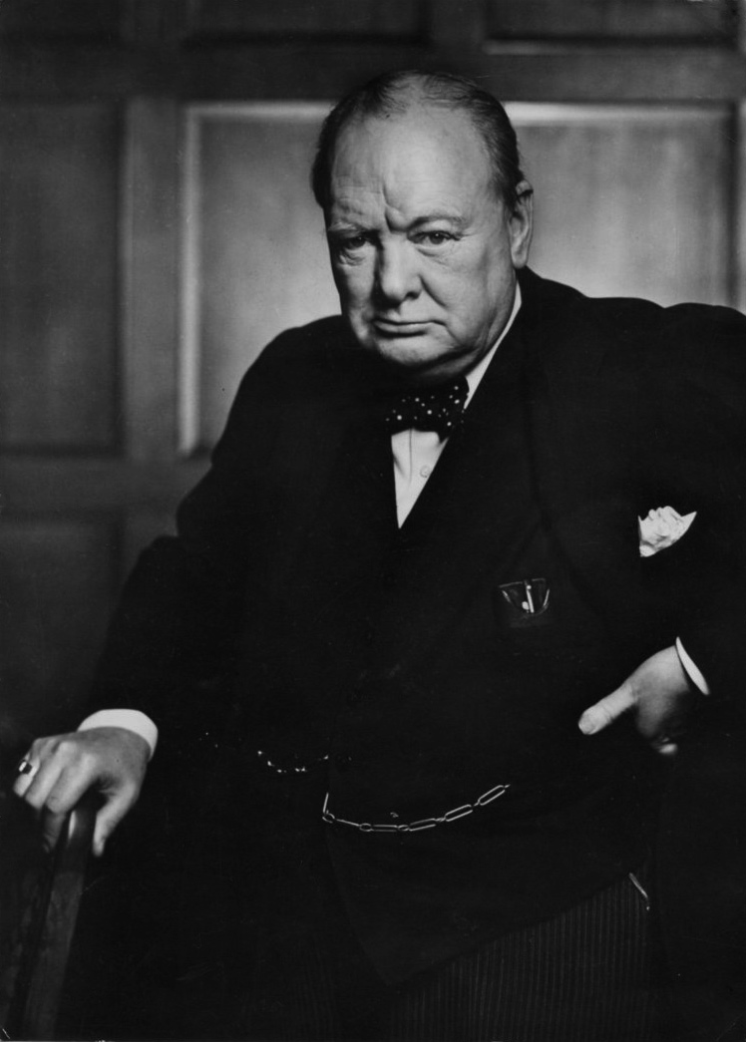

Slide 51
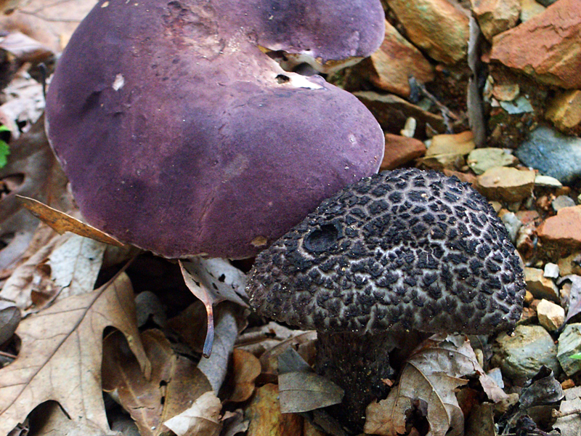

Slide 52
Mycorrhizae
Mycorrhiza
Root tip
Plant:
Water
Minerals
Protection
Communication
Fungus
Sugar
Notes:
Microrrhizae increase the root surface area by 10 to several thousand times
On communication, see: http://www.bbc.co.uk/news/science-environment-22462855
http://onlinelibrary.wiley.com/doi/10.1111/ele.12115/abstract;jsessionid=12C95617CA6DB35DA94207A51A857F85.d03t01

Slide 53
Cycle de l’Azote
N₂
Dinitrogen
Amino
acids
N₂O (Nitrous oxide)
NO (Nitric oxide)
NITROGEN FIXATION
DENITRIFICATION
AMINATION
NO₂⁻ (Nitrite)
AMMONIFICATION
NITRIFICATION
NH₄⁺
(Ammonia)
NH₂OH
(Hydroxylamine)
NO₂⁻
(Nitrite)
NO₃⁻
(Nitrate)
ASSIMILATION
-3 -2 -1 0 +1 +2 +3 +4 +5
Nitrogen Oxidation State

Slide 54
Cycle de l’Azote simplifié
N≡N
N₂ ≈ 80 % of the atmosphere
Atmospheric N Fixation via Thermal
Shock
Nitrogen
Fixation
Denitrification
NH₃ Ammonia used to make amino acids in plants
NO₃⁻ Nitrate in soil and water
O
Nitrification
N
O
O
Assimilation

Slide 55
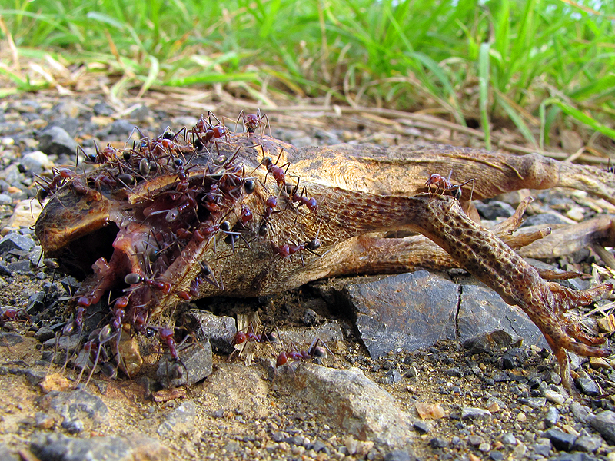

Slide 56
Man is the result of a purposeless and natural process that did not have him in mind.
George Gaylord Simpson

