Slide 1
You are free to use this presentation for your own personal study, or for lectures in a classroom setting. Feel free to modify and improve it for classroom use in any way that you see fit. I ask that it not be redistributed in whole or in part for any purpose without my written permission. If you would like to use it for some other purpose, or wish to share it using any media please contact me at:
tstandish@llu.edu
Thank you for respecting my wishes with this.

Slide 2
When is
Creation Sabbath?
26 October 2019
creationsabbath.net

Slide 3
grisda.org

Slide 4
Darwinism's Influence on Morality, Media and Political Discourse
Timothy G. Standish, PhD

Slide 5
“I do not seek to understand in order that I may believe, but rather, I believe in order that I may understand”
Neque enim quaero intelligere ut
credam, sed credo ut intelligam
Anselm of Canterbury
Notes:
Note that Anselm is going off Augustine here, “For understanding is the reward of faith. Therefore do not seek to understand in order to believe, but believethat you may understand; since, except ye believe, you shall not understand [Isaiah 7:9].” Augustine. Tractates (Lectures) on the Gospel of John, Tractate 29 (John 7:14-18) http://www.newadvent.org/fathers/1701029.htm . Note that the way Isaiah 7:9 as quoted is unusual and this doesn’t match any English translation I have found. The same word, Strong's H539 אָמַן ä·man’, is used for both ”believe” and “understand,” but is typically translated “established” as in: “If you will not believe, Surely you shall not be established.” Isaiah 7:9 NKJV.

Slide 6
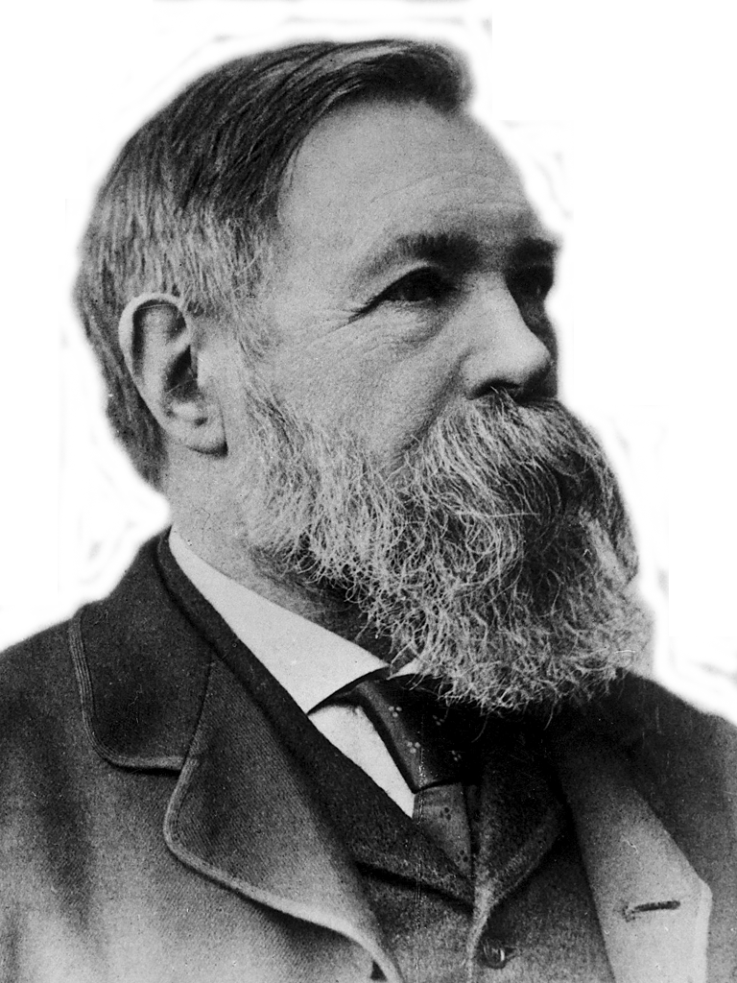
Just as Darwin discovered the law of evolution in
organic nature, so Marx discovered the law of evolution in human
history.
Friedrich Engels, 1883
Notes:
This was Frederick Engels’ Speech at the Grave of Karl Marx Highgate Cemetery, London. March 17, 1883.
http://www.marxists.org/archive/marx/works/1883/death/burial.htm

Slide 7
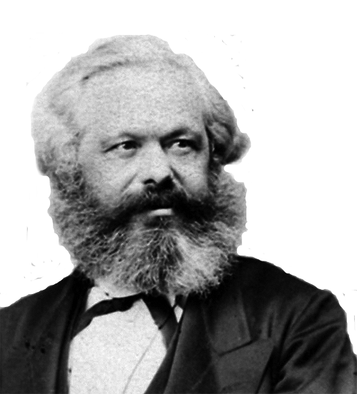
Although it is developed in the crude English style, this is
a book [Origin of Species]
which contains the basis
of natural history for
our views.
Karl Marx, 1860
Notes:
Karl Marx. 1860. Letter to Fredrich Engles 19 December. Quoted from: Marx and Engles Collected works Volume 41, Letters 1860-1864. 2010 Lawrence & Wishart Electric Book. p 232.

Slide 8
The history of all hitherto existing
society is the history of class struggles.
Die Geschichte aller bisherigen Gesellschaft
ist die Geschichte von Klassenkämpfen.
Karl Marx &
Friedrich Engels
Notes:
Karl Marx. 1860. Letter to Fredrich Engles 19 December. Quoted from: Marx and Engles Collected works Volume 41, Letters 1860-1864. 2010 Lawrence & Wishart Electric Book. p 232.

Slide 9
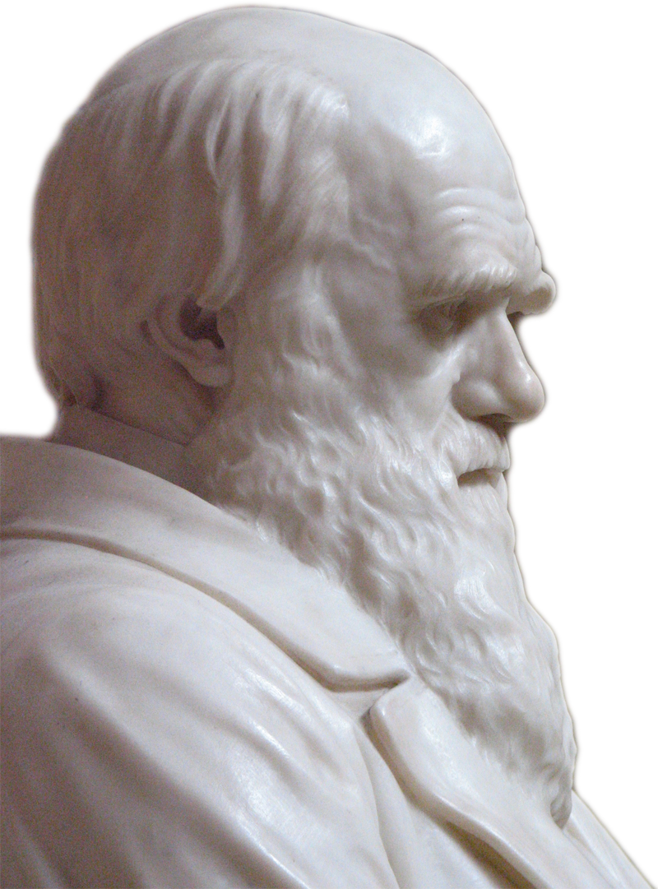
[T]he most closely-allied forms,--varieties of the same species, and species of the same genus
or related genera… Generally come into
the severest competition with each
other. Consequently, each new variety
or species, during the progress of its
formation, will generally press hardest
on its nearest kindred, and tend to
exterminate them.
Charles Darwin, 1859
Notes:
Darwin, C. R. 1859. On the Origin of Species by Means of Natural Selection, or the Preservation of Favoured Races in the Struggle for Life. First edition. John Murray, London. Pg. 110.

Slide 10
With savages, the weak in body or mind are soon eliminated; and those that survive commonly exhibit a vigorous state of health. We civilized men, on
the other hand, do our utmost to check the process of elimination. We
build asylums for the imbecile, the maimed and the sick; we
institute poor-laws; and our medical men exert their utmost
skill to save the life of every one to the last moment. There is
reason to believe that vaccination has preserved thousands,
who from a weak constitution would formerly have
succumbed to small-pox. Thus the weak members of civilized
societies propagate their kind. No one who has attended to
the breeding of domestic animals will doubt that this must be
highly injurious to the race of man. It is surprising how soon a
want of care, or care wrongly directed, leads to the
degeneration of a domestic race; but excepting in the case of
man himself, hardly anyone is so ignorant as to allow his
worst animals to breed.
Charles Darwin, 1882
Notes:
Charles R. Darwin, The Descent of Man, and Selection in Relation to Sex 2d edition. (London: John Murray, 1882)

Slide 11
Defend the weak and the fatherless; uphold the cause of the poor and the oppressed. Rescue the weak and the needy; deliver them from the hand of the wicked.
Psalm 82:3,4

Slide 12
Imago Dei
The Biblical view is that humans were created by the Creator God and He cares about all humans, not just the smart, powerful and healthy, but also “the least of these brothers and sisters of mine” (Matthew 25:40 NIV, Psalm 82:3,4)
It is an expression of God’s grace that he still loves humans, despite the fact that we all exhibit the repulsive effects of sin
“But God demonstrates his own love for us in this: While we were still sinners, Christ died for us.” (Romans 5:8 NIV)

Slide 13
At some future period, not very distant as measured by centuries, the civilised races of man will almost certainly exterminate, and replace, the savage races
throughout the world. At the same time the
anthropomorphous apes, as Professor
Schaaffhausen has remarked, will no doubt
be exterminated. The break between man
and his nearest allies will then be wider, for
it will intervene between man in a more
civilised state, as we may hope, even than the
Caucasian, and some ape as low as a baboon,
instead of as now between the negro or
Australian and the gorilla.
Charles Darwin, 1882
Notes:
Charles R. Darwin, The Descent of Man, and Selection in Relation to Sex 2d edition. (London: John Murray, 1882)

Slide 14
From one man he made all the nations, that they should inhabit the whole earth; and he marked out their appointed times in history and the boundaries of their lands.
Acts 17:26 NIV

Slide 15
Man is the result of a purposeless and natural process that did not have him in mind.
George Gaylord Simpson
Notes:
George Gaylord Simpson (1967) The Meaning of Evolution, revised edition. New Haven: Yale University Press. p. 345.

Slide 16
[T]he more a fetus or newborn approximates - or is proximate to - personhood, the greater his or her claim to life. Likewise the further beyond the threshold of incontestably personal life an adult individual is (for example, a patient with severely advanced Alzheimer's disease is beyond that threshold), the less clear is that individual's claim to protectable life.
Walters, 1997
Notes:
James W. Walters, What is a person?: An ethical exploration (Urbana: University of Illinois Press, 1997) quoted page X in the Forward by Lawrence J. Schneiderman, the actual quote is on page 63.

Slide 17
Walters’ Logic
Darwinism: humans are animals with no special status in the creation
The basis for human value and dignity is not rooted in their nature
Human rights are rooted in a variable quality called “personhood” related to their awareness or consciousness
Being human is not enough to ethically claim human rights such as the right to life
Notes:
11:55
Those who fall below some arbitrary level of consciousness do not qualify as persons and ethically only persons, not humans, have rights. Where exactly the threshold of consciousness is for becoming a person with the right to life is not clear.

Slide 18
Up to the age of thirty, or beyond it, poetry of many kinds, such as the works of Milton, Gray, Byron, Wordsworth, Coleridge, and Shelley, gave me great pleasure, and even as a schoolboy I took intense delight in Shakespeare, especially in the historical plays. I have also said that formerly pictures gave me considerable, and music very great delight. But now for many years I cannot endure to read a line of poetry: I have tried lately to read Shakespeare, and found it so intolerably dull that it nauseated me. I have also almost lost my taste for pictures or music. ... I retain some taste for fine scenery, but it does not cause me the exquisite delight which it formerly did…
Charles Darwin
Notes:
Darwin CR. 1958. The Autobiography of Charles Darwin 1809–1882 With original omissions restored Edited with appendix and notes by his grand-daughter Nora Barlow. Collins, St James's Place, London.
I have said that in one respect my mind has changed during the last twenty or thirty years. Up to the age of thirty, or beyond it, poetry of many kinds, such as the works of Milton, Gray, Byron, Wordsworth, Coleridge, and Shelley, gave me great pleasure, and even as a schoolboy I took intense delight in Shakespeare, especially in the historical plays. I have also said that formerly pictures gave me considerable, and music very great delight. But now for many years I cannot endure to read a line of poetry: I have tried lately to read Shakespeare, and found it so intolerably dull that it nauseated me. I have also almost lost my taste for pictures or music. Music generally sets me thinking too energetically on what I have been at work on, instead of giving me pleasure. I retain some taste for fine scenery, but it does not cause me the exquisite delight which it formerly did. On the other hand, novels which are works of the imagination, though not of a very high order, have been for years a wonderful relief and pleasure to me, and I often bless all novelists.

Slide 19
The rain comes falling from the sky,
To fill the stream that fills the sea
And that's where life began for you and me
Paul McCartney, Mamunia, 1973
Oli Gill
Notes:
Attribution: Oli Gill
Image from: http://en.wikipedia.org/wiki/Paul_McCartney#mediaviewer/File:Paul_McCartney_black_and_white_2010.jpg
The song Mamunia appears on Paul McCartney and Wings’ album Band on the Run released in 1973.
Mamunia comes from the Arabic Mamounia meaning “safe haven,” the name of a house McCartney saw in Merekesh when there. Ref: Vincent Perez Benitez. 2010. The Words and Music of Paul McCartney: The Solo Years. ABC-CLIO: Santa Barbara. P 56.

Slide 20
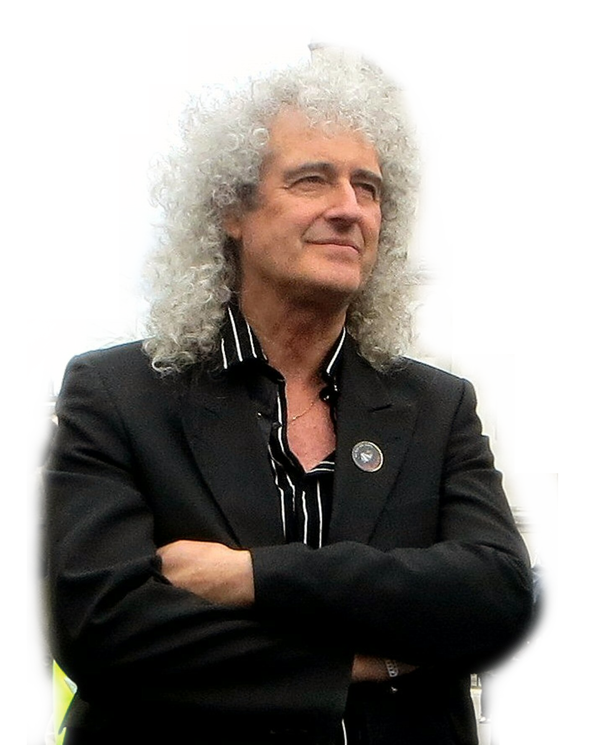
The universe: “a vast
agglomeration of
matter and energy
churning around in a
variety of ways,
evolving, never still,
never stable, and in
fact always
running down.”
Brian May
Brian Minkoff-London Pixels
Notes:
May – an astronomy PhD dropout – played lead guitar in the rock group Queen. May has now completed his PhD I think
http://www.brianmay.com/brian/brianssb/brianssboct06.html [emphasis in original].
Image modified from: http://upload.wikimedia.org/wikipedia/commons/0/0b/Brianmaywestminster.jpg
Picture credit: Brian Minkoff-London Pixels

Slide 21
He who was seated on the throne said, “I am making everything new!” Then he said, “Write this down, for these words are trustworthy and true.”
Revelation 21:5 NIV

Slide 22
Responsibility
Darwinism ultimately liberates individuals from responsibility for their actions
Free will is probably an illusion
No one can control their nature or the nurture they have experienced
Thus a person is no more responsible for their behavior than is a dog, mouse, tiger or bacterium

Slide 23
Responsibility
It is unreasonable to expect people not to act on their urges, as they are not responsible for them
Thus prohibitions against acting on sexual urges, such as sex outside marriage or homosexual behavior, are unreasonable
Taken to its logical conclusion, prohibition of and the concept of punishment for bad behavior is unreasonable as individuals can’t control their nature

Slide 24
Summary
Darwinism provides a consistent foundation for ethics
Because the Darwinist worldview is profoundly different from the Biblical worldview, ethics within the Darwinian framework are profoundly different
Central to the difference is a fundamentally different view of what human beings are
The Darwinist worldview, as it becomes integral to a society, will be reflected and perpetuated by the media produced by the society
Media amplifies the impact of Darwinism, resulting in a progressive loss of value for human life

Slide 25
For I am not ashamed of the gospel of Christ, for it is the power of God to salvation for everyone who believes, for the Jew first and also for the Greek. For in it the righteousness of God is revealed from faith to faith; as it is written, “The just shall live by faith.”
Romans 1:16,17 NKJV

Slide 26
The End
Notes:
Gilbert Meilander

Slide 27
grisda.org

Slide 28
You are free to use this presentation for your own personal study, or for lectures in a classroom setting. Feel free to modify and improve it for classroom use in any way that you see fit. I ask that it not be redistributed in whole or in part for any purpose without my written permission. If you would like to use it for some other purpose, or wish to share it using any media please contact me at:
tstandish@llu.edu
Thank you for respecting my wishes with this.

Slide 29
Let love be without hypocrisy. Abhor what is evil. Cling to what is good. Be kindly affectionate to one another with brotherly love, in honor giving preference to one another; not lagging in diligence, fervent in spirit, serving the Lord; rejoicing in hope, patient in tribulation, continuing steadfastly in prayer;
Romans 12:9-12 NKJV

Slide 30
There is neither Jew nor Gentile, neither slave nor free, nor is there male and female, for you are all one in Christ Jesus.
Galatians 3:28 NIV

Slide 31
“Although the fetus may, after a certain point, be capable of feeling pain, there is no basis for thinking it rational or self-aware, let alone capable of seeing itself as existing in different times and places. But the same can be said of the newborn infant. Human babies are not born self-aware or capable of grasping their lives over time. They are not persons. Hence their lives would seem to be no more worthy of protection than the life of a fetus.” (Peter Singer, 1995)
Notes:
emphasize that Singer advocates for euthanasia and infanticide based on his Darwinian views. In so doing, this grandson of Austrian Jews killed in the holocaust is not operating at the lunatic edge of ethical discussions about the nature of humans. He holds academic appointments at Princeton University as Ira W. DeCamp Professor of bioethics and the University of Melbourne as a professor of ethics. Further, Singer is widely considered to be among the most influential living bioethicists and parallel thinking is widely published in academic journals.
Peter Singer, Rethinking Life and Death: The Collapse of our Traditional Ethics (New York: St. Martin's Press, 1995) 210.

Slide 32
“The wide support for medical infanticide suggest that, instead of trying to find places to draw lines, we should accept that the development of the human being, from embryo to fetus, from fetus to newborn, and from newborn infant to older child, is a continuous process that does not offer us neat lines of demarcation between stages. But we may then add, so to is the development of the moral status of the human being.”
Peter Singer, 1995
Notes:
Peter Singer, Rethinking Life and Death: The Collapse of our Traditional Ethics (New York: St. Martin's Press, 1995) 130.

Slide 33
‘He will wipe every tear from their eyes. There will be no more death’ or mourning or crying or pain, for the old order of things has passed away.” He who was seated on the throne said, “I am making everything new!” Then he said, “Write this down, for these words are trustworthy and true.”
Revelation 21:4,5

Slide 34
“He is before all things, and in him all things hold together.”
Colossians 1:17 NIV

Slide 35
“By the word of the LORD the heavens were made, their starry host by the breath of his mouth.”
Psalm 33:6 NIV
Notes:
God did not use matter to make the universe; He used His word, something that is not material, to create the matter.

Slide 36
“He [Darwin] discovered a way in which the unaided laws of physics — the laws according to which things “just happen” — could, in the fullness of geologic time, come to mimic deliberate design. The illusion of design is so successful that to this day most Americans (including, significantly, many influential and rich Americans) stubbornly refuse to believe it is an illusion. To such people, if a heart (or an eye or a bacterial flagellum) looks designed, that’s proof enough that it is designed.”
Richard Dawkins, 2005
Notes:
Note that in this quotation the author, Richard Dawkins, encourages his readers to ignore the evidence of their senses and its logical interpretation. Materialistic Darwinism is a belief system in which believers must view the world through the eyes of faith. Dawkins, C. Richard. “The Illusion of Design,” Natural History 114(9)(2005): 35-37.

Slide 37
Therefore, just as sin entered the world through one man, and death through sin, and in this way death came to all people, because all sinned
Romans 5:12 NIV

Slide 38
For you created my inmost being; you knit me together in my mother’s womb.
I praise you because I am fearfully and wonderfully made; your works are wonderful, I know that full well.
Psalm 139:13,14 NIV

Slide 39
In spite of the oxymoron in the expression, we propose to call this practice ‘after-birth abortion’, rather than ‘infanticide’, to emphasise that the moral status of the individual killed is comparable with that of a fetus (on which ‘abortions’ in the traditional sense are performed) rather than to that of a child. Therefore, we claim that killing a newborn could be ethically permissible in all the circumstances where abortion would be. Such circumstances include cases where the newborn has the potential to have an (at least) acceptable life, but the well-being of the family is at risk.
Alberto Giubilini & Francesca Minerva, 2012
Notes:
12:00
Alberto Giubilini Francesca Minerva, “After-birth abortion: why should the baby live?” Journal of Medical Ethics (2012) doi:10.1136/medethics-2011-100411
For more examples see many publications of Singer’s collaborator Helga Kuhse including, Helga Huhse, “Death by non-feeding: Not in the baby's best interests,” Journal Of Medical Humanities 7(2):79-90. Michael Tooley has also advocated similar position: Michael Tooley, “Abortion and Infanticide,” Philosophy & Public Affairs (Autumn, 1972) 2[1]:37-65.

Slide 40
If we compare a severely defective human infant with a nonhuman animal, a dog or a pig, for example, we will often find the nonhuman to have superior capacities, both actual and potential, for rationality, self consciousness, communication, and anything else that can plausibly be considered morally significant.
Peter Singer, 1983
Notes:
Peter Singer, “Sanctity of Life or Quality of Life,” Pediatrics (1983) 72[1]:128-129.

Slide 41
[A]n evolutionary perspective denies that humans are different in kind from other animals; and one cannot reasonably make distinctions in morals where none exist in fact.
James Rachels, 1990
Notes:
James Rachels, Created From Animals: The Moral Implications of Darwinism (Oxford: Oxford University Press,1990), 174.

Slide 42
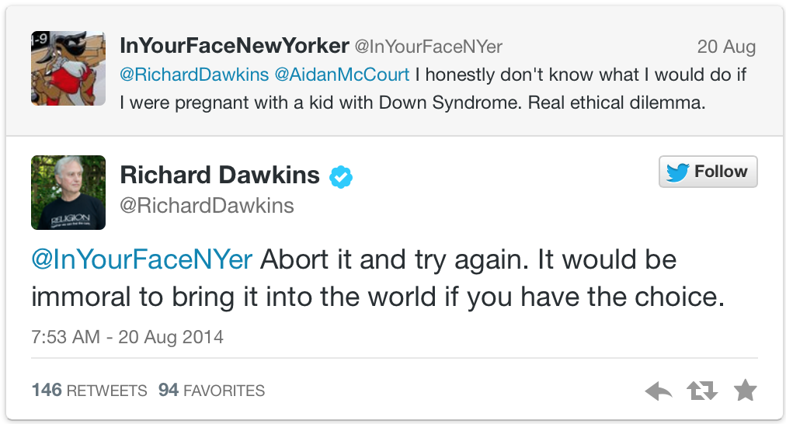
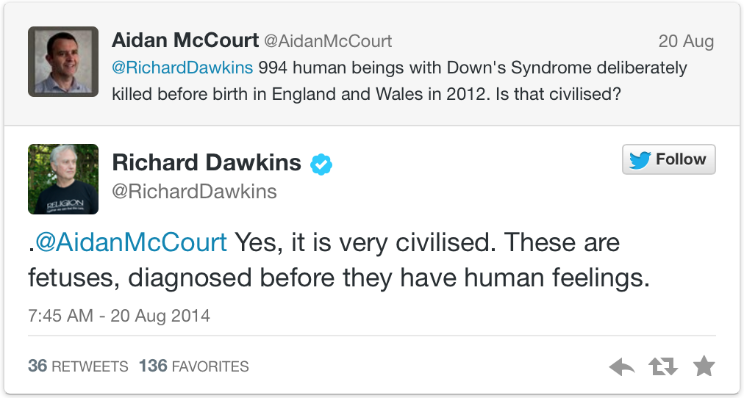
Notes:
Reference: http://www.bbc.com/news/blogs-ouch-28879659
Images are at the the same source, but these were screen shots from: http://www.theblaze.com/stories/2014/08/21/abort-it-and-try-again-atheist-richard-dawkins-ignites-firestorm-with-claim-that-its-immoral-to-knowingly-bring-a-baby-with-down-syndrome-into-the-world/#

Slide 43
Man in his arrogance thinks
himself a great work
worthy the
interposition of a
deity (sic), more
humble & I believe
truer to consider him
created from animals.
Charles Darwin, 1838
Notes:
12:05
Note that Darwin’s theory of evolution was not published until 1859 in the Origin of Species. This quote is from page 196-197 in Darwin’s Notebook C on transmutation as transcribed and printed in: Charles R. Darwin, “Darwin's Notebooks on Transmutation of Species Part II,” Second Notebook (February To July 1838) (ed. Gavin de Beer; London: Bulletin of the British Museum (Natural History) Historical Series 2[3], 1960), 106.

Slide 44
Had he [man] not been subjected during primeval times
to natural selection,
assuredly he would
never have attained
to his present rank.
Charles Darwin, 1888
Notes:
Darwin, CR. 1888. The Descent of Man, and Selection in Relation to Sex. 2nd Edition Vol. 1, John Murray, London. pg 119.

Slide 45
“[A] developing individual's right to life increases as he or she approaches the threshold of personal life. That is, the more a newborn approximates – or is proximate to – undisputed personhood (e.g. the status of readers of this essay), the greater his or her claim to life. The two pivotal criteria for determining personhood are the potentiality for and development toward becoming an undisputed personal being.”
Walters, 1992
Notes:
James W. Walters, "Proximate personhood as a standard for making difficult treatment decisions: imperiled newborns as a case study", Bioethics (1992) 6[1]:12-22.

