Slide 1
Molecular Biology as Evidence of Creation Suzanne Phillips Loma Linda University

Slide 2
The Bible tells us that God created everything including humans.
Modern Science (naturalism, humanism, etc.,) is interpreted to tell us we arrived on earth by evolution.

Slide 3
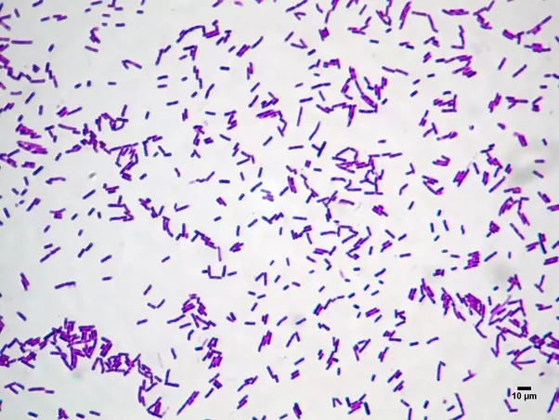
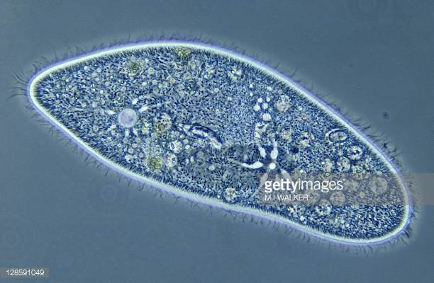
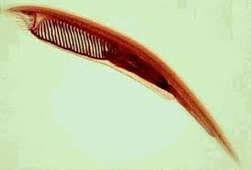
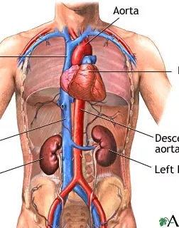
What is Evolution?
The above is Macro-Evolution
Evolution believes: This change is brought about because the organism lived in a changing environment, its DNA had mutations, that resulted in advantage in reproduction. Popular use of the word “evolution” implies a change for the better.

Slide 4
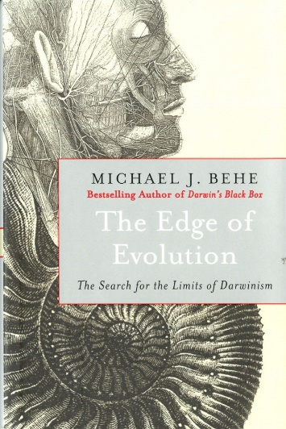
What is Evolution?
CHANGE
Do things change? DO SDAs believe that things change?? YES! SDA creationist do believe that change takes place. MICRO-evolution
EGW talked about the changes in organisms
Fixity of species:
In Darwin’s time, it was believed that animals left the ark as we see today.
Note the extraordinary timing of the introduction of Naturalism to the world
The Edge of Evolution. Michael Behe 2007

Slide 5
What is do we ACTUALLY see?
DATA
Many people willingly give up their belief in the biblical teaching of a 6-day creation and a flood because they find ONE bit of scientific data that they cannot understand, and doesn’t seem to fit what the bible teaches.
HOWEVER – there are MANY facts in the natural world that evolution cannot explain. Learning about just ONE of these should cause an evolutionist to give up the theory, and yet they do not!

Slide 6
What is do we ACTUALLY see?
DATUM # 1
CELLULAR COMPLEXITY: the most complicated machine, and irreducibly complex

Slide 7
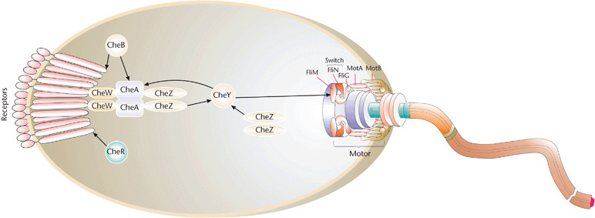
What is do we ACTUALLY see?
DATUM # 1

Slide 8
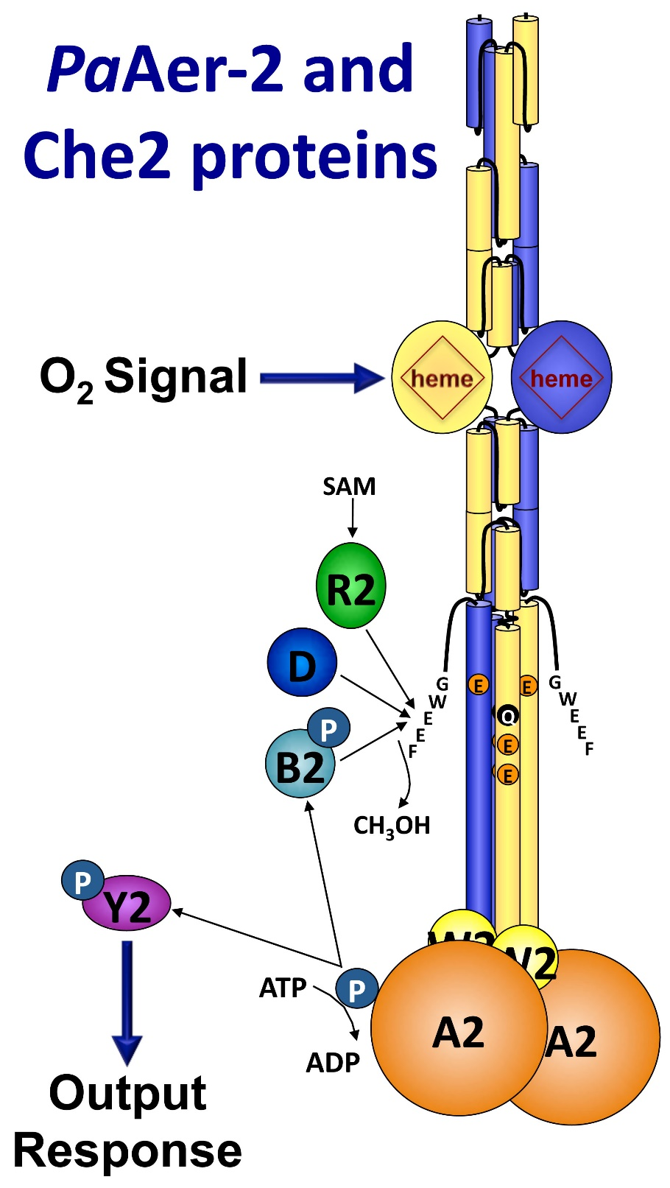
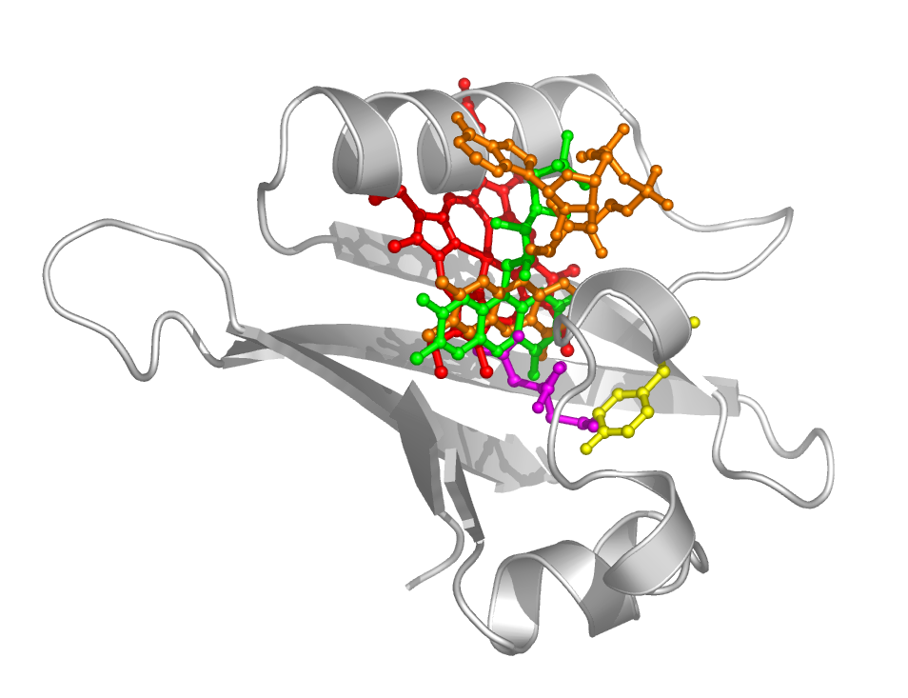

Slide 9
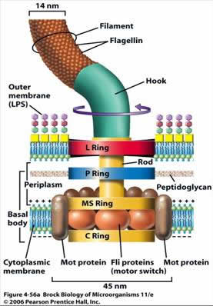

Slide 10
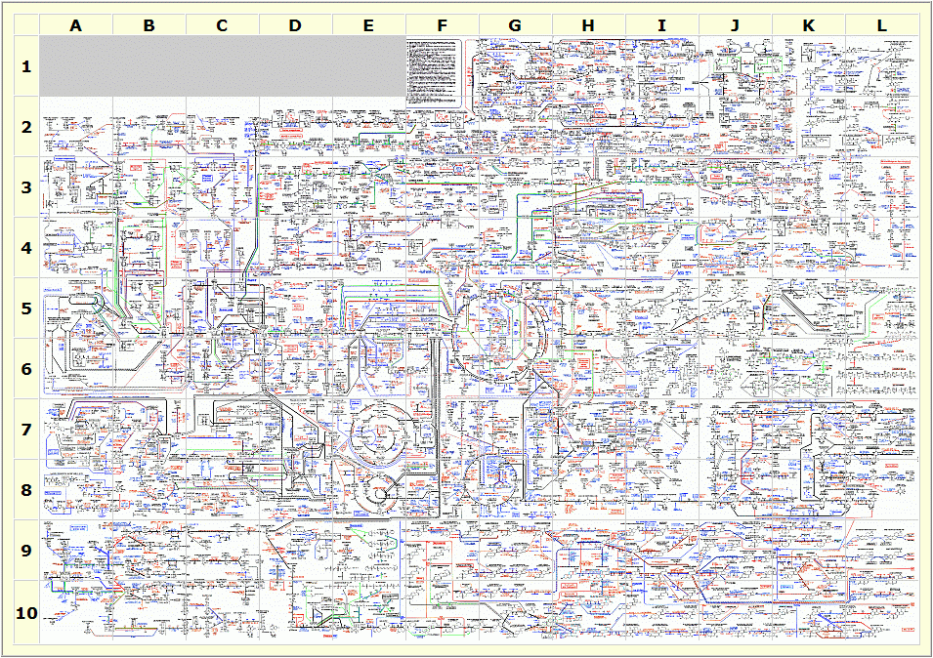

Slide 11
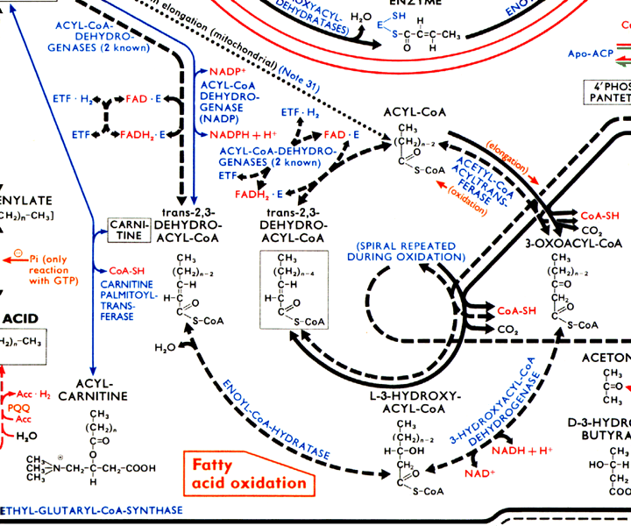

Slide 12
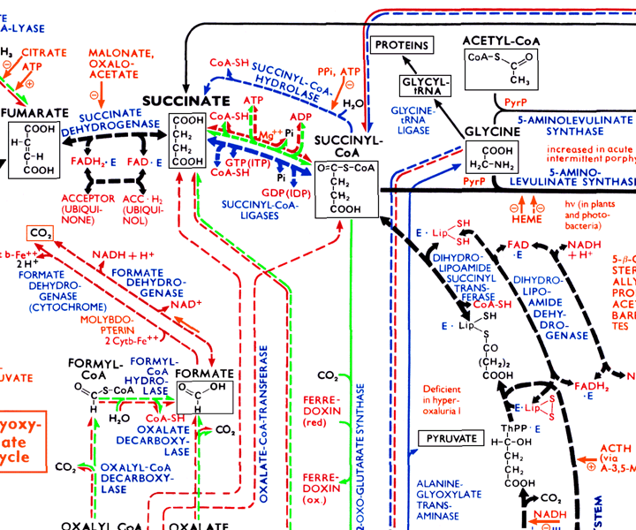

Slide 13
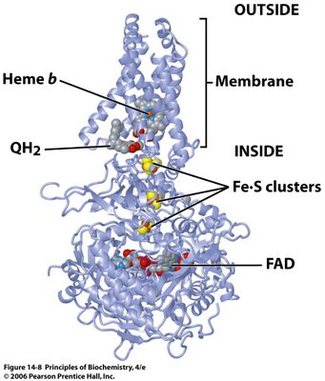
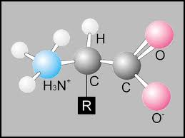

Slide 14
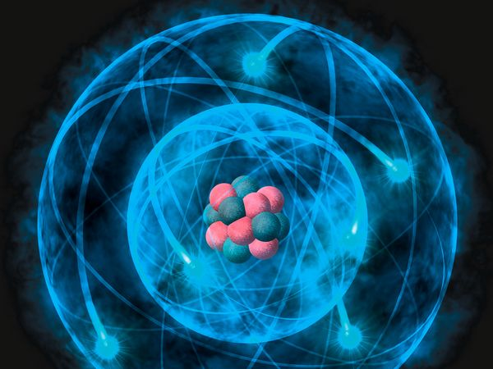

Slide 15
What is do we ACTUALLY see?
DATUM # 2
THE HUMAN MIND: the most stunning entity on the entire earth

Slide 16
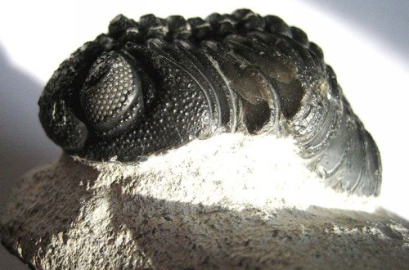
Complexity in fossil record.

Slide 17
3. Complexity in fossil record.

Slide 18
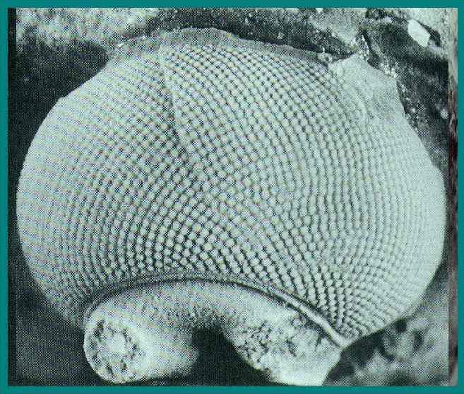

Slide 19
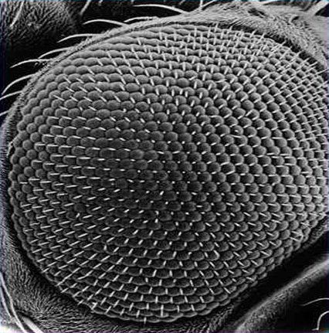
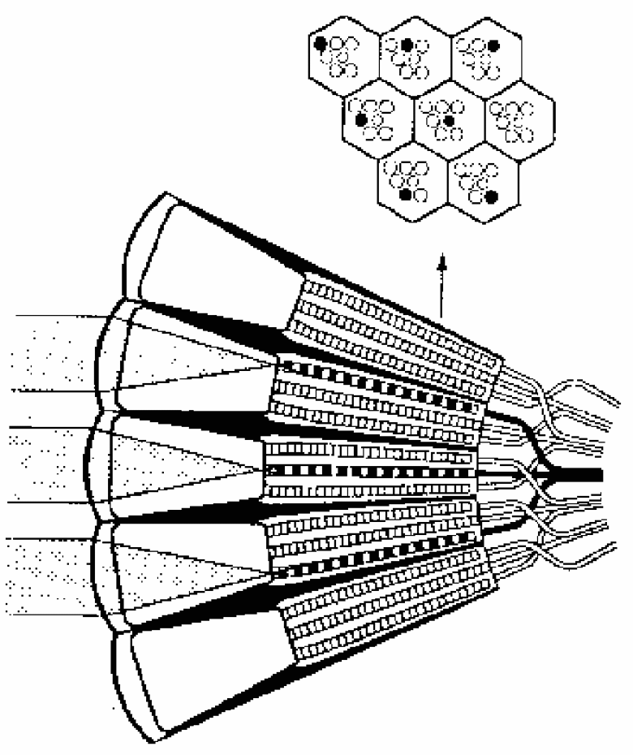

Slide 20
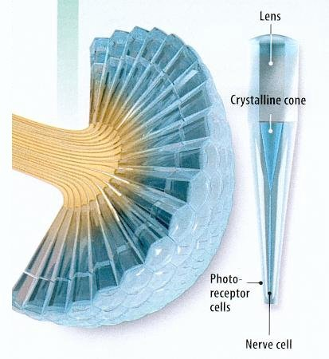

Slide 21
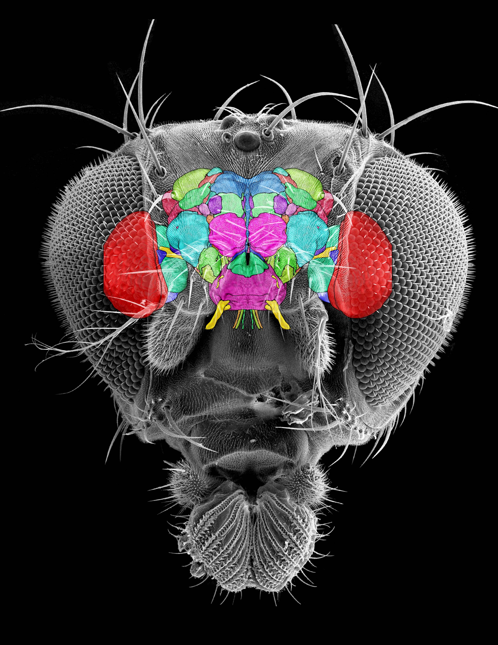
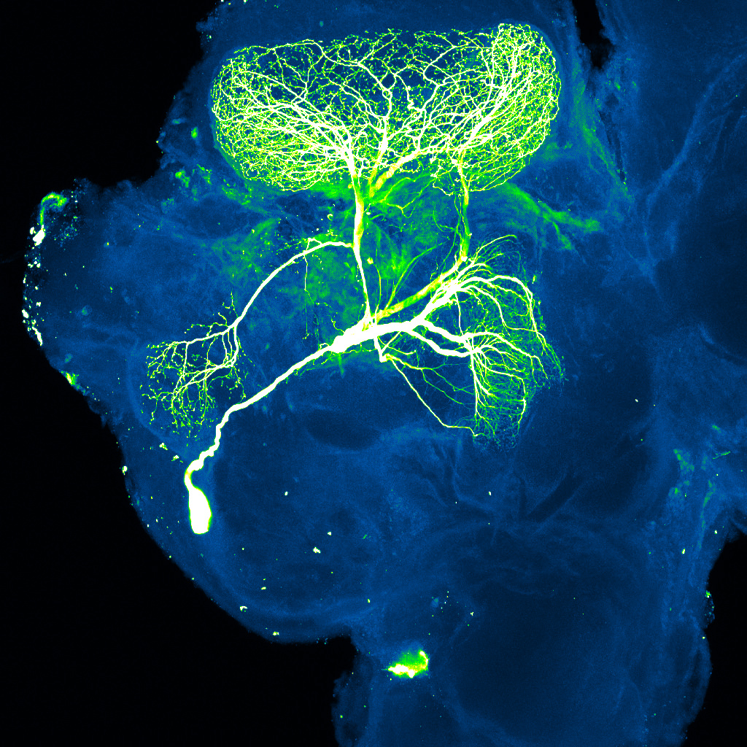
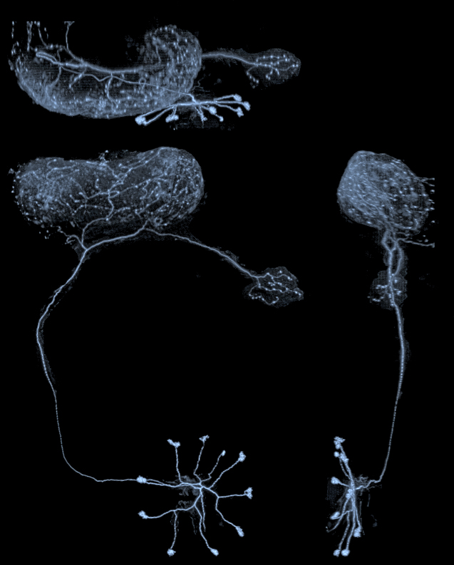

Slide 22
3. Complexity in fossil record.

Slide 23
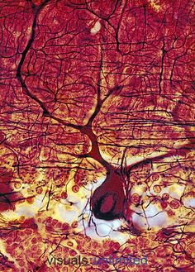
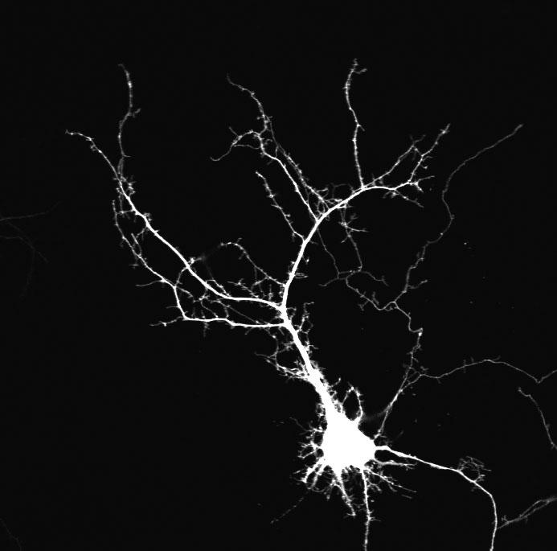

Slide 24
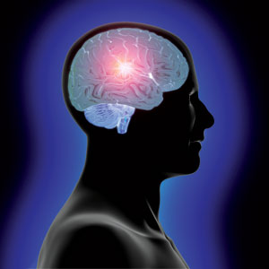
The Human Mind
Is natural selection sufficient to create the human mind?
The demands of our environment are not so stringent that they could have called forth the information and materials needed for the complex capabilities of the human brain.

Slide 25
What is do we ACTUALLY see?
DATUM # 3
INFORMATION: the most
complicated control mechanisms

Slide 26
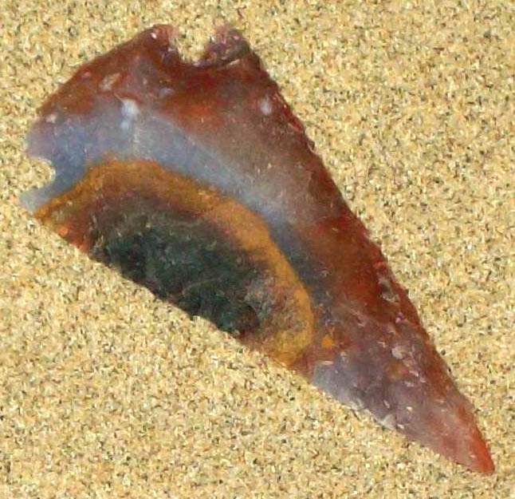
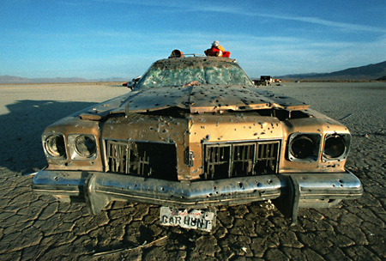
Source of Complexity?

Slide 27
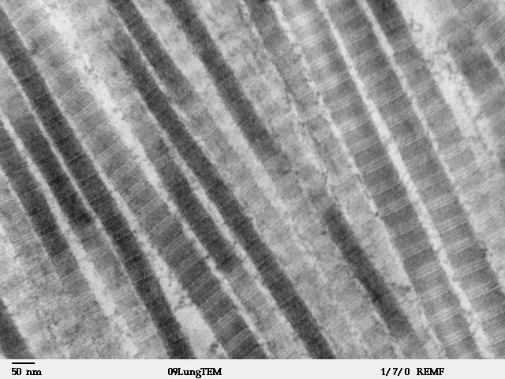
Louisa Howard

Slide 28
Rebar
Technyck

Slide 29
Louisa Howard

Slide 30
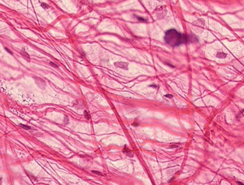
Collagen can be excreted from the cell.

Slide 31
Rebar
John P. Curtis

Slide 32
Mineralized Collagen Fibers in Bone
Sbertazzo

Slide 33
Rebar
LouisvilleUSACE
Notes:
SO… WHERE DOES REBAR COM FROM?

Slide 34
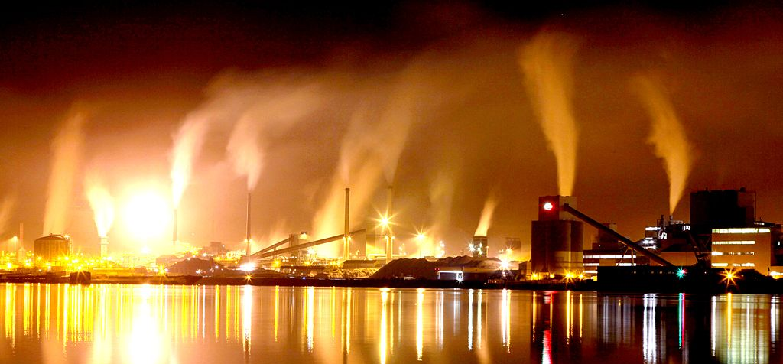
Rebar Source?
Bakker

Slide 35
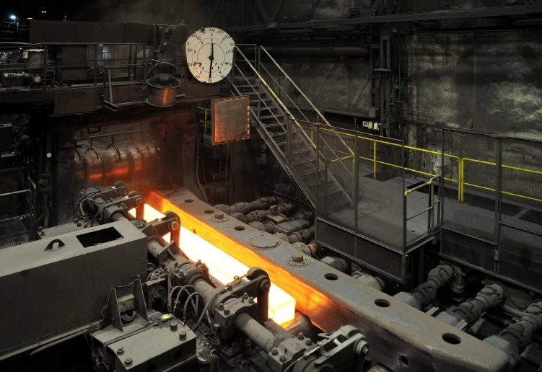
Rebar Source?
Schmimi1848

Slide 36
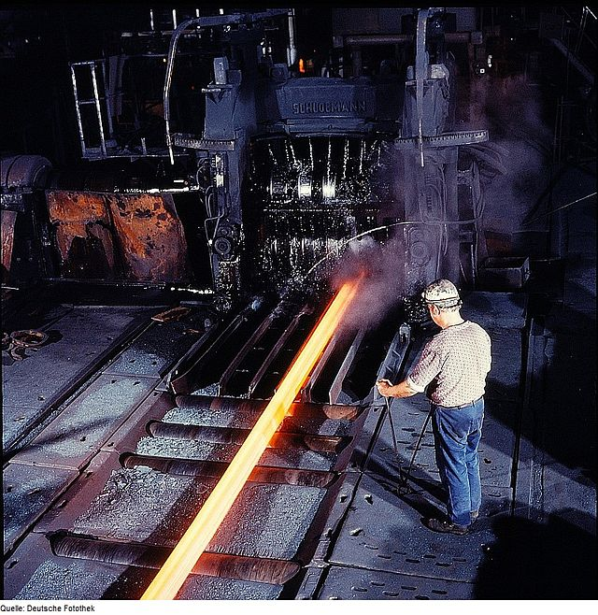
Rebar Source?
FotothekBot
Notes:
So what where does Rebar come from?

Slide 37
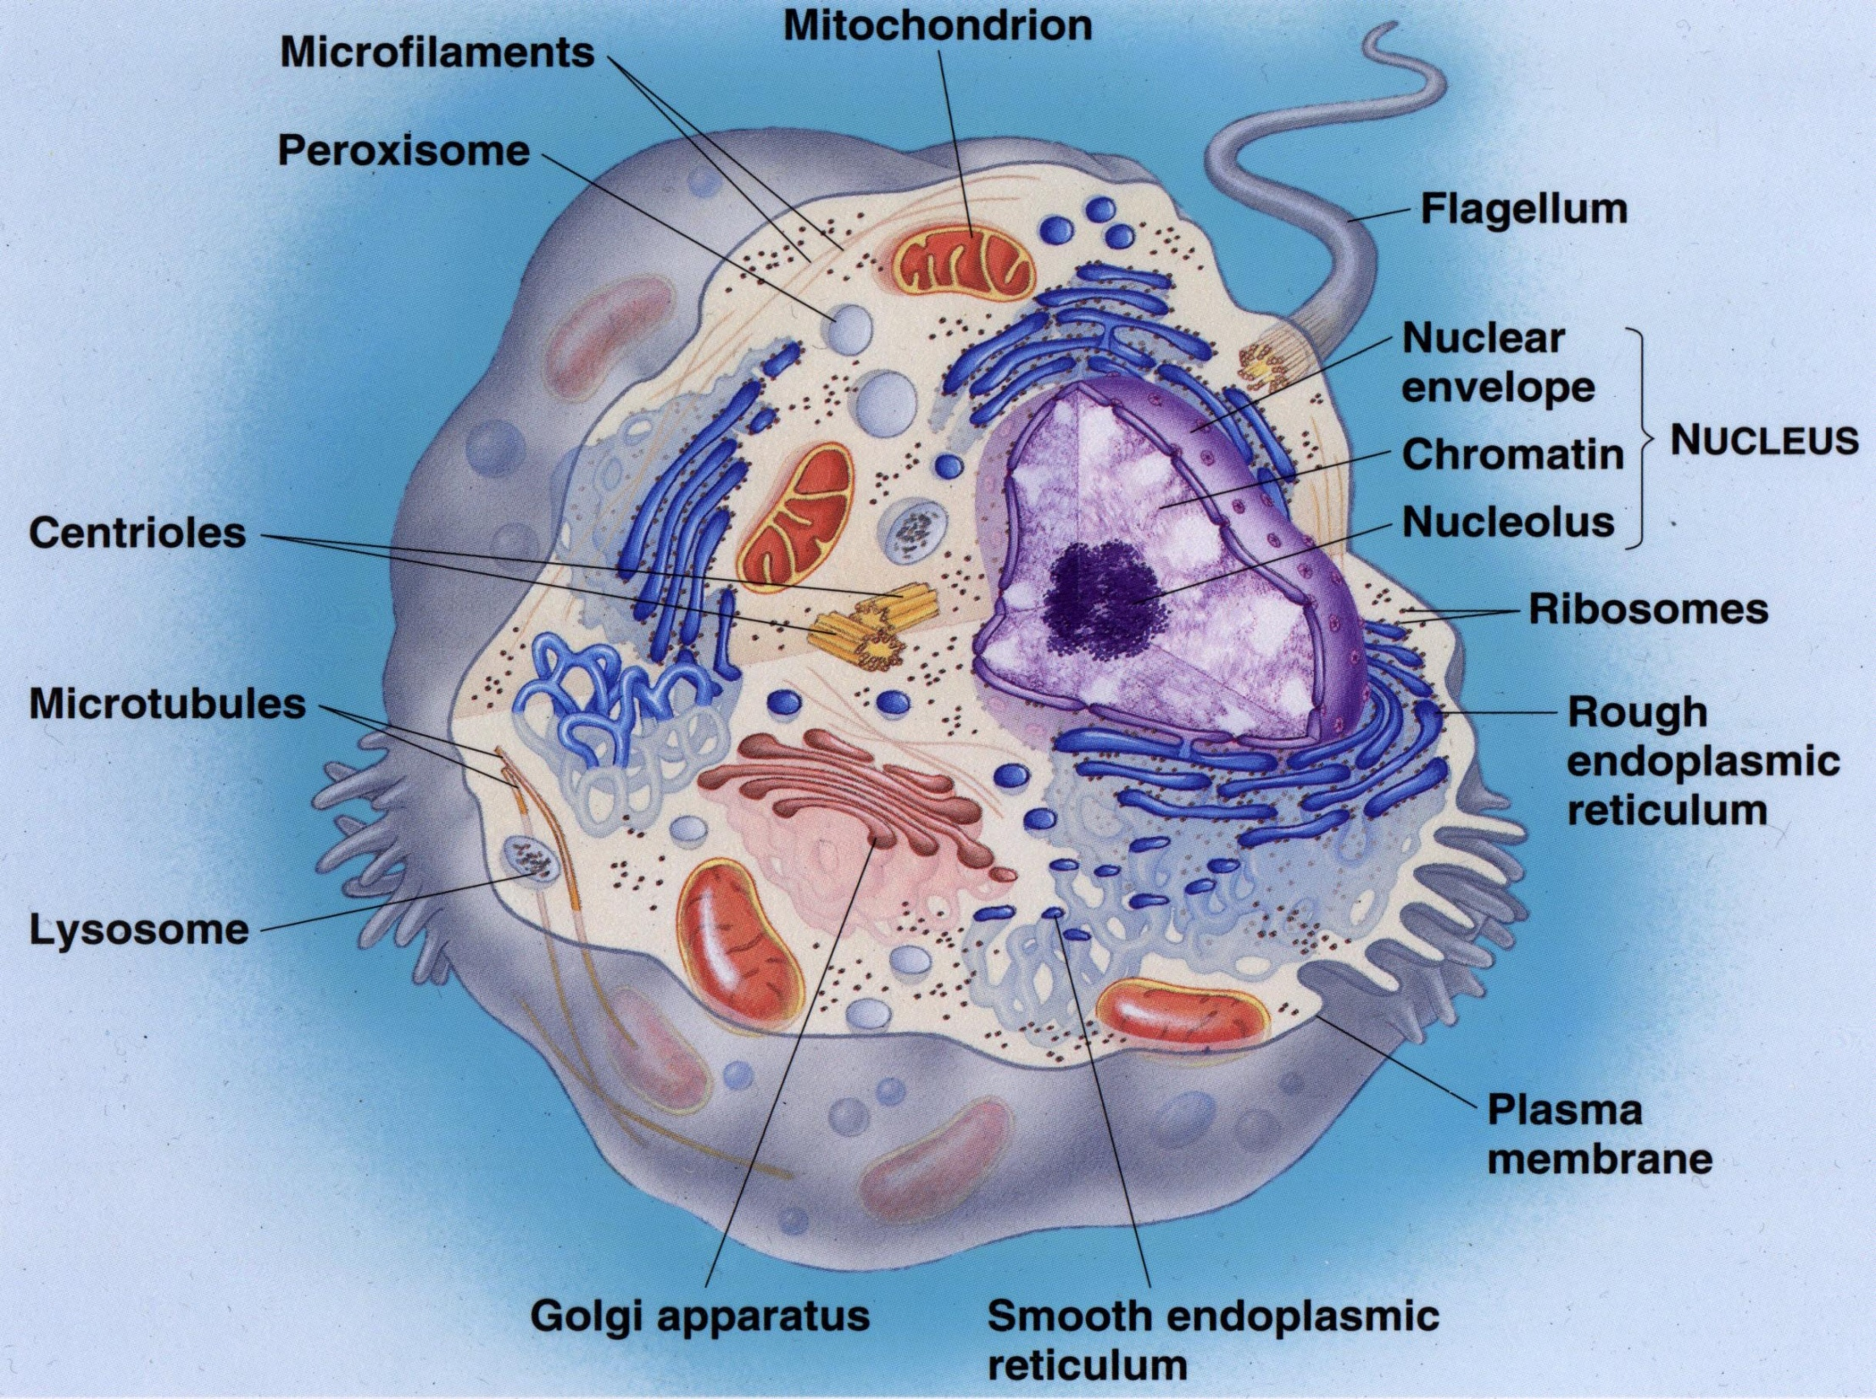
Where is the Collagen Machine?
Notes:
Well, here’s the better question – where is the electrical engineer in here? Where does the direction come from?

Slide 38
What is Evolution?
Mechanism of the theory of evolution:
Mutations are generated that give a competitive/reproductive advantage to an individual (and eventually a group of individuals) in a particular environment. (This doesn’t happen often enough to become fixed in a population.)
Natural selection selects those individuals with the reproductive advantage (because of genetic mutations) to become the dominate genotypes in the environment (We can say that phenotypes are selected for: species can change over time, especially if their environment changes – it seems more likely these are epigenetic changes, as those are easier to fix in a breeding group, hard to tell if they are genetic changes, and WHAT genetic changes are “big” changes)
Eventually only those individuals make up the species. (We only can analyze the species we have now. We don’t know if genes are completely lost, or if expression changes)
This cycle continues indefinitely leading to a complete change in the genotype, morphology, phenotype, behavior, and niche use, of the original population. Given enough time (540 million years), this has led to the variety of organisms present on earth today. (This has never been witnessed. There is no working model for any one of the multiple mechanisms. The fundamental principles of nature never go against entropy without the input of ordered energy)
So by definition, the reason FOR evolution is Propagation of an individual’s, or species’, genes in the environment (Can this account for the actual phenotypes we find? Why would an organism progress beyond bacteria or insects when they are the most reproductively successful?)

Slide 39
Is your belief in God’s word, while living during these generations of doubt, actually that outrageous?
Your belief in God’s word has a lot of validity:
There were witnesses to supernatural events in history. They wrote them down. They were demanded to recant, they were brutally tortured for their persistent telling of and belief in those events. At least 11 men. Hundreds more who didn’t write what we have access to also lost their lives. Millions killed through the centuries for believing as they do.
YOU are a witness to supernatural – God says, “I will give them an undivided heart, and put a new spirit in the: I will remove from them their heart of stone and give to them a heart of flesh. Then they will follow my decrees and be careful to keep my laws. They will be my people and I will be their God.” Ezekiel 11: 19&20. ie: my evil sister…

Slide 40
Evolution Cannot Account for:
The existence of the human mind with all of its capabilities that surpass the demands of our environment.
The existence of immense complexity within the cell, especially in molecular machines and informational molecules
The Cambrian explosion – the sudden appearance of nearly all phyla with no previous fossil record.

Slide 41
Evolution Cannot Account for:
The existence of the human mind with all of its capabilities that surpass the demands of our environment.
The existence of immense complexity within the cell, especially in molecular machines and informational molecules
The Cambrian explosion – the sudden appearance of nearly all phyla with no previous fossil record.
The origin of life
Mathematical /chemical/physical constants
DNA and informational molecules – the origins of information
Cosmology

Slide 42
Conclusions?
Hebrews invites us to practice our faith
What type of evidence are you EXPECTING?

Slide 43
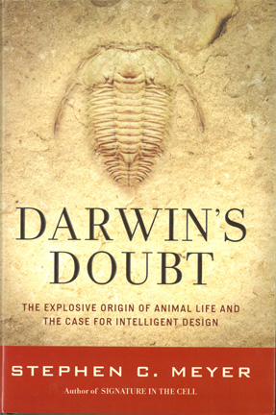
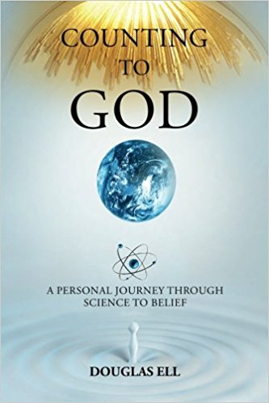
Recommended Reading:
Faith, Reason & Earth History. Leonard Brand & Art Chadwick 2016
FREE Download at Amazon.
Explore Evolution. Stephen Meyer, et al., 2007
Darwin’s Doubt. Stephen Meyer 2014
The Edge of Evolution. Michael Behe 2007
Counting to God. Douglas Ell 2014
FREE Download at Amazon.
Contested Bones. John Sanford & Chris Rupe 2018

