Slide 1
The Biblical Foundation for Adventist Education
Adventist
Education
By E. Edward Zinke
Illustrations by David Zinke
and Carol Raney
Motivation by Doug Zinke
and by Seven Grandchildren
Notes:
*

Slide 2
Doctrine and Personal Relationship with God
By E. Edward Zinke

Slide 3
What is Christianity?
Simeon Stylites – meditation
Keep the law
Go to church
Pay tithe and offerings
Know the doctrine
All things we can do for salvation

Slide 4
Christ’s Description of Eternal Life
“And this is eternal life, that they may know You, the only true God, and Jesus Christ whom You have sent.” Jn 17:3

Slide 5
God’s Love Letter
From cover to cover, the Bible is God’s love letter, not only in the NT but also in the OT
“Since you were precious in My sight, You have been honored, And I have loved you” Is 43:4
Notes:
Context, God’s judgment that on His people that they had turned to idols: Yet this reassurance of His love.

Slide 6
“Yes, I have loved you with an everlasting love; therefore with lovingkindness I have drawn you.” Jer 31:3
“I drew them with gentle cords, with bands of love.” Hos 11:4
“I will heal their backsliding, I will love them freely.” Hos 14:4

Slide 7
I will betroth you to Me forever;
Yes, I will betroth you to Me
In righteousness and justice,
In lovingkindness and mercy;
I will betroth you to Me in faithfulness,
And you shall know the LORD”
Hos 2:19, 20

Slide 8
“But God demonstrates His own love toward us, in that while we were still sinners, Christ died for us.” Rom 5:8
“Behold what manner of love the Father has bestowed on us, that we should be called children of God! Therefore the world does not know us, because it did not know Him” 1 Jn 3:1
“God is love.” 1 Jn 4:8
Notes:
Not limited to knowledge as in western thought. But knowledge that leads to a relationship.
Eternal life is the restoration of what was lost in Eden by sin. Restoration of a personal relationship with God.

Slide 9
God loves us each individually.
Christ would have died for you, for me.
It is not that God loves the world generically.
He loves each one personally.

Slide 10
Sin disrupts our relationship with God
sin
The transgression of the law

Slide 11
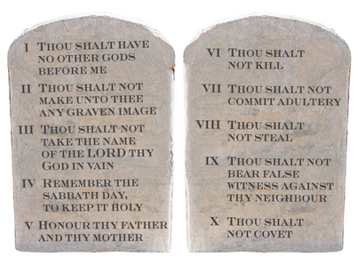
Sin disrupts our relationship with God
The law is a description of the character of God
God’s Character

Slide 12
Sin disrupts our relationship with God
When we break the law, we go against God’s character and break our relationship with Him
God’s Character’

Slide 13
God wants to restore our relationship with Him
“God was in Christ, reconciling the world to Himself.” 1 Cor 5:19
Notes:
God wants to restore our relationship with Him

Slide 14
Why Doctrine?
If Christianity is the restoration of a relationship, why doctrine?
Key elements of intimate relationships:
Knowledge of other person
Knowledge of self
Understanding of the proper relationship between us
Notes:
Why not simply concentrate on the relationship.
These three are only a few out of many

Slide 15
Doctrine…
Tells us about God
Helps us understand ourselves
Describes our proper relationship with God
eliasbrasil@gmail.com

Slide 16
Knowledge Matters
“Then she forgot me.” Hos 2:13
“And this is eternal life, that they may know You, the only true God, and Jesus Christ whom You have sent.” Jn 17:3
“I will betroth you to Me in faithfulness, and you shall know the LORD.” Hos 2:20

Slide 17
“There is no truth or mercy or knowledge of God in the land. . . My people are destroyed for lack of knowledge.” Hos 4:2, 4:6
“Let us peruse knowledge of the Lord.” Hos 6:3

Slide 18
And we know that the Son of God has come and has given us an understanding, that we may know Him who is true; and we are in Him who is true, in His Son Jesus Christ. This is the true God and eternal life.
¶ Little children, keep yourselves from idols. Amen. 1John 5:21, 22

Slide 19
Doctrines Influence Relationship by:
Their influence on character
The results of rejecting key elements of the personality of another person
Notes:
We become like what we admire most.
Rejecting a key characteristic of a friend impacts our potential relationship with them.

Slide 20
Illustrations
The Sabbath
Creation

Slide 21
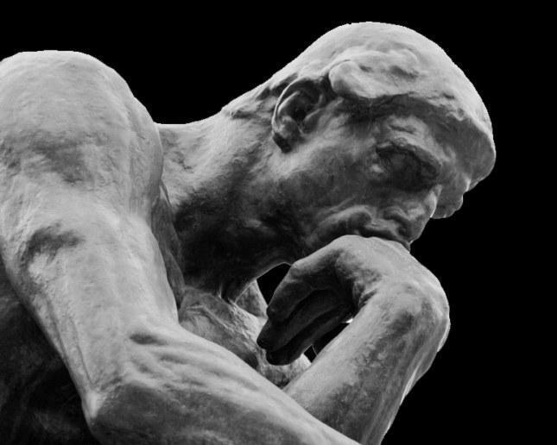
Does it matter what we think of God?
I think my spouse is a…

Slide 22
Does it matter what we think of God?
I think my spouse is a…

Slide 23
Does it matter what we think of God?
I think my spouse is a…

Slide 24
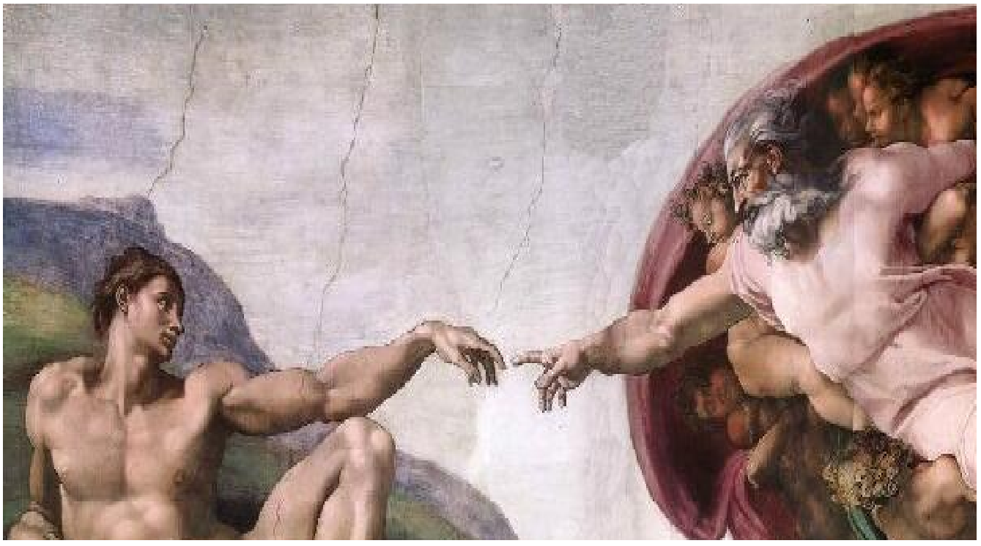
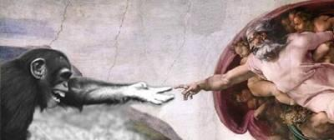
Which God represents the God of the Bible?

Slide 25
Who Do We Worship?
The active, revealing God of Abraham, Isaac, and Jacob?
The God of the Red Sea
The gods of Ahab, Ishtar, and Jezebel who do not respond, speak, or act?
The god of the Reed Sea who could not open the Red Sea?
Notes:
Click for the opposites to come in…
*

Slide 26
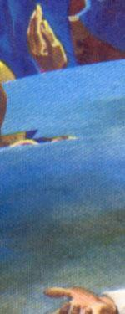
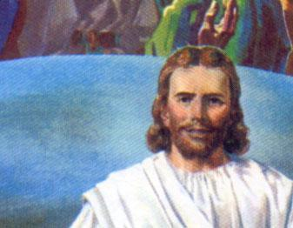
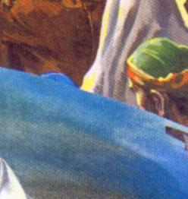
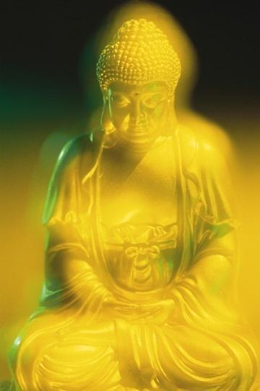
Love
Creator
Truth
Judge
Savior
Personal
Self-Revealing
All Powerful
Notes:
*

Slide 27
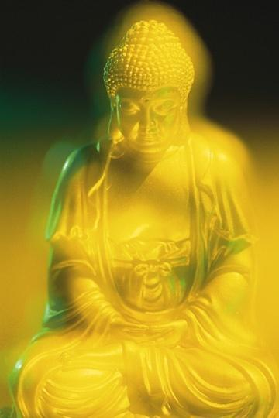
Love
Creator
Truth
Savior
Personal
Self-Revealing
All Powerful
Notes:
*

Slide 28
Love
Creator
Truth
Savior
Personal
Self-Revealing
Notes:
*

Slide 29
Love
Truth
Savior
Personal
Self-Revealing
Notes:
*

Slide 30
Love
Savior
Personal
Self-Revealing
Notes:
*

Slide 31
Love
Savior
Personal
Notes:
*

Slide 32
Love
Personal
Notes:
*

Slide 33
Love
Notes:
*

Slide 34
Notes:
*
When we reject key elements of God as He has revealed Himself to us, we create an idol of our own making, a “designer” God to worship.

Slide 35
We Have a Big God!

Slide 36
God Provides an Umbrella Large Enough to Cover Every Group of People
Jew, Gentile
Slave, Free
Rich, Poor
Educated, Uneducated
Male, Female

Slide 37
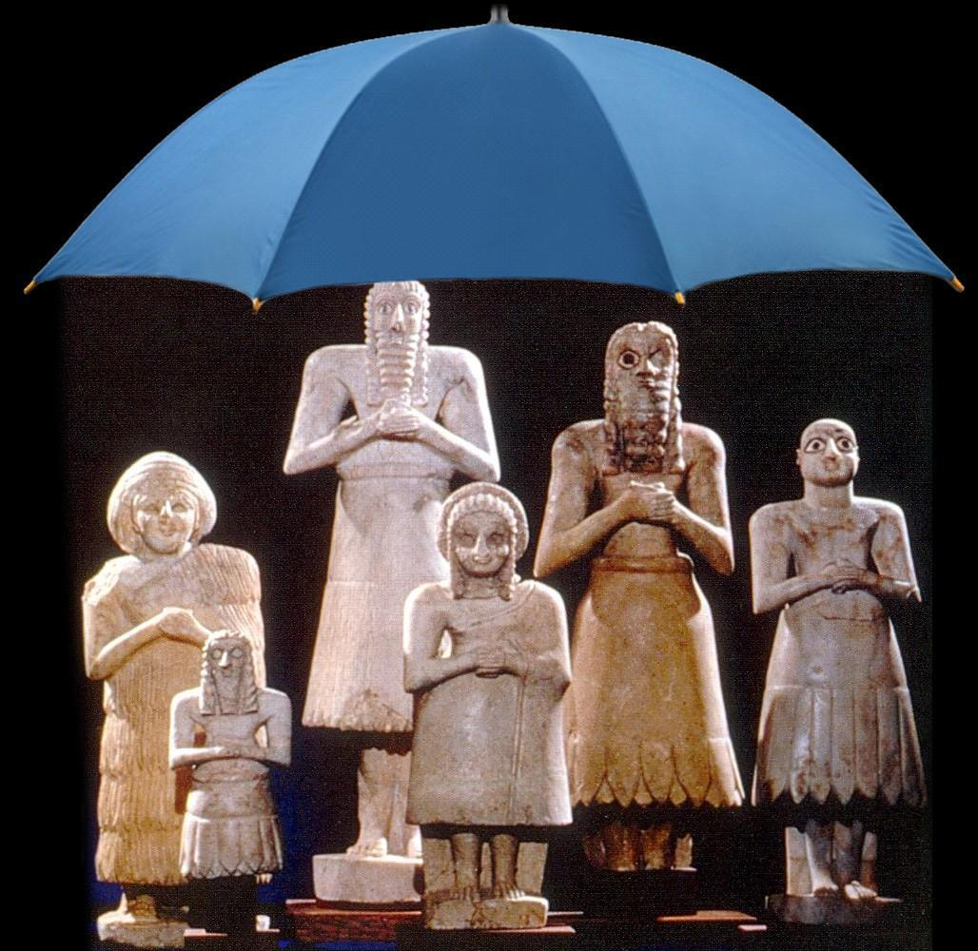
Some are asking for an umbrella large enough to cover all of the gods

Slide 38
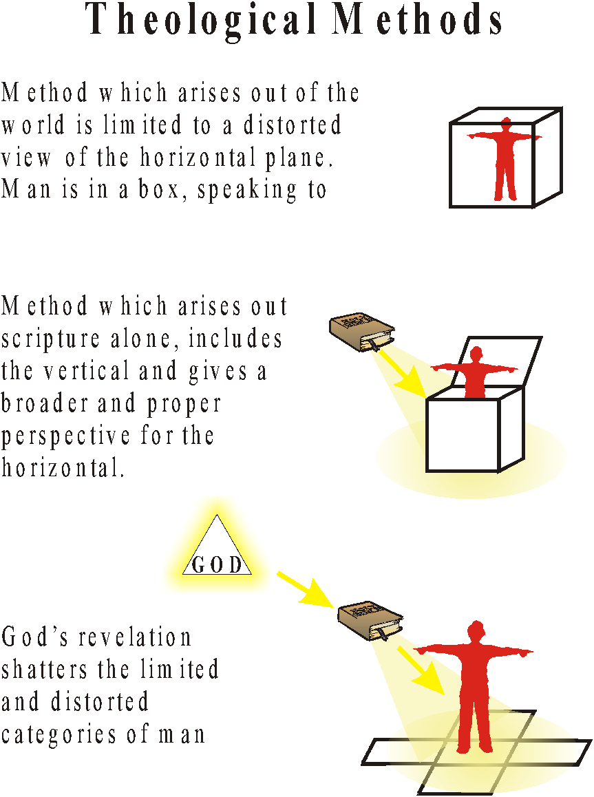
Notes:
*

Slide 39
Possible Relations Between Science & Scripture
Human Studies ALONE | Integration of Nature AND the Bible | Separation of Nature & the Bible | Nature AND the Bible with the Bible as Foundation
Human studies ALONE are the absolute foundation for all knowledge whether it comes from nature or from the Bible.
Notes:
Human studies—science, philosophy, history, psychology, etc. -- are alone the absolute foundation for all knowledge whether it comes from nature or from the Bible
*

Slide 40
Possible Relations Between Science & Scripture
Human Studies ALONE | Synthesis of Nature AND the Bible | Separation of Nature & the Bible | Nature AND the Bible with the Bible as Foundation
No valid truth in the Bible apart from human verification
Notes:
There is no valid truth in the Bible apart from human verification. Human study alone provides the way, the truth and the life.
*

Slide 41
Possible Relations Between Science & Scripture
Human Studies ALONE | Synthesis of Nature AND the Bible | Separation of Nature & the Bible | Nature AND the Bible with the Bible as Foundation
Truth is truth, wherever it may be found.
Synthesize human AND religious studies
Notes:
Truth is truth wherever it may be found. Nature and the Bible -- both bring a valid approach to knowledge. Human and religious studies provide the way, the truth and the life. (click) The task of the theologian is to integrate the knowledge from both worlds into a theological system.
*

Slide 42
Possible Relations Between Science & Scripture
Human Studies ALONE | Synthesis of Nature AND the Bible | Separation of Nature & the Bible | Nature AND the Bible with the Bible as Foundation
Science deals with nature ALONE, and the Bible deals with religion ALONE. They should be kept separate.
Both may be understood completely on their own.
Notes:
The realm of nature and of the Bible is radically separate. Science deals with nature alone, and the Bible deals with religion alone. The two do not intersect. (click) Both may be understood completely on their own. Since there is no connection between them, it is useless to try to synthesize them.
*

Slide 43
Possible Relations Between Science & Scripture
Human Studies ALONE | Synthesis of Nature AND the Bible | Separation of Nature & the Bible | Nature AND the Bible with the Bible as Foundation
God has revealed Himself both in nature and in the Bible. Both should be studied from the foundation of the Bible ALONE.
Notes:
God has revealed Himself both in nature and in the Bible. Nature by itself is sometimes misleading. Both may be legitimately studied from the standpoint of the Bible and the Bible alone. Christ alone as He is represented in His Word is the way, the truth and the life.
*

Slide 44
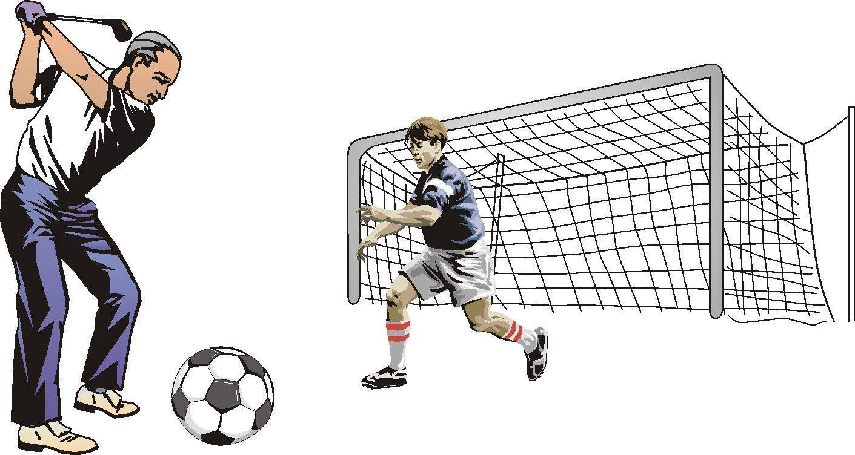
Notes:
*

Slide 45
Let’s compromise between the two…

Slide 47
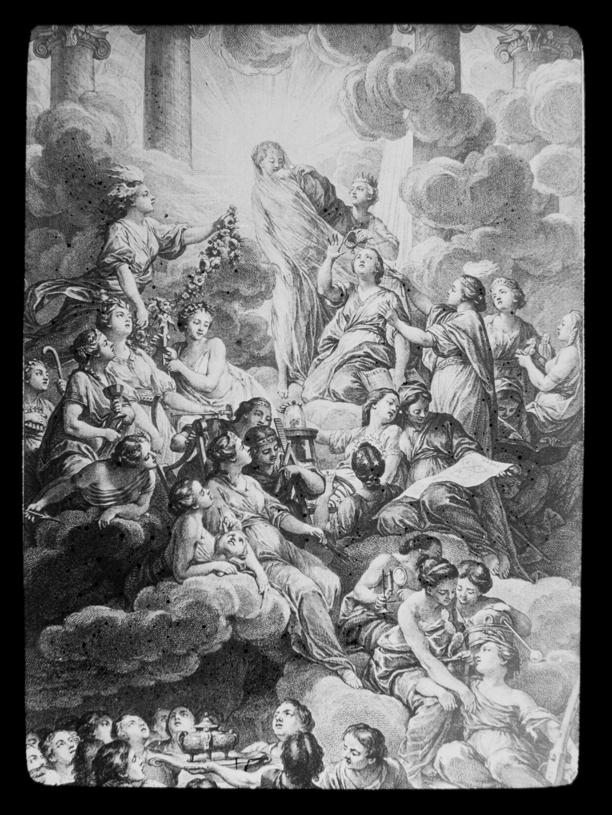

Slide 48
Notes:
I wanted to bring the light from the enlightenment to illuminate the Bible, like as if the bible needed my illumination. I was obscuring the bible and the God of the Bible rather than clarifying it.
*

Slide 49
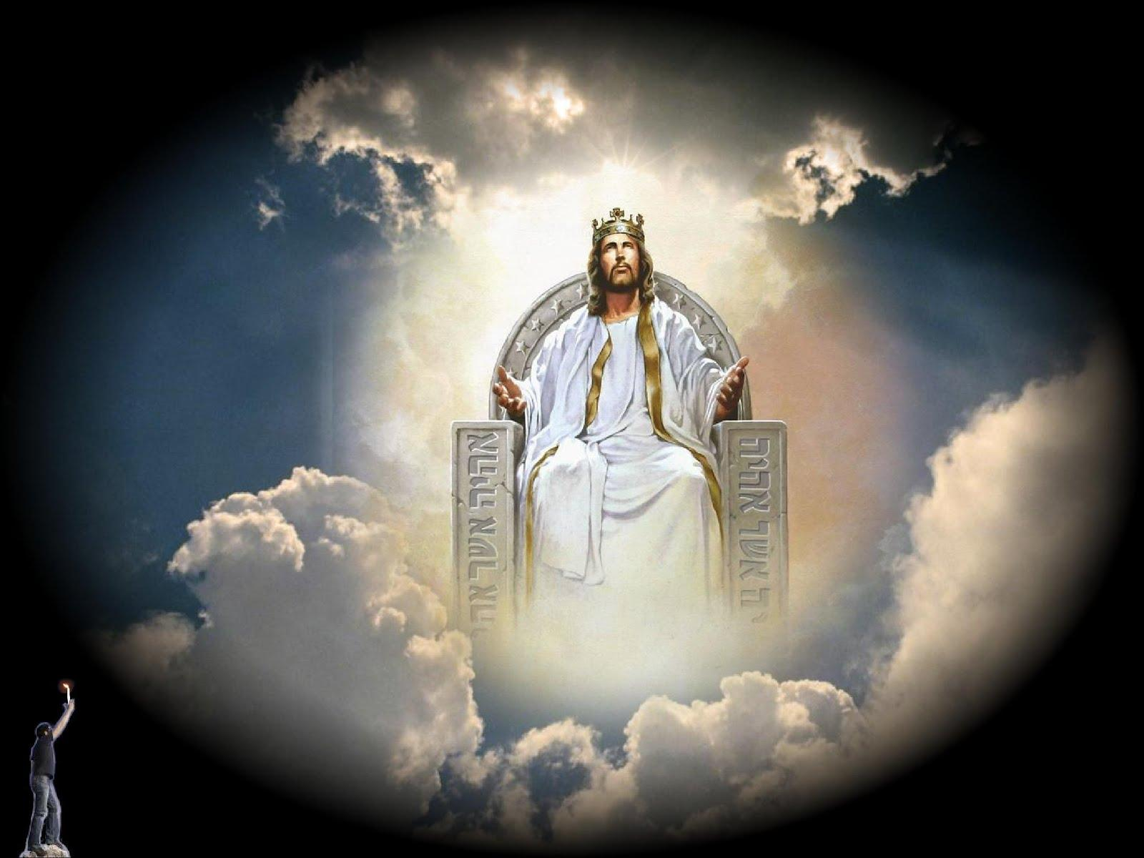
Notes:
Bottom, left hand corner. I brought my candle to attempt to illuminate the light of the world.

