Slide 1
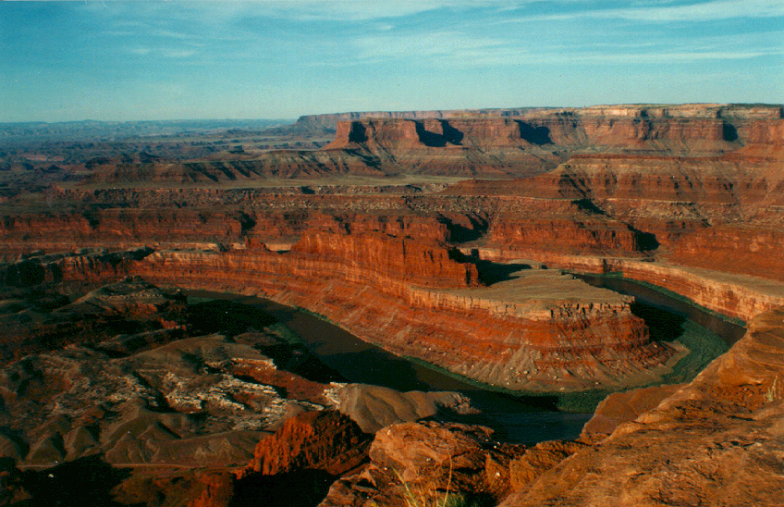
Radiocarbon dating

Slide 2
There Are Issues That Challenge the concept of a fiat creation
Radiometric dating
Other dating methods
Fossil record
  Orderly fossil record
  Hominid record
  Etc.

Slide 3
There Are Issues That support the concept of a fiat creation
Origin of life
Fossil record
  Sudden appearances
  General absence of intermediate forms
Sedimentology and Catastrophism
  Evidence of extraordinary events.
  General lack of evidence for time.
Molecular biology

Slide 4

What we see:
Evolution
Creation

Slide 5
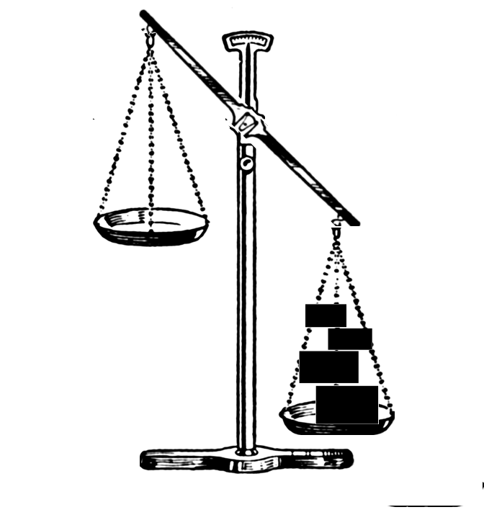
What we would like to see: (?)
Evolution
Creation

Slide 6
…or this:
Evolution
Creation
Evolution
Creation

Slide 7
What we see:
Evolution
Creation

Slide 8
Conclusion:
A = B
A = B
Therefore:
For those who know the science, the decision about origins is always going to be based upon something other than science.

Slide 9
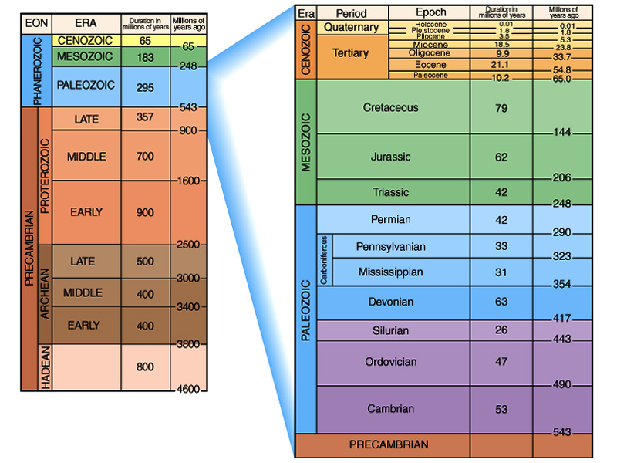
Simple Geologic Time Scale

Slide 10
“The present is The Key to the Past”
“Relative” Time
Principles Used to Determine “Relative Age”
  Principles of stratigraphy
  Unconformities
  Correlation
  The Standard Geologic Time Scale
“Absolute” Time
Principles of radioactive decay
  Instruments
  Assumptions
The age of the Earth

Slide 11
Radioactive Decay
Nucleus of an atom spontaneously changes
Independent of normal pressures and temperatures
In some cases nucleus gets smaller
In all cases, the kind of atom is changed
Happens at a known, measurable rate at present.

Slide 12
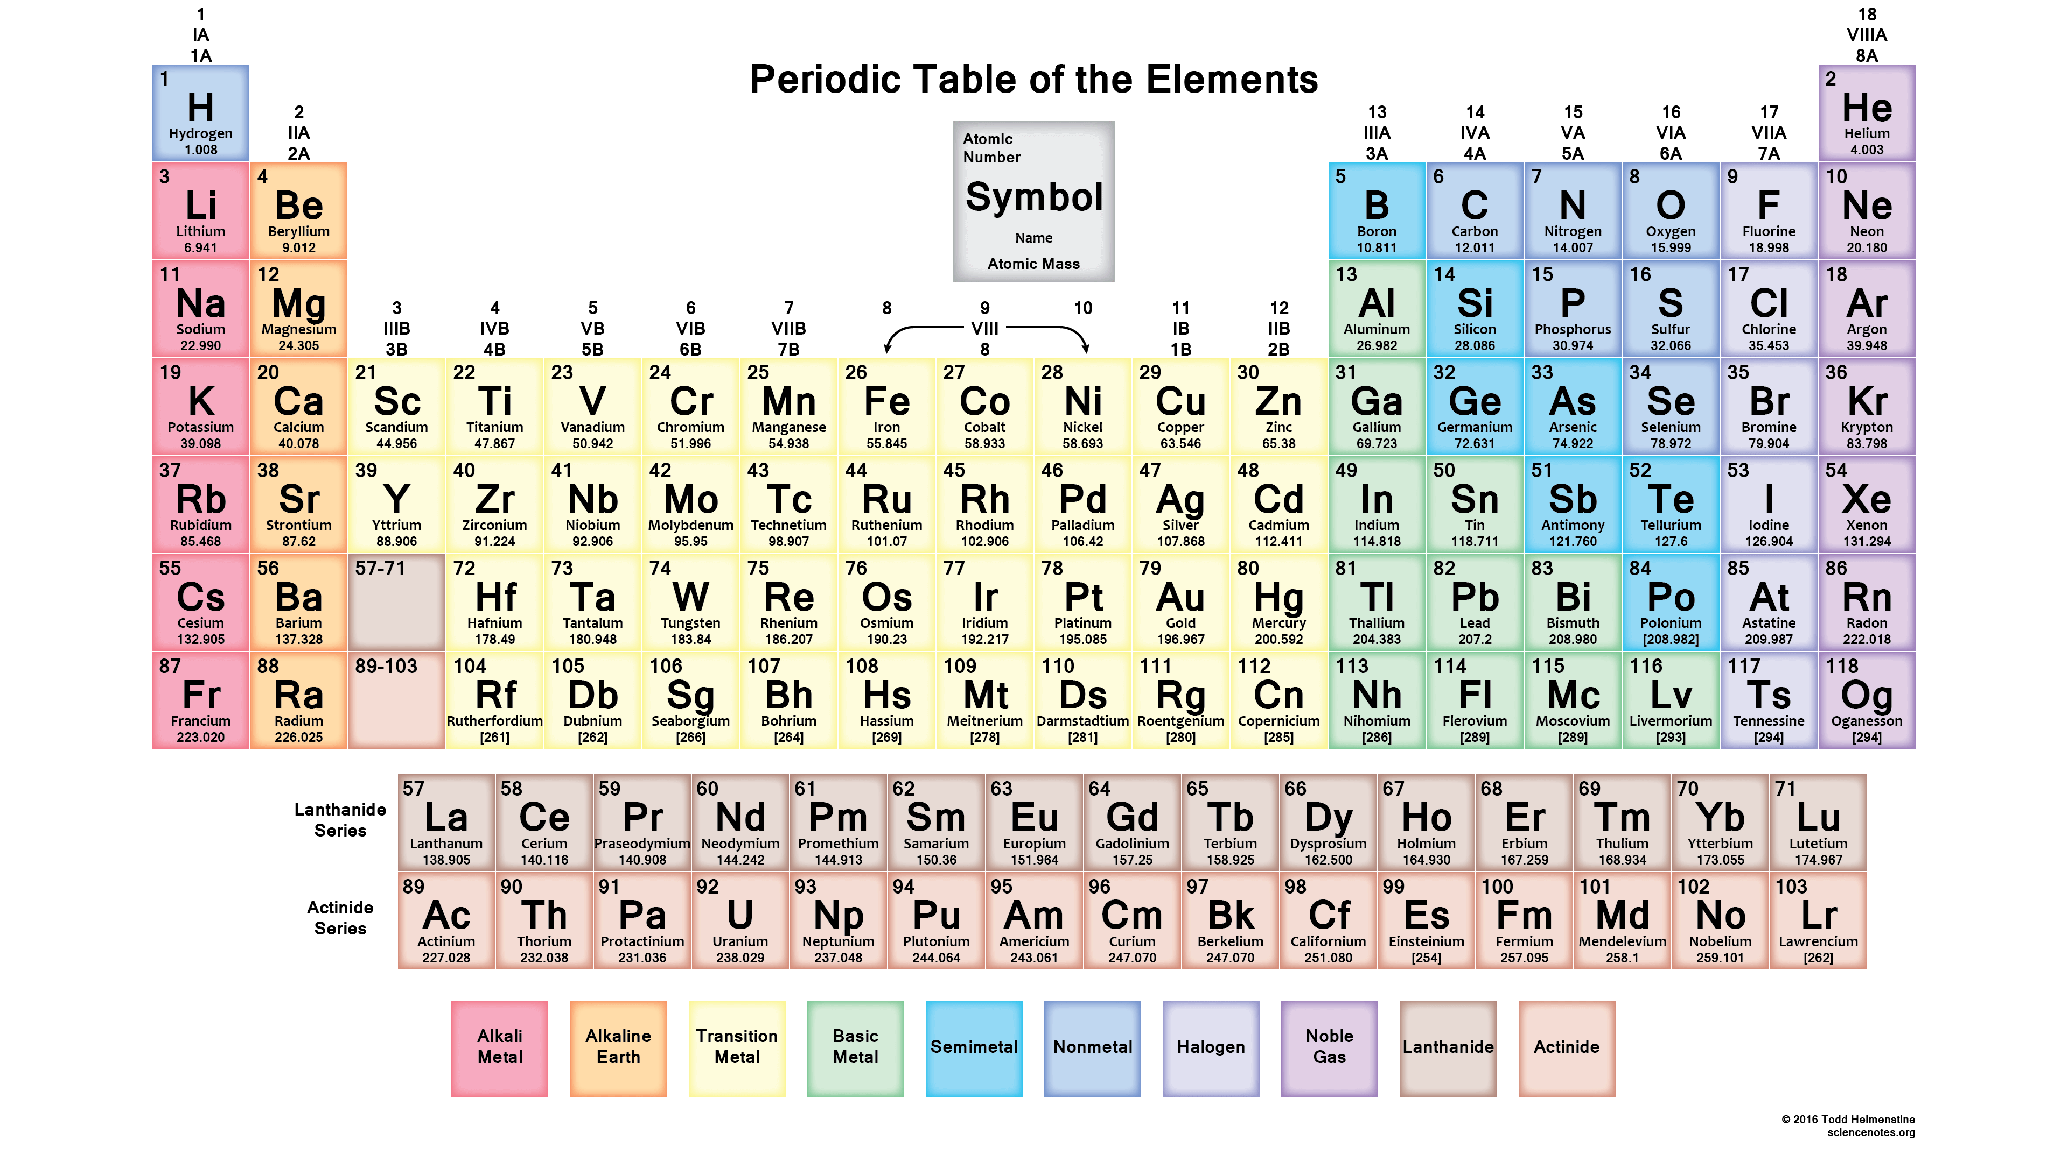
Periodic table of elements

Slide 13
The Carbon atom

Slide 14
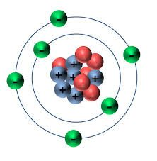
The atom

Slide 15
Alpha Decay
Alpha particle (helium nucleus) = composed of 2 neutrons and 2 protons
Alpha Particle is ejected from the nucleus, along with some gamma radiation
Atomic number goes down by 2
Atomic mass goes down by 4.

Slide 16
Beta Decay
An electron is ejected from the nucleus
Essentially a neutron becomes a proton
Atomic number increases by 1
Atomic mass remains the same.

Slide 17
Electron Capture
A proton becomes a neutron in the nucleus
Atomic number decreases by one
Atomic mass does not change.

Slide 18
Useful Isotope Systems
ISOTOPE | HALF LIFE | RANGE
¹⁴C -> ¹⁴N | 5730 yrs | < 60,000 yrs
⁴⁰K -> ⁴⁰Ar | 1.25 x 10⁹ yrs | > 100,000 yrs
⁸⁷Rb -> ⁸⁷Sr | 48.8 x 10⁹ yrs | > 1,000,000 yrs
²³⁸U -> ²⁰⁶Pb | 4.5 x 10⁹ yrs | > 1,000,000 yrs
²³⁵U -> ²⁰⁷Pb | 0.7 x 10⁹ yrs | > 100 x 10⁶ yrs
¹⁴⁷Sm -> ¹⁴³Nd | 106 x 10⁹ yrs | > 100 x 10⁶ yrs
²³²Th -> ²⁰⁸Pb | 14 x 10⁹ yrs | > 200 x 10⁶ yrs

Slide 19
The Radiocarbon System
Carbon has 6 protons in the nucleus
The most common isotope is ¹²C
  Has 6 protons and 6 neutrons in the nucleus
  Stable isotope
Some Carbon is ¹³C
  Has 6 protons and 7 neutrons in the nucleus
  Nonradioactive isotope.
Some Carbon is ¹⁴C
  Has 6 protons and 8 neutrons in the nucleus
  Radioactive isotope.

Slide 20
Radioactive decay of ¹⁴C
¹⁴C Nucleus
e⁻
¹⁴N Nucleus
6 Protons
8 Neutrons
7 Protons
7 Neutrons

Slide 21
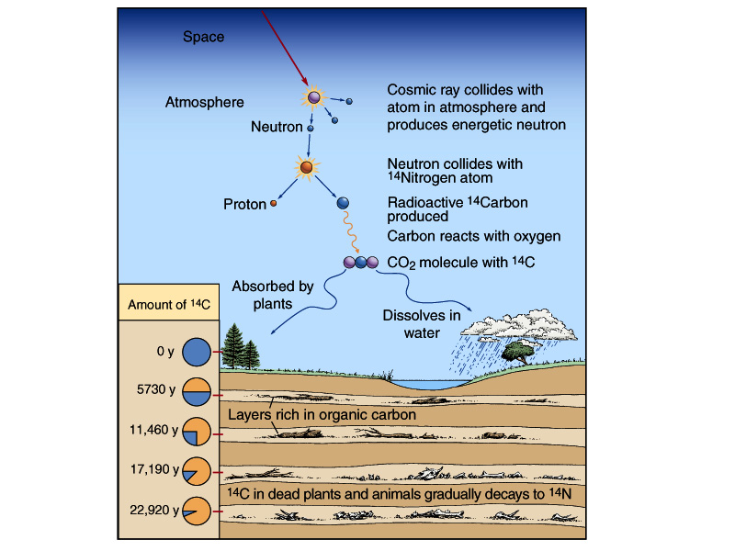
Carbon-14 radiometric clock

Slide 22
¹⁴C - ¹⁴N Isotope System
¹⁴C spontaneously decays to ¹⁴N at a constant rate (beta decay).
In a closed system the proportion of ¹⁴C (parent) to ¹⁴N (daughter) will change over time.
The amount of time it takes half of the parent isotope to decay is called the half-life.
We can graph this on a decay curve.

Slide 23
Radioactive Decay Curve
Percent Parent Isotope
Time (half-lives)

Slide 24
2 Half-lives

Slide 25
3 Half-lives

Slide 26
4 Half-lives

Slide 27
5 Half-lives

Slide 28
6 Half-lives

Slide 29
7 Half-lives

Slide 30
RADIOACTIVE DECAY CURVE
Daughter Isotope
% Atoms
Parent Isotope
# Half-Lives

Slide 31
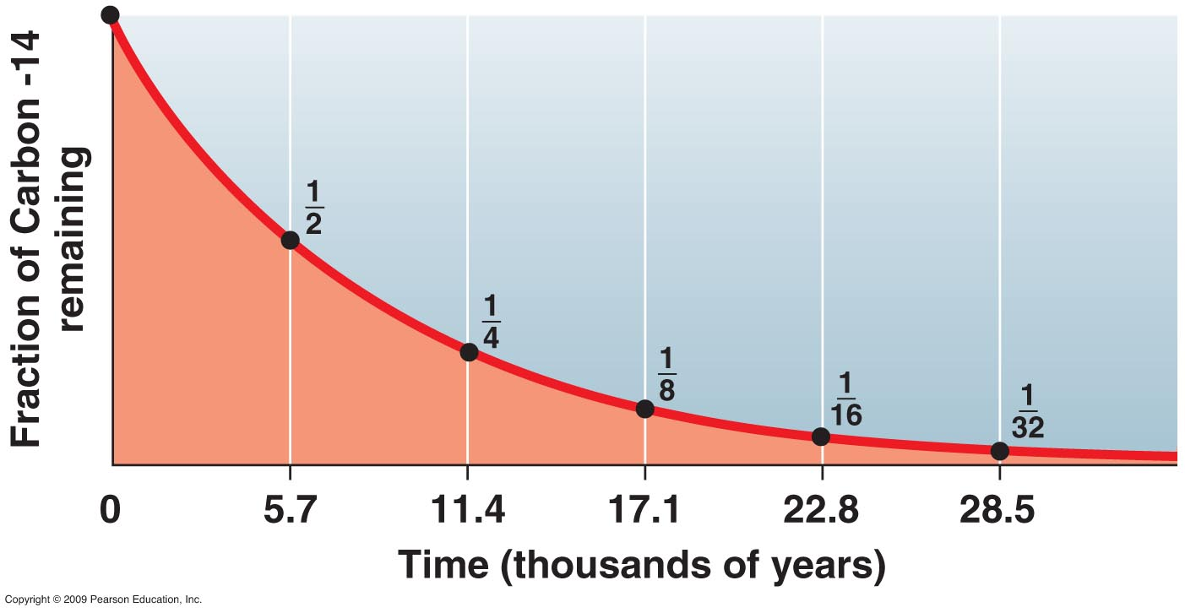

Slide 32
Carbon-14 radiometric clock

Slide 33
What Assumptions Have We Made?
Decay rate constant over time
Decay is unaffected by pressure and temperature
No parent or daughter atoms have escaped or been added
Starting amount of parent is known
Other assumptions, some of which may not be known to us yet …

Slide 34
Things to understand about 14C dating
Dates fossils, not generally rocks.
Limited to about 50,000 radiometric years.
Dependent on atmospheric level of radiocarbon at time organism was alive.
Generally calibrated by tree rings, which are in turn calibrated by ¹⁴C.
Radiocarbon can be exchanged with normal carbon from the environment after death.
Finding a control blank is a formidable problem for the method. Even diamonds thought to be a billion years old appear to contain radiocarbon.

Slide 35
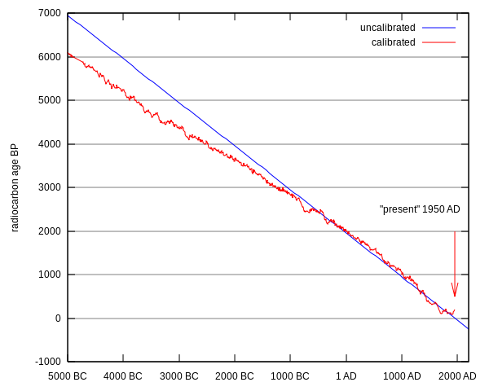
Deviations from expected decay curve

Slide 36
Survival of biomolecules argues for recent origin of dinosaurs and other forms
Current status based on work of Mary Schweitzer and others
Documented existence of tissues, proteins, blood cells in bones supposed to be 65 million years old as determined by radiometric dating.
Many other examples are now known of biomolecules lasting far beyond their physical chemical determined limits.

Slide 37
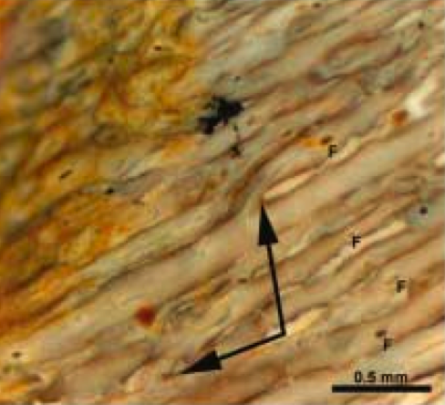
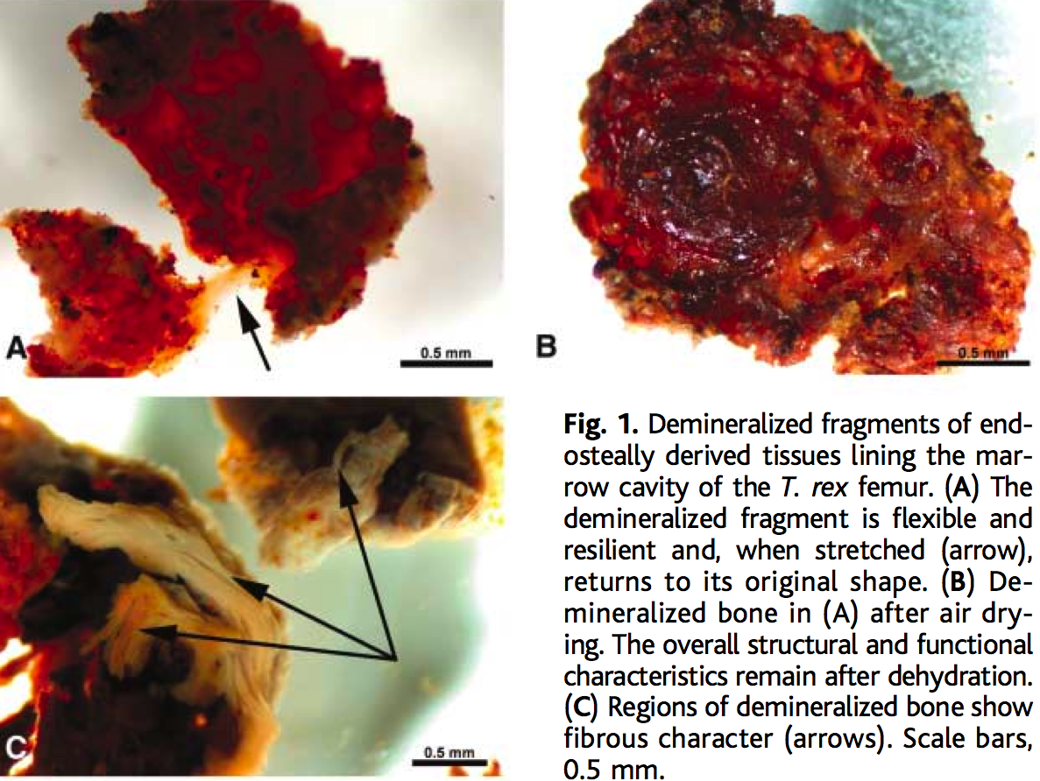
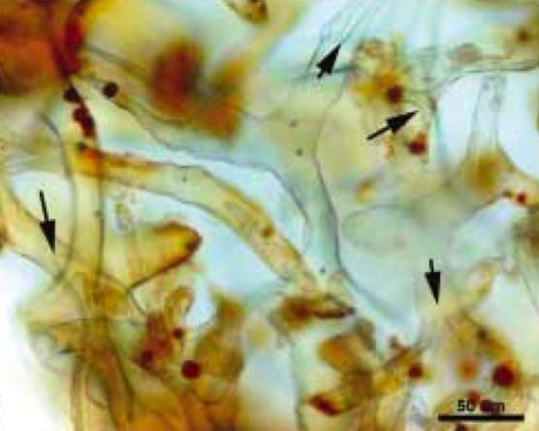
T. rex Tissue Examples
Notes:
Top right picture shows bifurcated vascular canals in partially demineralized cortical bone.
Bottom right picture shows branched transparent vessels with “cells” inside.

Slide 38
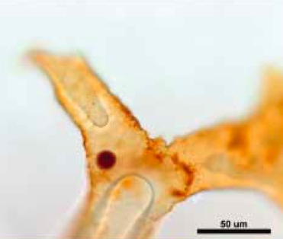
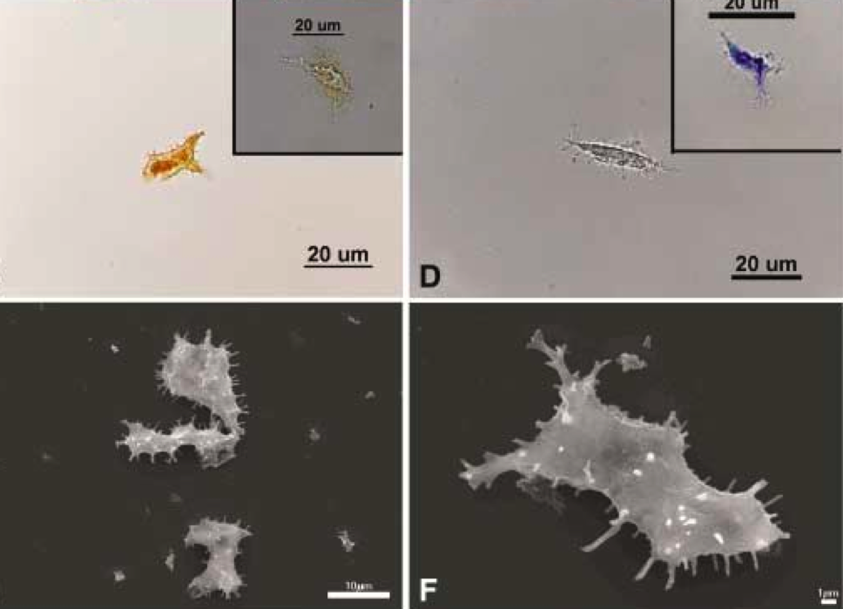
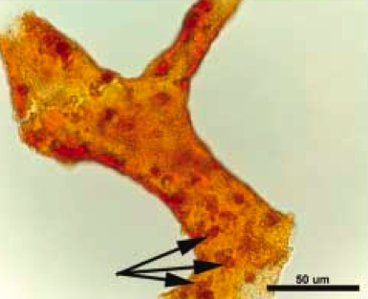
T. rex Tissue Examples
Notes:
Left image: Comparison of isolated T. rex “osteocyte” (left sides) with modern ostrich osteocyte images (top = light microscope, bottom = scanning electrom microscope).
Top right image: Hollow blood vessel with possible red blood cell inside.
Bottom right image: Vessels showing endothelial cell nuclei.

Slide 39
Conclusions
Radiocarbon is neither our friend nor our enemy. It is one way of assessing time that has liabilities, like every other method.
Radiocarbon dates are fairly accurate for historical dates, but deviate outside the range of history, and may deviate much more than calibration curves reveal.
Radiocarbon dates of supposedly very old materials show that there is a lot we do not yet understand.
Survival of biomolecules is indicative of a serious problem with the conventional interpretation of radiometric dates.

Slide 40
Potassium - Argon
Another important isotope system
Potassium is very abundant in rocks
Lots of isotope to measure
⁴⁰K Beta decays to ⁴⁰Ca most of the time
BUT, ~11% of the time electron capture occurs, causing ⁴⁰K to decay to ⁴⁰Ar
Can also be used to study thermal history of rocks.

Slide 41
What Assumptions Have We Made?
Decay rate constant over time
Decay is unaffected by pressure and temperature
Single daughter product is involved
No parent or daughter atoms have escaped or been added
Starting amount of daughter = Zero
Starting amount of parent is known
Other assumptions, some of which may not be known to us yet …

Slide 42
Summary & Conclusions
Several ways to calculate “absolute ages”
Most involve radioactive decay
All have specialized applications
All have certain limitations
No numerical age is truly “absolute”.
“At present, physical dates do not stand on their own. They must be compatible with stratigraphy. Stratigraphy has also served to highlight flaws and the relevance of unexpected factors in some physical procedures. So-called absolute dating is a misnomer, for physical dates provide numerical approximations, preferably considered within and constrained by a stratigraphic framework”
''Canons'' revisited and reviewed: Lester King's views of landscape evolution considered 50 years later. C. R. Twidale. Geological Society of America Bulletin 2003;115, no. 10;1155-1172

Slide 43
Time and the Fossil Record
The most common interpretation of radiometric data would take life on the earth far beyond Biblical timeframe.
Efforts to resolve the discrepancy head-on have not thus far been fruitful.
Certain features of the geologic record seem to contradict conclusions based on radiometric dates:

Slide 44
Issues in dating
Sediments appear to have accumulated rapidly
Sediments do not appear in equilibrium with the environment.
There is a general lack of erosion in the geologic record
Where radiometric dates are available, the events occurring between dated horizons rarely comport with the radiometric time.
Surviving biomolecules are found far out of possibility for radiometric time.

Slide 45
Sediment Accumulation Rates
Modern depositional rates are expressed in cm/yr.
Rates determined in a variety of environments where sediment is presently accumulating vary from less than 1 to more than 100, most often closer to 7-10 cm/yr.

Slide 46
Sediment Accumulation Rates
Depositional rates for rocks from the past (using radiometric dates) are expressed in cm/1000 years.
Rates vary from less than 1 to more than 100, most often closer to 10-20 cm/1000 years.
Calculations based upon the behavior of sedimentary particles gives rates of accumulation that are from 2000 to 10 million times faster than the rates based on radiometric time. *
Discrepancy most readily understood if a short time frame is applied
  *Reconstruction of Paleolithodynamic Formation Conditions of Cambrian-Ordovician Sandstones in the Northwestern Russian Platform. G. Berthault, A.V. Lalomov, and M.A. Tugarova. Lithology and Mineral Resources. 46:60-70. 2011

Slide 47
Issues in dating
Sediments appear to have accumulated rapidly
Sediments do not appear in equilibrium with the environment.
There is a general lack of erosion in the geologic record
Where radiometric dates are available, the events occurring between dated horizons rarely comport with the radiometric time.
Surviving biomolecules are found far out of possibility for radiometric time.

Slide 48
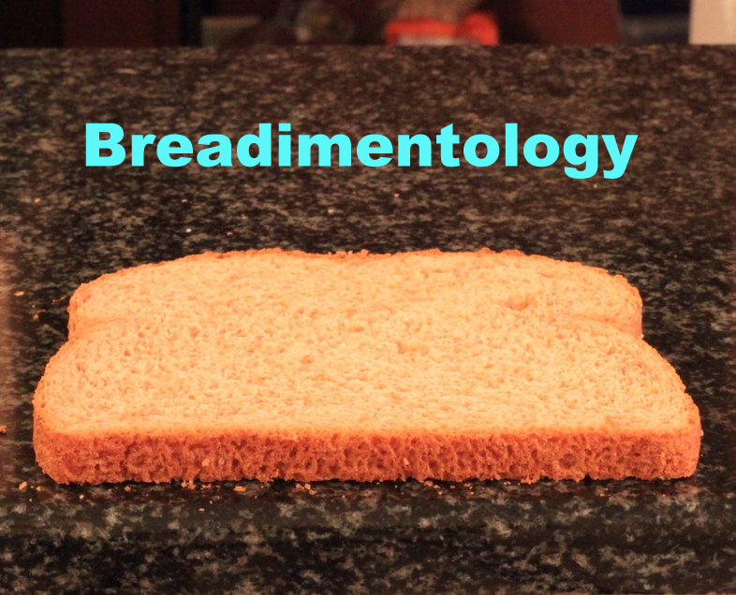

Slide 49
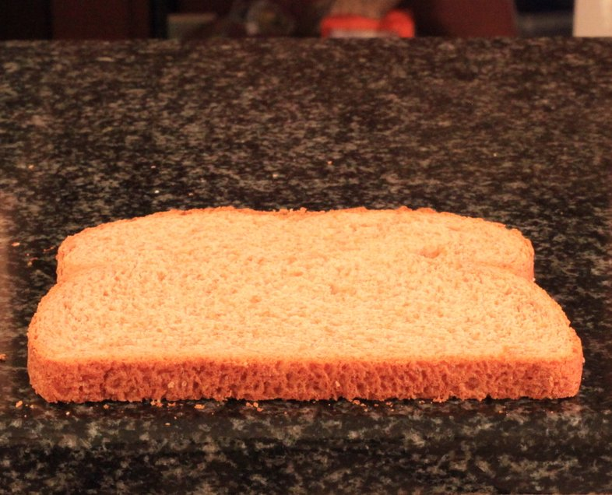

Slide 50
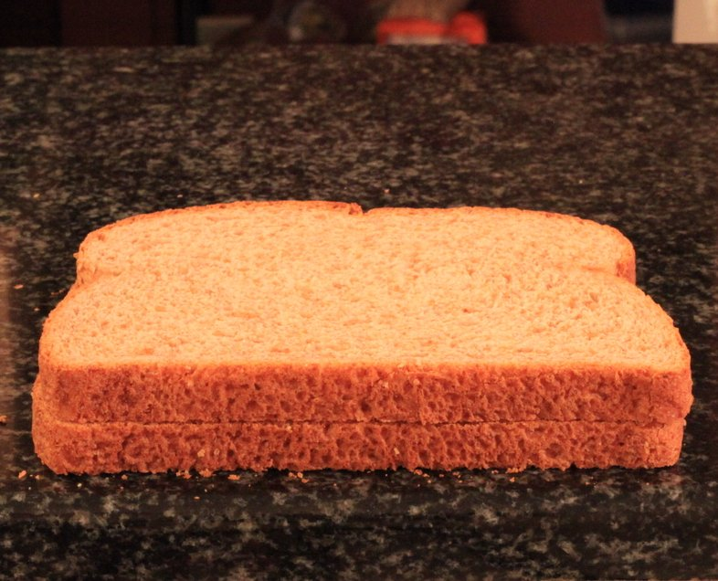

Slide 51
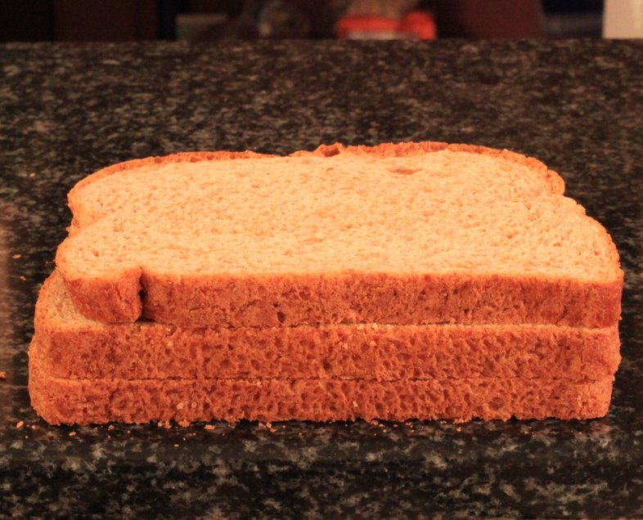

Slide 52
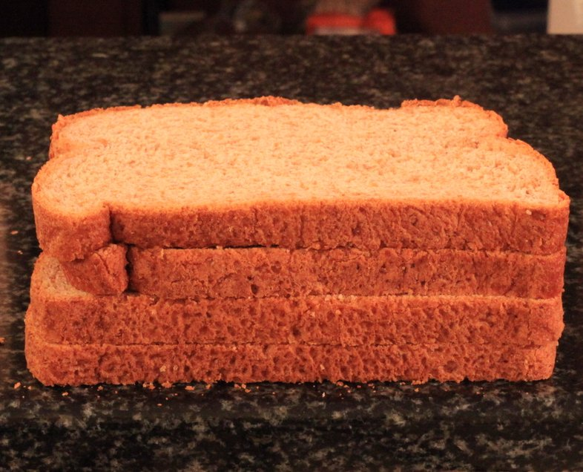

Slide 53
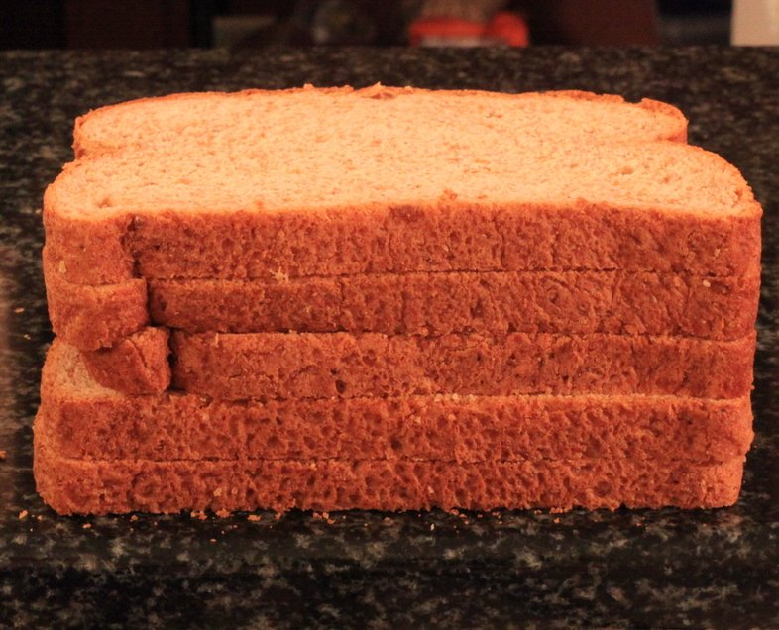

Slide 54
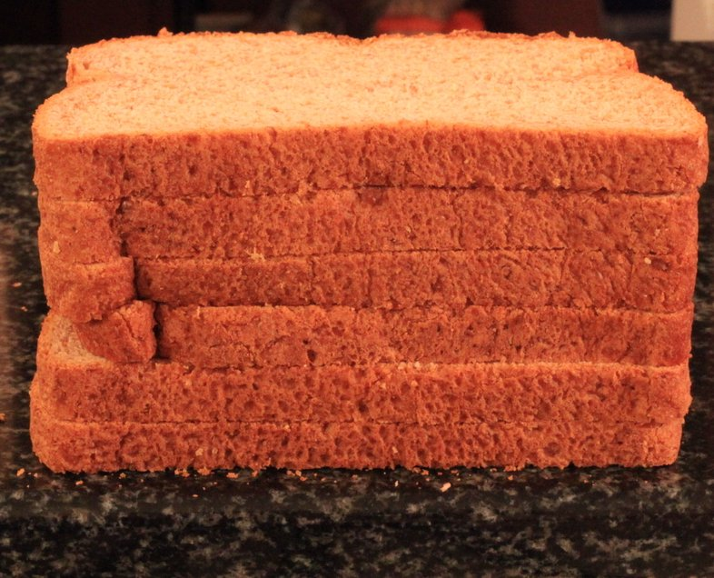

Slide 56
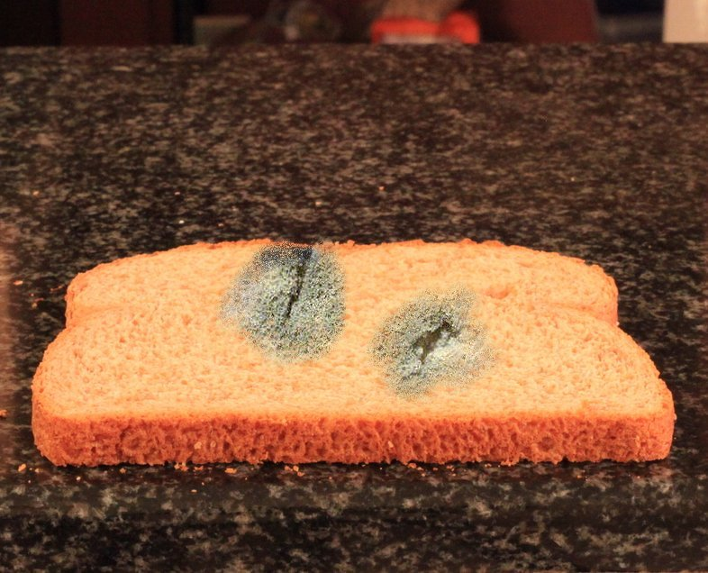

Slide 57
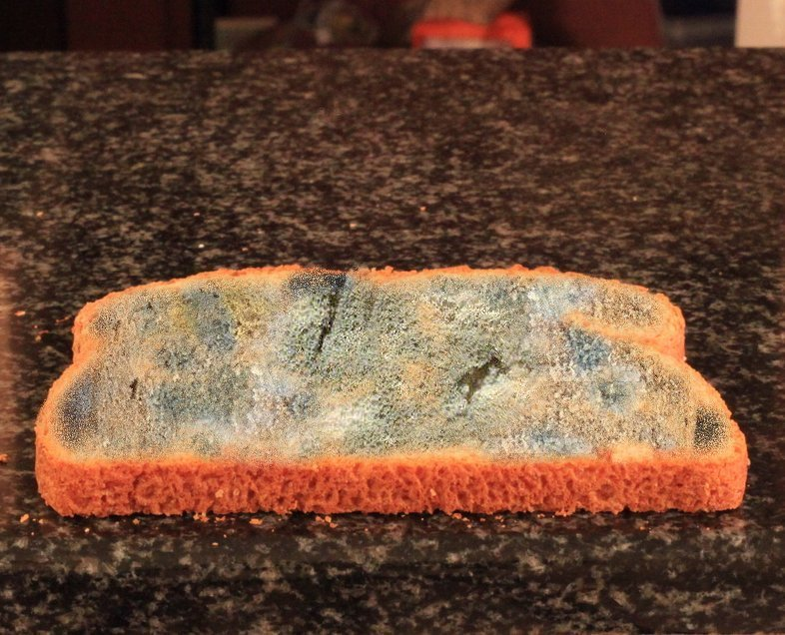

Slide 58
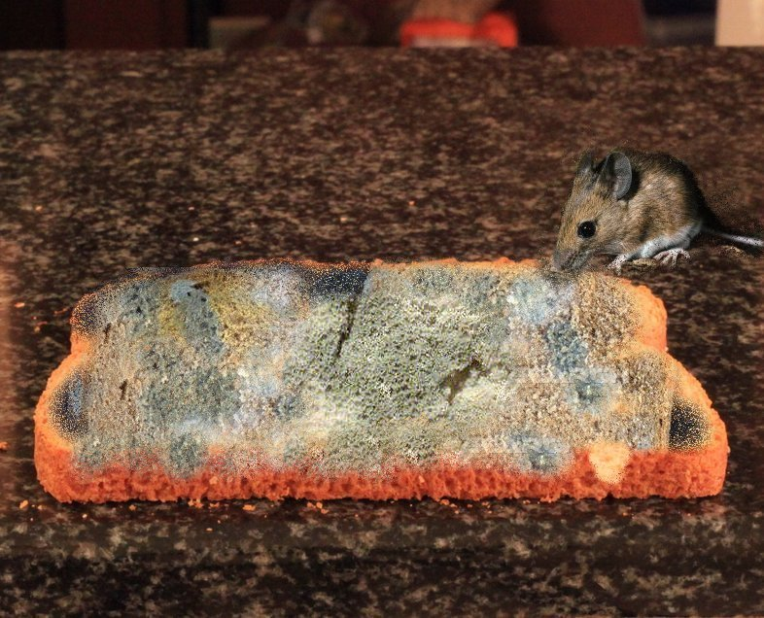

Slide 59
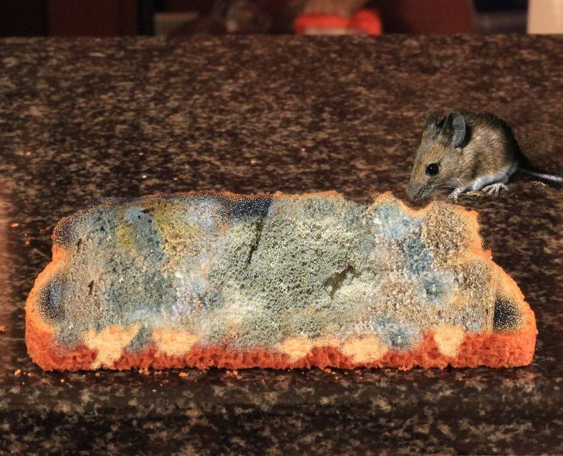

Slide 60
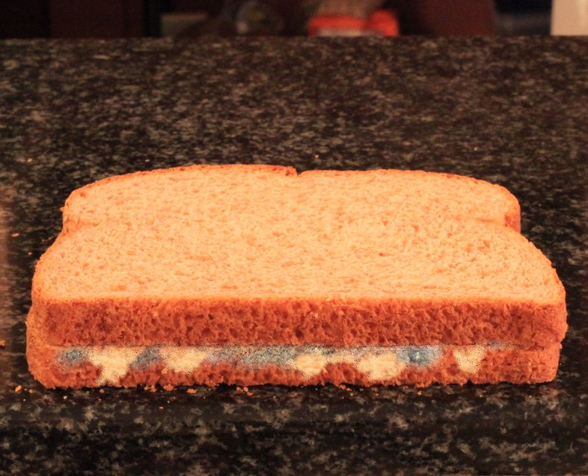

Slide 61
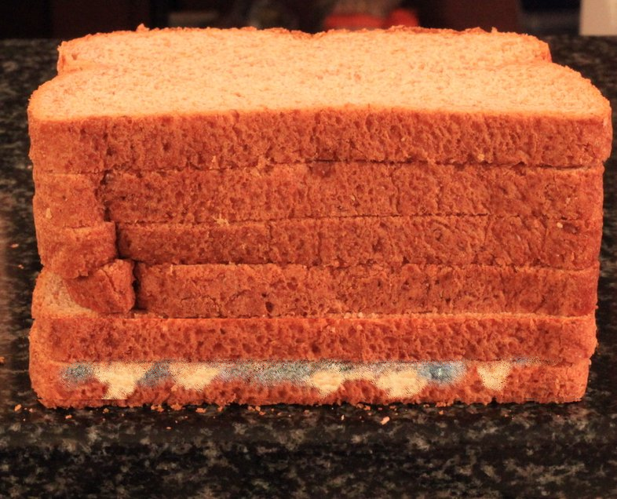

Slide 63
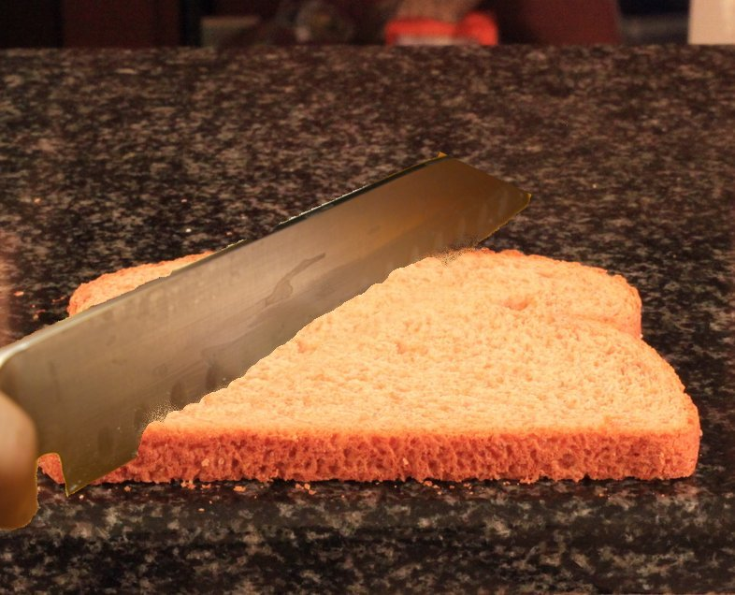

Slide 64
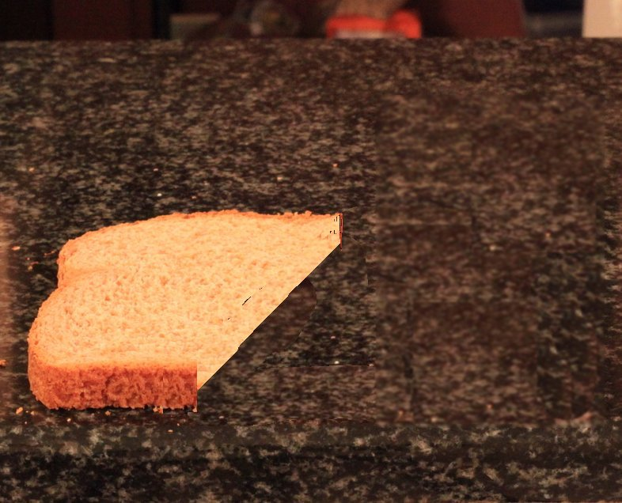

Slide 65
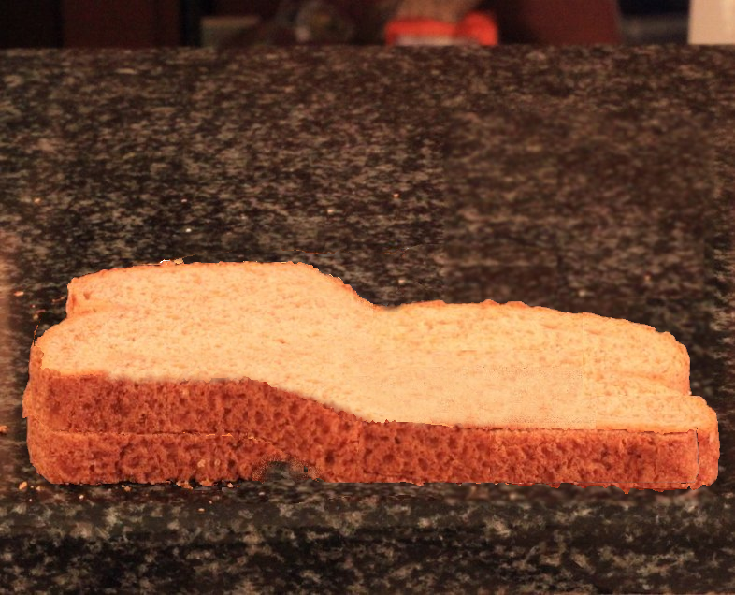

Slide 66
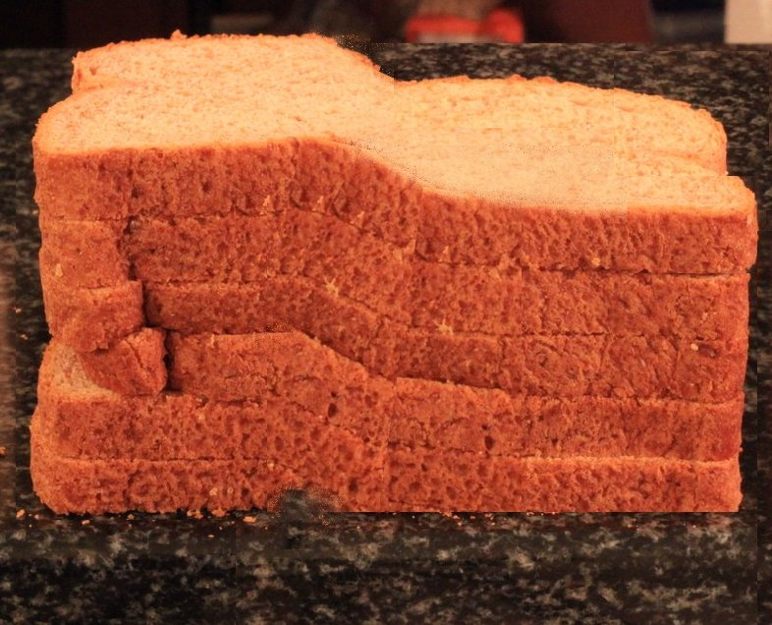

Slide 67
Bioturbation
Why are any sedimentary features preserved in sediments? Bioturbation (sediment recycling by organisms) should eliminate all traces of internal structure in beds.
What do we see?

Slide 68
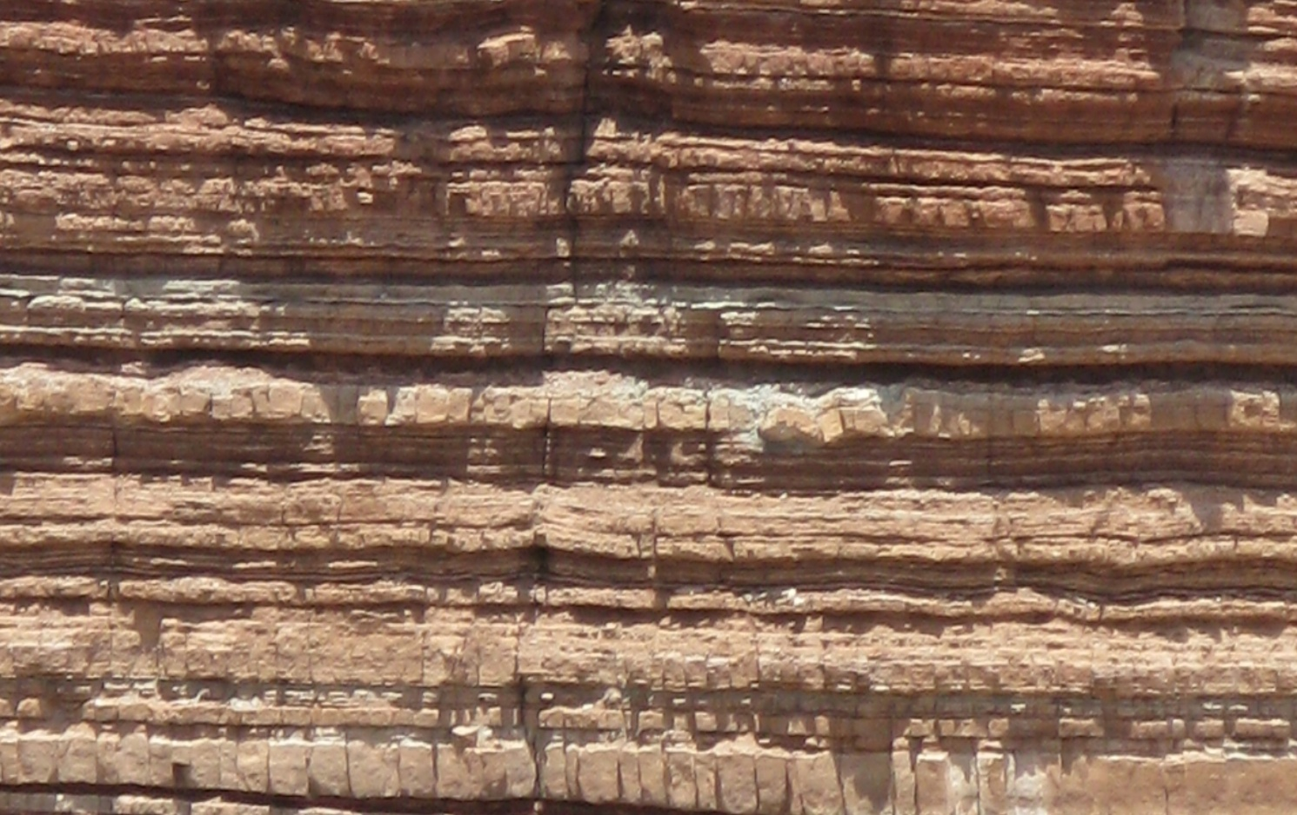

Slide 69
Bioturbation
  Modern observed rates for homogenization are 1 year or less in marine setting.
  How fast do marine invertebrates burrow? Experimental rates indicate complete homogenization of sediments to a depth of 10 cm (about 4 inches) can be achieved in less than an hour under some conditions.*
  *(10,000 deposit feeders per square meter.) M.K. Gingras, S.G. Pemberton, S. Dashtgard, and L. Dafoe. Paleo, Paleo, Paleo. 270:280-286. 2008.

Slide 70
Bioturbation
  Typical rates given for sediment accumulation in rock layers based upon radiometric dates are ~ 10 cm/1000 years
At that rate, all sediments should be thoroughly homogenized and there should be no sedimentary structure anywhere.
Instead, we find homogenized sediments are exceedingly rare in the geologic column.

Slide 71
Bioturbation
“The overall density or degree of bioturbation is a sediment property that has received much attention. 100 per cent bioturbation of the substrate is the natural end product of the activity of the endobenthos. Failure to reach 100 per cent, or the failure of that state to be preserved in the rock record, are conditions that require explanation.”
Bromley, Richard G. 1990. Trace Fossils: Biology and Taphonomy. London: Unwin Hyman. P. 200.

Slide 72
Examples
One section of many we have studied in detail:
  Hurricane Mesa in SW Utah
  Mesozoic sediments of the Moenkopi (Lower Triassic) Formation, Shinarump Conglomerate of the Chinle Formation (Upper Triassic).

Slide 73
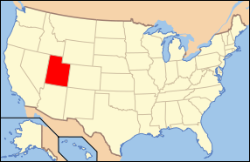
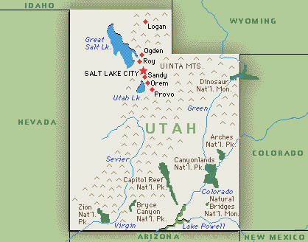
Utah

Slide 74
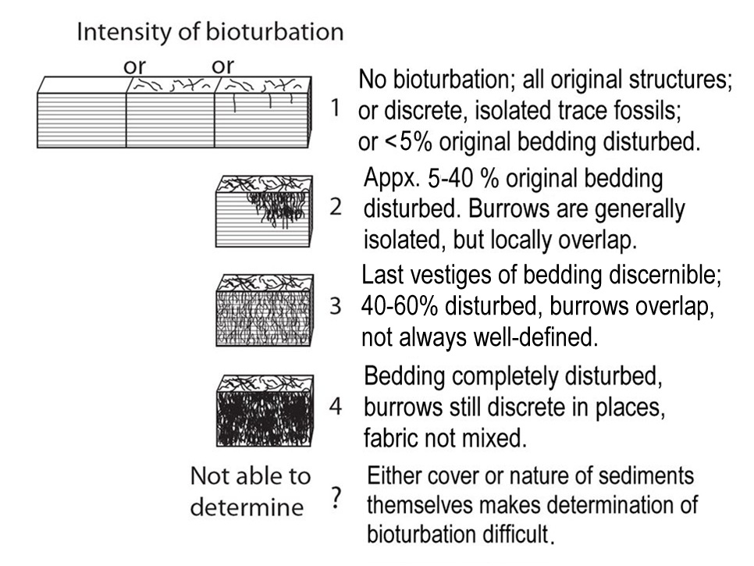

Slide 75
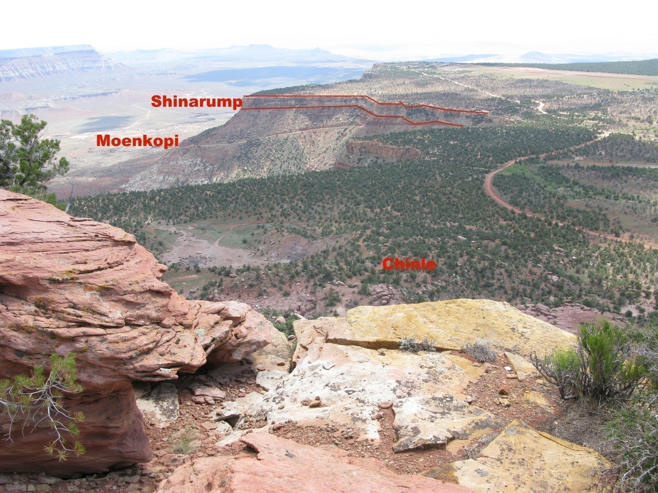

Slide 77
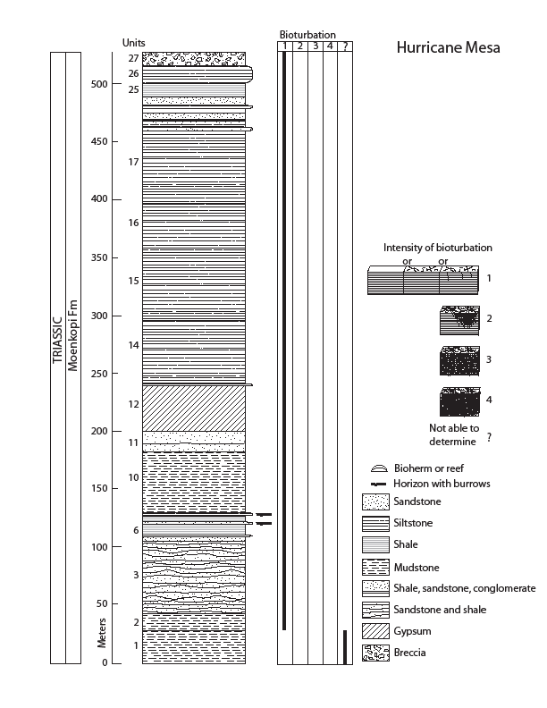

Slide 78
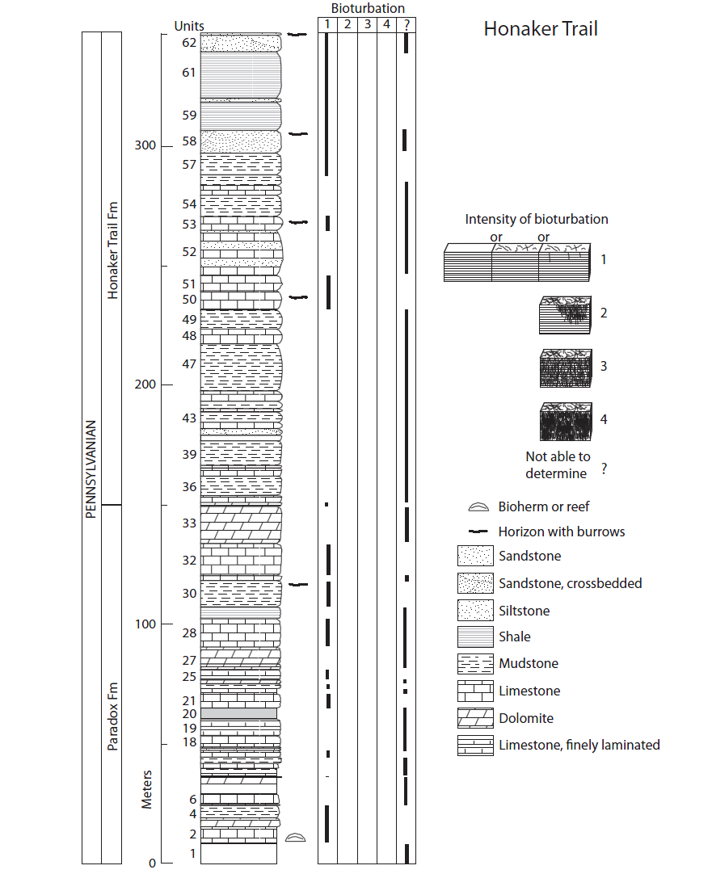

Slide 79
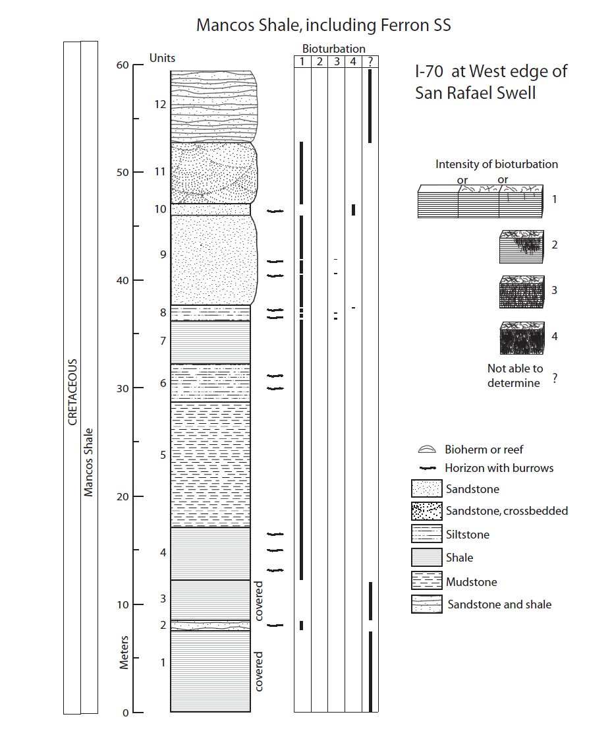

Slide 80
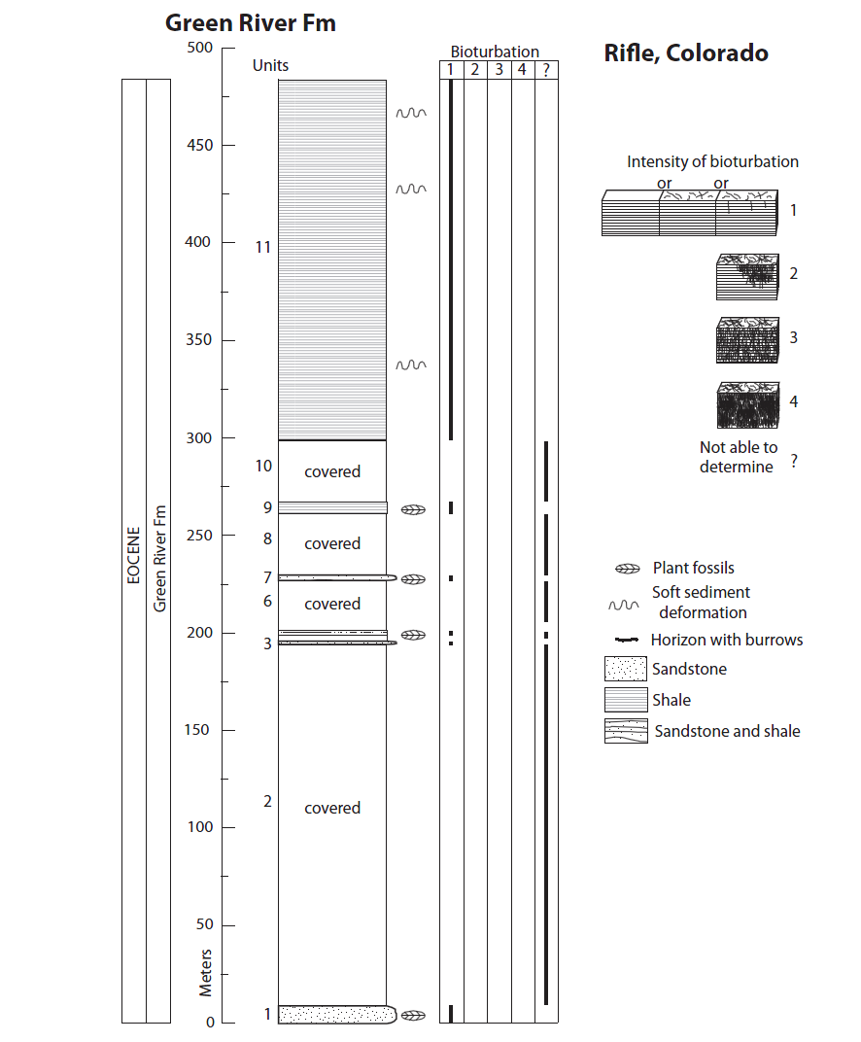

Slide 81
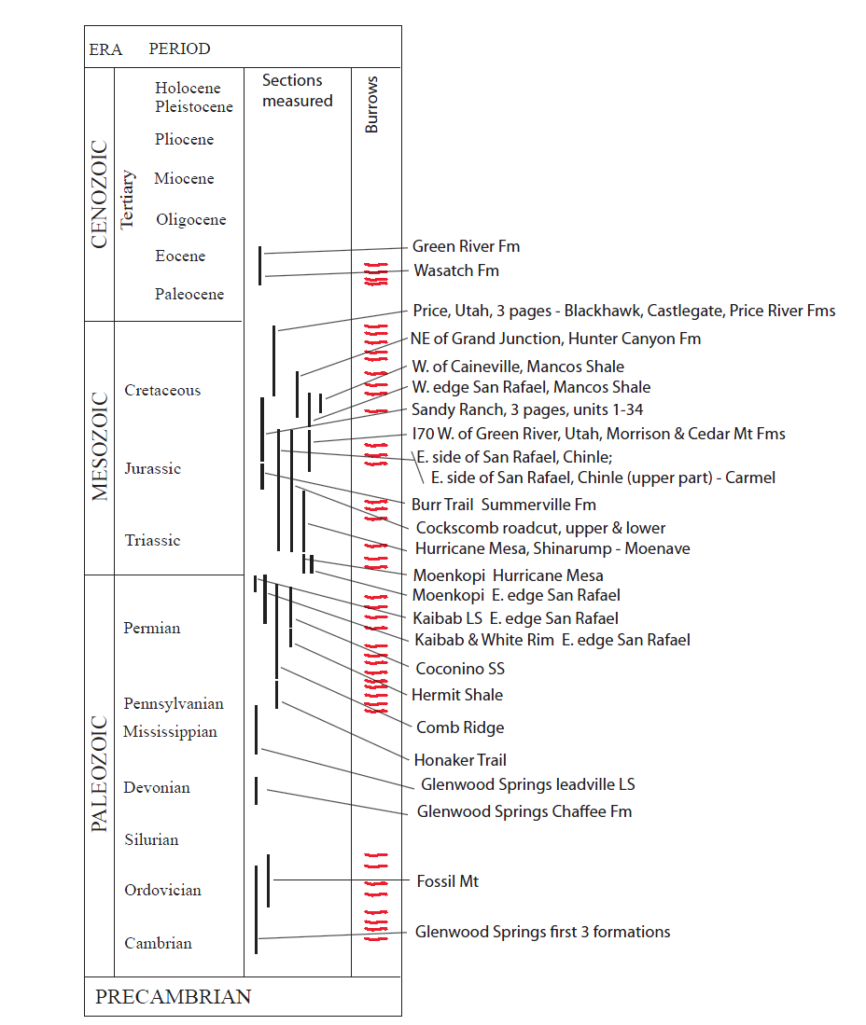

Slide 82
Bioturbation
Only reasonable way to preserve sedimentary features is by rapid deposition and burial, consistent with short time.

Slide 83
Issues in dating
Sediments appear to have accumulated rapidly
Sediments do not appear in equilibrium with the environment.
There is a general lack of erosion in the geologic record
Where radiometric dates are available, the events occurring between dated horizons rarely comport with the radiometric time.
Surviving biomolecules are found far out of possibility for radiometric time.

Slide 84
Erosion - Lack of Evidence for Time
Moenkopi is Lower Triassic
Middle Triassic is missing in the Southwestern U.S.
Moenkopi overlain by Upper Triassic Shinarump conglomerate. Estimated 10-15 million radiometric years between deposition of Moenkopi and Shinarump.
In southern Utah, there is no evidence for the passage of time between the upper Moenkopi and the overlying Shinarump Conglomerate.
Load casts on the base of the Shinarump indicate the Moenkopi was still unconsolidated mud when Shinarump was deposited.

Slide 85
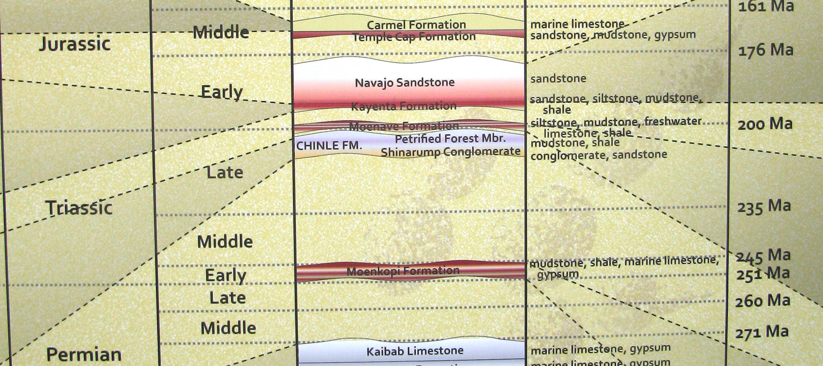
Triassic Stratigraphy in utah
Upper/Late Triassic (Tr3)
Rhaetian | (203.6 ± 1.5 – 199.6 ± 0.6 Mya)
Norian | (216.5 ± 2.0 – 203.6 ± 1.5 Mya)
Carnian - Shinarump in Upper | (228.0 ± 2.0 – 216.5 ± 2.0 Mya)
Middle Triassic (Tr2)
Ladinian | (237.0 ± 2.0 – 228.0 ± 2.0 Mya)
Anisian – Moenkopi (?) | (245.0 ± 1.5 – 237.0 ± 2.0 Mya)
Lower/Early Triassic Moenkopi
Olenekian | (249.7 ± 0.7 – 245.0 ± 1.5 Mya)
Induan | (251.0 ± 0.4 – 249.7 ± 0.7 Mya)

Slide 86
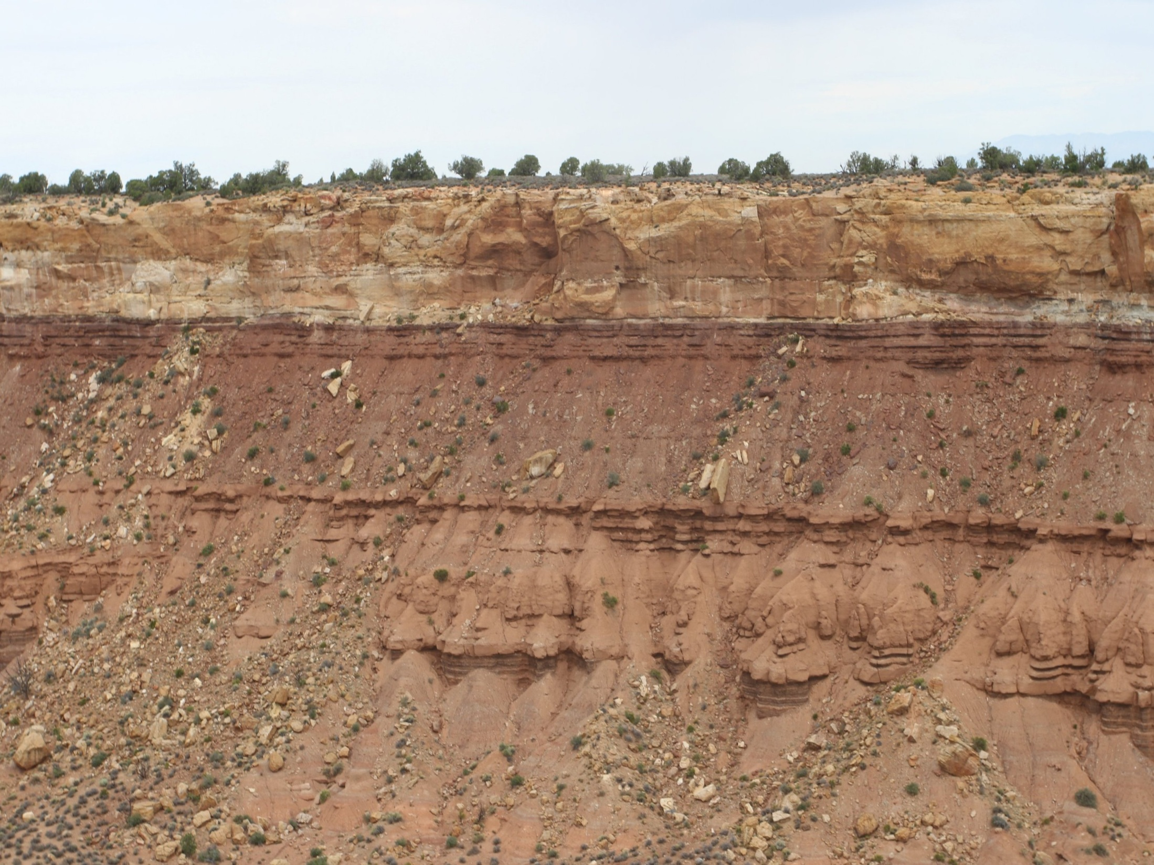
Moenkopi – Shinarump Contact

Slide 87
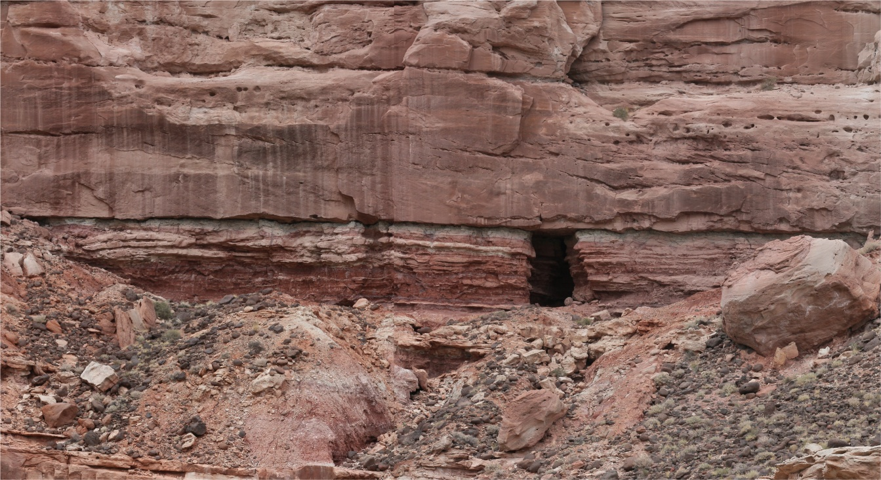
Contact
Shinarump
Moenkopi

Slide 88
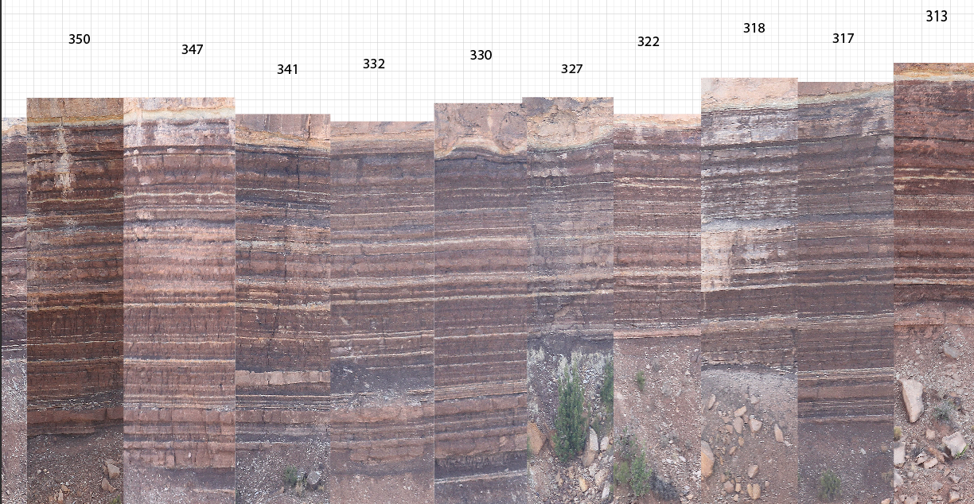
5 km

Slide 89
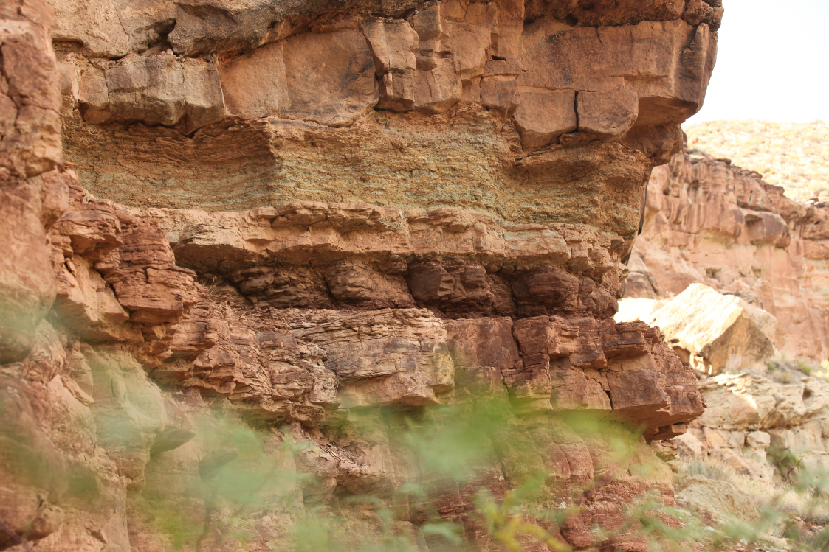
Shinarump
Load casts
Contact
Moenkopi

Slide 90
Episodes of non-deposition
Clearly the Moenkopi did not sit for 15 million years without erosion, or deposition, or lithification.
This is not an isolated example. Frequently, periods of non-deposition are invoked to explain radiometric discrepancies or fossil gaps in the geologic column. The example just considered is minor compared to some such as the Cambrian to Mississippian hiatus in some places in Grand Canyon presumed to represent 140 million years.
These episodes of non-deposition are most readily explained by a model of rapid deposition and burial, consistent with short time.

Slide 91
Erosion – Continents are still here
Erosional Rates
  Modern erosion rates on active margins (California coastline, etc) are .75 to 1.5 ft eastward per year. Similar rates apply on other coasts.
  At this rate, California beaches will be in Florida in less than 15 million years.
  Conservative and realistic rates of continental erosion based on modern erosion rates, suggest all of North America will be eroded to sea level in 10 to 33 million years (latter figure allowing for isostatic rebound)*.
  *Gilluly, James, 1955, Geologic contrasts between continents and ocean basins : Geol. Soc. America Special Paper 62, p. 7-18.

Slide 92
Erosion – Continents are still here
  Current erosion rates determined by a wide variety of indicators would have North America eroded to sea level many times in 600 million radiometric years that life is supposed to have been on the earth
  Has not happened even once – the presence of the geologic column in many places in North America and around the world evidences this.
  Most easily explained in short time

Slide 93
Issues in dating
Sediments appear to have accumulated rapidly
Sediments do not appear in equilibrium with the environment.
There is a general lack of erosion in the geologic record
Where radiometric dates are available, the events occurring between dated horizons rarely comport with the radiometric time.
Surviving biomolecules are found far out of possibility for radiometric time.

Slide 94
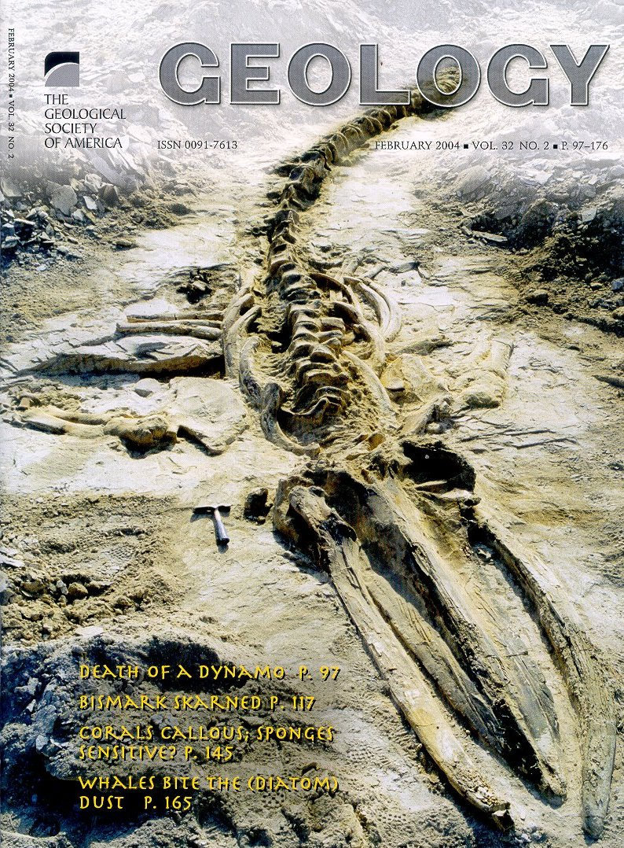

Slide 95
Issues in dating
The Miocene–Pliocene Pisco Formation, 350 km south of Lima, Peru, is a diatomaceous, tuffaceous deposit 200–1000 m thick that was deposited in shallow bays over a span of 10–12 m.y., as calibrated by K-Ar (De Muizon and DeVries, 1985; Dunbar et al., 1990). It also contains abundant whales and other vertebrates. If the sedimentation rate was relatively constant over 10–12 m.y. during deposition of the Pisco Formation, the diatomaceous sediment accumulated at 10 cm/k.y., which is consistent with other accumulation rates reported here. If these average rates of accumulation pertained through the fossiliferous portions of the diatomaceous sediment, however, it would have taken thousands of years to bury an individual whale. However, the whales are too well preserved for such slow burial processes. Our research addressed the relationship between the depositional rate and the preservation of the whales.

Slide 96
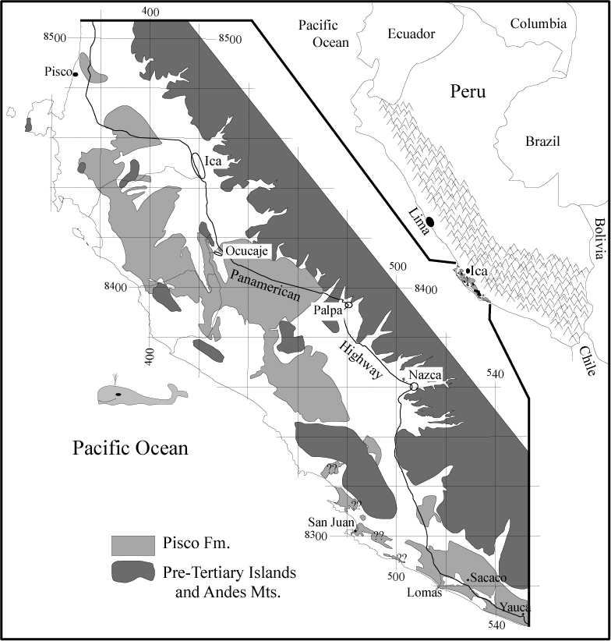
Our Principal Research Areas

Slide 97
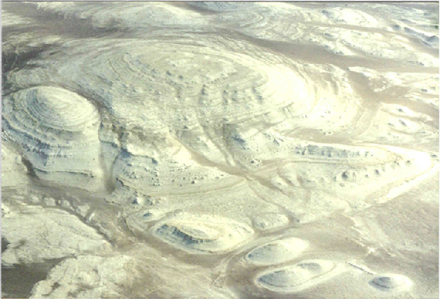
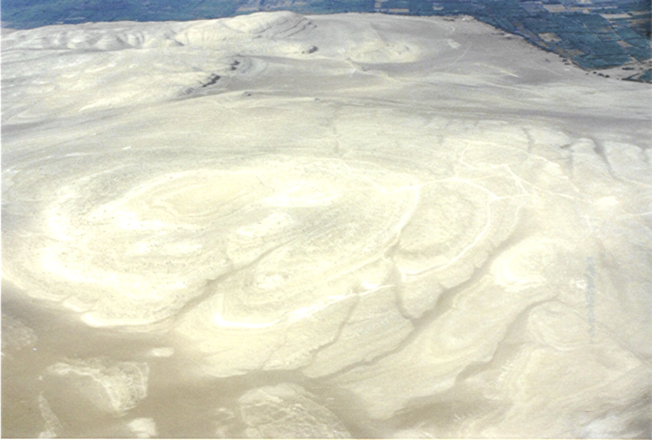

What Do We Find?
Cerro Queso Grande
North Cerro Blanco
Cerro Queso Grande

Slide 98


WCBA-20 (“Fernanda”)
Baleen preserved
Shark teeth associated, but no shark tooth marks on bones
No evidence of bioturbation in the associated sediments
Completely articulated
Upside down
Both flippers preserved

Slide 99


Whale WCBa-32 (“Carmen”)
Upside down
Completely articulated
Shark teeth associated, but no shark tooth marks on bones
One limb missing

Slide 100

Aerial Distribution of Fossil Whales in Northern Cerro Blanco
N= 346 whales

Slide 101

Aerial Distribution of Fossil Whales at Cerro Queso Grande
N= 69 whales

Slide 102

Vertical Distribution of Fossil Whales at All Sites
As a result of last summer’s research, we now know that this interval also contains abundant fossil whales

Slide 103


Preservation of Baleen
Five specimens with their baleen plates were found

Slide 104




Examples of Baleen Plates of Fossil Whales
WCBa-20
W-403
WC-33
baleen
WCBa-343

Slide 105


Z53 CETOT
baleen

Slide 106

whale
~40cm
Baleen Plates
IC-23
And 8 more whales in a 50 m radius

Slide 107


IC-23
Baleen of a modern specimen

Slide 108


Since baleen is made of keratin it does not long as bone when the animal dies and decays.
The occurrence of baleen plates preserved indicates that rapid burial had to happen.
WCBa-20

Slide 109

DEPOSITIONAL ENVIRONMENT

Slide 110
Conclusions
[...Several lines of evidence seem to allow the possibility that the Pisco Formation diatomaceous sediment accumulated more rapidly than commonly occurs today. For example, Pisco Formation diatom frustules do not show evidence of dissolution, perhaps because, in the relatively shallow water, they accumulated too rapidly to dissolve. Sedimentary structures also indicate tidal current action and storms, which could have acted to concentrate diatoms in the shallow bays along the Peruvian coast. The well-preserved whale carcasses seem to require rapid burial, within weeks to months for any given whale, to account for their preservation and articulation, including fossilization of some nonbony tissues. This necessity of rapid burial indicates that, at times in the past, diatom accumulation rates were much higher than those typical in modern oceans. […]

Slide 111
Issues in dating
Sediments appear to have accumulated rapidly
Sediments do not appear in equilibrium with the environment.
There is a general lack of erosion in the geologic record
Where radiometric dates are available, the events occurring between dated horizons rarely comport with the radiometric time.
Surviving biomolecules are found far out of possibility for radiometric time.

Slide 112
“Ancient” DNA and Protein
Recently have numerous claims of DNA, proteins, and even tissues from fossils and live bacteria reported to be tens or hundreds of millions of years old.
Authors generally claim “Wow, DNA and proteins must be able to survive for a long time!”
Very compelling reasons to think they are wrong.

Slide 113

Research on Banks Island
High Arctic Canada

Slide 114
DNA Longevity: the issue
Cytosine, one of the four chemical compounds comprising DNA, is most labile and breaks down in a predictable manner over a finite interval, altering the structure of DNA.
Half-life (time required to destroy half of the cytosine) for cytosine in a DNA molecule, is about 200 years at room temperature. Even at frozen temperatures half-life of cytosine is about 17,000 years. The probability of finding intact DNA after 10 half lives is nil.
If fossil deposits older than Recent (since last glacial retreat) contain intact DNA, they must be very much younger than the value assigned based on radiometric dating and fossil correlation.

Slide 115
DNA Longevity: the challenge
High Arctic Canada has deposits with a variety of assigned geologic ages frozen in permafrost at least since the last glacial advance of the Pleistocene, that contain fossil plant materials that appear to be unaltered or very slightly altered from their fresh condition.
These observations will enable us to test the hypothesis that these fossil arctic peat deposits are thousands, and not tens of millions of years old. If the fossils do contain DNA, then the probability that radiometric dating is yielding information other than real time would rise significantly.

Slide 116

g
4.7
g
17.1
Notes:
Red arrows designate the Ballast Brook formation (17.1) and the Beauford formation (4.7)

Slide 117

Banks Islandg

Slide 118

Banks Islandg
Inuvik
Notes:
Inuvik was our starting place, the end of the Dempster Highway, the northernmost road in Canada. We flew here and joined Lee and Lucy who had driven.

Slide 119

B
Ballast Brook
g
Sach’s Harbor
Notes:
Our goal was the Ballast Brook at the northern most tip of Banks Island. So far north that in the summer the sun is high in the sky 24 hours a day and magnetic compasses do not work at all.

Slide 120

Arctic Ocean
f Ballast Brook
Our Campsite g
Notes:
Ballast Brook flows in a mile wide valley as a braided river system. Although the rivers are relatively shallow (knee high was as deep as we encountered) they flow very fast.

Slide 121

Notes:
Our valley showing the braided river system east of camp.

Slide 122

Notes:
We are on our own until July 19 or whenever after that the weather and their scheduling allows.

Slide 123

Notes:
Our camp a few hours later. With 24 hours of sunlight there was no reason to goto bed!

Slide 124

“Facilities”
Camp
i
i
Notes:
Bathroom facilities were required since we had two women with us. No trees, no hills, just a blue plastic tarp strung between a fuel barrel and a deer cart.

Slide 125

Notes:
Our camp the first morning!

Slide 126

Notes:
Wolf track leading away from our camp. We attributed the lack of interest in us to our vegetarian fare.

Slide 127

Notes:
Wolf covered with ice.

Slide 128

Notes:
Small herd of muskox on rim of canyon across river.

Slide 129

Notes:
Probably the most dangerous animal in the arctic, this male ox was surprised by us and instead of running he put on a show of aggression. We held our ground but did not offer any further signs of hostility. After fuming, growling, pawing and sharpening his horns for about 10 minutes, he finally slowly made his way for a distance then took off at a full run.

Slide 130

Notes:
Each group leaving camp was required to have at least two people and a gun, in this case a 12 gauge with slugs.

Slide 131

Notes:
Ordeal every morning was putting on waders to cross five or more rivers. Most had flow velocities that made crossing particularly hazardous. Often you had to shuffle feet along the bottom to keep from being swept away.

Slide 132

Notes:
Looking across slope along peat layer to a site where we are prospecting for cones.

Slide 133

Notes:
Heston digs to expose frozen layer in peat. Note near vertical slope in mud. We had to cut places to stand.

Slide 134

Notes:
Huge lof fallen from wood debris dam in Beauford Fm.

Slide 135

Notes:
Massive amounts of woody debris cascading down the slope.

Slide 136

Notes:
Note huge amounts of woody plant debris protruding from the peat. Here and elsewhere permafrost layer is just below the surface.

Slide 137

Notes:
Compressed cones extracted from permafrost peat layer

Slide 138

Notes:
A spruce cone from the peat layer. Notice how the lower bracts have started to open as the cone dries.

Slide 139

Notes:
He permafrost shown here a few inches in from the surface.

Slide 140

Notes:
Removing a block of frozen (permafrost) peat consisting of wood and plant parts.

Slide 141


fb_menu_settings_dropdown="nul" clickboundfb_menu_settings_dropdown="null">
Notes:
Two sides of a block of peat cut from permafrost layer with a chain saw

Slide 142

Notes:
Trunk of a tree that is probably the only standing tree on the island. It may have been dead for thousands of years. We took a sample to date.

Slide 143

Notes:
Trunk of a tree that is probably the only standing tree on the island. It may have been dead for thousands of years. We took a sample to date.

Slide 144

Notes:
Huge rock embedded in laminated sediments filled with pine needles

Slide 145
Conclusion
Sedimentology indicates by rates of deposition, general absence of bioturbation or interstratal erosion, absence of evidence for time between units and by other features that radiometrically determined time is not giving us correct values for real time. The survival of biomolecules far beyond experimental values likewise challenges the radiometrically-determined dates.
The meaning of radiometrically-determined time should be reevaluated.

Slide 147

Whale evolution
Mesonychid: Robert Carroll - “[i]t is not possible to identify a sequence of mesonychids leading directly to whales,” This statement understate the problem.[10] It is not even possible to identify a single ancestral species. All known mesonychids are excluded from the actual chain of descent by the paleontologists’ own criteria.
Pachycetus: Gingerich - ‘In time and in its morphology, Pakicetus is perfectly intermediate, a missing link between earlier land mammals and later, full-fledged whales.’
de Muizon - ‘All the postcranial bones indicate that pakicetids were land mammals, and … indicate that the animals were runners, with only their feet touching the ground.’
Robert L. Carroll, Patterns and Processes of Vertebrate Evolution (Cambridge: University Press, 1997), 329.
Gingerich, P.D., The whales of Tethys, Natural History, p. 86, April 1994.
de Muizon, C., Walking with whales, Nature 413(6853):259–260, 20 Sep. 2001.

Slide 148
Richard Dawkins on “Junk DNA”
Before ENCODE: “Pseudogenes are genes that once did something useful but have now been sidelined and are never transcribed or translated. They might as well not exist, as far as the animal's welfare is concerned. But as far as the scientist is concerned they very much exist, and they are exactly what we need for an evolutionary clock. .. . . What pseudogenes are useful for is embarrassing creationists. It stretches even their creative ingenuity to make up a convincing reason why an intelligent designer should have created a pseudogene --a gene that does absolutely nothing and gives every appearance of being a superannuated version of a gene that used to do something, unless he was deliberately setting out to fool us."
Dawkins then continues: "Leaving pseudogenes aside, it is a remarkable fact that the greater part (95 percent in the case of humans) of the genome might as well not be there, for all the difference it makes." The Greatest Show on Earth, 2009, pp 332-333.
After ENCODE: "I know there are some creationists who have jumped on it because they think it is awkward for Darwinism. Quite the contrary, of course. It is exactly what a Darwinist would hope for -- is to find usefulness in the living world."

Slide 149
“Pseudogenes are not pseudo any more
“The study of functional pseudogenes is just at the beginning. There remain many questions to be addressed, such as the regulatory elements controlling the cell or tissue specific expression of pseudogenes. But, definitely, the so-called pseudogenes are really functional, not to be considered any more as just “junk” or “fossil” DNA. Surely, many functional pseudogenes and novel regulatory mechanisms remain to be discovered and explored in diverse organisms.”
Wen et al, RNA Biology 9:27-32. Jan 2012

Slide 150
Richard Dawkins on “Designed”
“Its terribly terribly tempting to use the word designed, time and again I have to bite my tongue, and stop myself. [...] when talking to other biologists, we none of us bother to bite our tongues, we just use the word designed.“
Richard Dawkins, Waking up in the Universe, 1991 Royal Institution Christmas Lecture; 2nd lecture - Designed and designoid objects.

Slide 151
Prothero on stasis
The first major discovery was that stasis was much more prevalent in the fossil record than had been previously supposed. […]. If species didn’t appear suddenly in the fossil record and remain relatively unchanged, then biostratigraphy would never work—and yet almost two centuries of successful biostratigraphic correlations was evidence of just this kind of pattern. As Gould put it, it was the “dirty little secret” hidden in the paleontological closet. Most paleontologists were trained to focus on gradual evolution as the only pattern of interest, and ignored stasis as “not evolutionary change” and therefore uninteresting, to be overlooked or minimized. Once Eldredge and Gould had pointed out that stasis was equally important (“stasis is data[sic]” in Gould’s words), paleontologists all over the world saw that stasis was the general pattern, and that gradualism was rare—and that is still the consensus 40 years later.

Slide 152
Prothero on stasis
In my dissertation on […]fossil mammals […], I had over 160 well-dated, well-sampled lineages of mammals, so I could evaluate the relative frequency of gradualism versus stasis in an entire regional fauna. I also had a wide geographic spread […]. I had large fossil samples of many species, with dozens at each level, and excellent stratigraphic data. When I finally plunged in and plotted and analyzed my data carefully, it was clear that nearly every lineage showed stasis, with one minor example of gradual size reduction in the little oreodont Miniochoerus. I could point to this data set and make the case for the prevalence of stasis without any criticism of bias in my sampling. More importantly, the fossil mammals showed no sign of responding to the biggest climate change of the past 50 million years […]. In North America, dense forests gave way to open scrublands, crocodiles and pond turtles were replaced by land tortoises, and the snails changed from those typical of Nicaragua to those of Baja California. Yet out of all the 160 lineages of mammals in this time interval, there was virtually no response.

Slide 153
Prothero on stasis
After six years of work and publication, the conclusion is clear: none of the common Ice Age mammals and birds responded to any of the climate changes at La Brea in the last 35,000 years, even though the region went from dry chaparral to snowy piñon-juniper forests during the peak glacial 20,000 years ago, and then back to the modern chaparral again.
In four of the biggest climatic-vegetational events of the last 50 million years, the mammals and birds show no noticeable change in response to changing climates. No matter how many presentations I give where I show these data, no one (including myself) has a good explanation yet for such widespread stasis despite the obvious selective pressures of changing climate. Rather than answers, we have more questions—and that’s a good thing! Science advances when we discover what we don’t know, or we discover that simple answers we’d been following for years no longer work.

Slide 154
evolutionary relationships priapulids (group of marine worms)
See http://www.sciencedaily.com/releases/2012/10/121009092533.htm.
Excerpt: He explained: "The fossils from the Cambrian period can cause a real headache for evolutionary biologists. Instinct tells us to expect simple organisms evolving over time to become increasingly more complex. However during the Cambrian period there was an apparent explosion of different major groups of animals, all appearing simultaneously in the fossil record. We looked at priapulid worms, which were among the first ever predators. What's remarkable is that they had already evolved into a diverse array of forms -- comparable to the morphological variety of their living cousins -- when we first encounter them in the Cambrian fossil record. It's precisely this apparent explosion of anatomical diversity that vexed Darwin and famously attracted the attention of Harvard biologist Stephen Jay Gould."
Dr Ruta, from the School of Life Sciences at the University of Lincoln, continued: "Our work has shown that despite many new fossil finds, including many from China in the last decade, the picture remains largely unchanged.

Slide 155
New Fossils Suggest Ancient Origins of Modern-Day Deep-Sea Animals
A collection of fossil animals discovered off the coast of Florida suggests that present day deep-sea fauna like sea urchins, starfish and sea cucumbers may have evolved earlier than previously believed and survived periods of mass extinctions similar to those that wiped out the dinosaurs.
Previously, researchers believed that these present-day animals evolved in the relatively recent past, following at least two periods of mass extinction caused by changes in their oceanic environment. The new fossil collection described in this study predates the oldest known records of the present-day fauna. "We were amazed to see that a 114 million year old deep-sea assemblage was so strikingly similar to the modern equivalents," says lead author Ben Thuy.
According to the authors, this evidence shows that the ancestors of modern deep-sea animals have lived in these deep waters for much longer than previously thought. That this collection of fossils appears to have survived several drastic changes in oceanic climates also suggests that deep-sea biodiversity may be more resilient than shallow-water life forms, and more resistant to extinction events than previously thought.
Thuy B, Gale AS, Kroh A, Kucera M, Numberger-Thuy LD, et al.. Ancient Origin of the Modern Deep-Sea Fauna. PLoS ONE, 2012 DOI: 10.1371/journal.pone.0046913

Slide 156
The half-life of DNA in bone: measuring decay kinetics in 158 dated fossils
Claims of extreme survival of DNA have emphasized the need for reliable models of DNA degradation through time. By analysing mitochondrial DNA (mtDNA) from 158 radiocarbon-dated bones of the extinct New Zealand moa, we confirm empirically a long-hypothesized exponential decay relationship. The average DNA half-life within this geographically constrained fossil assemblage was estimated to be 521 years for a 242 bp mtDNA sequence, corresponding to a per nucleotide fragmentation rate (k) of 5.50 ! 10–6 per year. With an effective burial temperature of 13.1°C, the rate is almost 400 times slower than predicted from published kinetic data of in vitro DNA depurination at pH 5. Although best described by an exponential model (R2 = 0.39), considerable sample-to-sample variance in DNA preservation could not be accounted for by geologic age. This variation likely derives from differences in taphonomy and bone diagenesis, which have confounded previous, less spatially constrained attempts to study DNA decay kinetics. Lastly, by calculating DNA fragmentation rates on Illumina HiSeq data, we show that nuclear DNA has degraded at least twice as fast as mtDNA. These results provide a baseline for predicting long-term DNA survival in bone.
Proceedings of the Royal Society B: Biological Sciences (2012). Published online before print October 10, 2012, doi:10.1098/rspb.2012.1745.

Slide 157

Correlations between age and DNA preservation

Slide 158
New finding affects understanding of formation of the solar system
March 29, 2012
A global collaboration including five University of Notre Dame researchers has revised the half-life of samarium-146 (146Sm), reducing it to 68 million years from 103 million years. Their finding is published in the journal Science today

Slide 159
“Absolute” dating
“At present, physical dates do not stand on their own. They must be compatible with stratigraphy. Stratigraphy has also served to highlight flaws and the relevance of unexpected factors in some physical procedures. So-called absolute dating is a misnomer, for physical dates provide numerical approximations, preferably considered within and constrained by a stratigraphic framework”
''Canons'' revisited and reviewed: Lester King's views of landscape evolution considered 50 years later. C. R. Twidale. Geological Society of America Bulletin 2003;115, no. 10;1155-1172

