Slide 1
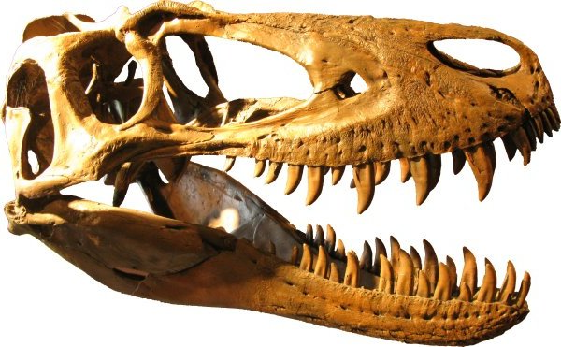
Taphonomy of a Large Upper Cretaceous Dinosaur Bonebed in Northeastern Wyoming
A. Chadwick and K. Snyder

Slide 2
Bonebed in the Lance Formation
Edmontosaurus dominated bone beds are widespread in Upper Cretaceous.
Lance Formation not officially covered.
This work is an effort to fill that gap using the taphonomic history of this bonebed to explore the paleobiology and social structure of these amazing creatures – 10 – 15 meters long, 3000 kg.
Considering over 22,000 elements recovered over a 20 year period.
Hope is this will broaden the discussion of Edmontosaurus and gain insight into the complexity of catastrophic death assemblages
Notes:
Dinosaur Park, Horseshoe Canyon, Two Medicine, Hell Creek, Prince Creek and Lance Creek
Christians 1992, Colson tangentially 2004, Sternberg 1970, Tedesco 1997, Chadwick et al 2006 and Weeks 2016

Slide 3
Depositional history
Lance is deposited on western margin of Western Interior Seaway.
Westerly source for sediments and paleocurrent data indicate Powder River Basin not yet a factor
Sediments in study area are poorly indurated black mudstones and claystones and tan to white fine grained lithic sandstones.
Bonebed in eastern limb of the PR syncline in the mid to upper part of the Lance.
Westward dip of 1-3 degrees and absence of dependable stratigraphic markers and wild variations in lithology necessitate estimating stratigraphic position of bed in Lance.

Slide 4
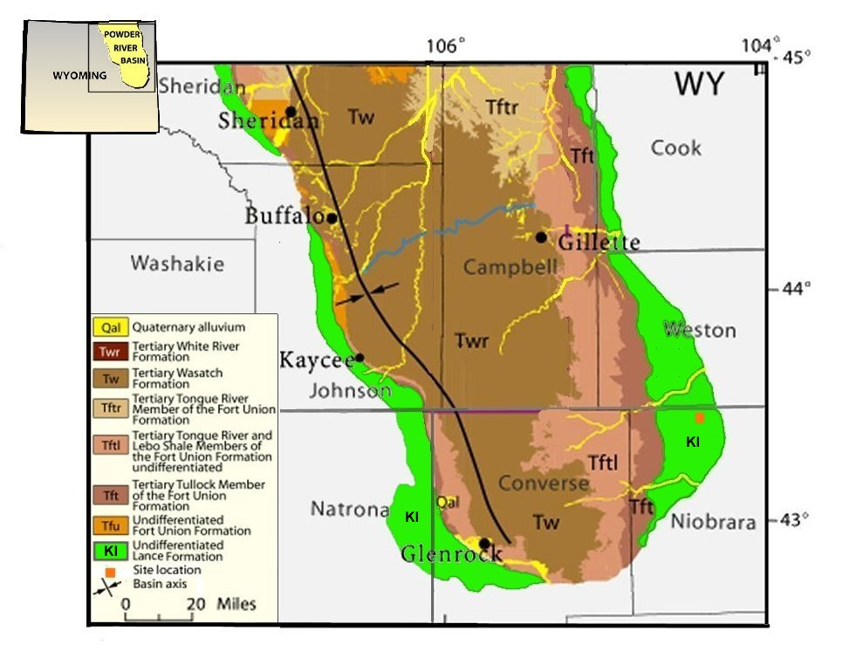
Together with the Fox Hills, the Lance attains a thickness
f
Notes:
Uppermost deposit of the PRB Underlain by Fox Hills and overlain by Ft. Union
Together with the Fox Hills, the Lance attains a thickness in excess of 1 km in southern part of the basin

Slide 5
Our Project
Initiated in 1996
Cooperative project sponsored by
  Earth History Research Center
  Southwestern, Southern Adventist University
  Hanson Research Station
Current operations at Hanson Research Station in Wyoming in June and from July to June in Texas at Southwestern Adventist University where preparation, curation and analysis take place.

Slide 6
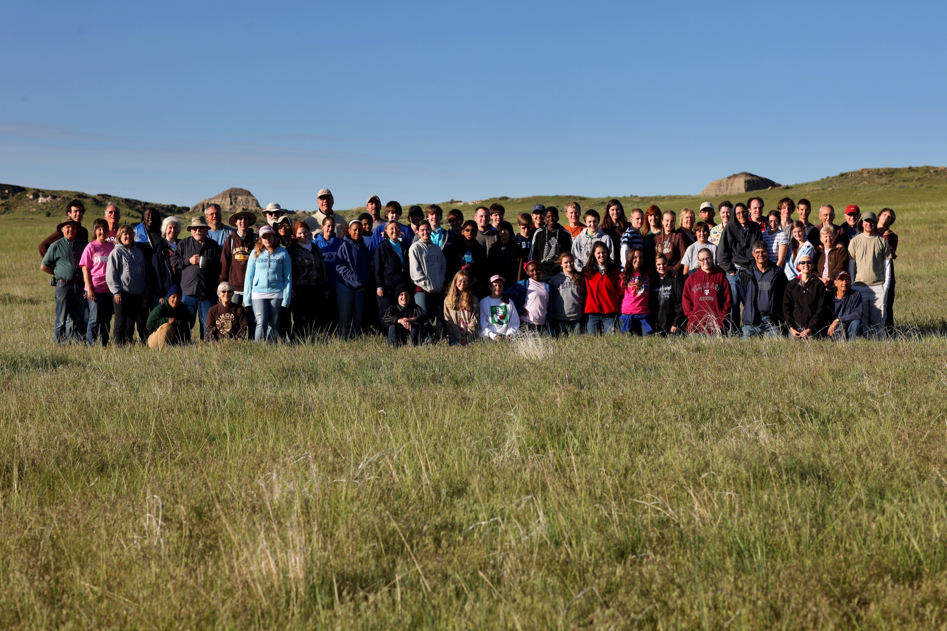
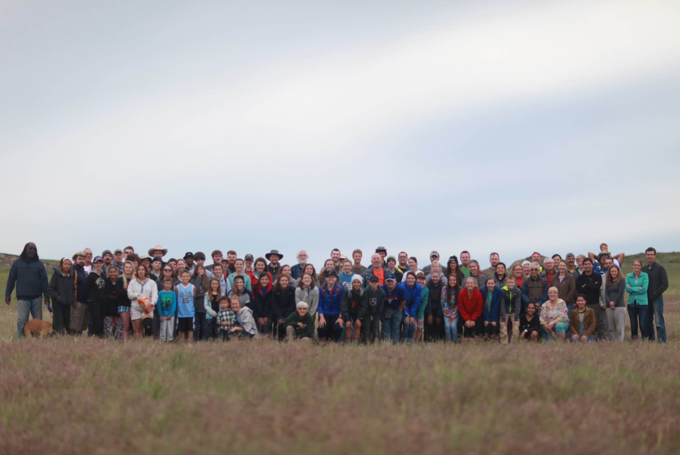
91 of 133 participants
June 2015

Slide 7
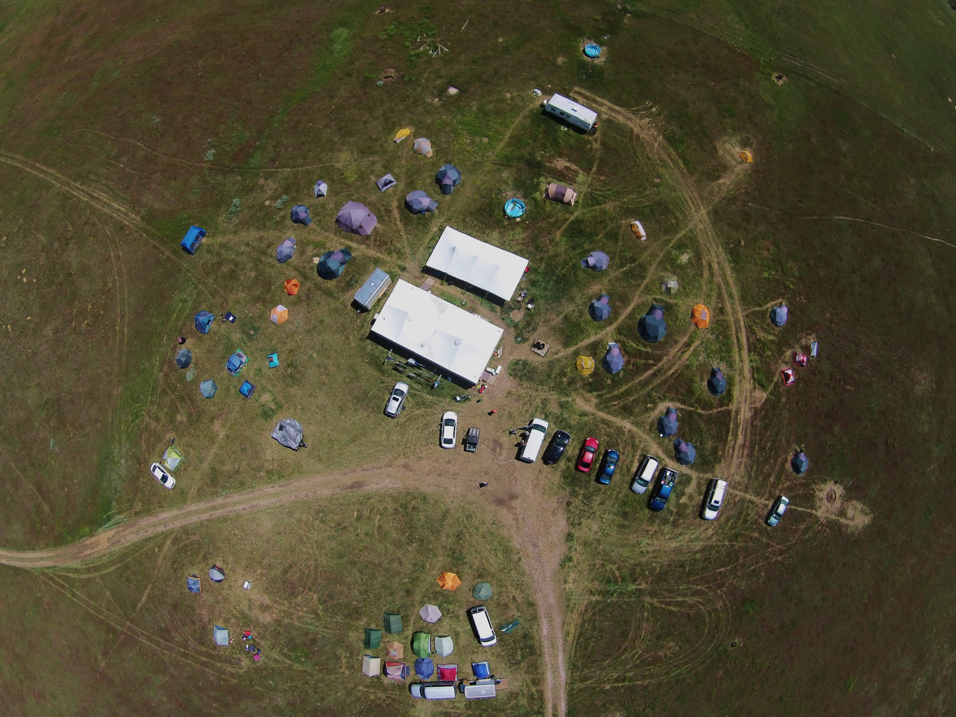
Hanson Research Station from 1000 feet

Slide 8
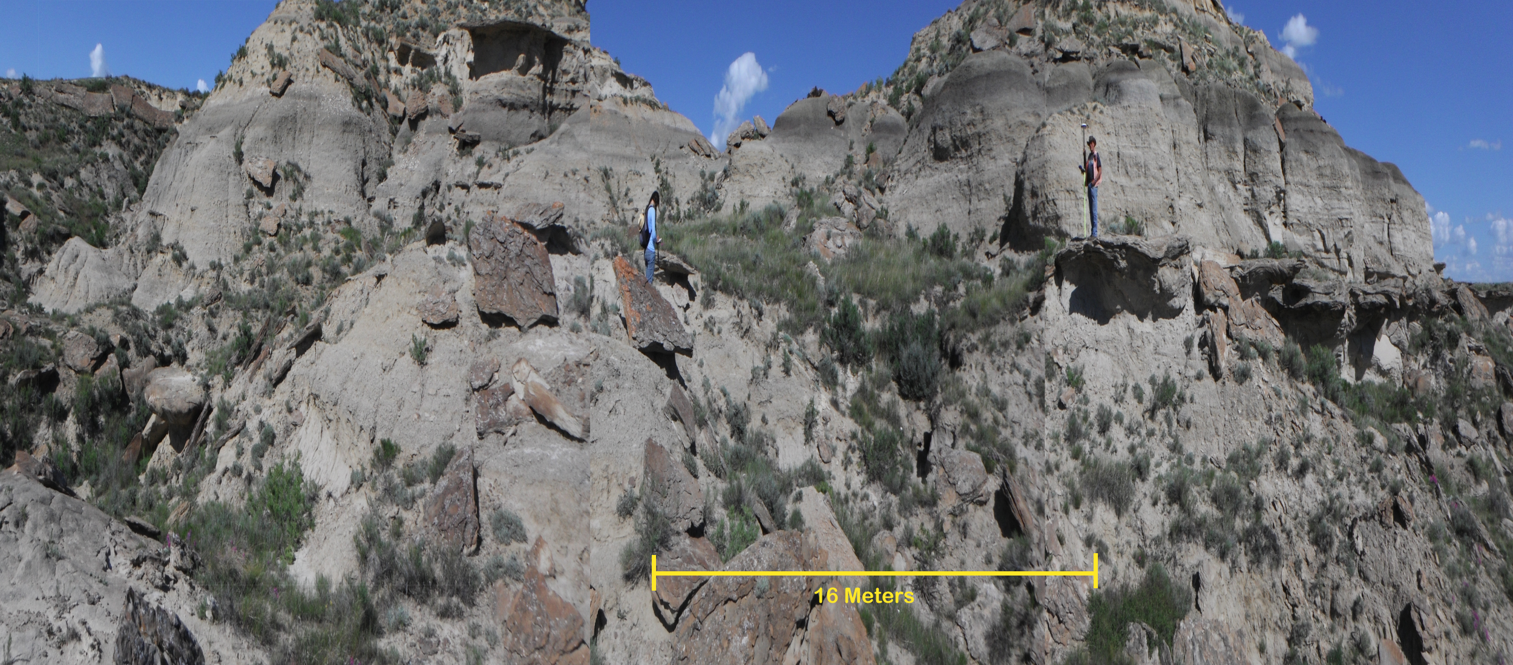
Sediments of the Lance Formation
Mudstone Sandstone

Slide 9
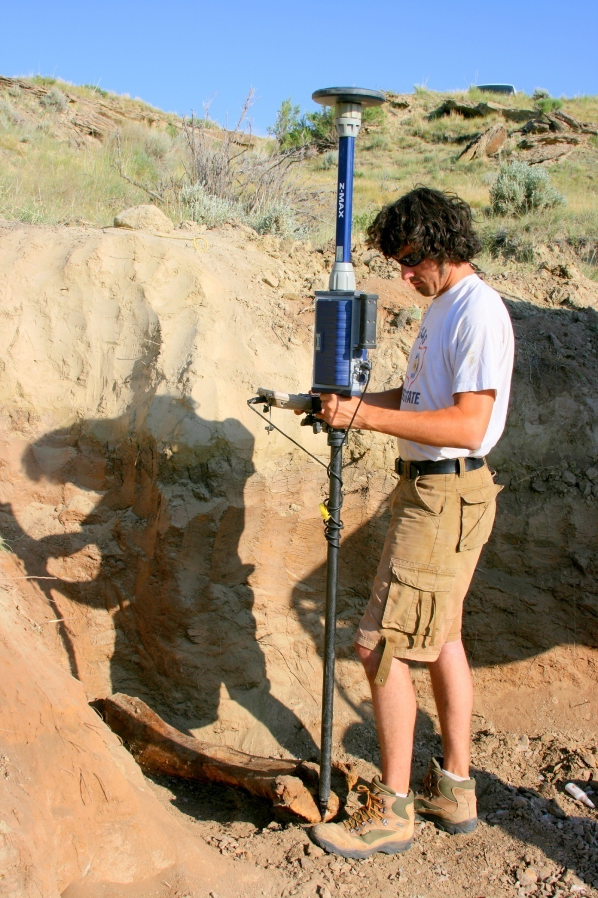
Sandstone
Claystone

Slide 10
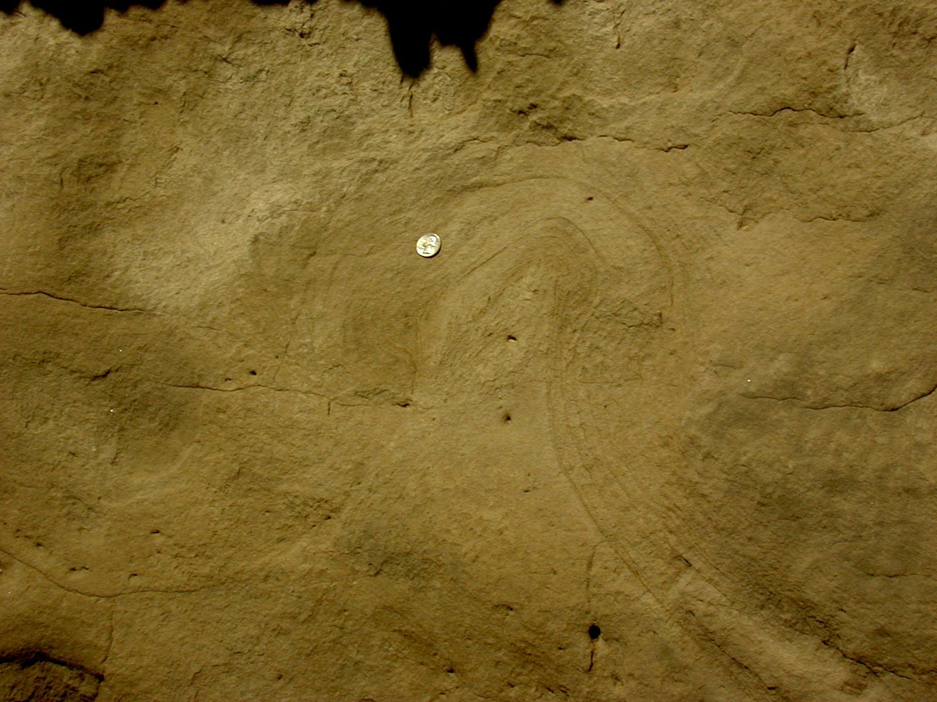
Liquid evulsion features

Slide 11
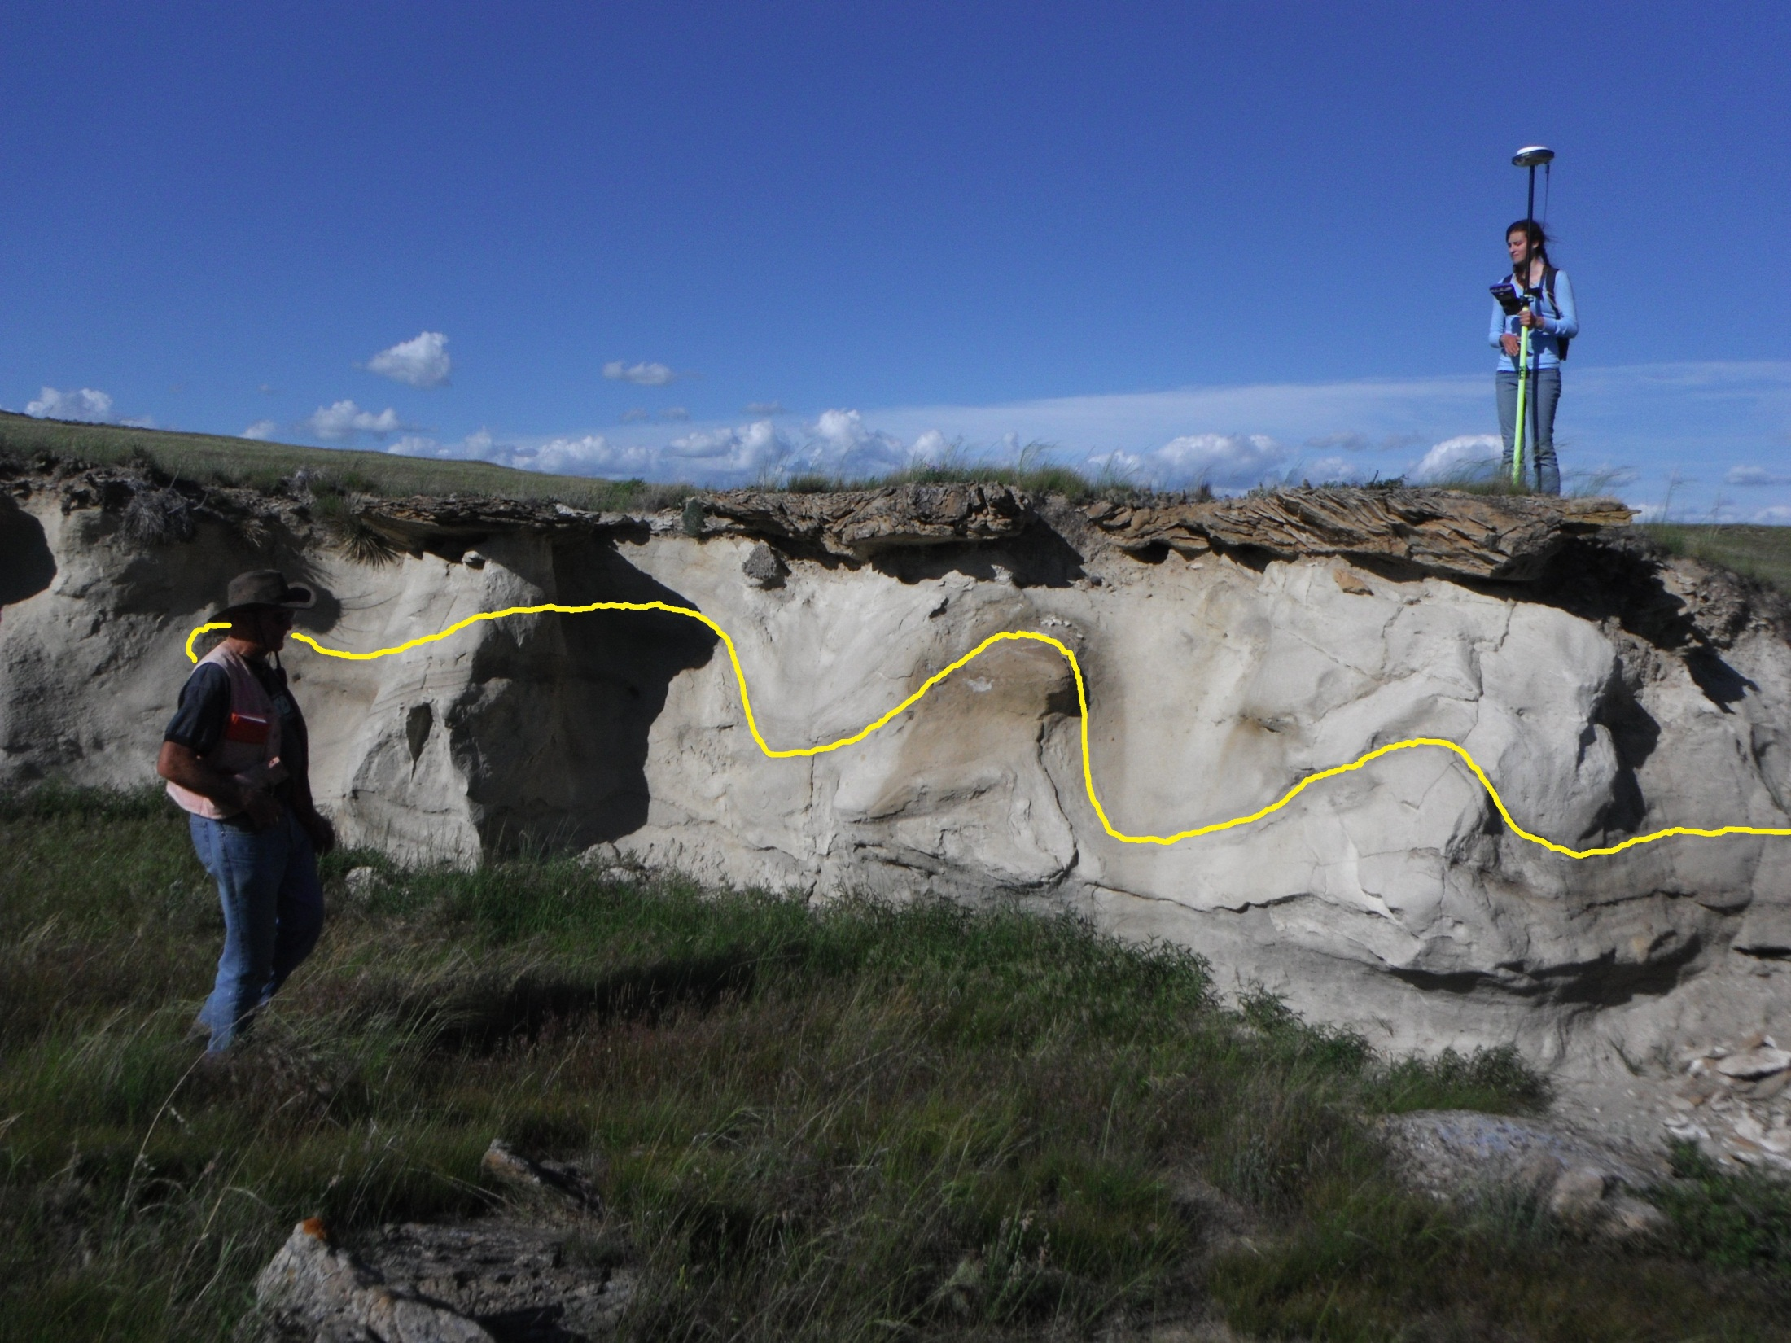

Slide 12
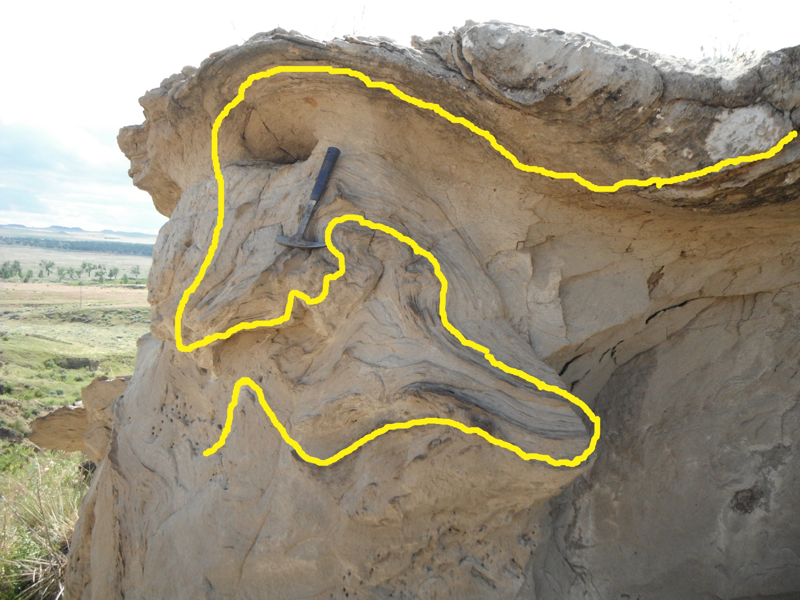

Slide 13
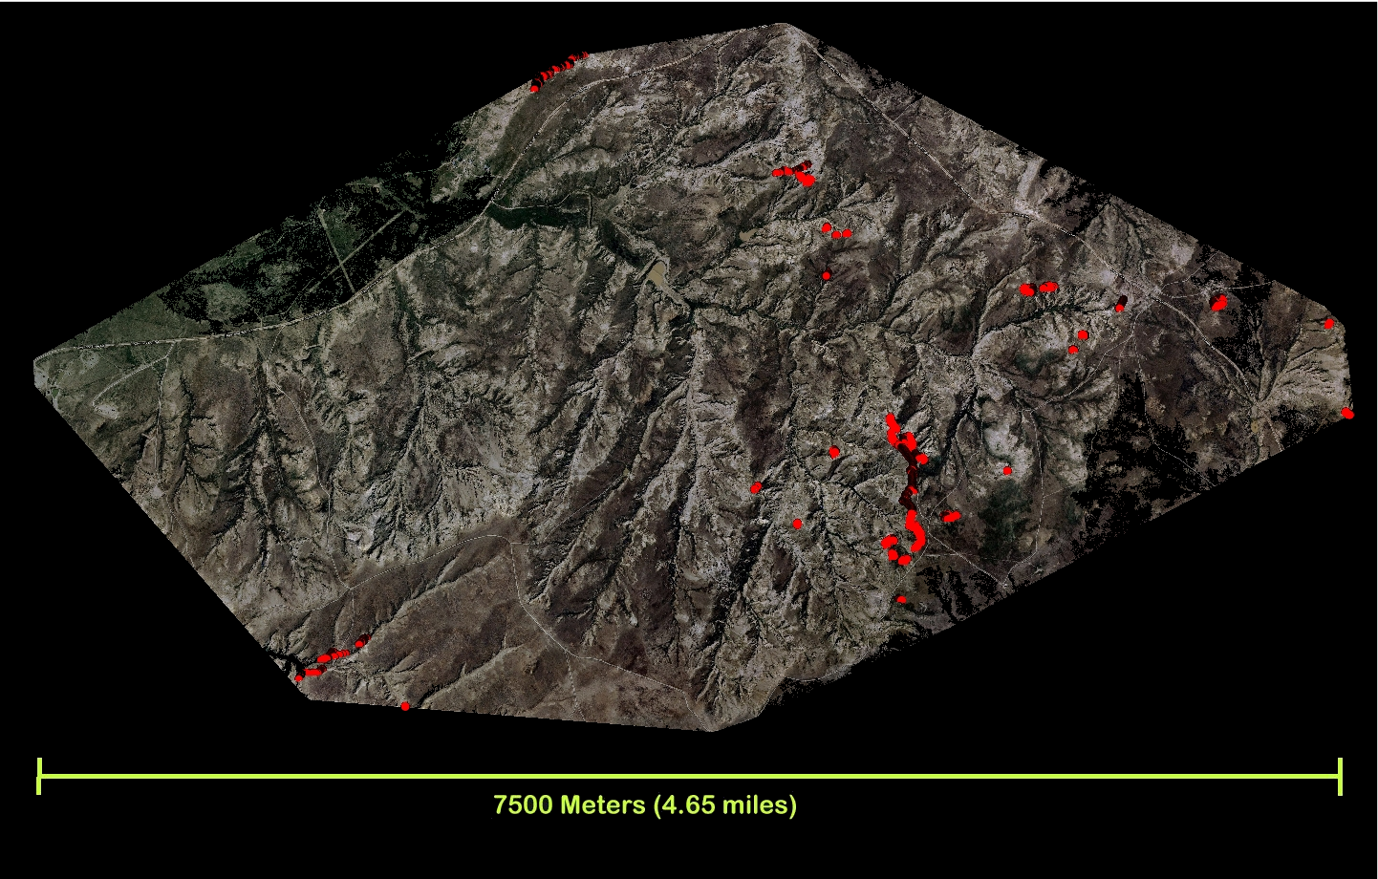
Extent of Seismite

Slide 14
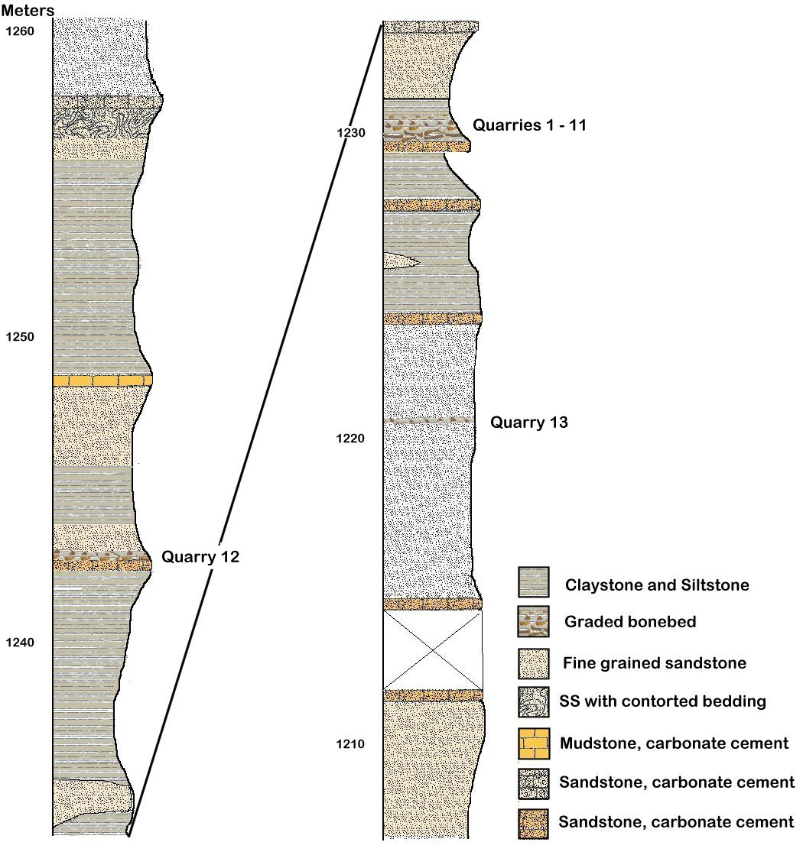

Slide 15
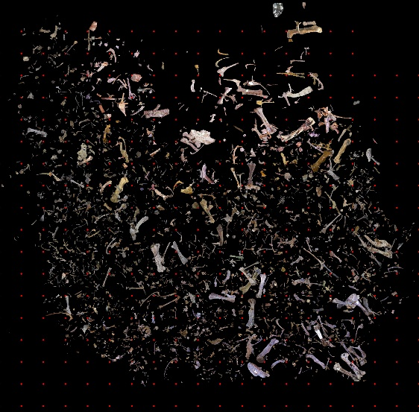
QUARRIES 1-11

Slide 17
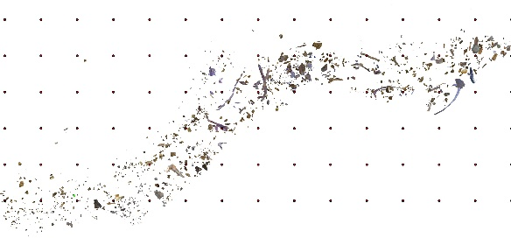
QUARRY 12

Slide 18
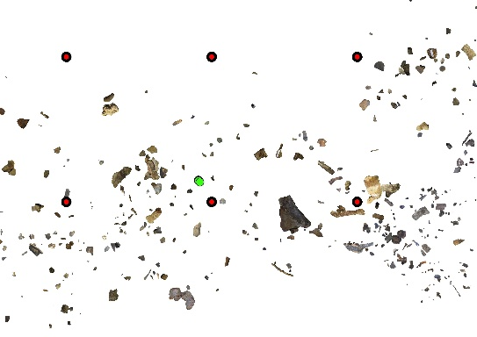
QUARRY 12

Slide 20
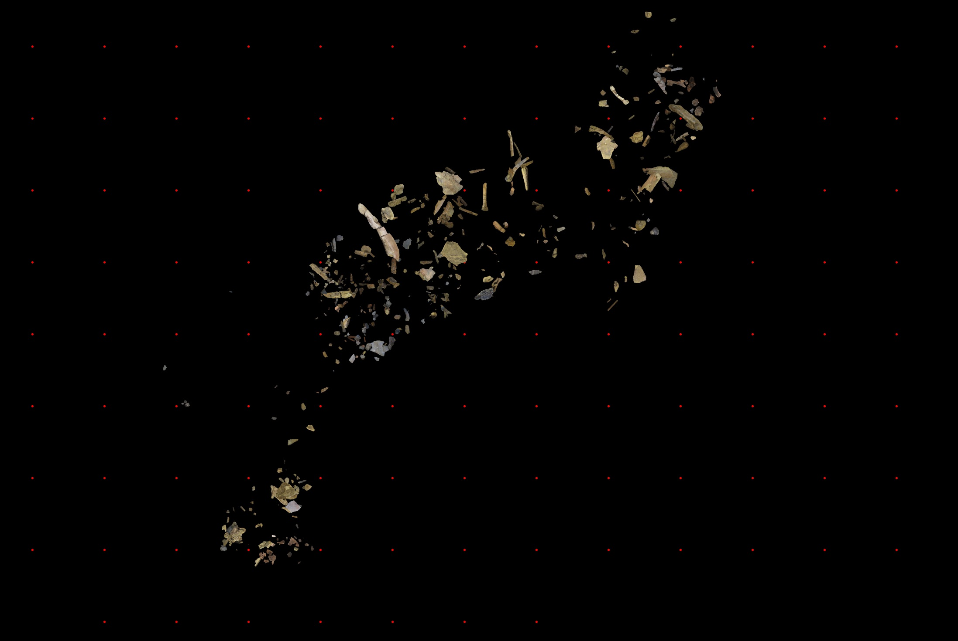
QUARRY 13

Slide 21
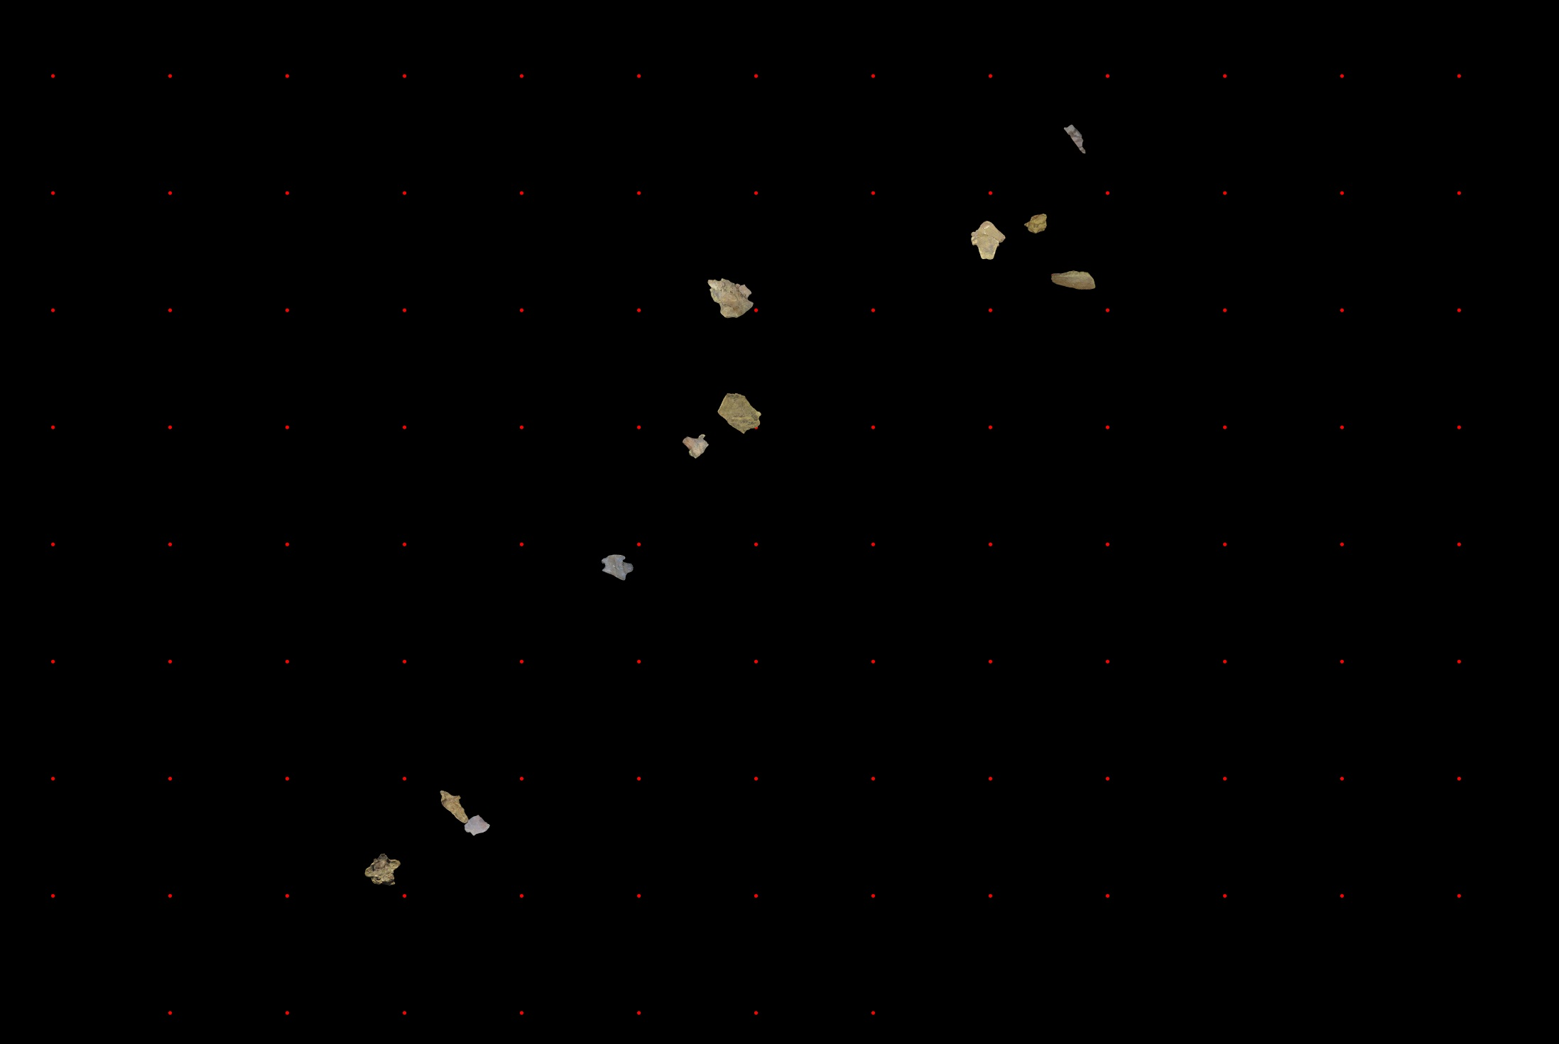
QUARRY 13

Slide 22
GPS-GIS Technology
New technology for mapping bones in the quarry using high resolution GPS equipment.
GPS data is combined with digital photos of bones in the computer.
The bones can then be seen in the computer just as they looked in the ground , but with the dirt removed.

Slide 23
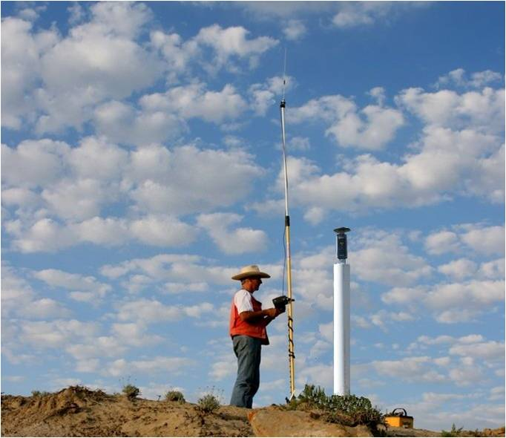

Slide 24
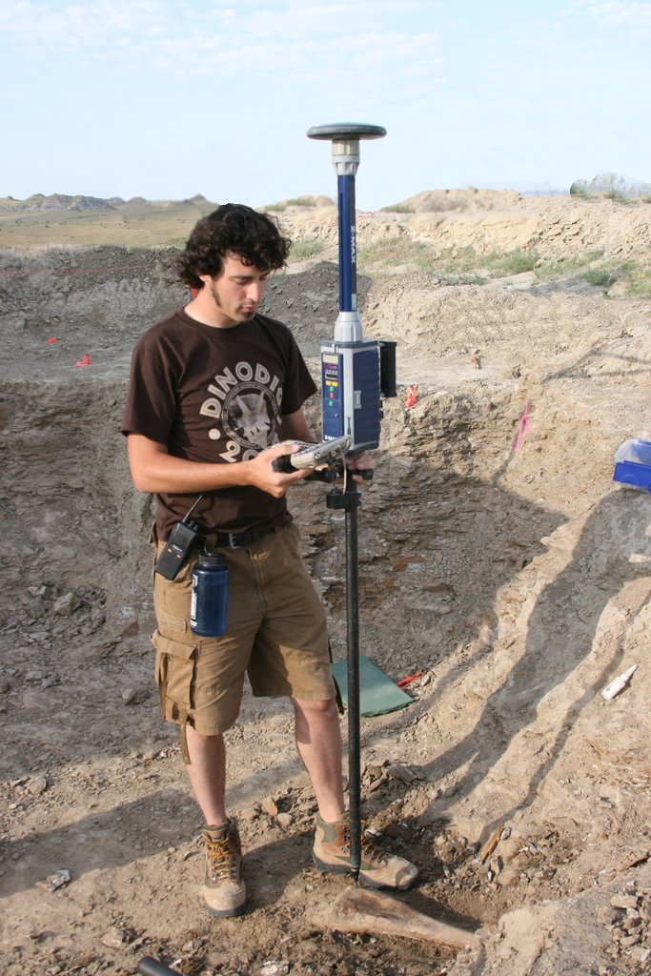

Slide 25
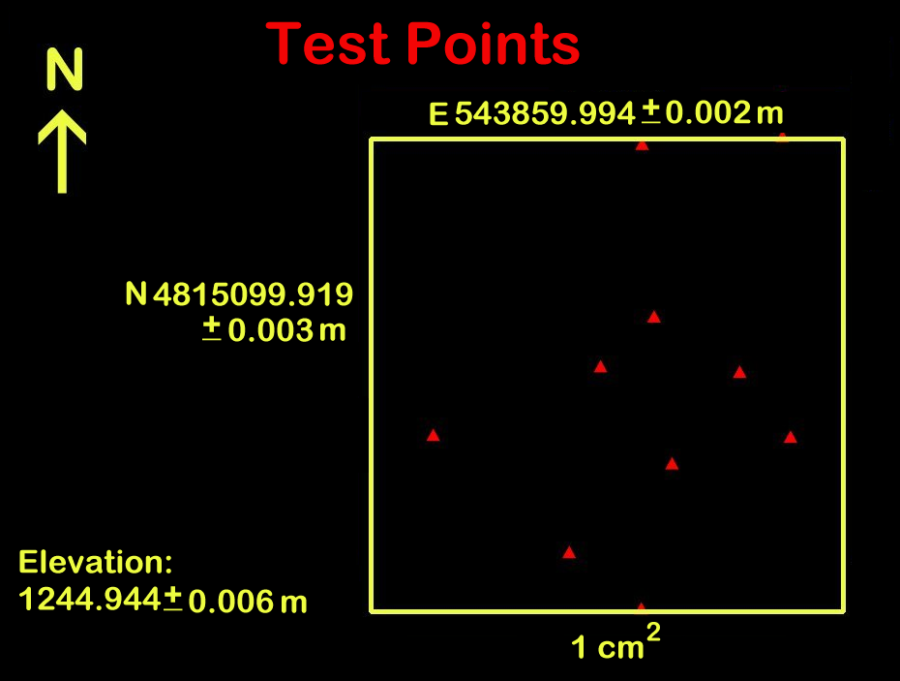

Slide 26


Slide 27
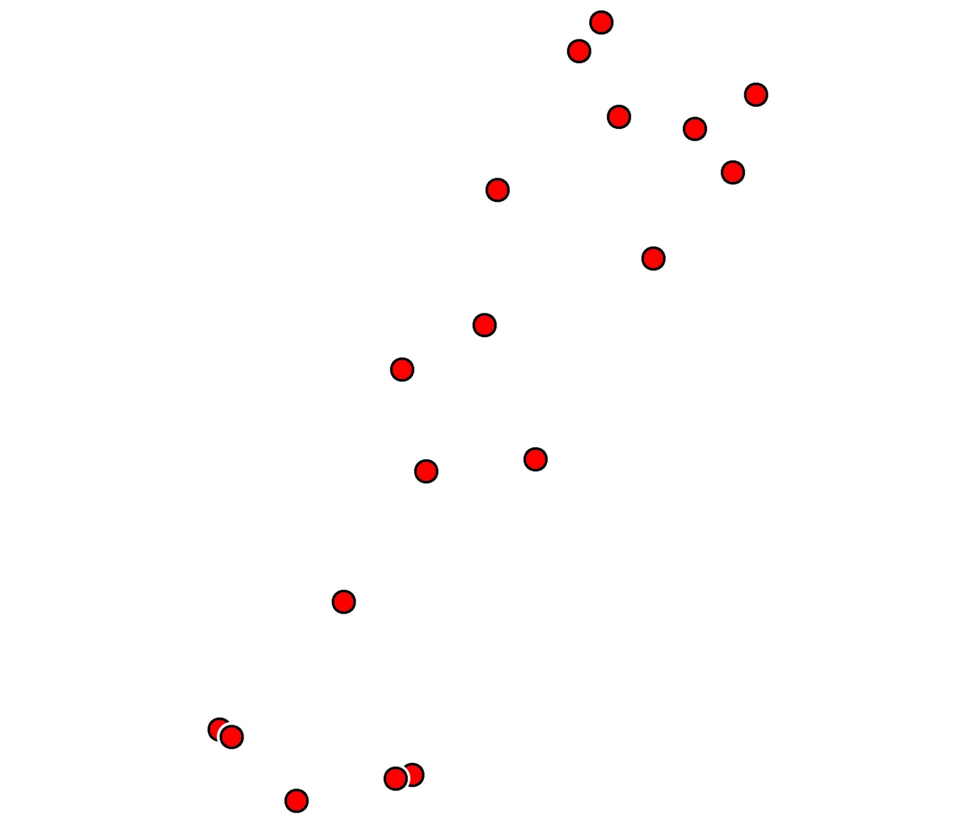

Slide 28
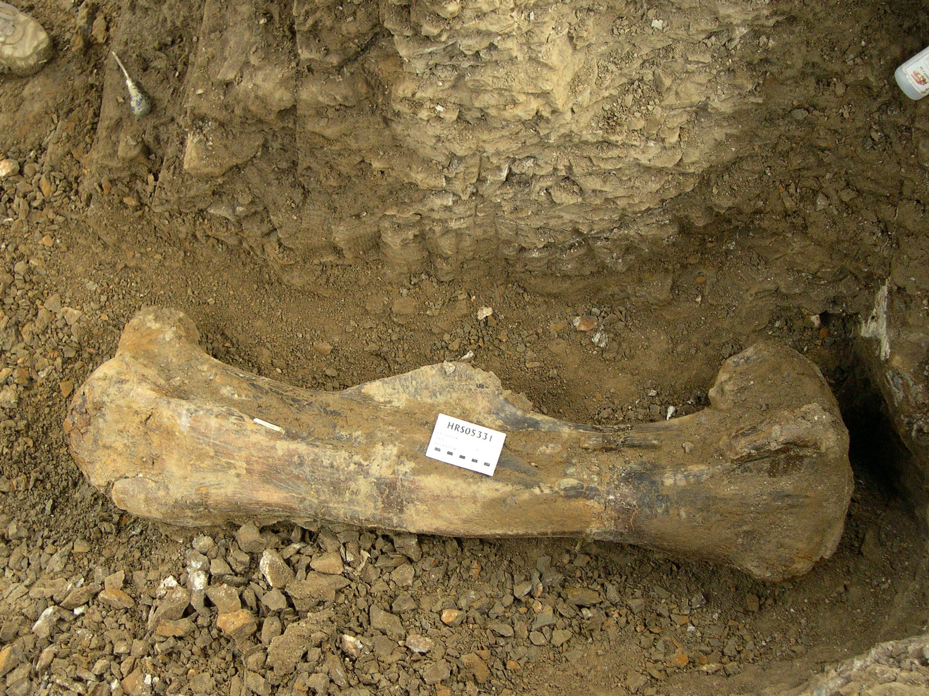

Slide 29
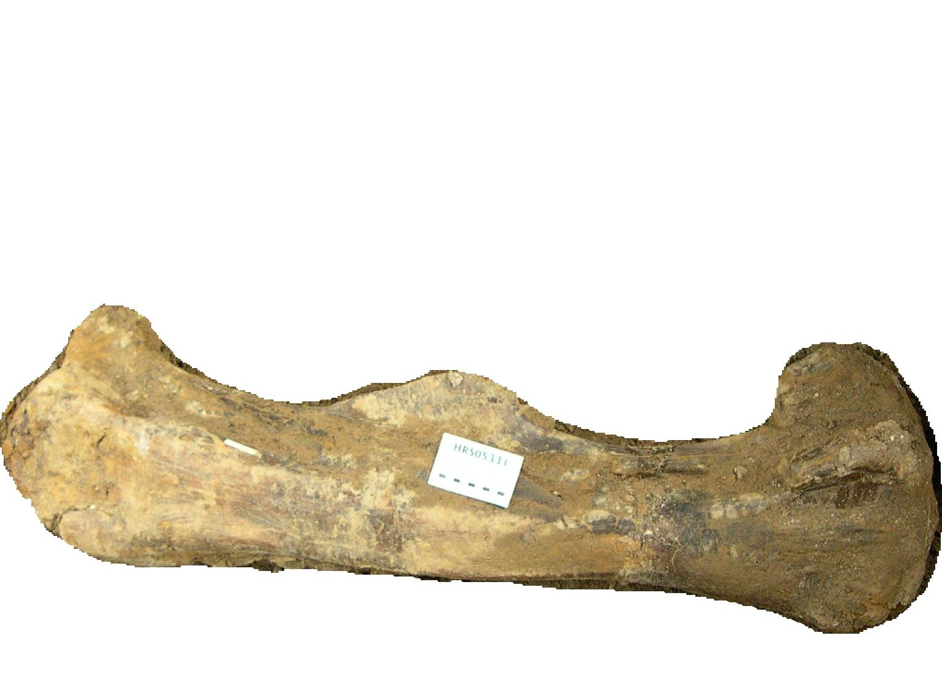

Slide 30
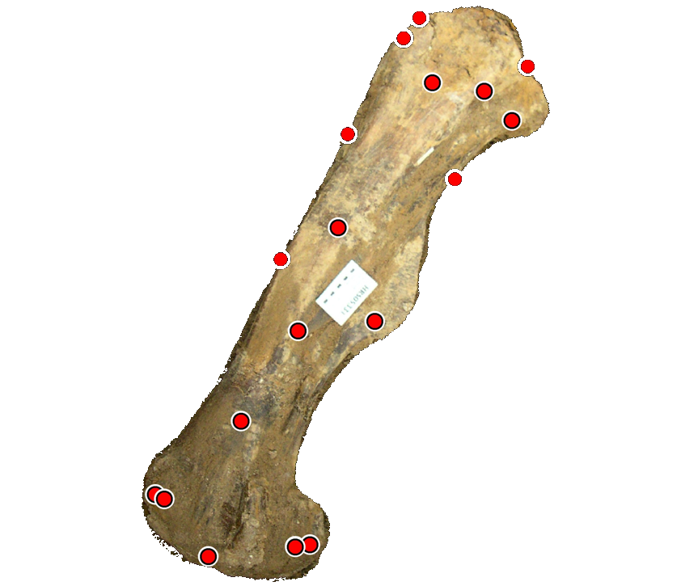

Slide 31
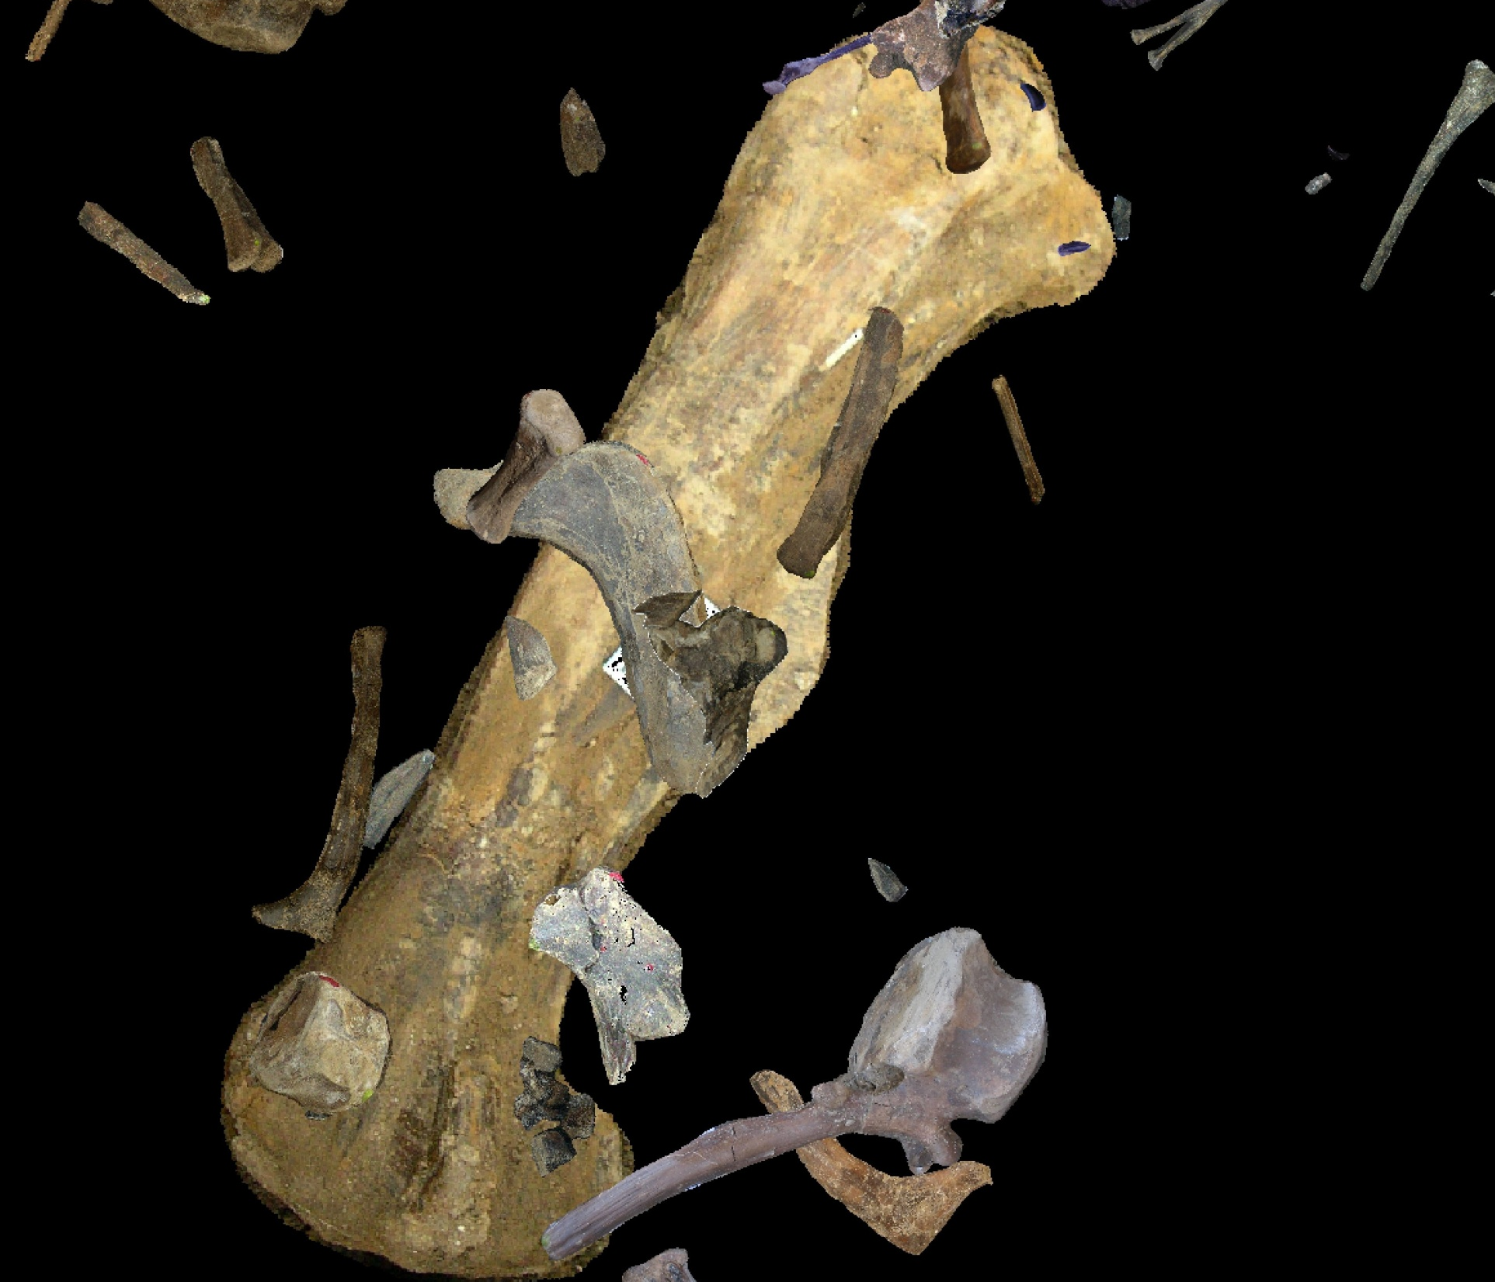

Slide 33
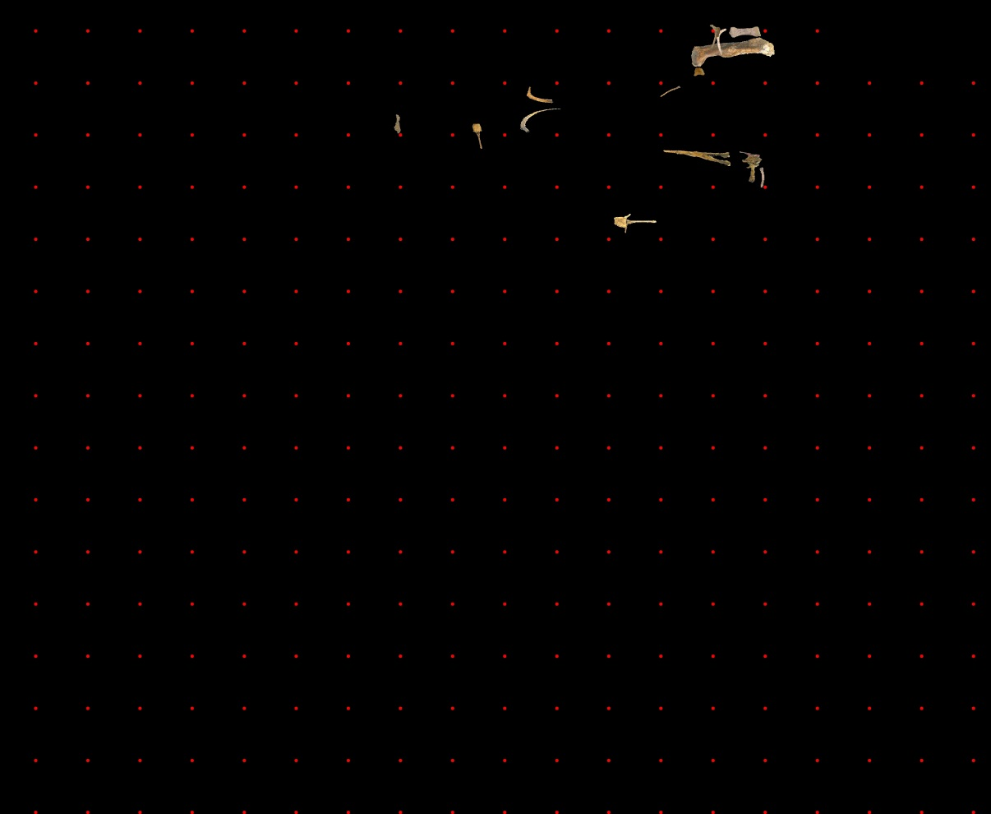
NORTH QUARRY 1999

Slide 34
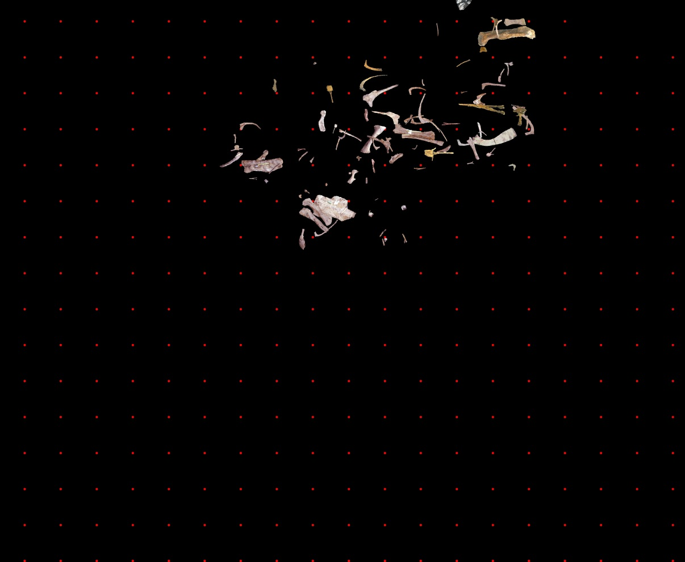
NORTH QUARRY 2000

Slide 35
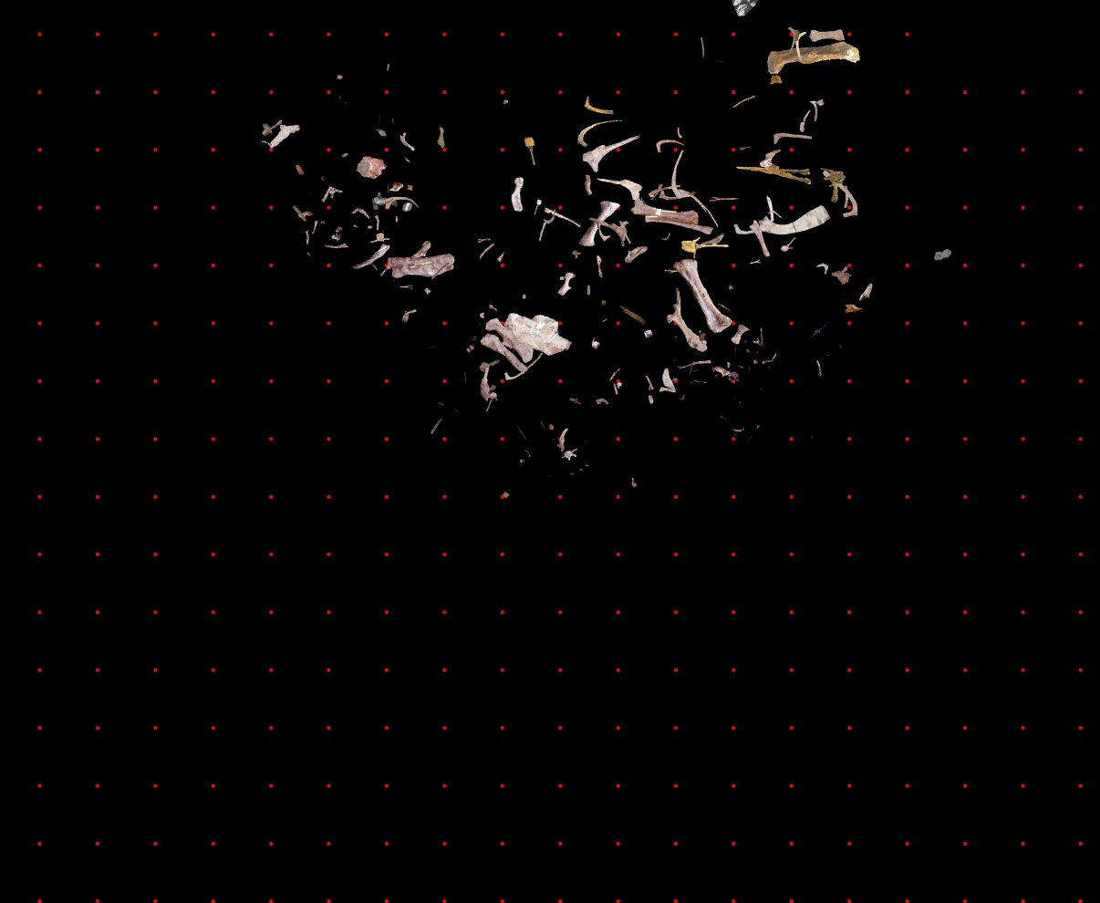
NORTH QUARRY 2001

Slide 36
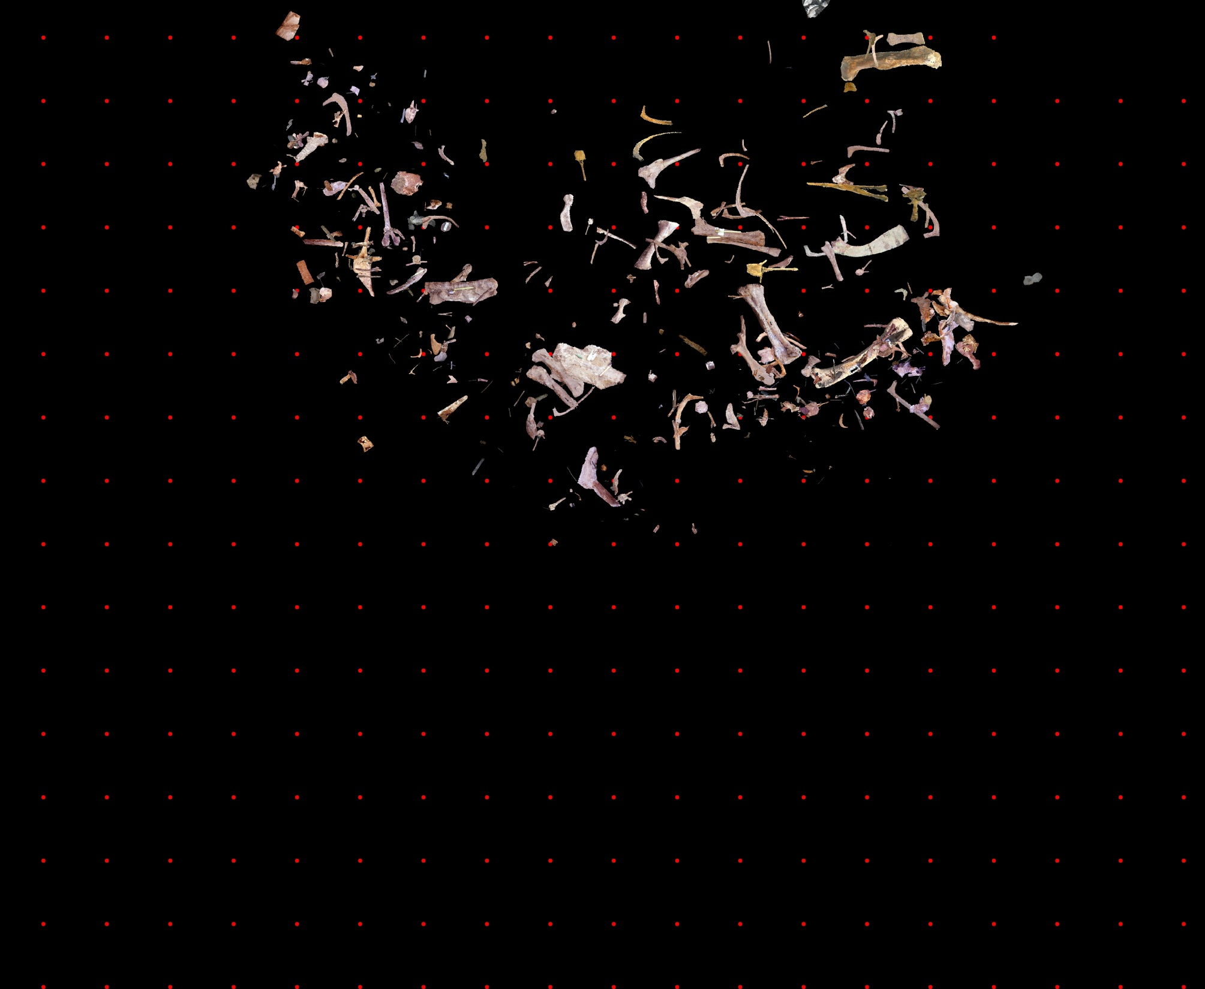
NORTH QUARRY 2002

Slide 37
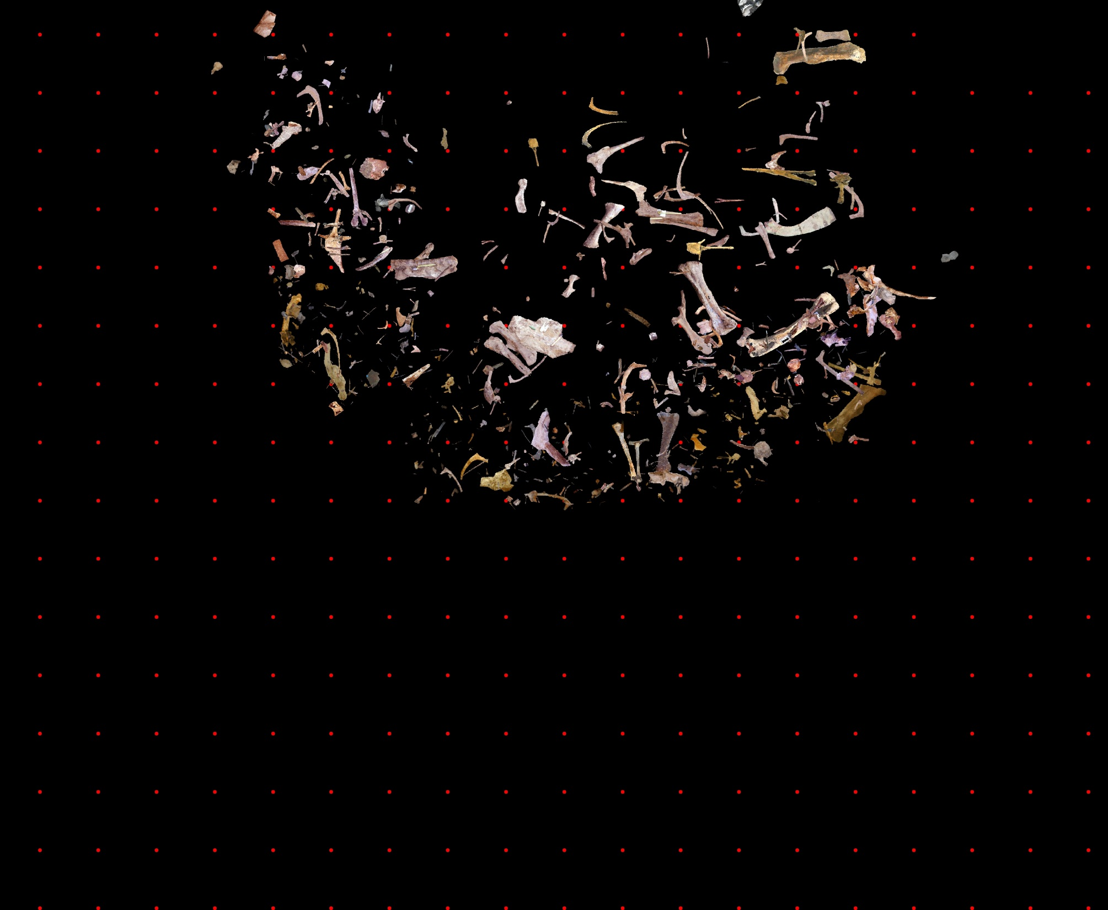
NORTH QUARRY 2003

Slide 38
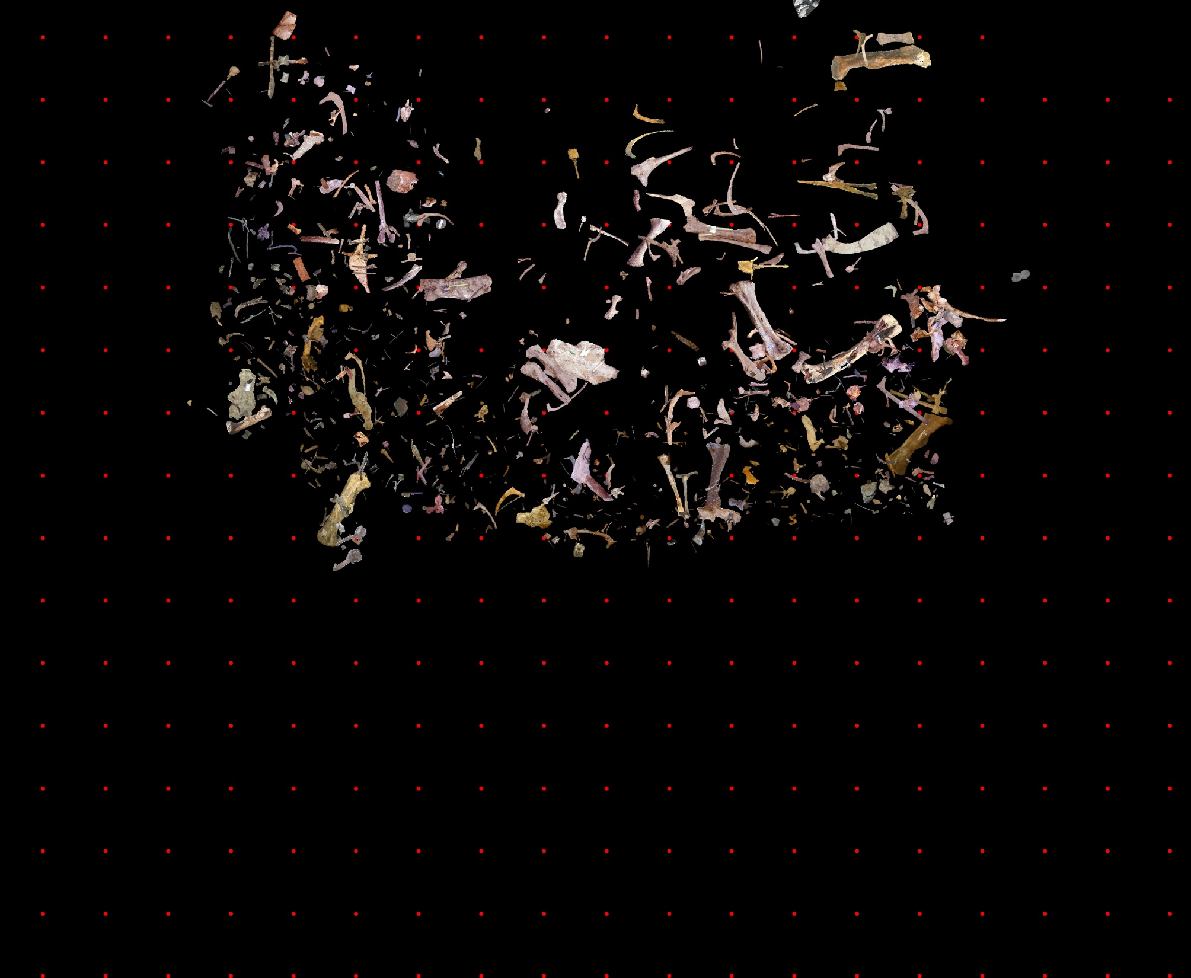
NORTH QUARRY 2004

Slide 39
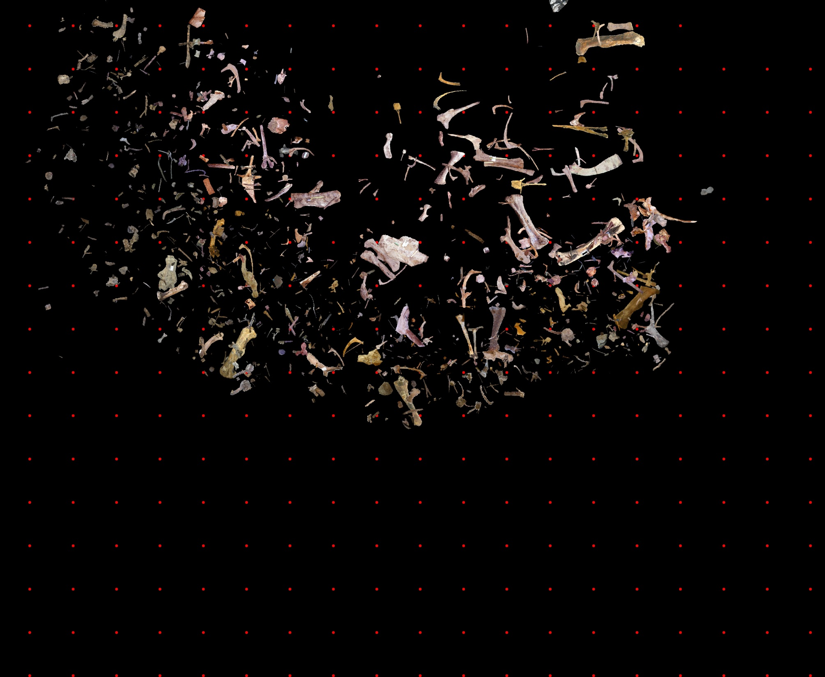
NORTH QUARRY 2005

Slide 40
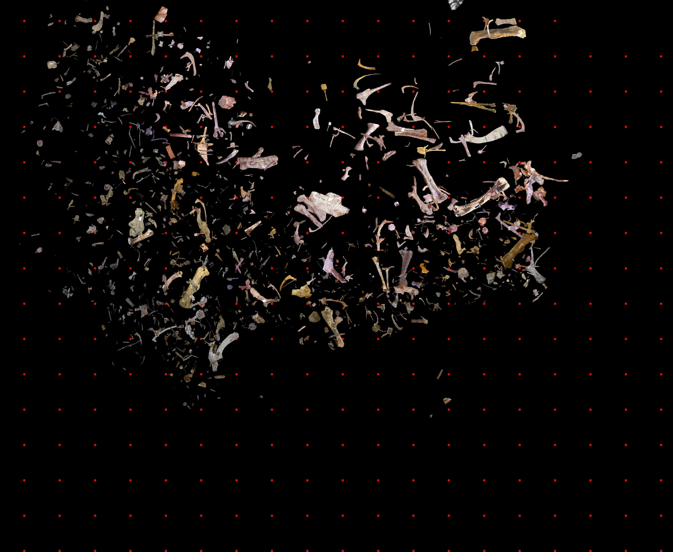
NORTH QUARRY 2006

Slide 41
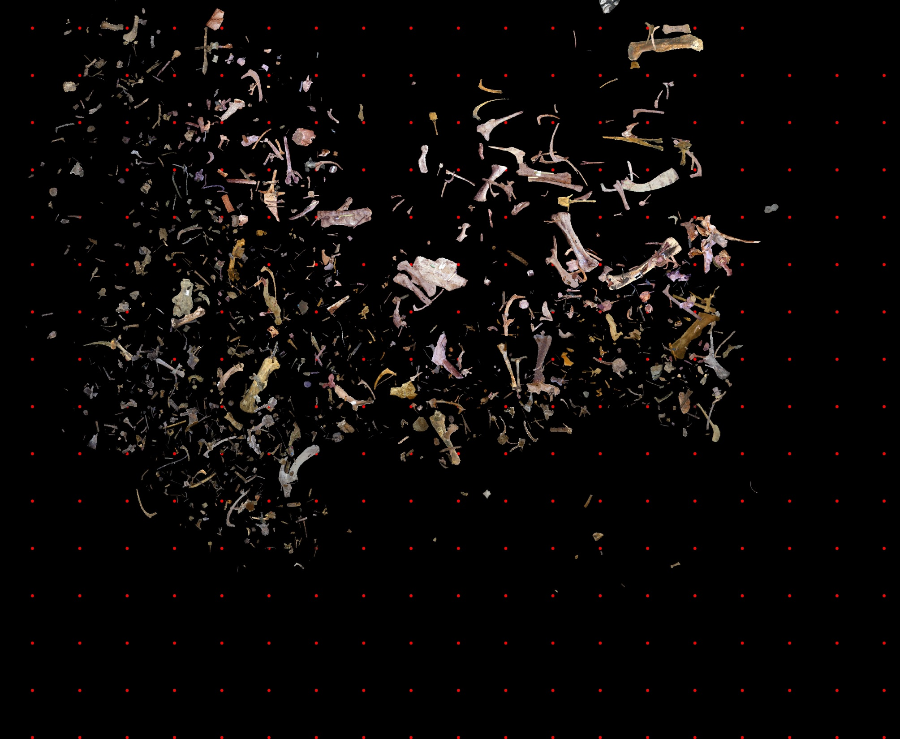
NORTH QUARRY 2007

Slide 42
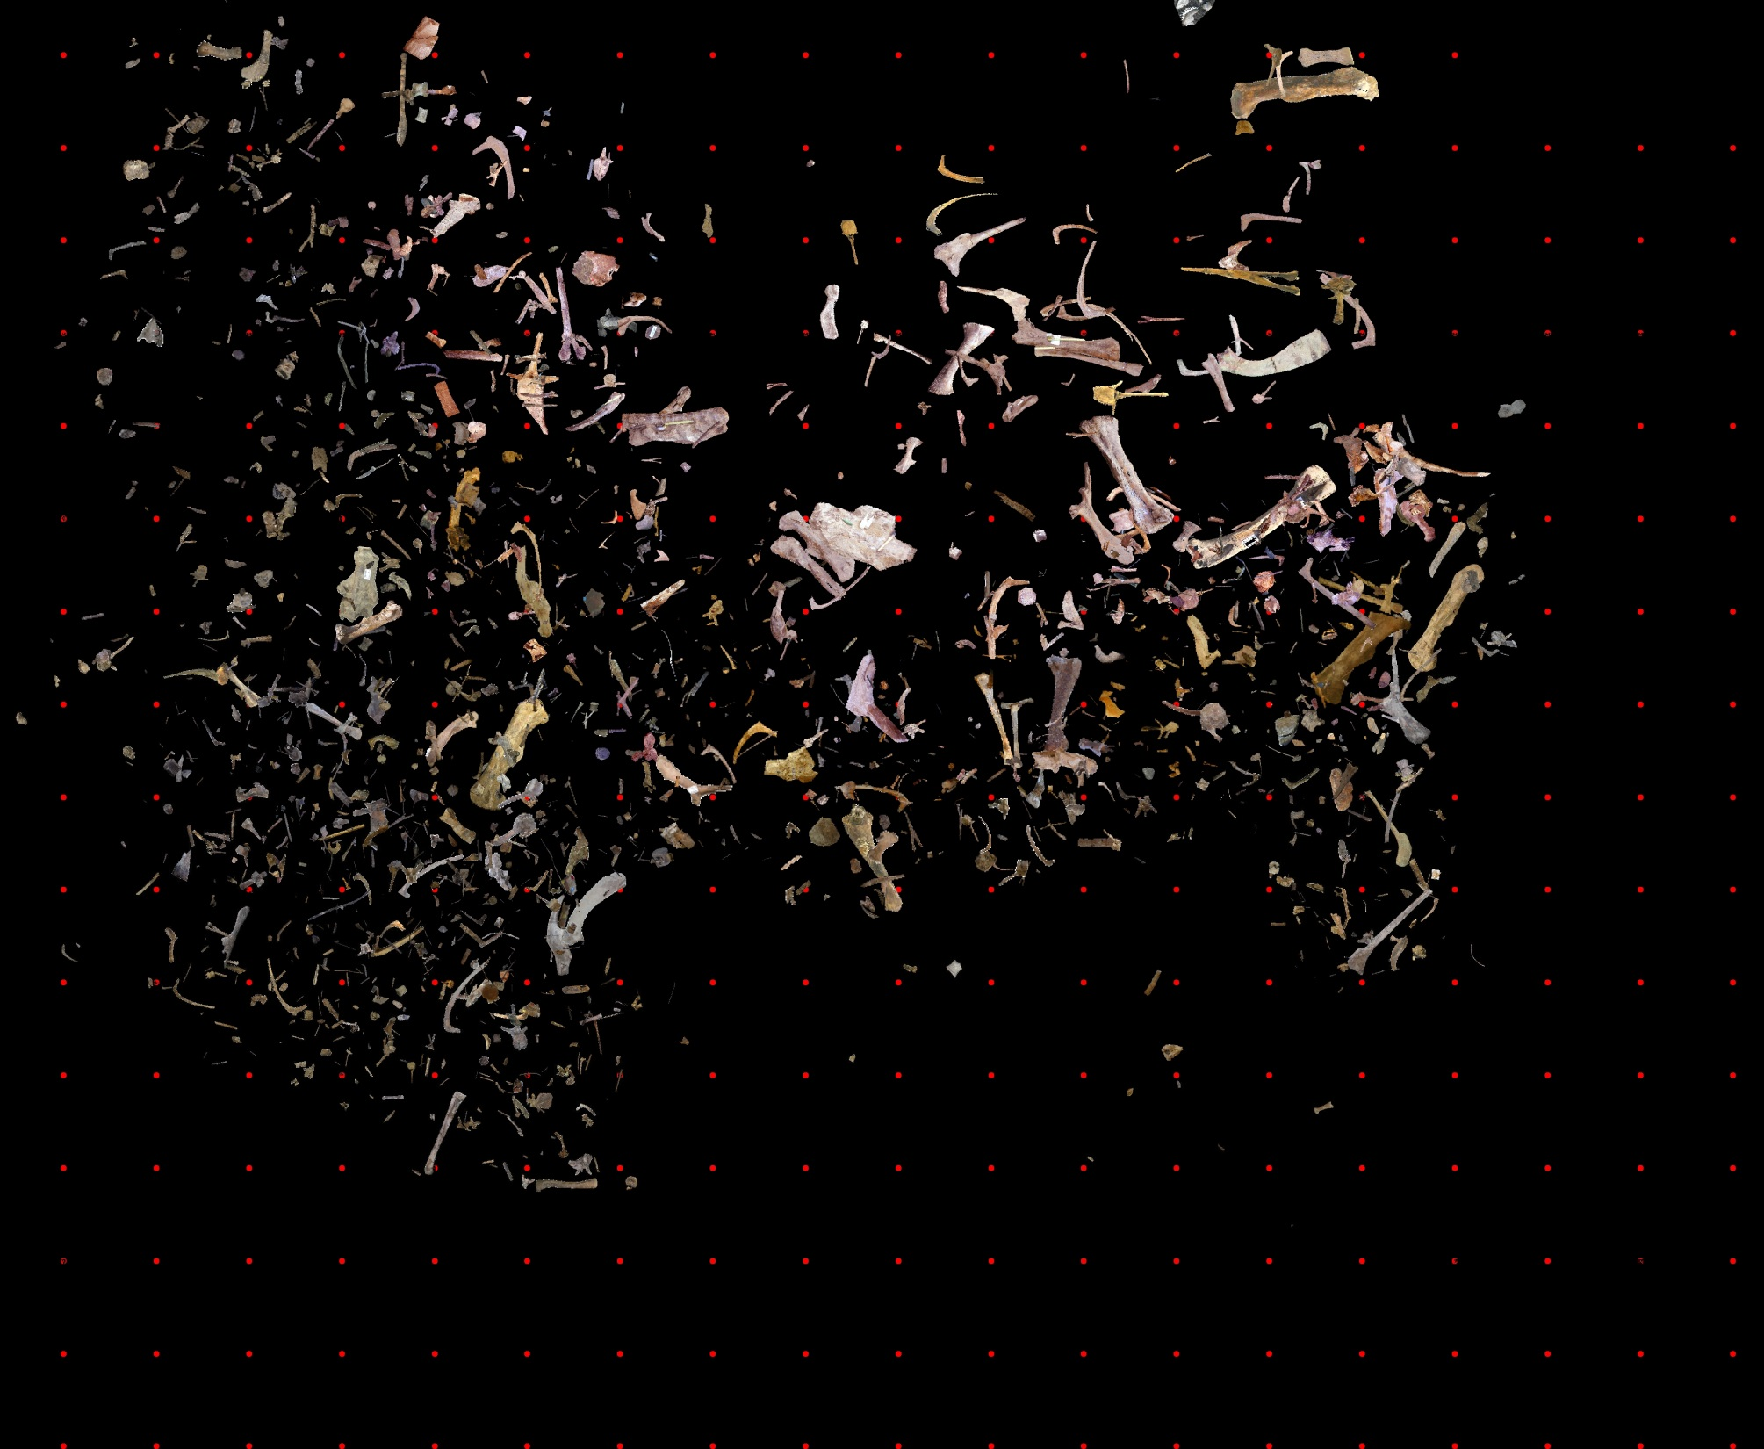
NORTH QUARRY 2008

Slide 43
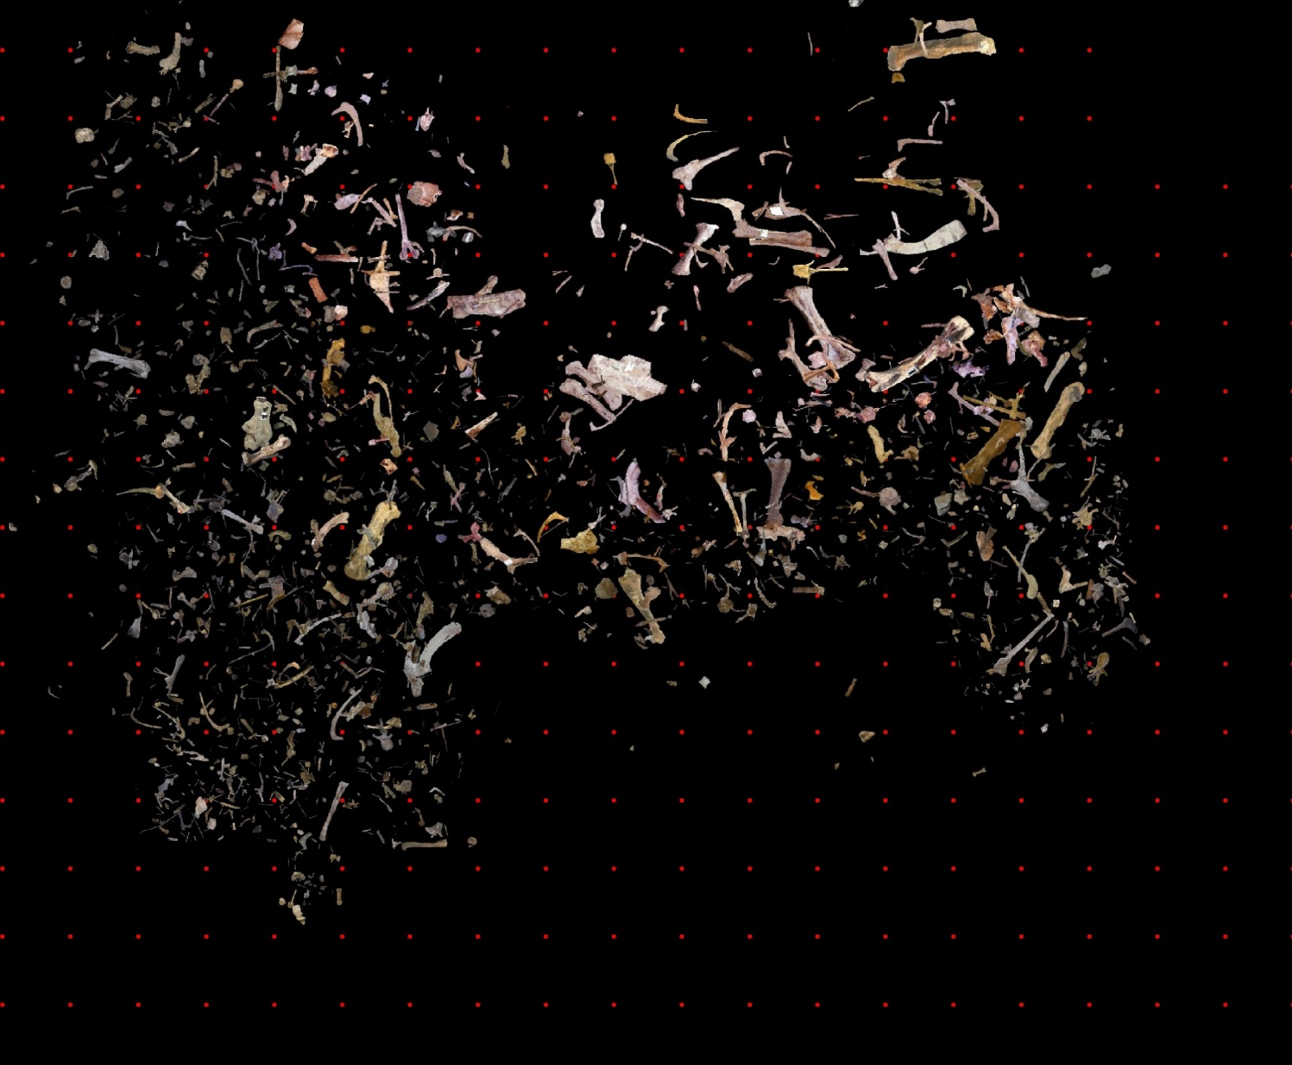
NORTH QUARRY 2009

Slide 44
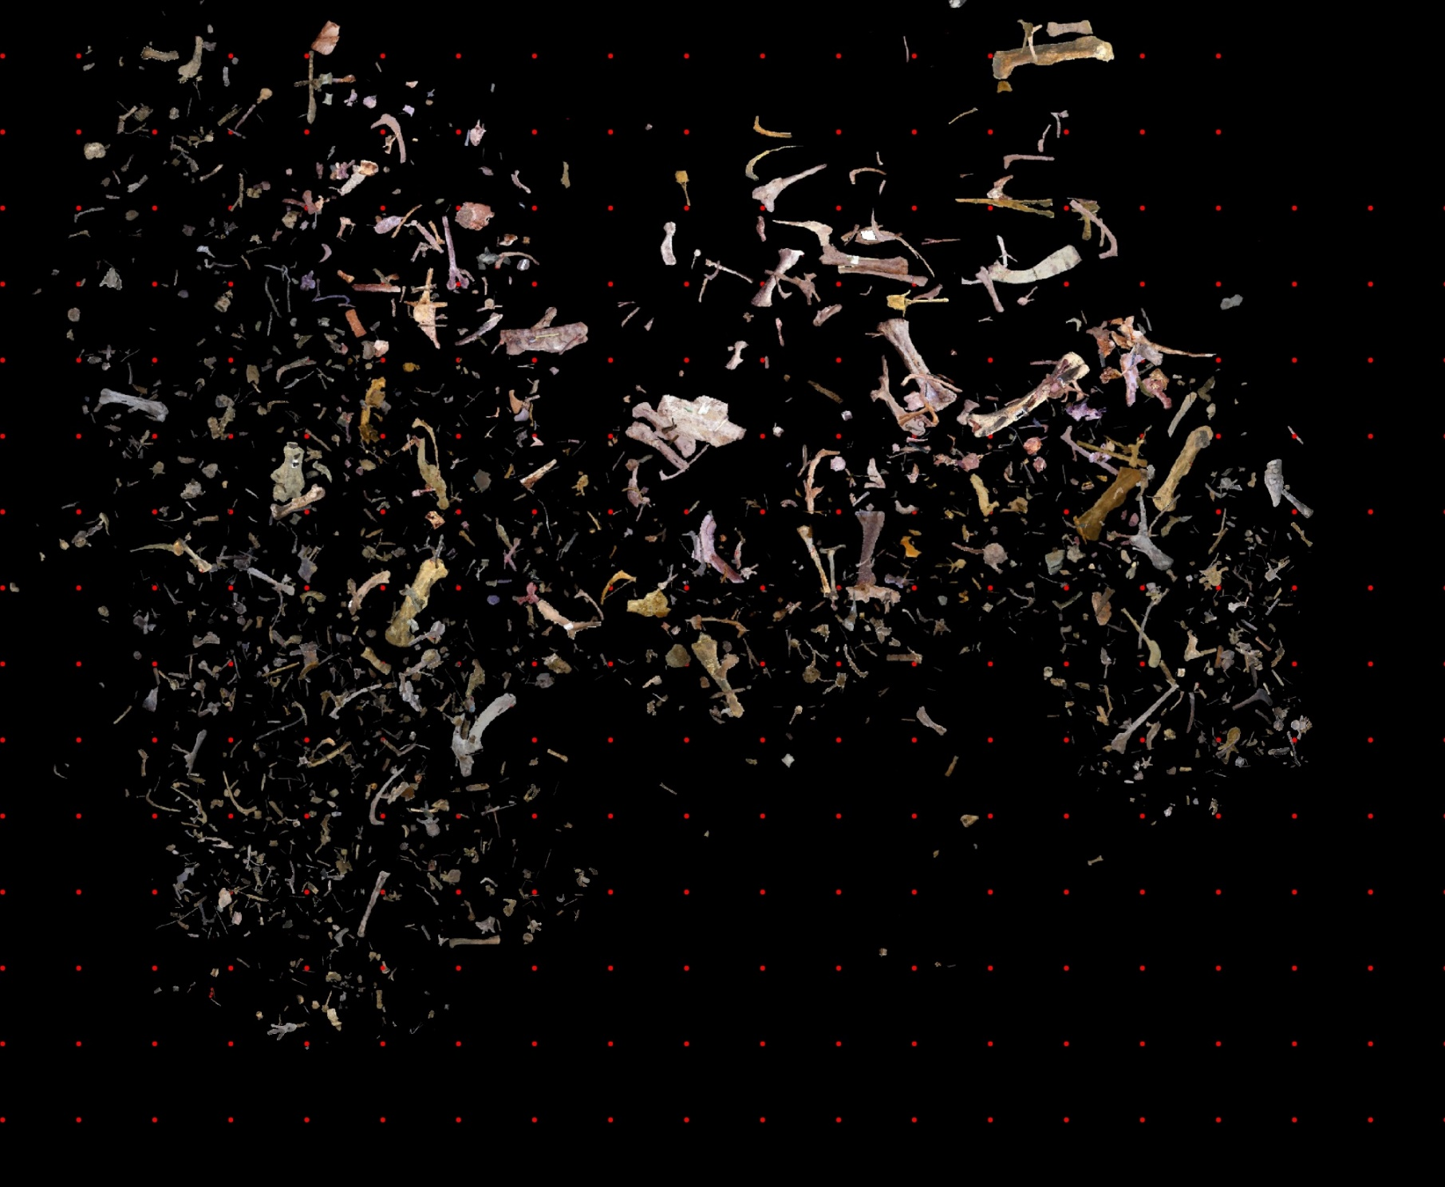
NORTH QUARRY 2010

Slide 45
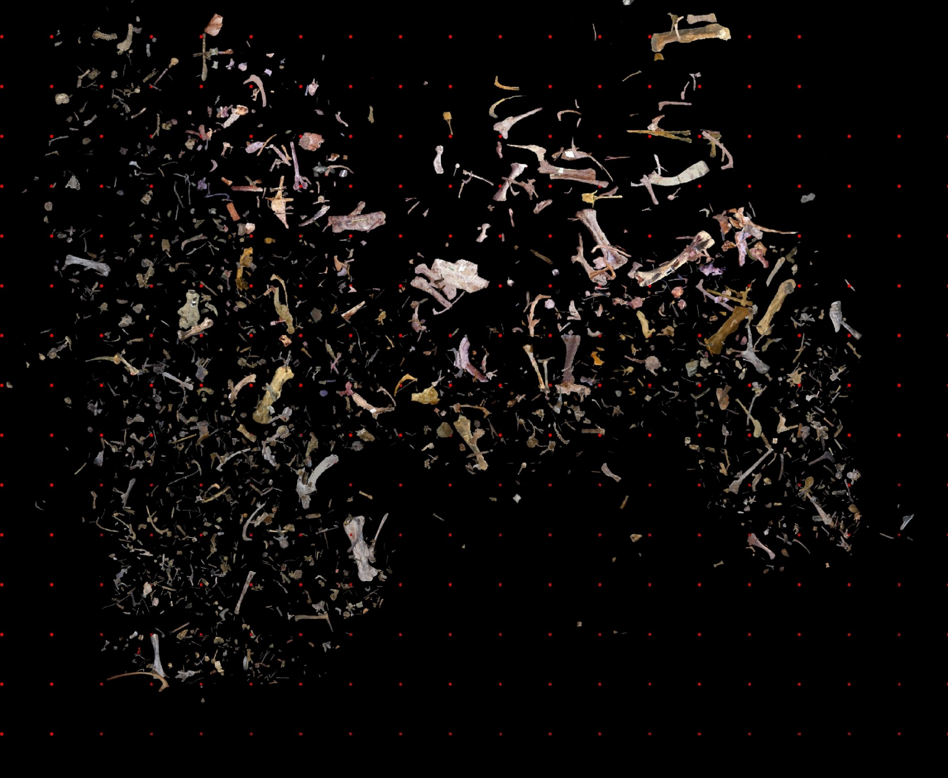
NORTH QUARRY 2011

Slide 46
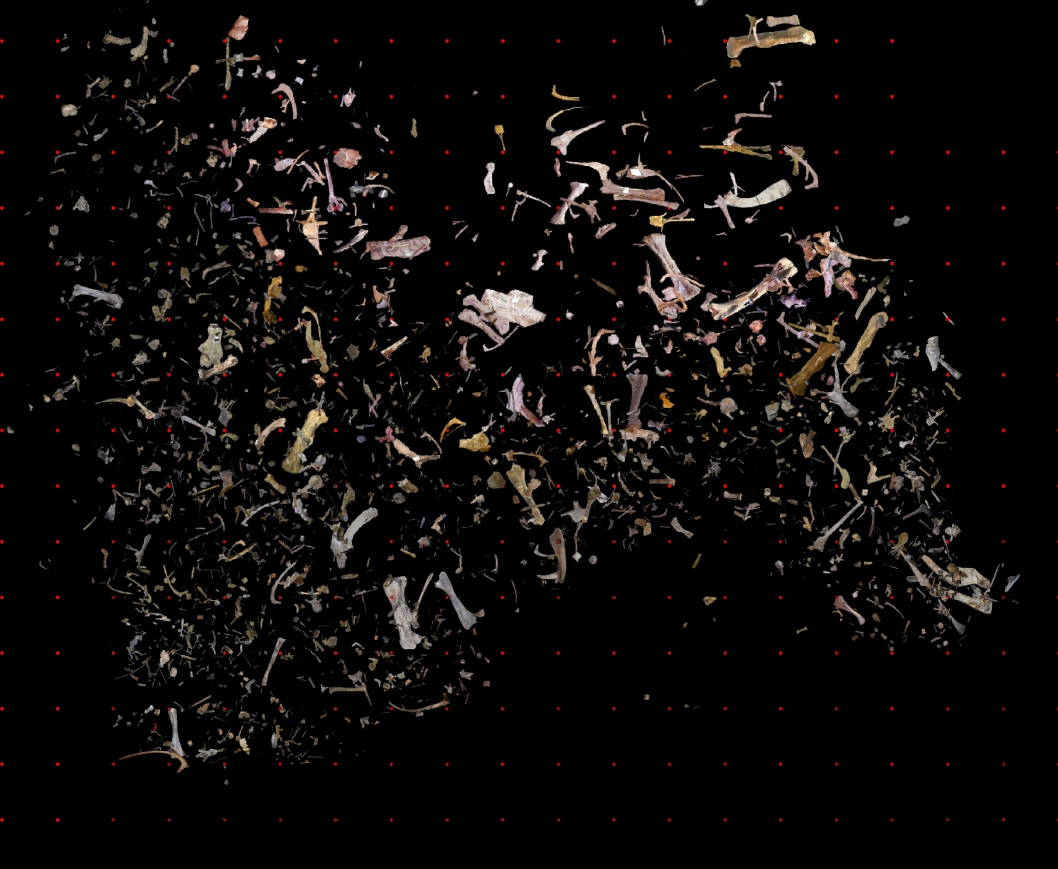
NORTH QUARRY 2012

Slide 47
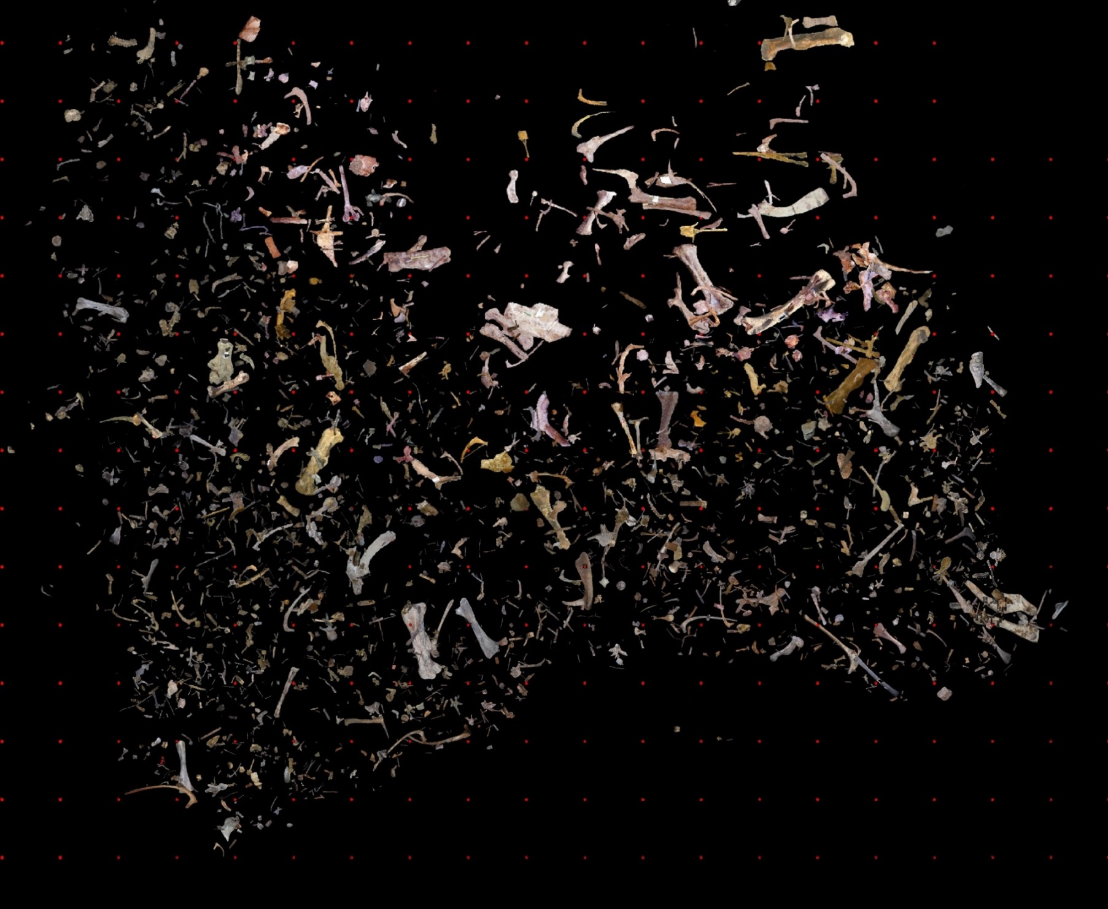
NORTH QUARRY 2013

Slide 48
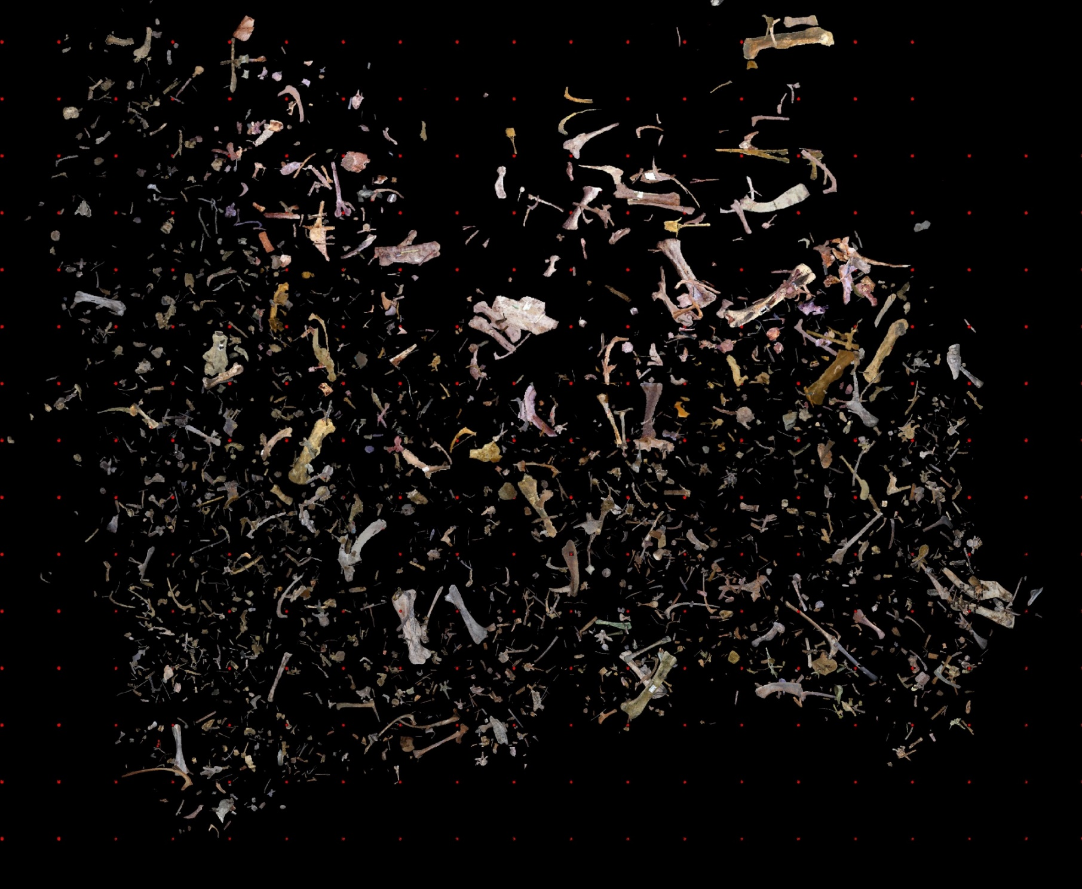
NORTH QUARRY 2014

Slide 49
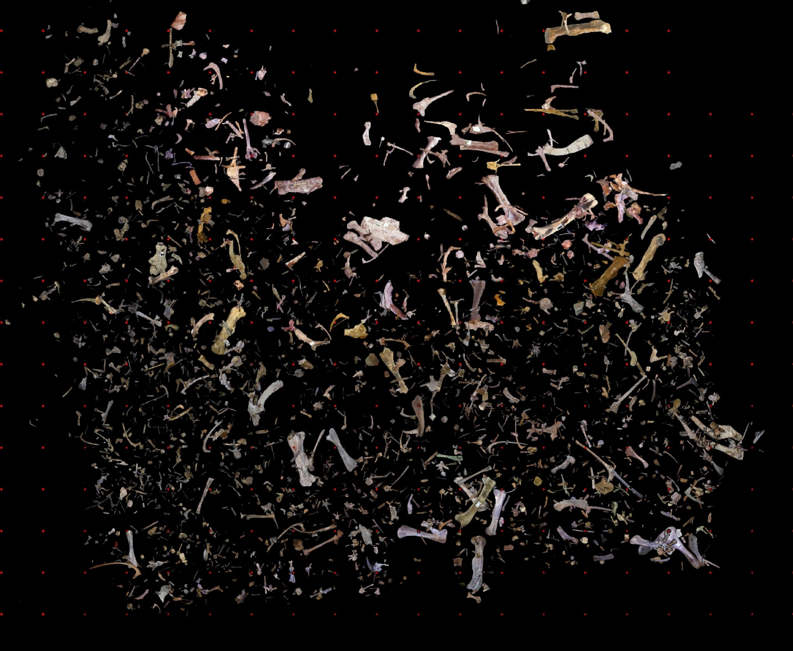
NORTH QUARRY 2015

Slide 50
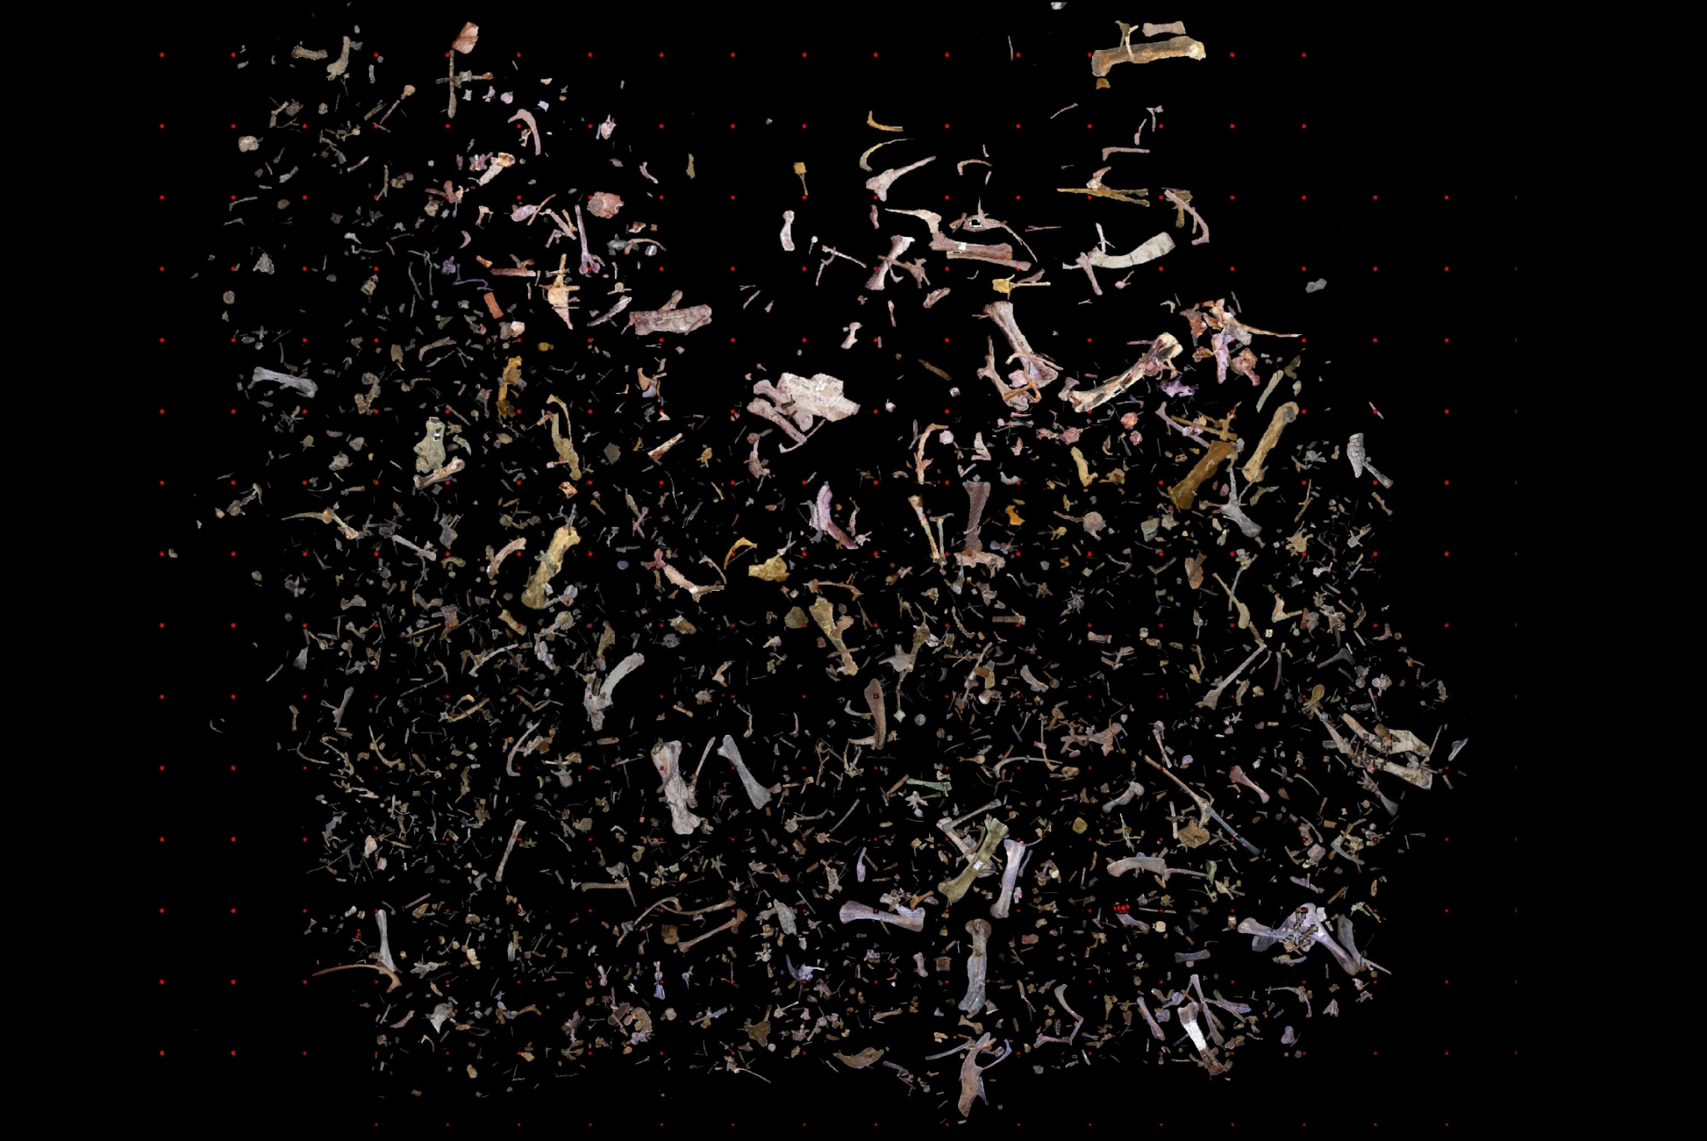
NORTH QUARRY 2016

Slide 51
NORTH QUARRY 2017

Slide 52
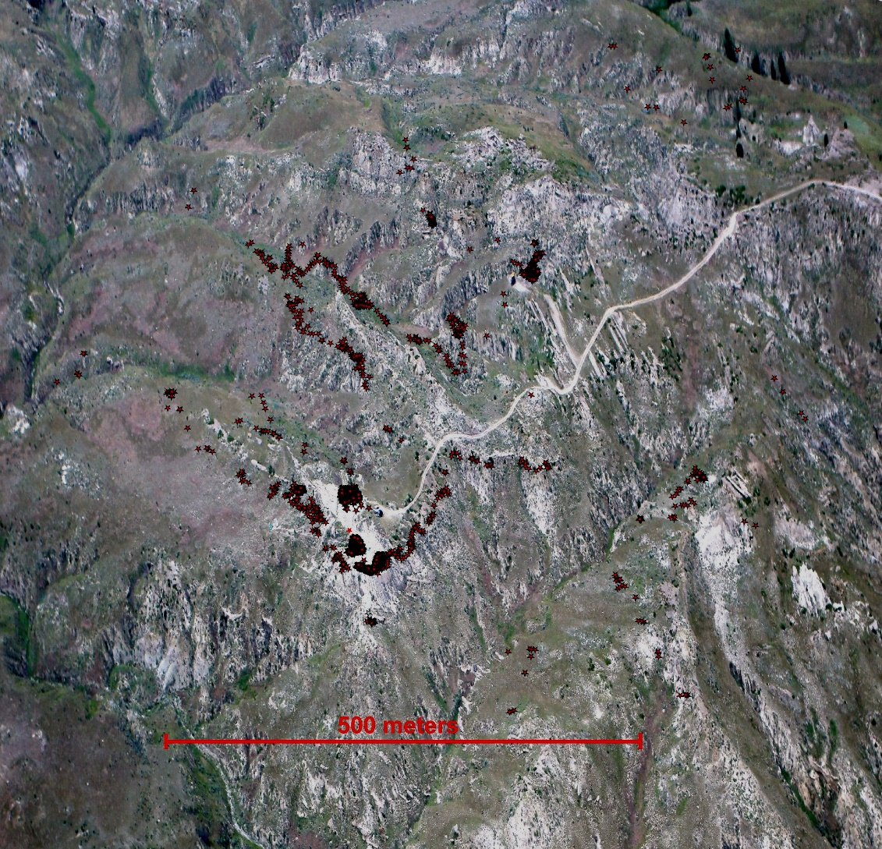
The Bonebed

Slide 54
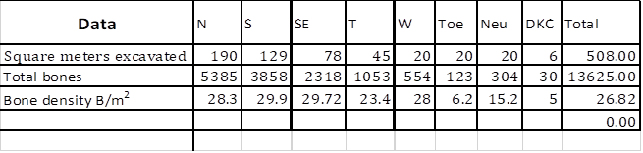
Bone density

Slide 55
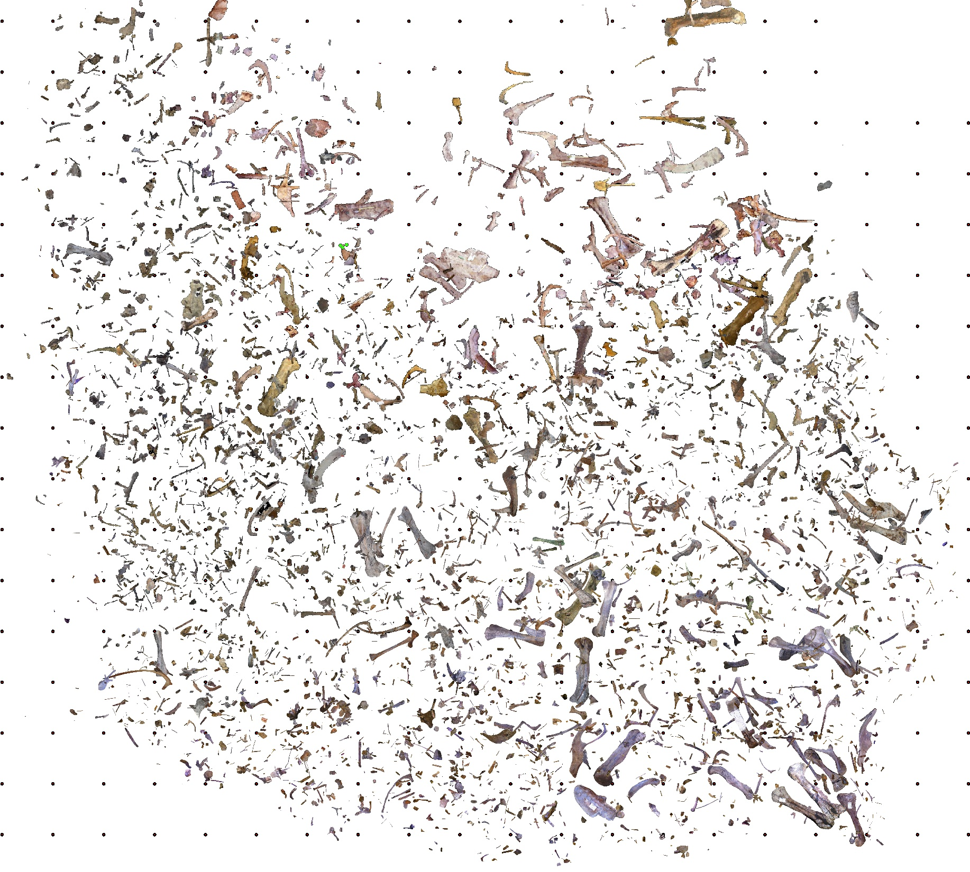
North Quarry 1996 - 2018
NORTH QUARRY 2017
1 meter

Slide 57
Articulation
In main bonebed, (the topic of this presentation), disarticulation is nearly complete (>99.9%) for specimens excavated thus far.
Typical for Upper Cretaceous bonebeds.
Clear tooth marks are rare (<4%), although evidence of scavenging is abundant from shed teeth of numerous carnivores.

Slide 58
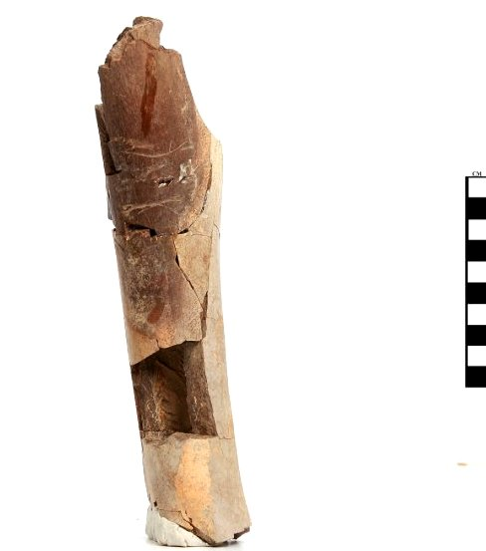
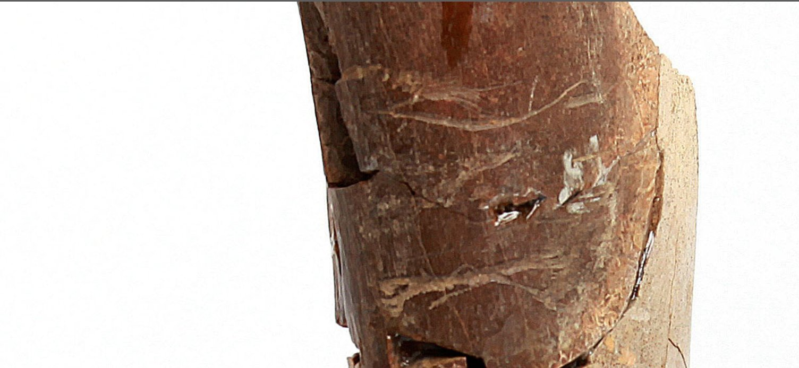
Toothmarks

Slide 59
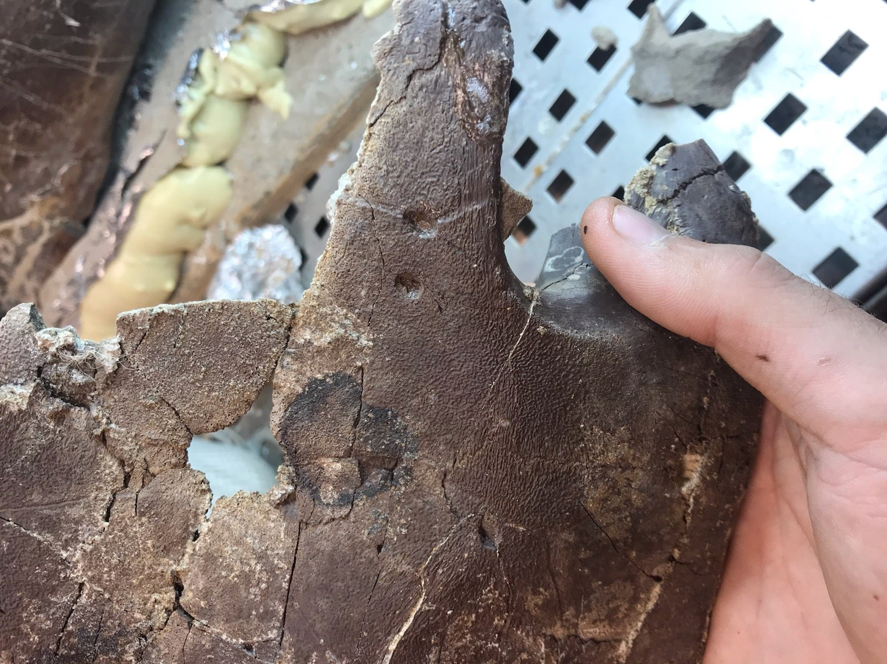
Toothmarks

Slide 60
Vertical distribution
All quarries within the main bonebed have revealed the bones to be deposited as a normally graded bed.
We know this because our data collection techniques permit us to easily assess this.
Apparently this condition is common in Upper Cretaceous bonebeds, but was not noticed by others.

Slide 61

Quarry 2
0.0-0.2 meters
Vertical Distribution

Slide 62
Quarry 2
0.2-0.4 meters
Vertical Distribution

Slide 63
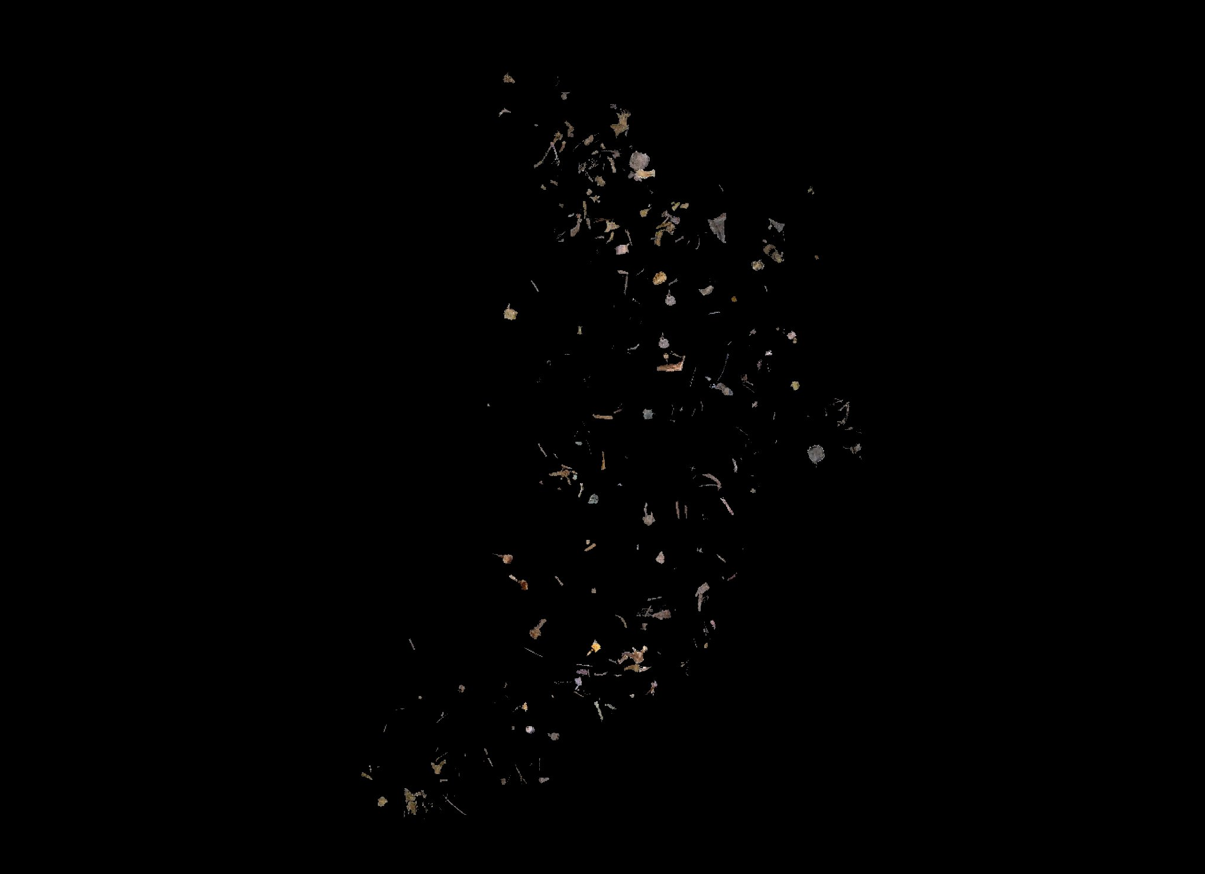
Quarry 2
0.4-0.6 meters
Vertical Distribution

Slide 64

Quarry 2
0.6-0.8 meters
Vertical Distribution

Slide 65


Quarry 2
0.8-1.0 meters
Vertical Distribution

Slide 66
orientation
Bones do not generally display a strong orientation in the bonebed.
This also is typical for Upper Cretaceous bonebeds.

Slide 67
Fig. 9. Long bone orientation of main quarries.

Slide 68
orientation
Bones do not generally display a strong orientation in the bonebed.
This also is typical for Upper Cretaceous bonebeds.
Requires a depositing process that does not strongly orient clasts. May also indicate the velocity of the depositing current.
Another advantage to our methods is we have plunge data on every bone. Most bones are horizontal. Occasionally even large elements are vertical.

Slide 69
Taxa represented
Taxa are mostly (>95%) dinosaurian, mostly Edmontosaurus (94%).
Nine genera of Saurischia, 5 of Ornithischia in the quarries of the main bonebed.
Non-dinosaurs include lizards, snakes, mammals, birds, crocodiles and alligators, turtles, fish and mollusca.
Plant species identified from macrofossils or pollen from our quarries include palms, cycads, conifers, elms, hickory, walnut, ephedra, ferns, dinoflagellates, Aquilapollenites, and Wodehousia.
Notes:
Shed teeth of theropods are important because we do not commonly find theropod bones in the quarries. Evidently the theropods were scavenging the carcasses prior to their fnal entombnment in the bonebed. We discovered the second Nanotryrannus ever found, and because we have dentary and maxillary with teeth, we can compare the shed teeth with these bona fides and be quite sure when we have a Nanotyrannus shed tooth.

Slide 70
Taxa represented
# elements for given taxon

Slide 71
Taxa represented
# elements for given taxon

Slide 72

dentary of didelphodon sp.

Slide 73
Predator – prey ratios
Typical predator – prey ratios for mammals are on the order of 1:10.
Typical ratios for Edmontosaurus quarries range from 1:6 to 1:50.
Our quarries yield consistently a ratio of about 1:20, meaning that predators are underrepresented in these deposits.

Slide 74
Element distribution
Voorhies and Behrensmeyer’s approaches may not be valid for dinosaur bones.
In this presentation, using bones from the first 20 years work, a total of 8,460 identifiable elements, excluding tendons and teeth and indet.
MNI for currently excavated bones based on 114 pubes, the most frequently encountered bone, 61 of which were from left side (9 undetermined). This yields 61 – 66 individuals.
Using typical bone count for adult animals (390), expect in excess of 24,000 bones. Recovery rate is 36%.
Ribs present a special problem.

Slide 75

Bone recovery from skull

Slide 76

Bone recovery from body

Slide 77
Region | Element | Overall | %TOT this paper | Ullmann 2017 | Gangloff 2010 | Scherzer 2010 | Evans 2015
 | #Elements |  | 8460 | 4702 | 2769 | 537 | 1612
 | MNI |  | 61 | 44 | 36 | 8 | 11
 | Basisphenoid |  | 15 | 16 | 37
 | Exoccipital |  | 21 | 13 | 21 | 19
 | Jugal |  | 52 | 57 | 37 | 6
 | Maxillary |  | 45 | 51 | 11 | 31
 | Nasal |  | 66 |  |  | 6
 | Parietal |  | 9 | 11 | 16
 | Premaxillary |  | 24 |  |  | 25
 | Quadrate |  | 62 | 61 | 66 | 38
 | Squamosal |  | 26 |  |  | 6
 | Frontal |  | 18 | 43 | 13 | 25
 | Postfrontal |  | 30 |  |  | 13
 | Postorbital |  | 14 | 31 | 26 | 13
Mandible | Dentary |  | 96 | 43 | 76 | 75 | 41
Axial | Vertebra, caud. |  | 9 | 41 | 31 | 3 | 5
 | Vertebra, cerv |  | 18 |  |  | 2 | 1
 | Vertebra, dors |  | 7 | 7 | 3 | 9 | 51
 | Chevron |  | 15 |  |  | 4
 | Rib |  | 68 |  |  | 50 | 25
 | Rib, cervical |  | 10 |  |  | 3

Slide 78
Region | Element | Overall | %TOT this paper | Ullmann 2017 | Gangloff 2010 | Scherzer 2010 | Evans 2015
 | #Elements |  | 8460 | 4702 | 2769 | 537 | 1612
 | MNI |  | 61 | 44 | 36 | 8 | 11
 | Clavicle |  | 27 |  |  | 31
 | Coracoid |  | 7 |  |  |  | 23
 | Humerus |  | 48 |  |  | 69 | 9
 | Metacarpal |  | 21 | 71 | 29 | 13 | 3
 | Phalanx, manus |  | 11 | 14 | 6 | 2
 | Radius |  | 50 | 48 | 61 | 56 | 0
 | Scapula |  | 65 | 32 | 34 | 50 | 0
 | Ulna |  | 39 |  |  | 44 | 0
 | Ungual, manus |  | 7 |  |  | 2
Pelvic | Astragalus |  | 15 |  |  | 6
 | Femur |  | 49 |  |  | 63 | 32
 | Fibula |  | 67 |  |  | 69 | 36
 | Ilium |  | 27 |  |  | 50 | 86
 | Ischium |  | 85 |  |  | 56 | 91
 | Metatarsal |  | 25 | 81 | 47 | 25 | 3
 | Phalanx, pes |  | 13 | 15 | 7 | 4
 | Pubis |  | 99 |  |  | 63 | 82
 | Sacrum |  | 9 |  |  |  | 0
 | Tibia |  | 46 | 38 | 71 | 31 | 23
 | Ungual, pes |  | 4 |  |  | 8

Slide 80
Age distribution
Ontogenic representation is a key taphonomic element for learning about the dinosaurs. Was our bonebed multigenerational or age restricted?
If the quarry contains only younger animals, the explanation for the death assemblage may go to ecological conditions or panic in flight, etc. If they are all older animals the explanations become more difficult. Do the animals exhibit altricial or precocial habits? Do they grow to maturity in a few years, or like the crocodile, do they require many seasons to mature?
In our case, the herd of animals that was decimated was composed almost entirely of adult animals.

Slide 81


Slide 82
Weathering, abrasion, fracturing
Weathering – assessment of weathering is done by examination of the bone surface. With mere months of exposure, cracks begin to develop in the cortex of the bone. The longer the bone is exposed, the more susceptible it becomes to cortical damage.
Abrasion – determination of state of abrasion enables the investigator to assess damage during transport. Transport generally is a process that degrades sharp edges, rounds and perhaps even breaks bones.
Fracturing – bone breakage can occur by any of a variety of processes. Understanding how to read these is essential in taphonomy. Were the bones scavenged? Were they trampled? Were they broken during transport? Or were they broken by burial or by excavators? All important.

Slide 83
Weathering, abrasion, fracturing

Slide 84
Discussion
Articulation
Vertical distribution
Orientation
Taxa represented
Element distribution
Maturity of assemblage
Weathering
Abrasion
Fracturing
Predation

Slide 86

Depositional Setting

Slide 87


Slide 88


Slide 89


Slide 91


Slide 92


Slide 94


Slide 95


Slide 96
Recognition of our work
After a visit to our lab in Keene, one paleontologist wrote:
“I was astounded. I have never seen before such a precise and comprehensive data management system for field paleontology and for the lab. No other museum or university comes close for dinosaur digs.
Thanks for sharing your expertise.
Another well-known paleontologist [a full length movie has been made of his life] wrote me:
“I must say, every time I go to your website, that you have the best site for looking a[t] your collections of any institution.”

Slide 97
Conclusions
An unusual and VERY RICH bone bed in eastern Wyoming is opening a window into the past.
It is widely acknowledged that dinosaurs and many other forms were killed by a catastrophe of global proportions.
Even at this stage in our investigation at this site we find abundant evidence for catastrophic death and burial of dinosaurs.
Having our eyes wide open to alternative explanations is always a good thing in science.
Doing excellent work with God’s guidance is its own reward.

Slide 98
More Information
Creation-Evolution issues
http://origins.swau.edu
Online Fossil Museum http://fossil.swau.edu
Educational Online Museum http://dinosaur.swau.edu
Dinosaur Research Project http://dinosaurproject.swau.edu

Slide 99
Online Fossil Museum http://fossil.swau.edu

