Slide 1
Serving the Seventh-day Adventist Church www.grisda.org

Slide 2
What Is The Geoscience Research Institute?
An institute of the General Conference of Seventh-day Adventists
Began in 1958
Located at Loma Linda University
Our purpose is to study nature in the light of the biblical revelation of creation, and share this understanding with others.

Slide 3
Who Are We?
Ronny Nalin – Geology: Sedimentology
Raul Esperante – Vertebrate Paleontology
Ben Clausen – Geology: Igneous and
metamorphic rocks
Tim Standish – Molecular Biology
Jim Gibson – Historical Biology
Jennise Logan – Administrative Assistant
Mephi Herrera – Website

Slide 4
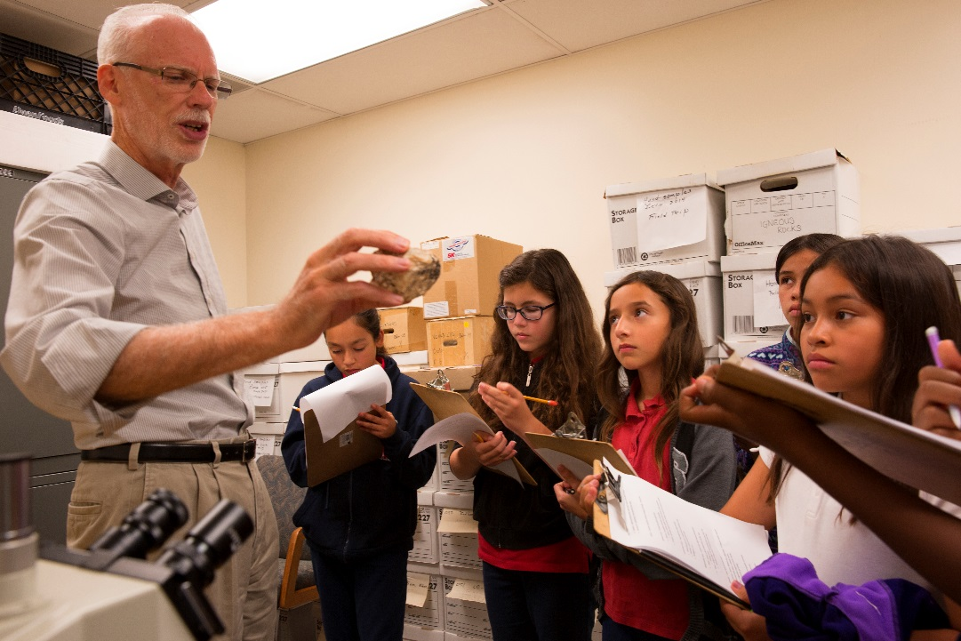
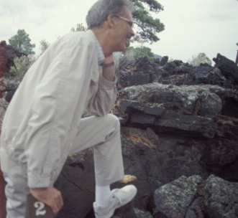
GRI Staff Ben Clausen, PhD
Research Interests:
Nuclear physics shell modeling
Radioisotope dating
Igneous petrology
Notes:
Ben Clausen has a Master’s degree in geology and a PhD in nuclear physics. His current research is in geochemical trends in the Southern California batholith, a large mass of granitic rocks underlying much of Southern California. Ben manages the web site for the Institute, and leads in the meetings of BRISCO, the Biblical Research Institute Science Council.

Slide 5
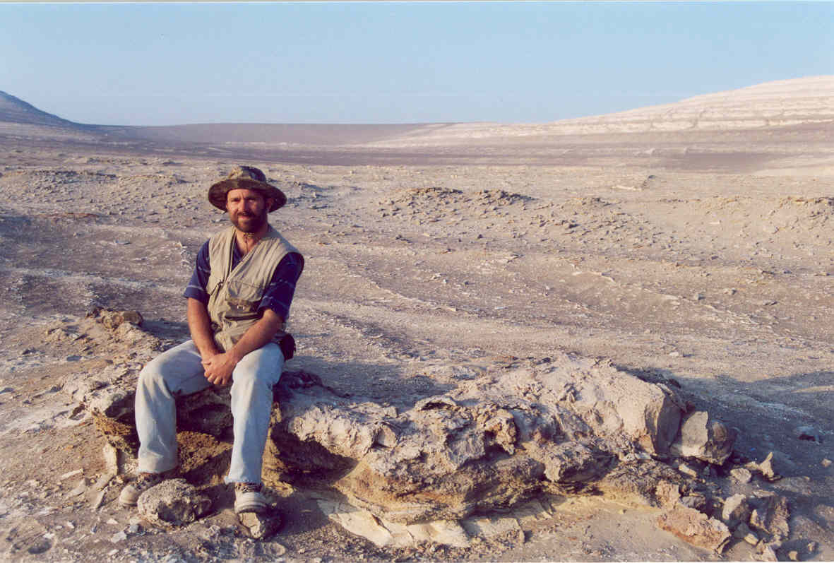
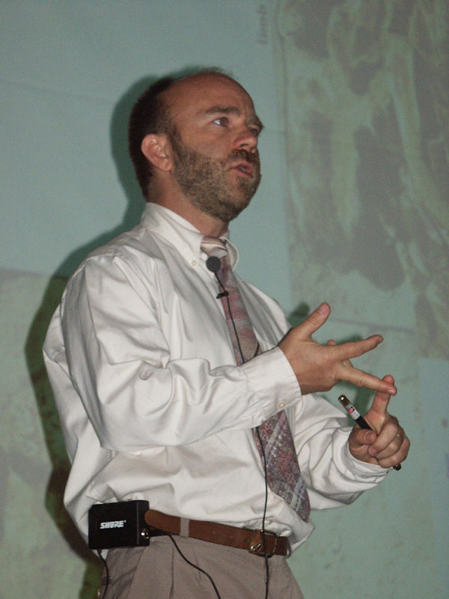
GRI Staff: Raul Esperante, PhD
Research Interests:
Processes of fossilization
Whale fossils in Peru
Whale fossils in Spain
Notes:
Raul Esperante has a PhD in biology with an emphasis in paleontology. His current research is a study of fossil whales preserved in deposits of diatomaceous earth in Peru. Raul is bilingual, which is a great asset to the Institute. Raul is assuming the editorship of our Spanish language magazine, Ciencia de los Origines.

Slide 6
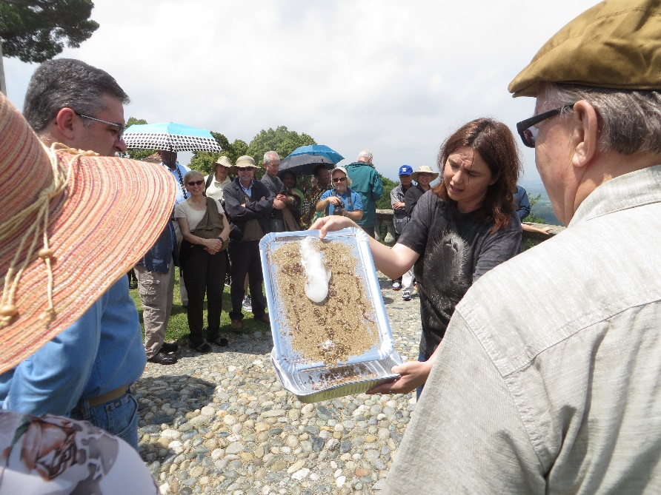
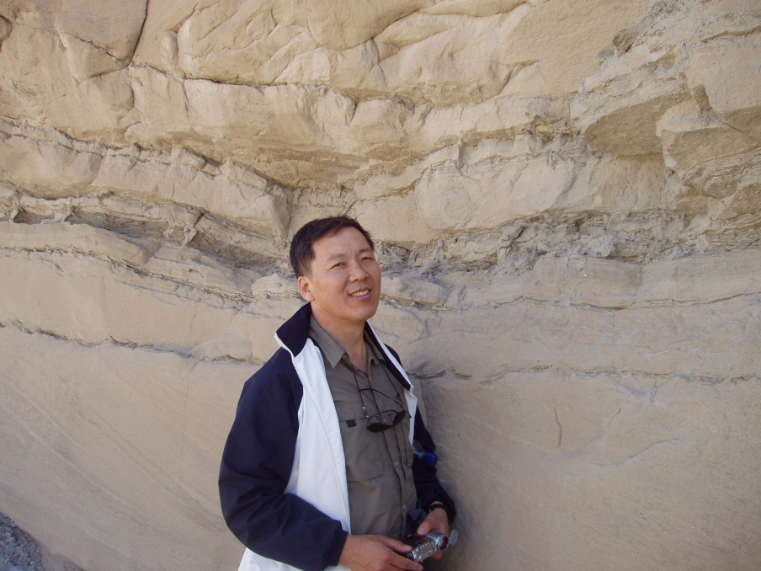
GRI Branch Offices Partnering with a Division
Noemi Duran Royo, PhD Europe (Spain)
Choi Chong Geol (John), PhD
Asia (Korea)
Notes:
Jacques Sauvagnat is the director of our branch office in France. His research interests are in the study of fossil ostracodes (a kind of tiny arthropod). He also edits a magazine, Science et Origines, published twice a year, and teaches a class in science and religion.
Antonio Cremades directs our branch office in South America. His research is in the area of biometrics, especially of the human hand.

Slide 7
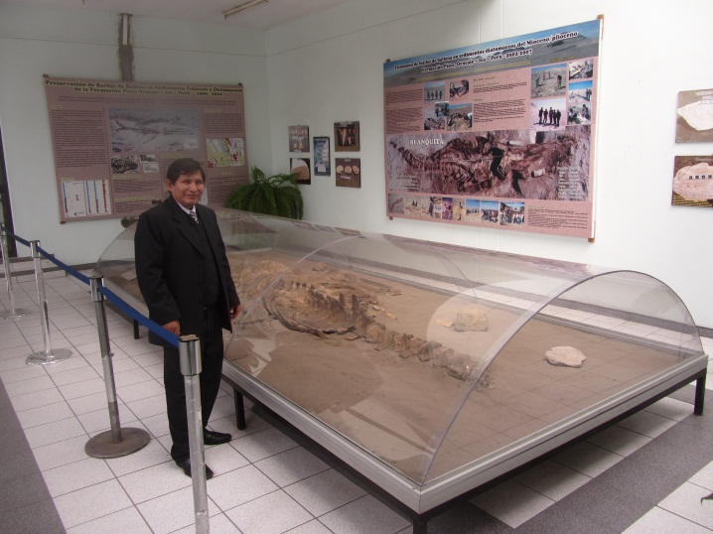
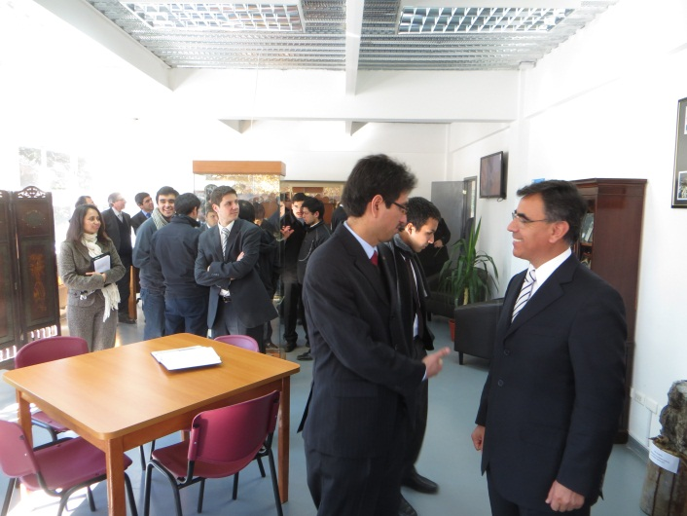
GRI Resource Centers Partnering with a University
Peru Adventist University
Chile Adventist University

Slide 8
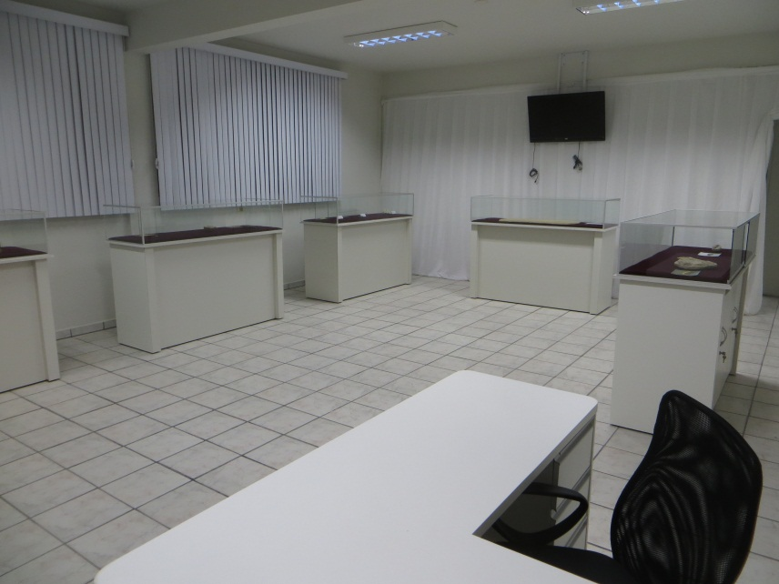
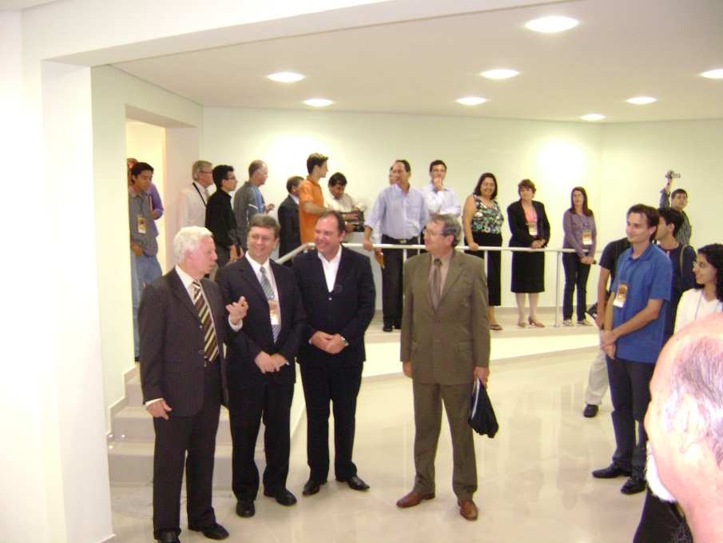
GRI Resource Centers Partnering with a University
Northeast Brazil Adventist University
UNASP (Brazil Adventist University College

Slide 9
Creation Sabbath
Fourth Sabbath in October, each year.
Sponsored by the General Conference.
Celebrations in churches, schools, conferences.
Ideas include sermons, lectures, displays, nature walks, videos, classroom activities.
Special website at CreationSabbath.net
GRI Resource Centers form natural sponsors for the local area.

Slide 10
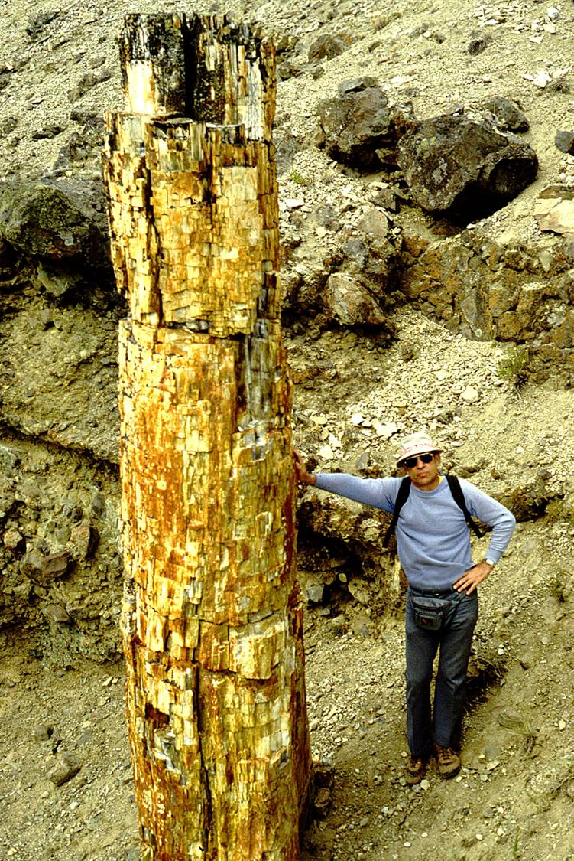
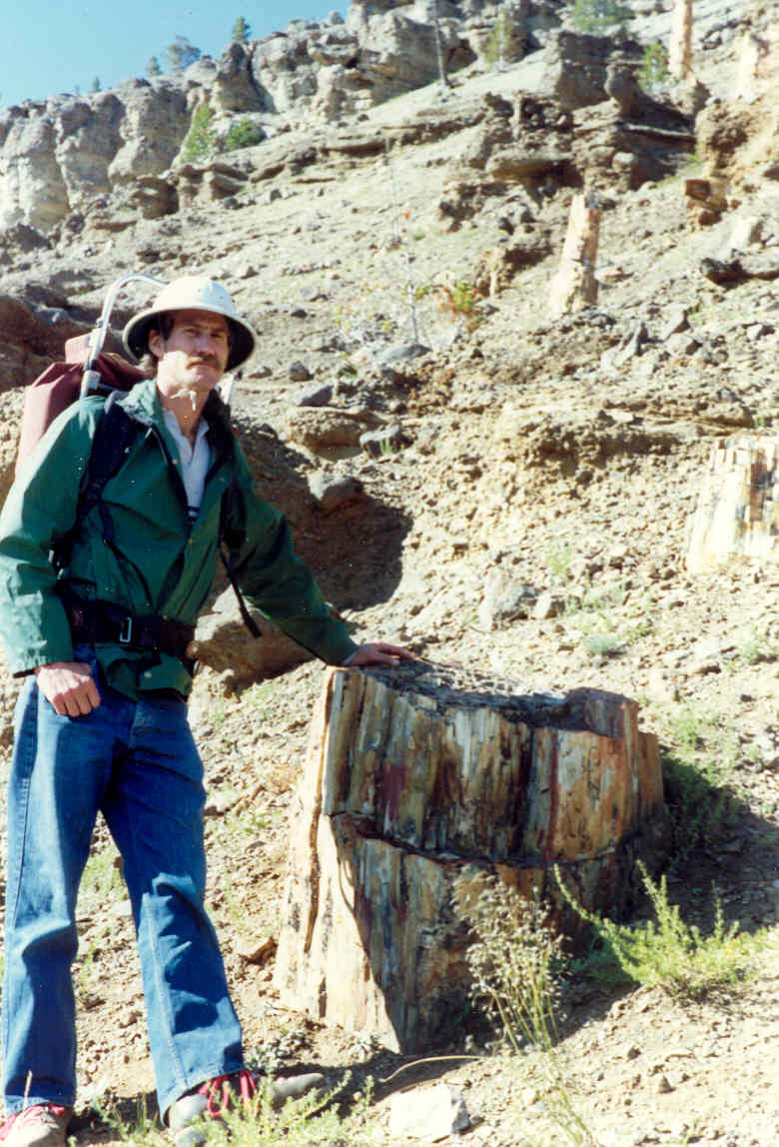
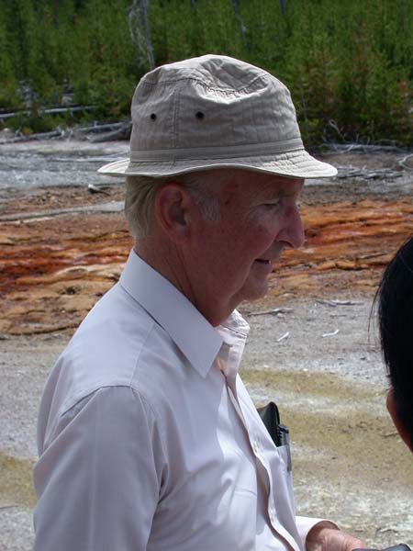
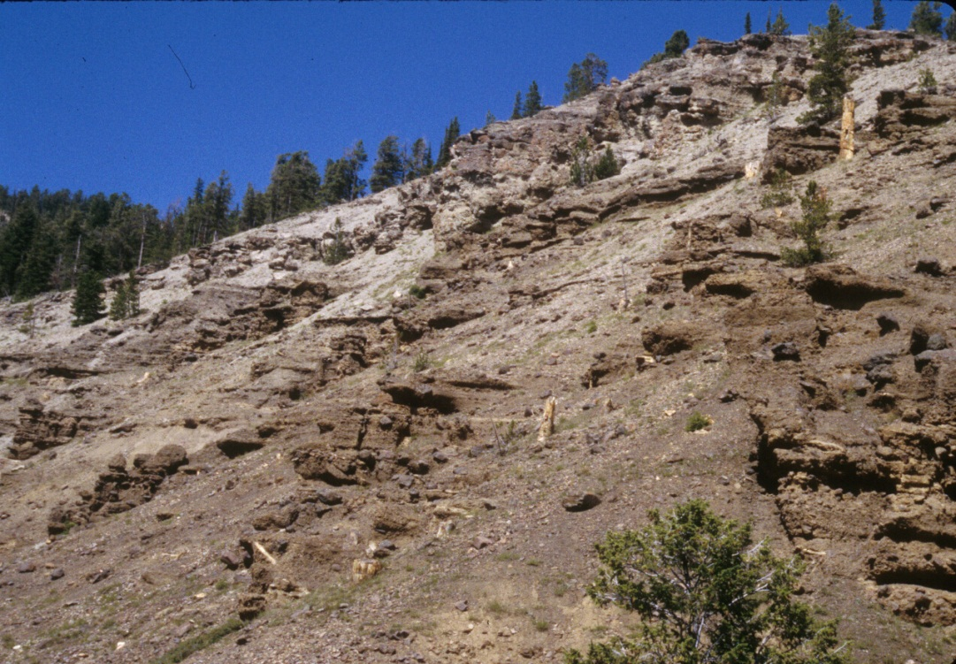
Yellowstone Fossil Forest
Clyde Webster
Once thought to require hundreds of thousands of years, but now believed to have been deposited catastrophically
Many layers of upright fossil trees.
Harold Coffin
Mike Arct
Notes:
The Yellowstone fossil forest is a sequence of 70 or more successive layers of fossil trees, interspersed with layers of volcanic ash and leaves. It was long interpreted as representing long periods of time when trees grew in place, were buried by volcanic eruptions, and replaced by new forests. Research sponsored by the Geoscience Research Institute has revealed that these trees were probably transported into their present position, and did not grow there. The deposit appears the be deposited catastrophically rather than representing hundreds of thousands of years.

Slide 11
Lessons from Research
Check the data for yourself – it may have been interpreted incorrectly.
Problems that seem unexplainable may be resolved, such as the Yellowstone “fossil forest.”
Don’t expect quick answers. The Yellowstone project took 30 years, and there is still more work that could be done.

Slide 12
Our Website WWW.GRISDA.ORG
Articles on creation, science, and theology.
News and announcements.
Sign up for quarterly electronic newsletter.
Recommendations for books, videos, etc.
Materials for classrooms – videos, powerpoints, articles, posters.
Link to free e-book by Brand and Chadwick: Faith, Reason and Earth History.

Slide 13
What Can We Do For the Church in Africa?
Creation Sabbath – What is the date next year? (October 26, 2019)
Help with information – www. grisda.org (articles, books, videos, posters, etc)
Resource Centers – Rusangu University, Bugema University, Babcock University, more?
Faith and Science Conferences at colleges, universities, teachers meetings, pastors meetings.

